Slide 1
NETWORK EFFECTS and
MULTI-SIDED PLATFORMS (Part II)
Copyright 2020
WEEK 8-9

Slide 2
Note on final exam
  Week after Thanksgiving (equiv. to “week 11”)
  Three hours
  Comparison to midterm
    Identical layout
    More questions, more material
    Less rushed, in general
  Cumulative
  Open book and notes
  Case covers food order/delivery platforms

Slide 3
Week 9 Recap
  Network effects present when value improves with others’ use
  Account for majority of recent blockbuster startup successes
  Fundamental challenge = coordination (“chicken-or-egg” prob.)
  Not adopting the preferred technology ∈ Nash equilibria
  Strategic options clearly increase likelihood of success
  Last week: Adoption
  This week: Tipping / shakeouts / wars of attrition / etc.

Slide 4
Week 9 Agenda
  “Did a winner take all?”
  Characterize platform outcomes
    Linkedin vs. Google+
    Xbox vs. Playstation
  “Is the market going to tip?”
  Predict platform structure in equilibrium | market attributes
  Billion dollar question: “Can we tip it towards our platform?”
  Characterize optimal strategies | expected platform structure

Slide 5
Platform structure and competition

Slide 6
Market structure vs. platform structure
  Market structure determined by # and offerings of firms
  Network effects complicate the issue
  Key question is who interacts with whom and with how many
  Platform structure determined by both sides’ interactions

Slide 7
Platform structures
  WTA all users engage with same platform
  Multi-homing user interacts with >1 platform
  Mono-homing user interacts with 1 platform
  (but diff’t users choose diff’t platforms)
  Mixed homing combination of multi-/mono-homing
  Both sides of the market make these decisions: you could have, e.g., multi-homing on one side and mono-homing on the other

Slide 8
Platform structures
Network | Side 1 Users | Side 1 Structure | Side 2 Structure | Side 2 Users
DVD players | Households |  |  | Movie studios
Video games
Credit cards
Online handmade goods
Shopping mall
Digital documents

Slide 9
Platform structures
Network | Side 1 Users | Side 1 Structure | Side 2 Structure | Side 2 Users
DVD players | Households | WTA (Blu-Ray) |  | Movie studios
Video games
Credit cards
Online handmade goods
Shopping mall
Digital documents

Slide 10
Platform structures
Network | Side 1 Users | Side 1 Structure | Side 2 Structure | Side 2 Users
DVD players | Households | WTA |  | Movie studios
Video games | Consumers | Mono | Multi | Game developers
Credit cards
Online handmade goods
Shopping mall
Digital documents

Slide 11
Platform structures
Network | Side 1 Users | Side 1 Structure | Side 2 Structure | Side 2 Users
DVD players | Households | WTA |  | Movie studios
Video games | Consumers | Mono | Multi | Game developers
Credit cards | Shoppers | Multi | Mult./Mix. | Merchants
Online handmade goods
Shopping mall
Digital documents

Slide 12
Platform structures
Network | Side 1 Users | Side 1 Structure | Side 2 Structure | Side 2 Users
DVD players | Households | WTA |  | Movie studios
Video games | Consumers | Mono | Multi | Game developers
Credit cards | Shoppers | Multi | Mixed | Merchants
Online handmade goods | Buyers | WTA (Etsy) |  | Creators/builds
Shopping mall
Digital documents

Slide 13
Platform structures
Network | Side 1 Users | Side 1 Structure | Side 2 Structure | Side 2 Users
DVD players | Households | WTA |  | Movie studios
Video games | Consumers | Mono | Multi | Game developers
Credit cards | Shoppers | Multi | Mixed | Merchants
Online handmade goods | Buyers | WTA |  | Creators/builds
Shopping mall | Consumers | Mono/Mix. | Multi | Stores
Digital documents

Slide 14
Platform structures
Network | Side 1 Users | Side 1 Structure | Side 2 Structure | Side 2 Users
DVD players | Households | WTA |  | Movie studios
Video games | Consumers | Mono | Multi | Game developers
Credit cards | Shoppers | Multi | Mixed | Merchants
Online handmade goods | Buyers | WTA |  | Creators/builds
Shopping mall | Consumers | Mixed | Multi | Stores
Digital documents | Readers | WTA (PDF) |  | Writers

Slide 15
Determinants of platform structure

Slide 16
Platform structure determinants
  Four environmental factors determine platform structure
  Mostly beyond our control
  Clearly impact incentives
  Critical to consider when making strategic decisions

Slide 17
#1 Scale economies
  Fixed costs mechanically fall per unit
  Marginal costs rise per unit (re: isolation of decision-makers, inertia, public relationships visibility, bureaucracy, etc.)
  Some examples
    Constant marginal costs ~ manufacturing pencils
    Natural monopoly ~ landline telecommunications
  Scale economies → fewer platforms expected
  Large scale economies → tipping much more likely
  Don’t get stuck on this—often just a question of natural monop.

Slide 18
#2 Homing costs (1/2)
  Platform structure ∈ {WTA, mono-homing, multi-homing, mixed}
  Multi-homing costs = hassle and/or expense of maintaining presence on multiple platforms
  Energy, expenditures can be up-front, ongoing, at termination
  Example: membership in the Linkedin community
  High multi-homing costs → fewer platforms expected

Slide 19
#2 Homing costs (2/2)
  Relatively higher or lower multi-homing costs?
  Facebook / Google+ (from social media user’s perspective)
  Mastercard / Amex (from cardholder’s perspectives)
  Analog world: VHS / Betamax (from household’s perspective)
  Digital world: Windows / Mac OS (from consumer’s perspective)

Slide 20
#3 Strength of NE (1/2)
  NE are typically not all-or-nothing feature of product or service
  Extensive margin question: will it function without a network?
  Intensive margin question: will it function with a limited network?
  Strong NE on the extensive margin → fewer platforms expected
  Strong NE on the intensive margin → tipping more likely

Slide 21
#3 Strength of NE (2/2)
  Extensive margin
  Can an Amex card function without any vendors?
  What about a Sony Discman without any CDs?
  What about an Android phone without third-party apps?
  Intensive margin
  Can fax machines exist on a limited network?
  What about mobile dating apps?
  What about Amazon?

Slide 22
#4 Preferences for variety of platform function
  Relates to question we could have asked outside NE discussion: “How many product varieties do we see in equilibrium?”
  Depends on how heterogeneous preferences are
  Non-networked example: hotels vs. car wash
  Networked example: dating apps vs. driving apps
  Strong preference heterogeneity → more platforms expected

Slide 23
Interim recap
  Platform structures
    Winner-take-all
    Multi-homing
    Mono-homing
    Mixed
  Determinants
    Scale economies
    Homing costs
    Strength of NE
    Preference heterogeneity

Slide 24
Market tips → “Winner-take-all”
  In big markets, WTA = unicorn startup successes
  In the data, WTA typically derived from 1 of these 3 situations:
Strong network effects + large scale economies (rare)
[e.g., Telephone company operators]
Rel. weak preference for variety
+ multi-homing costs are high on both sides
+ at least one side has strong network effects
[e.g., DVD since film and hardware = expensive]
Rel. weak preference for variety
+ multi-homing costs are high on at least one side
+ that side has strong network effects
[e.g., PDF since software/readers = cheap but publishing in many formats = costly]

Slide 25
Network effects:
Managerial implications

Slide 26
Real world platform wars
  How should management strategically act?
  Do you expect WTA?
    Yes → Do you have the obviously dominant technology?
      Yes → Aggressive adoption strategy
      No → Exit
      Unsure → Avoid war of attrition
    No → Turn to steady-state positioning / pricing / promotion
  [Details on following slides]

Slide 27
Case 1: WTA and you have dominant platform
  Resembles single-agent promotion of adoption…

Slide 28
Case 1: WTA and you have dominant platform
  Decision is whether to adopt VHS or Beta standard
  Assume payoffs known and Sony dominates JVC
Movie studios
 | VHS | Beta
VHS | (2,2) | (-1,-1)
Beta | (-1,-1) | (1,1)
Households

Slide 29
Case 1: WTA and you have dominant platform
  Resembles single-agent promotion of adoption
  What strategies work here?
    Introductory pricing, advertising—raise prices later
      Example: Yahoo/E-Bay in Japan
    Exploit any heterogeneity in adoption time / social influence
      Example: CES targets early adopters
    Step in and vertically integrate—disintegrate later
      Example: Nintendo
    Variants thereof

Slide 30
Case 2: WTA but you have inferior platform
  In the absence of extenuating circumstances, exit!

Slide 31
Case 3: WTA but no dominant platform [1/3]
  Decision is whether to adopt VHS or Beta standard
  Generalize level of payoffs here
Movie studios
 | VHS | Beta
VHS | (α, α) | (-1,-1)
Beta | (-1,-1) | (β, β)
Households

Slide 32
Case 3: WTA but no dominant platform [2/3]
  So far we took the standpoint of winning platforms
  Assumed there is an obviously dominant technology (e.g., everyone knew β<α)
  Asked “How we do we ensure (α, α) is played?”
  Answered “JVC spent some amount λ to ‘win the war’”
    λ comprised subsidies, incentives, advertisements, …
    Sony couldn’t profitably spend that amount of money
    Everyone—Sony, JVC, studios, households—knew this

Slide 33
Case 3: WTA but no dominant platform [3/3]
  Real world = messy, uncertain, with evolving technology
  Suppose, for example, payoffs to β = 1.4, to α = 1.6
  Suppose, alternatively, α∈(1,2) and β∈(1,2)
  This matters for managers because a platform war can become a war of attrition, which is often incredibly destructive
  [Illustration on following slides]

Slide 34
Platform war: Illustration [1/3]
  Auction 1
    Prize: a $20 bill
    Bidding is voluntary
    Bid by writing down a dollar amount (increments of $1)
    Highest bidder wins
    Pays second highest bid amount
  Who would play this game? What happens?

Slide 35
Platform war: Illustration [2/3]
  Auction 2
    Prize: a $20 bill
    Bidding is voluntary
    Bidding starts at $1, increments of $1
    Bid by calling out the dollar amount
    Auction ends when no new bidders
    High bidder wins the $20, pays her bid amount
    2nd highest bidder also pays her bid (but doesn’t get $20)
  Who would play this game? What happens?

Slide 36
Platform war: Illustration [3/3]
  Auction 2 illustrates a war of attrition
  It is obviously dangerous
  Sufficient conditions
    Winner take all
    Bids are sunk
  Used to model a wide variety of economic phenomena
    Lobbying
    Labor strikes
    Litigation
    Armed conflict
    Platform “shakeout”

Slide 37
War of attrition: Managerial implications [1/3]
  As the approximately dominant technology…
    Rationality: like with collusion, assess it in your rivals
    Adoption: follow prior slides’ optimal application
    Magnitude: massive up-front investment required
    Signal: make your intentions clear immediately
    Commit: useful tactic in either case
  As the laggard technology…
    Can you leapfrog them technologically?
    Can you preemptively commit ahead of them?
    Can you simply outspend a constrained rival to coordinate?

Slide 38
War of attrition: Managerial implications [2/3]
  (cotd.)
  When no one knows what they are doing, which is often true…
    Merge, noting that aspects of the war—that you remain very small and unprofitable—may enable mergers that would otherwise be blocked (e.g., Sirius Satellite and XM radio)
    Interoperability (e.g., Diner’s Club, Visa, Mastercard, etc.)
    Exit (e.g., shakeout of 300-to-1 word processors in 1990s)

Slide 39
War of attrition: Managerial implications [3/3]
  Final caveat: in a war of attrition, even the winner can lose
  Examples: DAT tapes, 56k modems
  Wars dragged on so long that the technology was obsolete before the market tipped (i.e., before the war was over)

Slide 40
Case 4: Multi-platform equilibrium
  Suppose in equilibrium, we do not expect a WTA outcome
  Recall market characteristics
    Moderate fixed costs
    Strongly heterogeneous preferences
    Low enough multi-homing costs
    Weak enough network effects
  Positioning, pricing and promotions follow prior logic
    Follow guidance re: weeks 1-7 (i.e., charge a relatively high price to the inelastic side of the platform)
    Charge relatively lower price to party generating NES

Slide 41
Takeaways

Slide 42
Platforms beyond 42001
  Large # of strategic considerations beyond the course
    NE reinforcing data-based learning and vice versa (e.g., traffic apps, driver assistance, thermostats)
    Flexible work arrangements (i.e., the “gig” economy)
    Trust, ratings, and reviews
    Developing regulation
      Privacy
      Antitrust
  Note that the largest “disruptions” are only ideas at this moment
  Consider related Booth courses (e.g. Austan’s), related lit.

Slide 43
Takeaways
  As usual, we’ll revisit the key issues in the cases
  - Break –
  Dropbox: It Just Works
  Ridesharing

Slide 44
WEEK 9 CASE: Dropbox
Thomas Wollmann
thomas.wollmann@chicagobooth.edu

Slide 45

Introduction

Slide 46
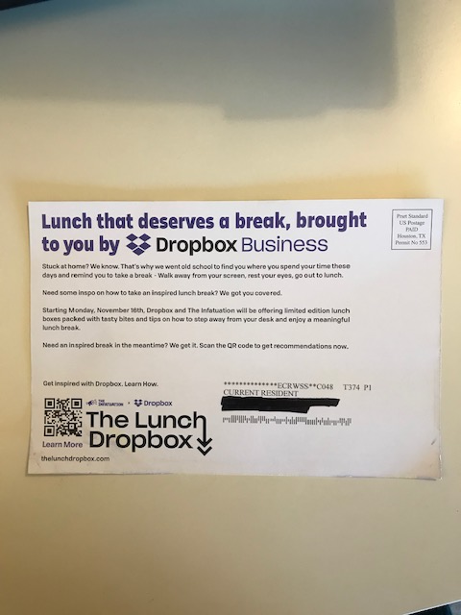
Promotions continue into 2020…
  Credit Molly [Fall 2020]

Slide 47


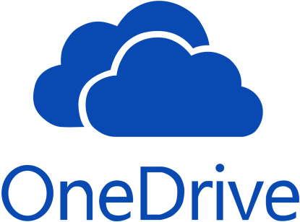
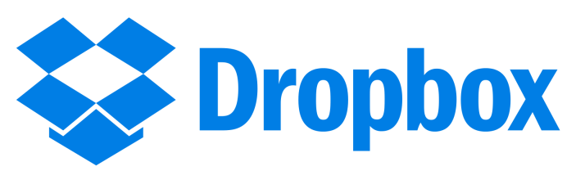

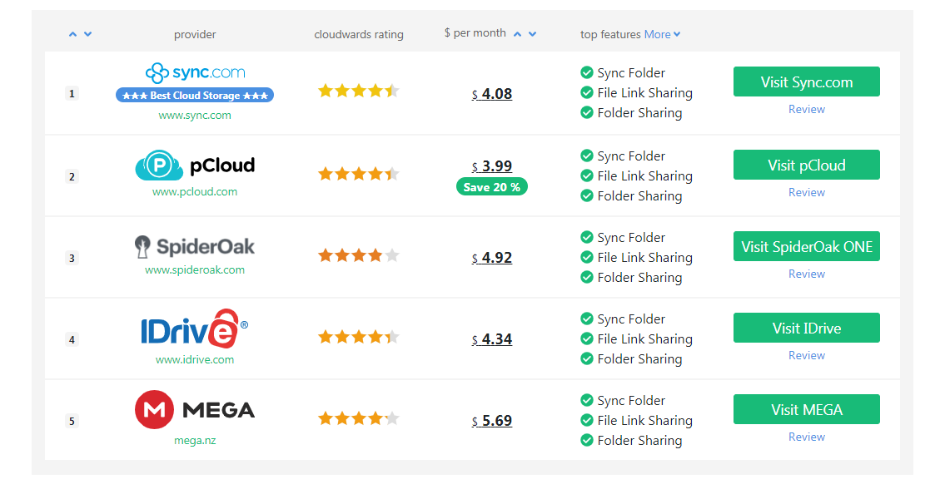

A shakeout?

Slide 48
Dropbox
Update

Slide 49
Alliances and acquisitions
  2011-2013
  Integrates with Facebook (so you can share files in FB groups)
  Acquired Snapjoy: picture archive and aggregation
  Acquired Mailbox: email management app for iOS
  Acquired Endorse: mobile coupons
  2014-Present
  Hackpad
  Clementine
  CloudOn
  Many others…

Slide 50
Uh oh.
  In case, Dropbox: 2GB freemium and $9.99/mo. for 5-10GB
  Microsoft OneDrive reboot
    2012: 15-30GB freemium and $1.99/mo. for 50GB, Integrate Office365 → 1TB (Unlimited for Office365 Pro)
    2015: scaled back freemium/unlimited but damage is done
  Google Drive reboot: counters with $1.99 for 100GB in 2015
  Apple iCloud reboot
  Amazon, many others
  However, prices have stopped falling—Drive still at $1.99/mo.

Slide 51
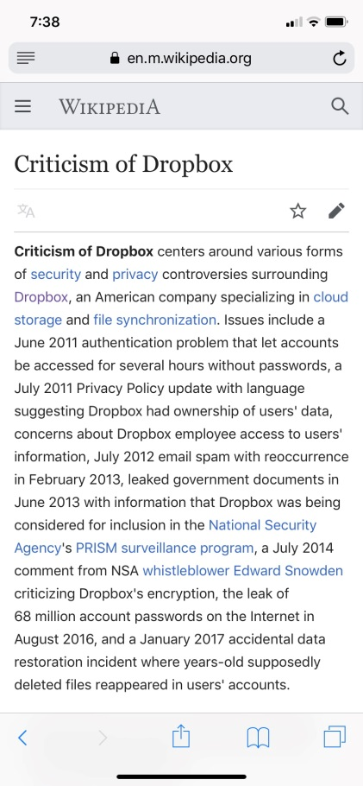
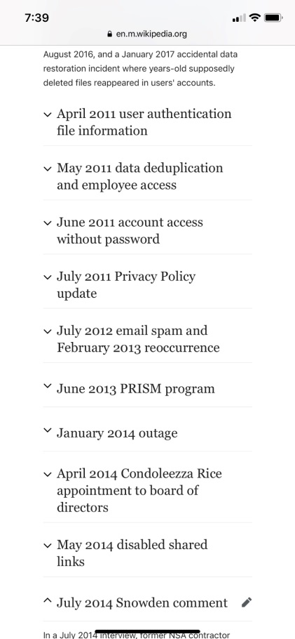
Segmentation.
  Snowden scandal → IT flips out on Dropbox
  Example: U of C only lets me store your grades on Box, not Dropbox
  Note necessarily “bad”—might just reveal tradeoffs

Slide 52

Wow.
  Despite this, reaches 500MM users by 2015
  Revenue grew nearly 100% between 2015-present
  At or around $1B in revenue
  2013-2014: value @ $4B
  2014-2015: value @ $10B
  2018 IPO forecast: $10B
  2019-2020: value @ $7.5-9.5B

Slide 53
I have no idea what will happen... but you would still probably like to be Drew.
  Wildly valuable service
  Switching costs might be low
  Long-run preference heterogeneity very unclear
  Low upfront capital expenditures and ongoing expenses
  100,000 users in first week
  Revenue positive immediately (no comparison to Dotcom bust)
  Intellectual property value still unclear—it was the only part of the Y-Combinator application that was redacted!

Slide 54
WEEK 9 CASE: Ride Sourcing
Thomas Wollmann
thomas.wollmann@chicagobooth.edu

Slide 55


Introduction
  UBER launched 2009, valued at $62.5 $70 $100 $115 billion!?
  What created the opportunity?

Slide 56

Competing platforms
  VS.
  VS. …?

Slide 57
Ridesourcing
Update

Slide 58
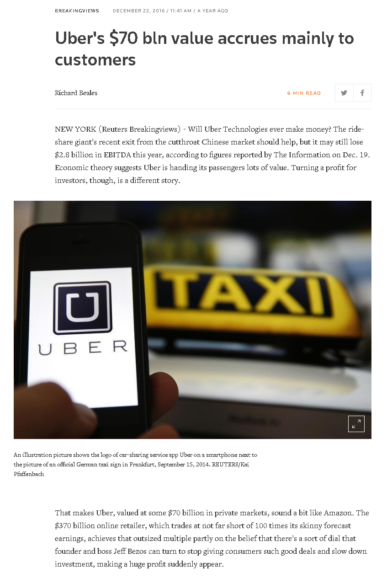
2016-2018 updates
  Uber
    By FYE 2016, EBITDA -2.8B
    IPO expected—on track for $70B
    Data breach, etc.: shares reportedly down to $50B
  Lyft valued at $11B (10/17)
  Both firms still remarkable relative to capital expenditures!

Slide 59
2019-2020 updates
  Uber losing $5B on $3B in revenue (2019)
  IPO at about $110B—down to $47B, then up to $87B
  Lyft losing $1.1B on $720MM in revenue (2019)
  IPO forecast $20-25 billion—down to $7B, then up to $13B
  Students in 2015/2016 sections lampooned peers who said WofA, no clear path forward… now, not so obvious!
  Interesting to see this play out in real time—especially when economics cuts through endless superfluous considerations…
  Final word: Prop 22 passes in CA on 11/4/2020

Slide 60
Course Takeaways
WEEK 10+

Slide 61
For the future
  A few final suggestions…

Slide 62
Avoid non-answers
  You might hear justifications for strategic actions such as
    “It is consistent with our values”
    “It is reflects our core competencies”
    “It matches our goals”
    “It fits with the vision of management”
    “It is our strategy”
  Circular and communicates you have no idea what you’re doing
  Do not say these things internally
  If others say it, then they are stupid, lying, or lazy

Slide 63
Think causally
  Correlation ≠ causation
  First case discussion: OBP causes winning
  Alternative explanation?
    Good coach teaches you how to get on base
    Good coach also motivates players to win
  NYT: 4+ cups of coffee → live longer
  Be wary of applying history blindly
  Be especially aware of executive/entrepreneurial war stories
  Applied theory is not subject to this critique

Slide 64
Be precise about positioning
  Point to a particular structural or environmental change
  Clearly map out tradeoffs and reasons why others can’t imitate
  Consider each position or location within the industry
    Valuable? Unique? Complementary? Sustainable?
    Think through market size, entry barriers, and elasticities
    Think also about how rivals are likely to respond—the “game” that your firm is playing
    Use tools like signals, commitment, deterrence, coordination (but do not obviously break the law!)
  These are not buzzwords—the underlying intuition is precise

Slide 65
Life after 42001
  You will hear a lot of nonsense when you leave here
  Some will not fit with the lessons here
  Either ignore it or reconcile it with theory or call me
  The main lessons here are very unlikely to be wrong—we had anecdotes and theory, now data and even more data
  Make sure you can communicate these points clearly
  Do not bury the intuition in elitist jargon
  Note: this appears to be working—we see it in employer surveys!
  Even more recently, in rankings and matriculation decisions

Slide 66
Good luck!
  There are huge opportunities to innovate
  Faculty here think you are differentiated in the market
  Keep me in the loop—I’ve learned a lot from students describing experiences that don’t square with the cases (it improves future iterations of the class, and it improves policymaking)
  My door is always open [Harper 306]

Slide 67
  Thank you!

