Slide 1
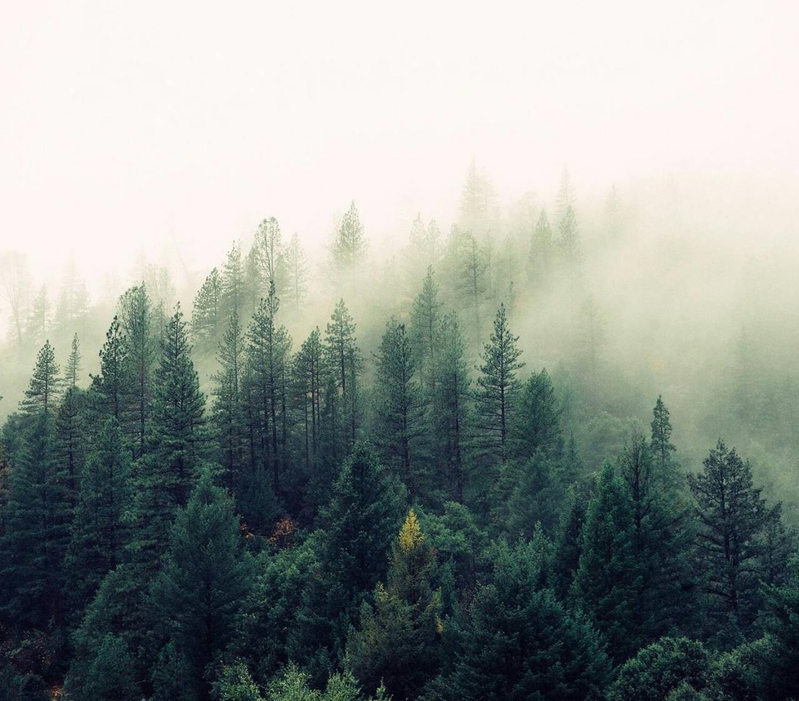
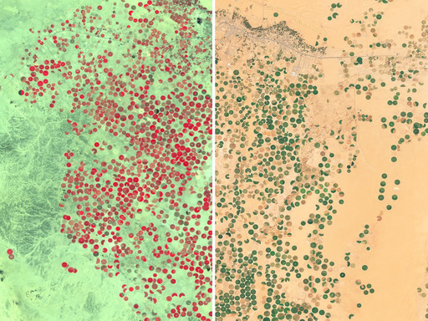
Cropland Mapping For Cropland Classification
Using Sentinel satellite data and machine learning
13/08/2025
ThePhoto by PhotoAuthor is licensed under CCYYSA.

Slide 2
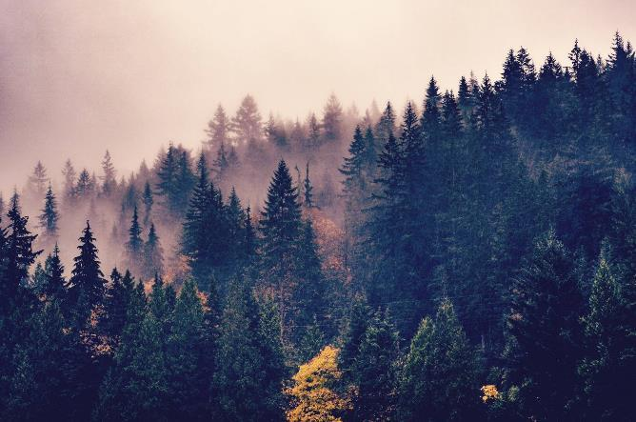


Problem Statement
Current cropland maps in arid/semi-arid regions are often inaccurate.
High uncertainty limits their usefulness for policy and planning.
Cropland areas can be visually similar to pasture and steppe land, making classification
challenging.
Lack of reliable, up-to-date maps hinders food security planning and land management.

Slide 3
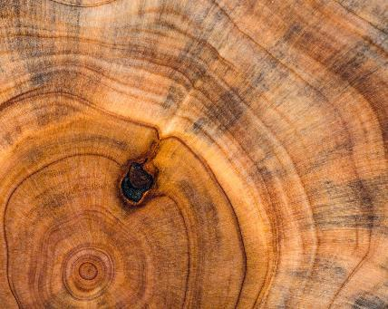
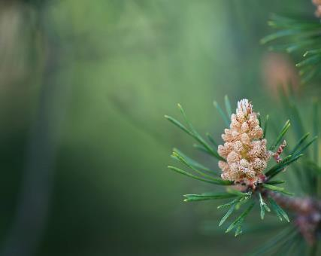
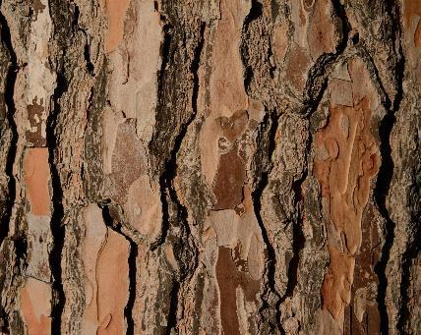

Objectives
Accurately identify cropland in arid and semi-arid regions.
Use satellite imagery and geospatial data for classification.
Develop an automated model for cropland detection at pixel/region level.

Slide 4
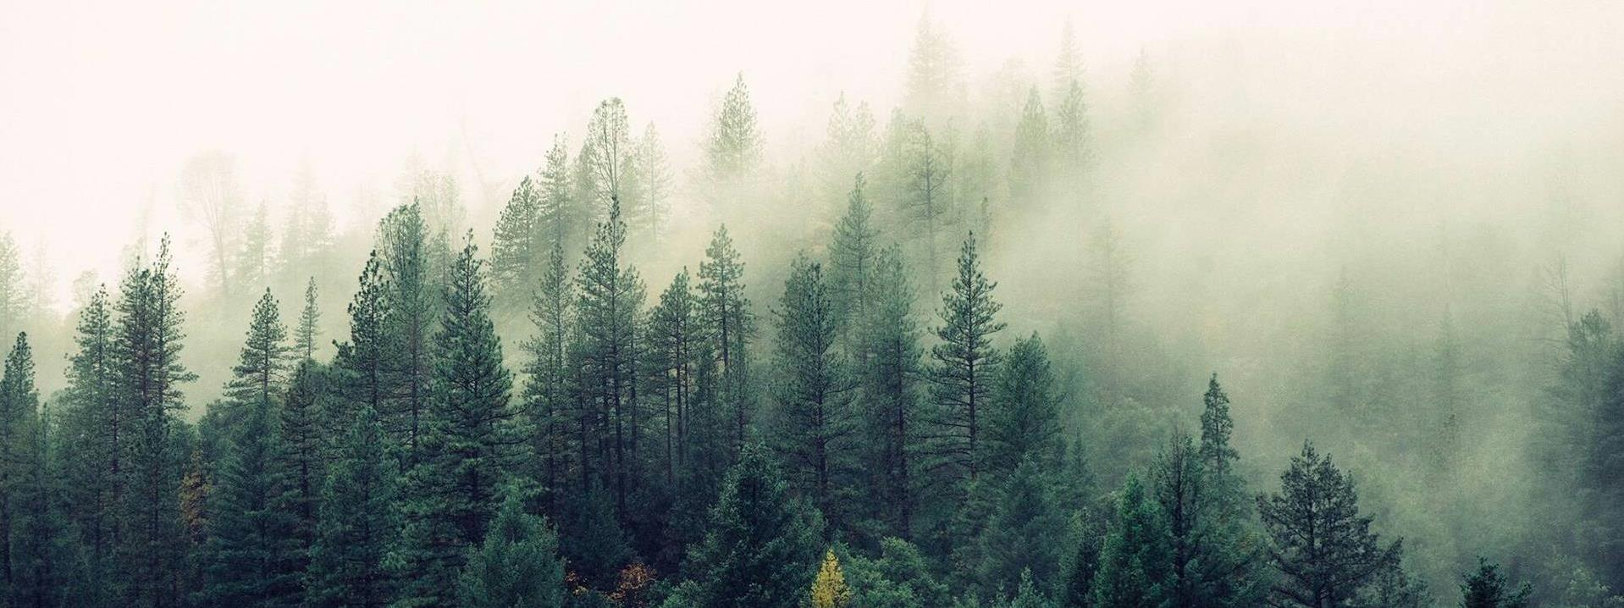
Business Understanding
Links to food security, environmental monitoring and climate resilience.
Climate change is expanding dry lands.
Need for data-driven agricultural monitoring tools.
Combine AI technical interest with real-world impact.

Slide 5
Data Understanding
Multi-temporal Sentinel-1 (SAR) and Sentinel-2 (optical) imagery.
Labelled training data for cropland classification.
Sentinel-1: Radar reflectance data.
Sentinel-2 : Optical reflectance data.
Geographic focus : Fergana and Orenburg regions.

Slide 6
Data Preprocessing
Removed Null values and duplicates
One-hot encoding
Applied tokenization.
Dealt with class imbalance

Slide 7
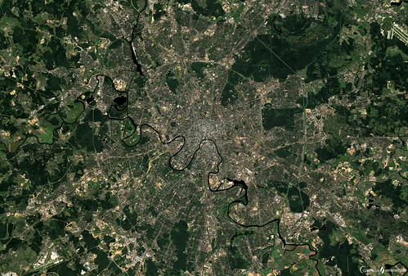
Modeling
We implemented multiple classification models:
Random Forest.
XGBoost.
Neural networks.
This Photo by Unknown Author is licensed under CC BY

Slide 8
Results Comparison
Model | Accuracy | F1 Score | Precision
Random Forest | 64.24 | 59.18 | 63.01
XGBoost | 67.81 | 65.02 | 67.94
Neural Networks | 92 | 92 | 91.0

Slide 9
Conclusion
.
Machine learning models can effectively classify cropland in arid/semi-arid areas.
Neural Network performed best among tested models.
Integrating Sentinel-1 and Sentinel-2 imagery improves accuracy.
Methodology can be adapted for other geographic regions.

Slide 10
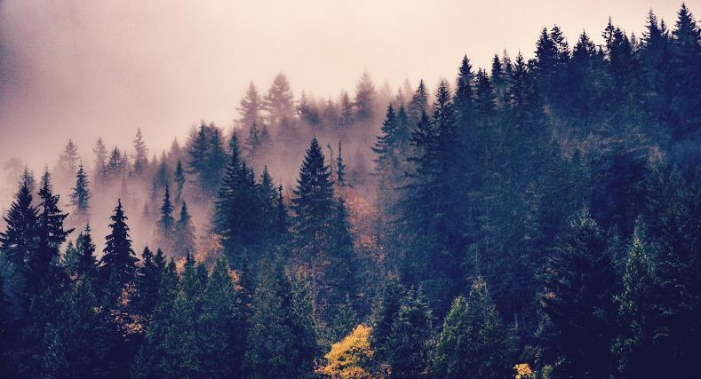
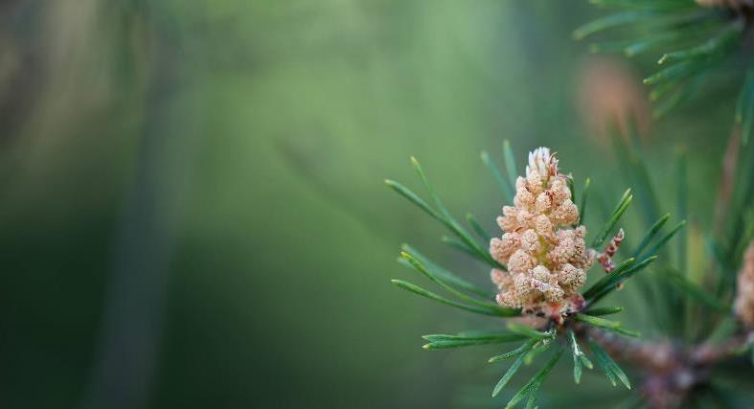
Recommendations
Expand dataset to cover more regions and seasons.
Test deep learning models for potentially higher accuracy.
Integrate additional environmental data (e.g., soil, climate).
Collaborate with agricultural agencies for real-world validation.

Slide 11
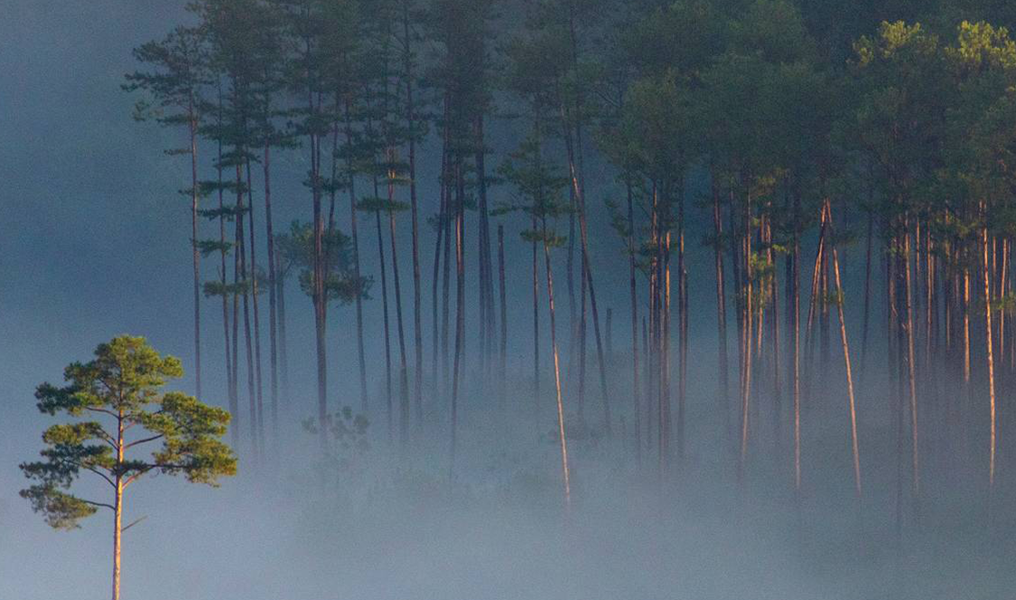
Thank you!
James Wachira
Tim Musungu
Vivian Kwamboka
Calvin Mutua
Ibrahim Hashim

