Slide 1
Program Name goes here
Link to github Repository: Github
Links to trello board / project management tools: Trello
You MUST provide evidence showing how the problem has been decomposed, how the components have been developed and trialled, and of how they have been assembled and tested to create a final, working outcome.

Slide 2
Relevant Implications
Explain the relevant implications here. Please watch this video to learn how to do this.
Notes:
Explain the relevant implications here. Then as you work, develop your code, discuss how the implications are being met.

Slide 3
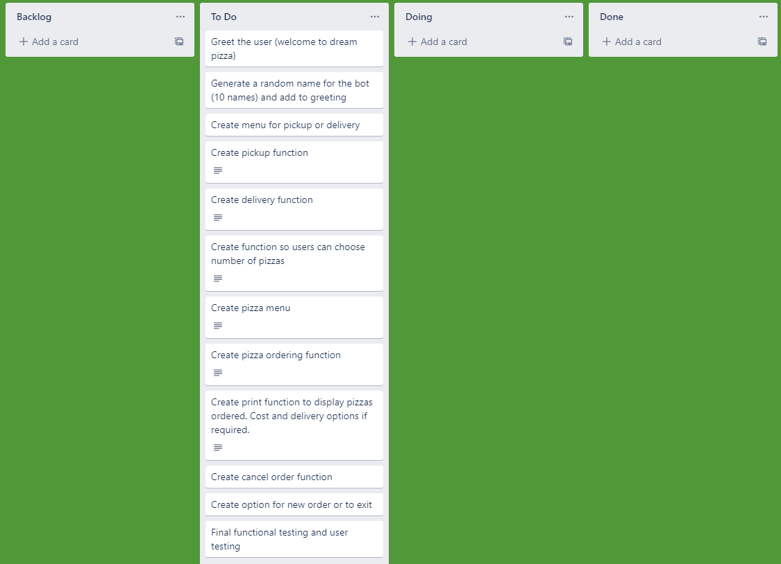
Decomposition
Notes:
Paste screenshots of your initial Trello board / task decomposition on this slide. If you have a long list, you might need to break it up into several columns. Delete this instruction when you are done.

Slide 4
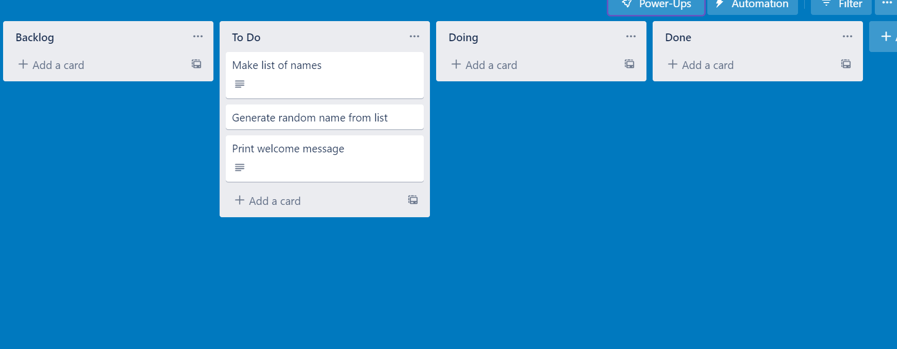
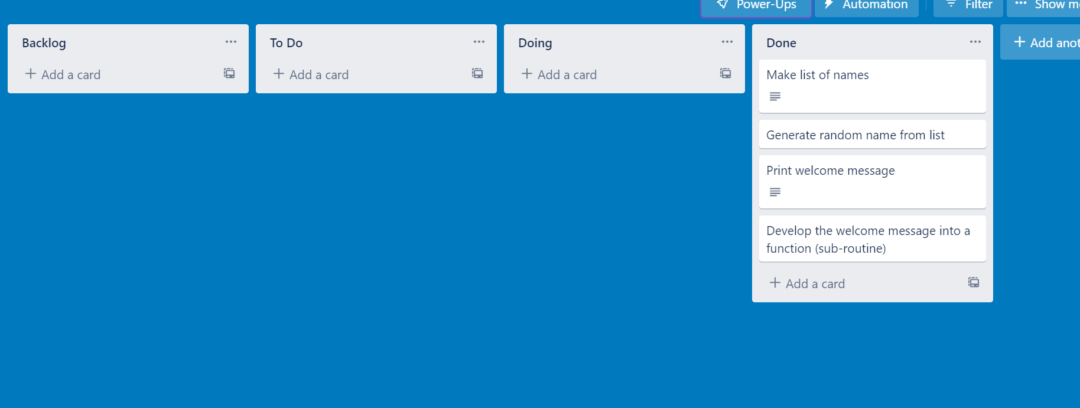
Component 1 (Trello screenshot)
Version 1
Version 2

Slide 5
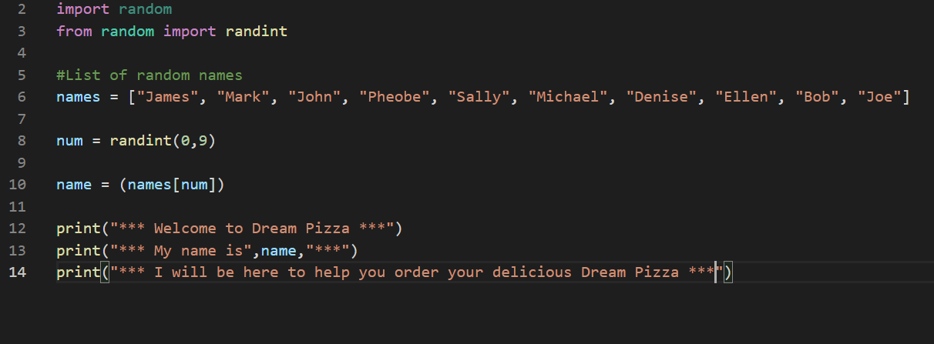

Component 1 - Test Plan (?and screenshot)
Test Case | Expected Values
Run program | Print welcome message with random name from list of names – Runs correctly

Slide 6
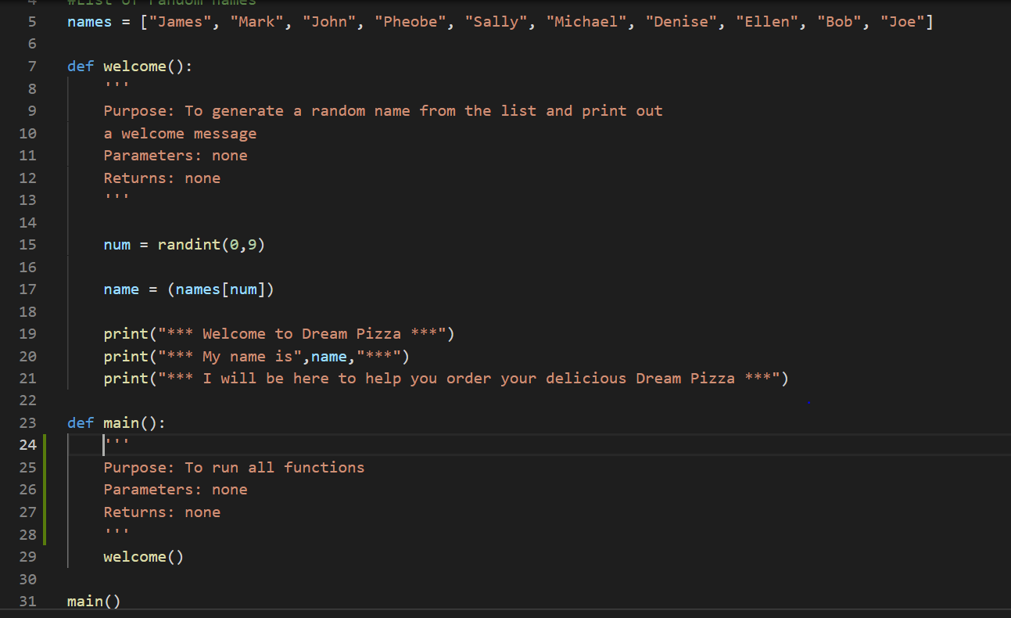
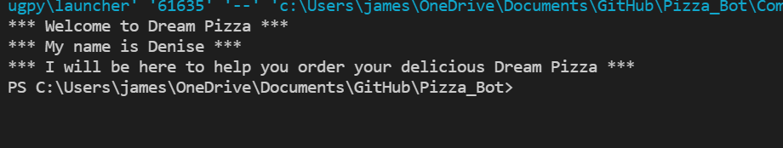
Component 1 version 2 - Test Plan (?and screenshot)
Test Case | Expected Values
Run program | Print welcome message with random name from list of names – Runs correctly

Slide 7
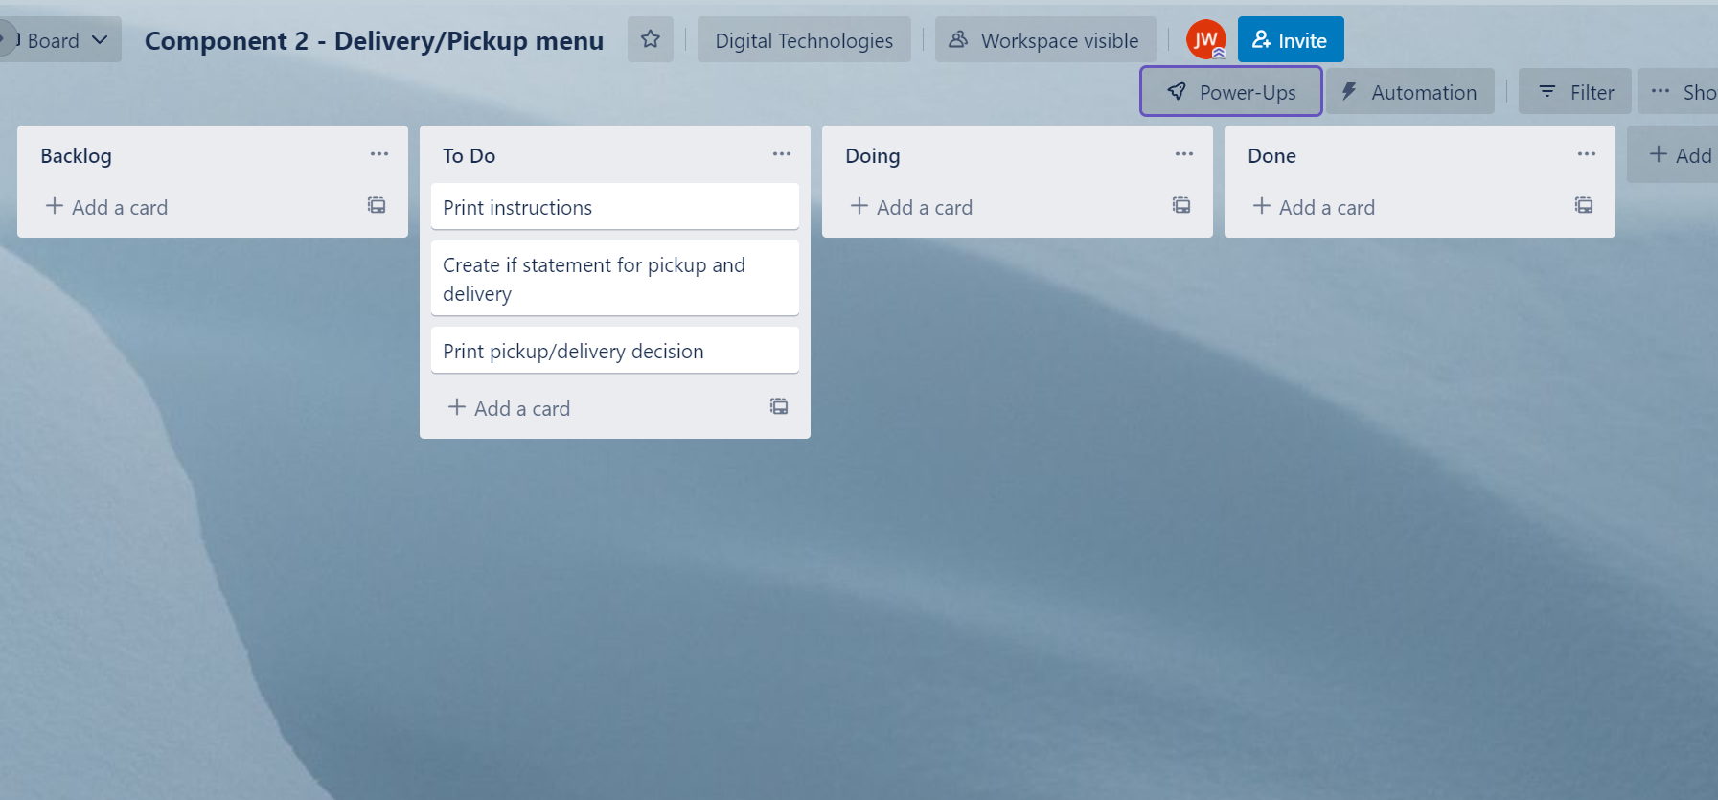
Component 2 (Trello screenshot)

Slide 8
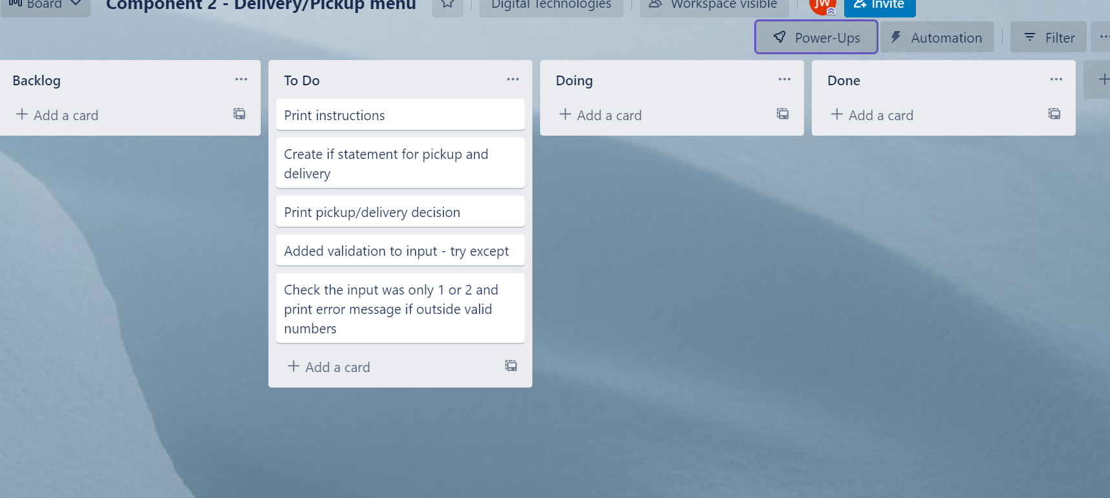
Component 2 version 2 (Trello screenshot)

Slide 9
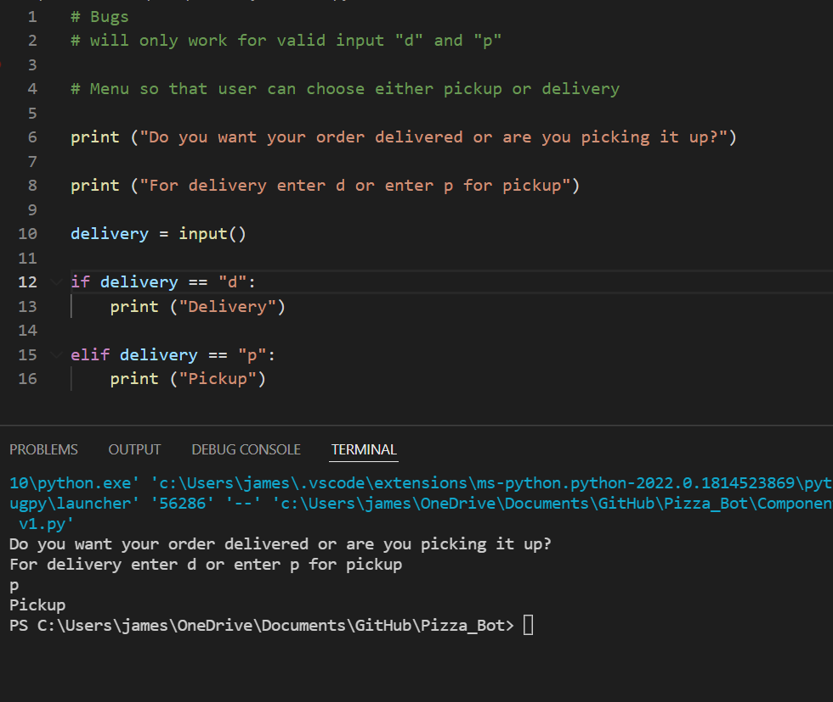
Component 2 version 1 - Test Plan (?and screenshot)
Test Case | Expected Values
Run program | Enter p program prints pickup Enter d program prints delivery Enter invalid program stops

Slide 10
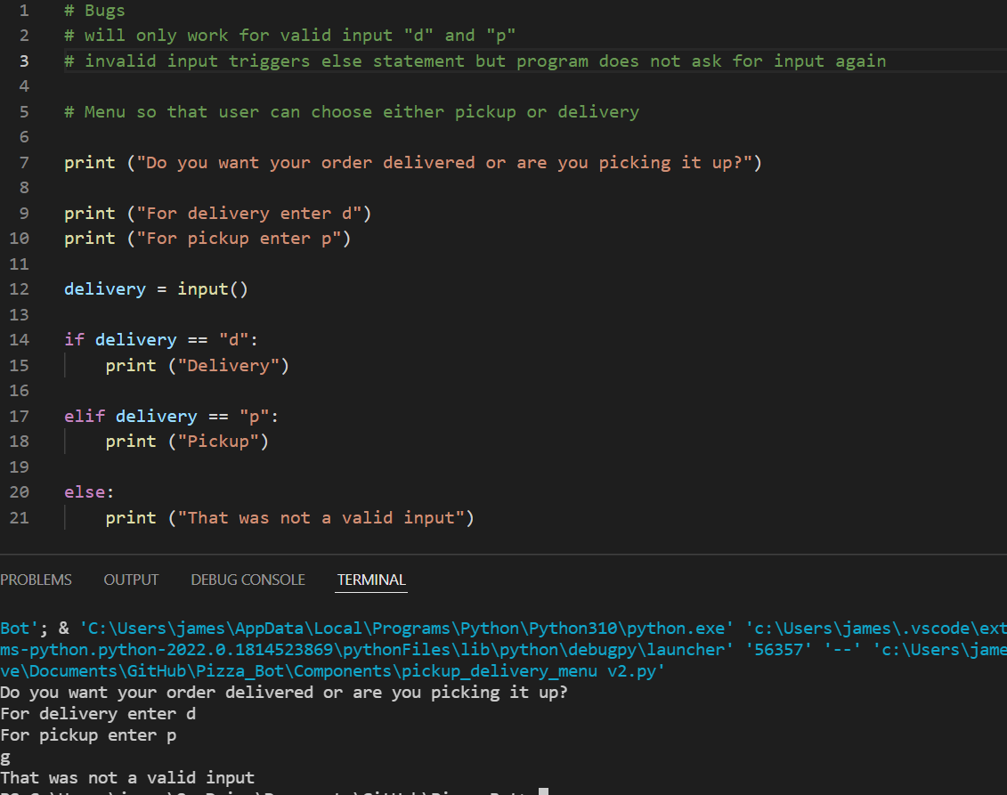
Component 2 version 2 - Test Plan (?and screenshot)
Test Case | Expected Values
Run program | Enter p program prints pickup Enter d program prints delivery Enter invalid program prints error message

Slide 11
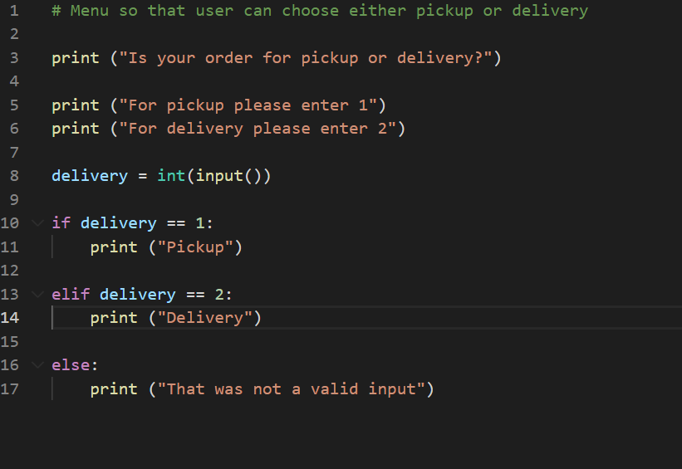
Component 2 version 3 - Test Plan (?and screenshot)
Test Case | Expected Values
Run program | Enter 1 program prints pickup Enter 2 program prints delivery Enter invalid program displays value error

Slide 12
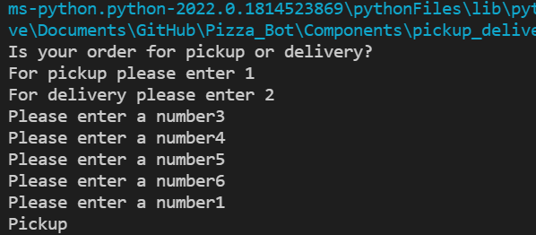
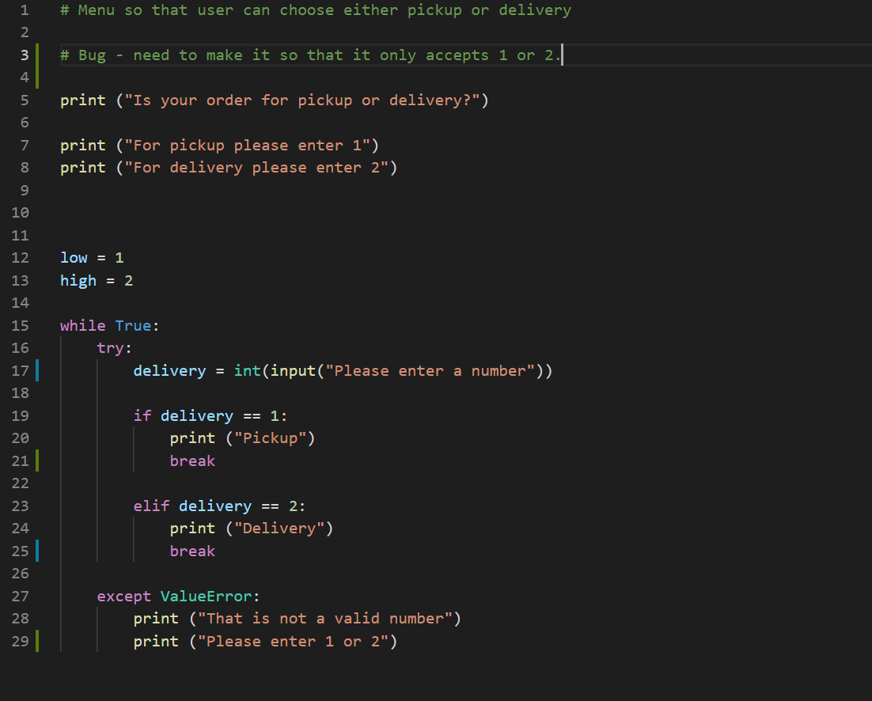
Component 2 version 4 - Test Plan (?and screenshot)
Test Case | Expected Values
Run program | Enter 1 program prints pickup Enter 2 program prints delivery Enter invalid program prints error message Enter number other than 1 or 2 does not work

Slide 13
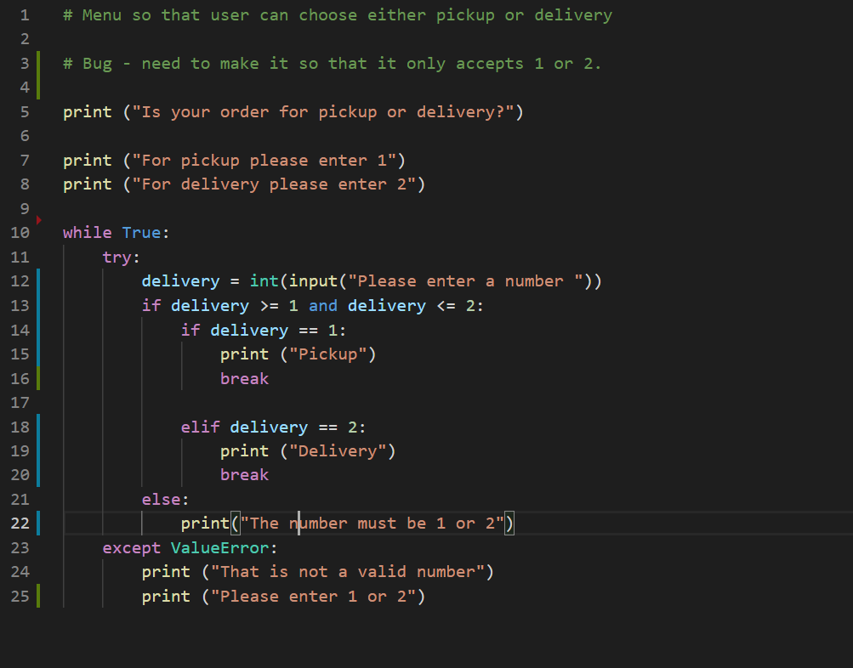
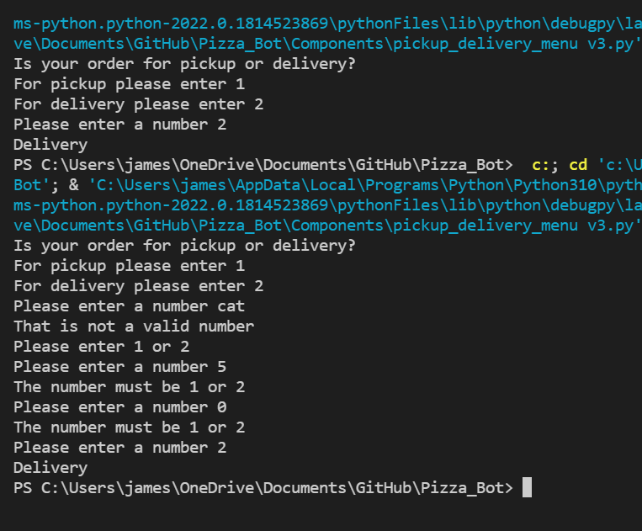
Component 2 version 5 - Test Plan (?and screenshot)
Test Case | Expected Values
Run program | Enter 1 program prints pickup Enter 2 program prints delivery Enter invalid entry program prints error message then asks for input again Enter number other than 1 or 2 error message and asks for entry again

Slide 14
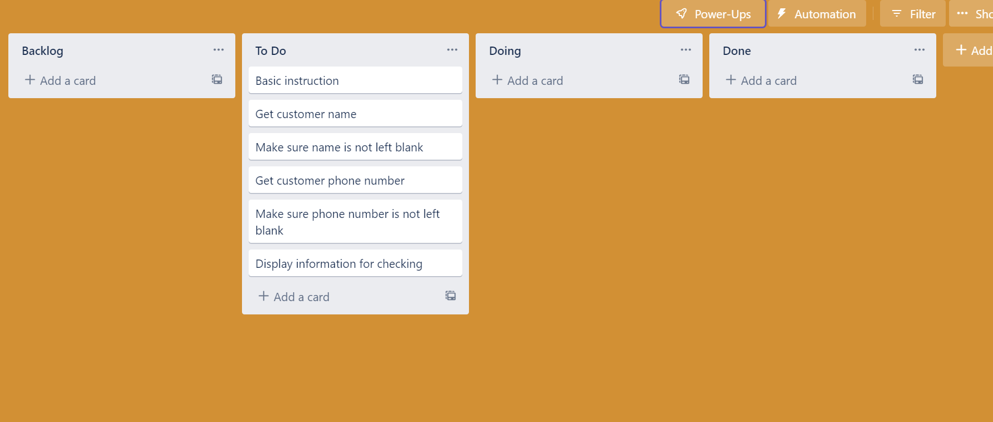
Component 3 Pickup info (Trello screenshot)

Slide 15
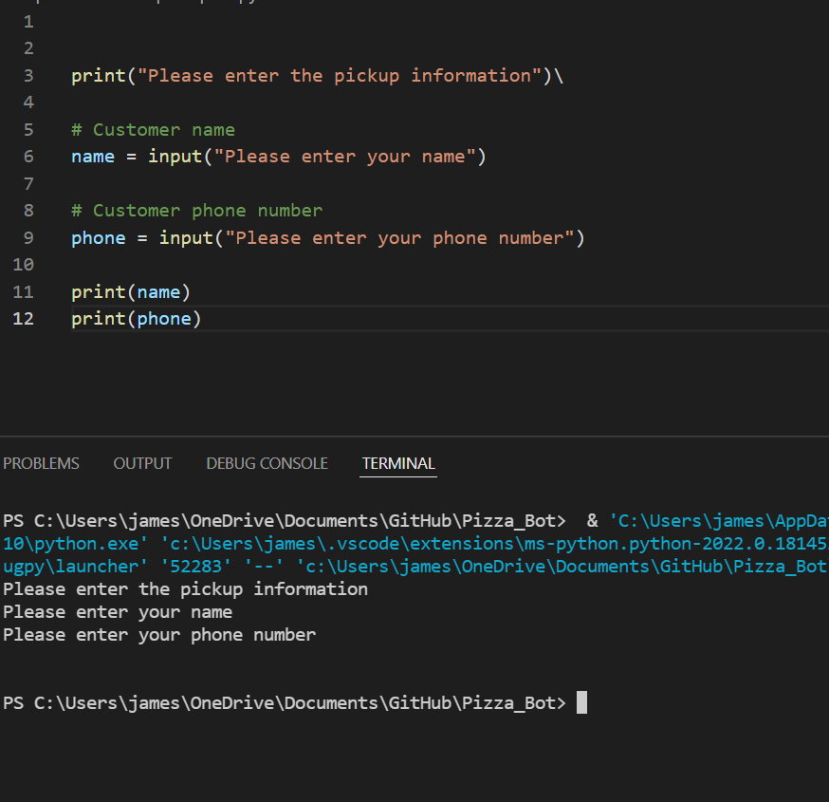
Component 3 version 1 - Test Plan (?and screenshot)
Test Case | Expected Values
Input name Input phone number Left input blank | Printed name correctly Printed phone number correctly Accepted blank and printed blank input

Slide 16
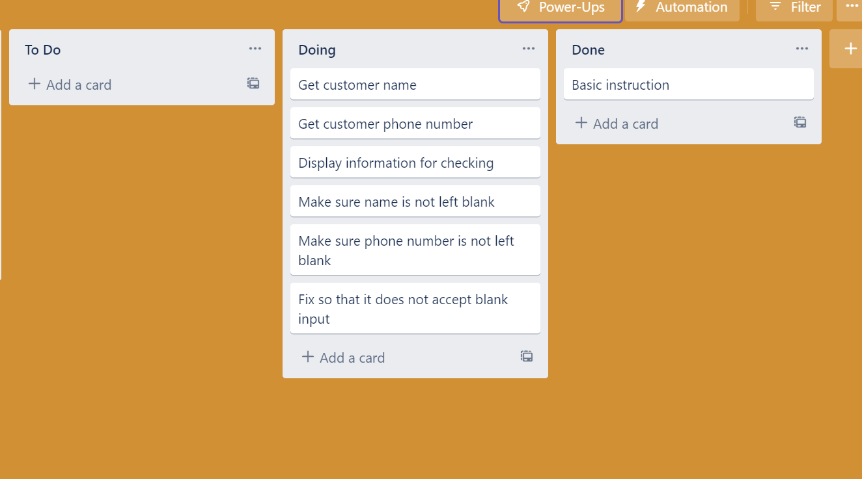
Component 3 Pickup info v2 (Trello screenshot)

Slide 17
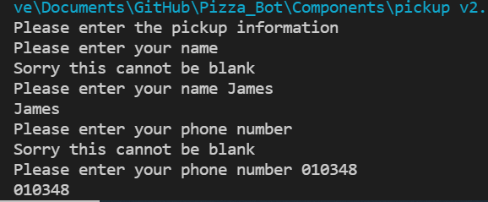
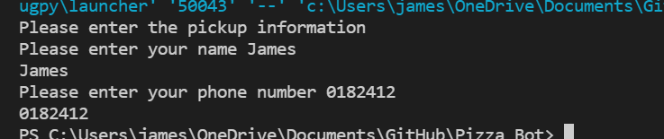
Component 3 v2 - Test Plan (?and screenshot)
Test Case | Expected Values
Input name Input phone number Left input blank | Printed name correctly Printed phone number Prints “Sorry this cannot be blank” – goes back to input

Slide 18
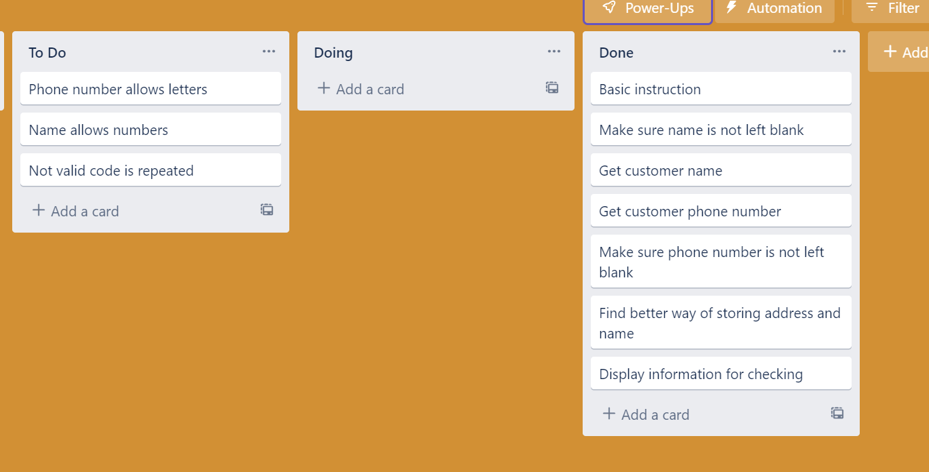
Component 3 Pickup info v3 (Trello screenshot)

Slide 19
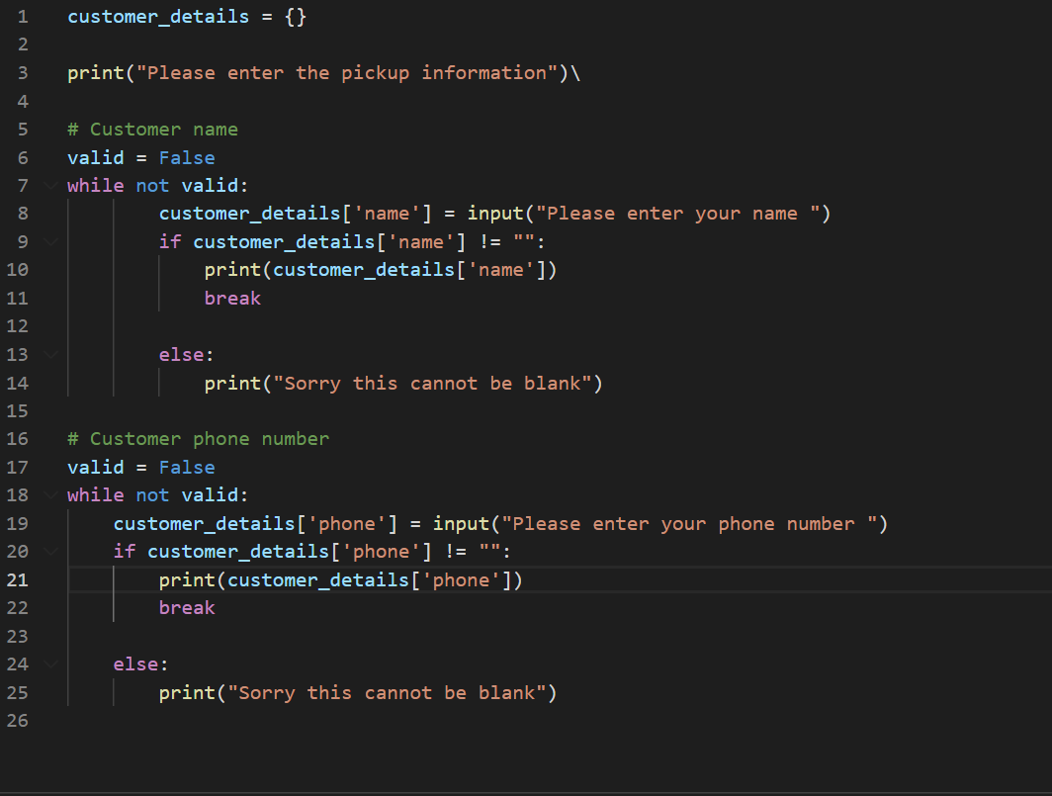
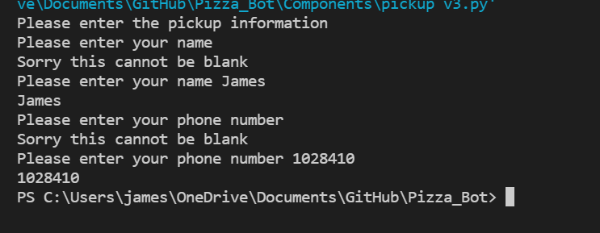
Component 3 v3 - Test Plan (?and screenshot)
Test Case | Expected Values
Input name Input phone number Left input blank | Printed name correctly Printed phone number Prints “Sorry this cannot be blank” – goes back to input

Slide 20
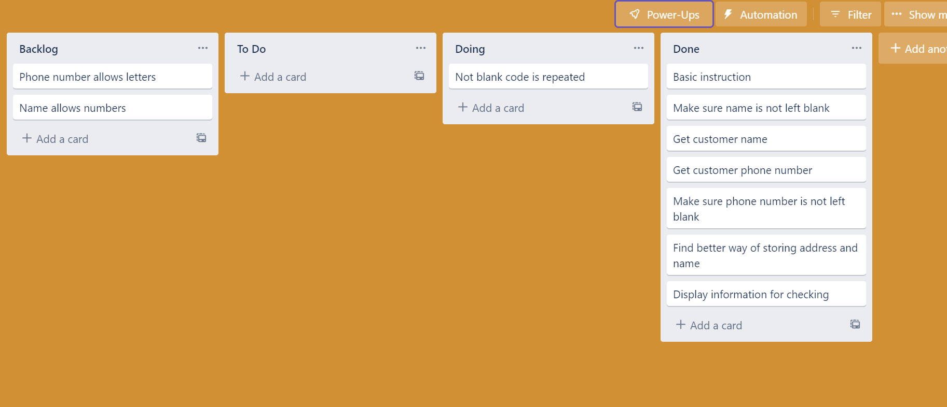
Component 3 Pickup info v4 (Trello screenshot)

Slide 21
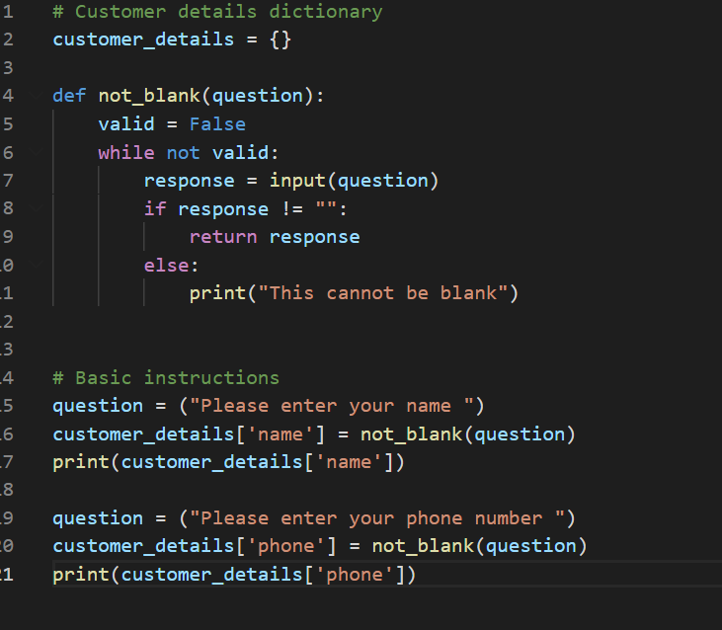
Component 3 v4 - Test Plan (?and screenshot)
Test Case | Expected Values
Input name Input phone number Left input blank | Printed name correctly Printed phone number Prints “Sorry this cannot be blank” – goes back to input

Slide 22
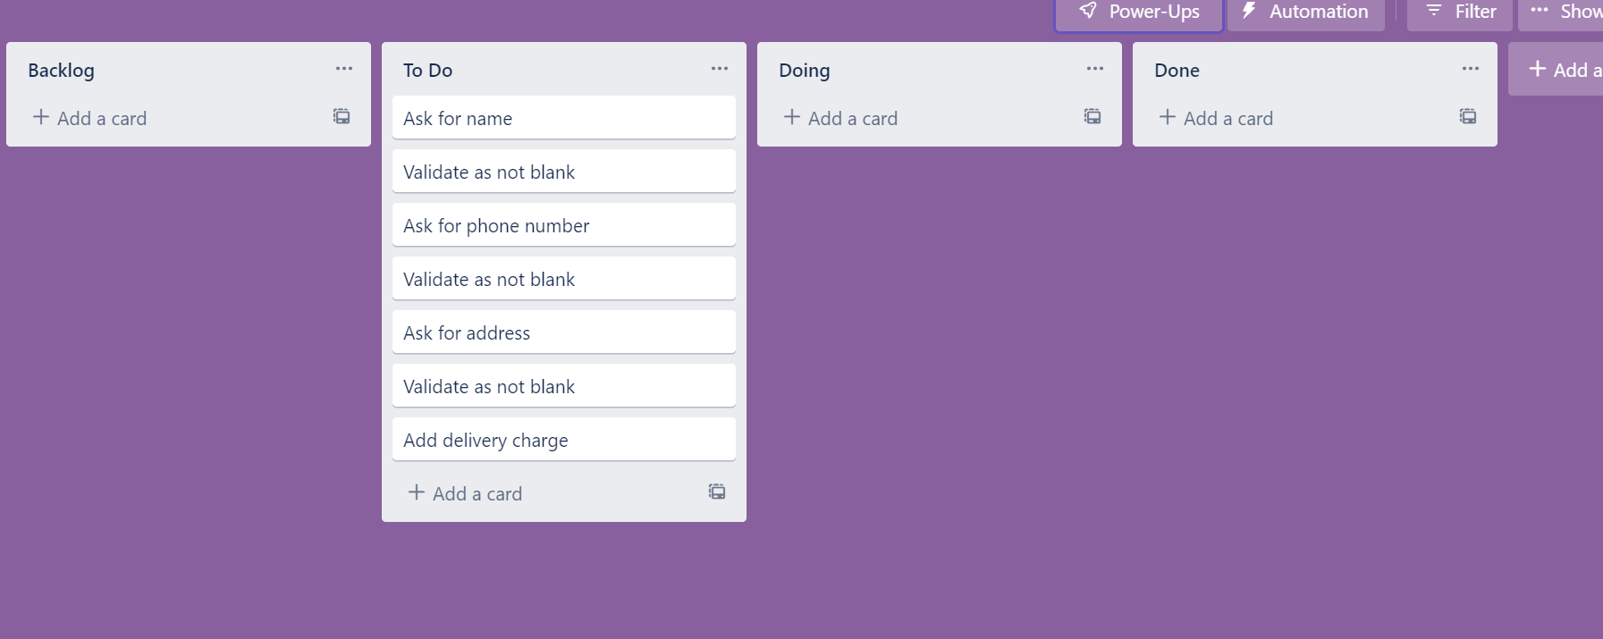
Component 4 Delivery info (Trello screenshot)

Slide 23
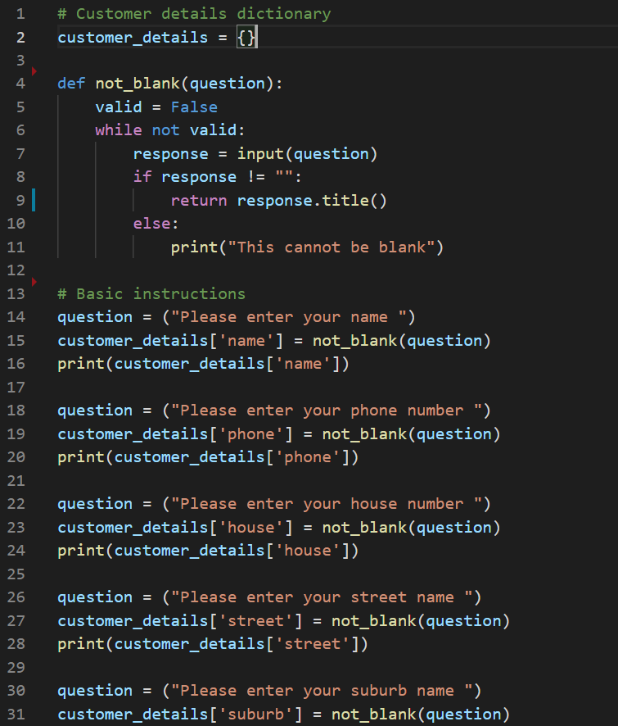
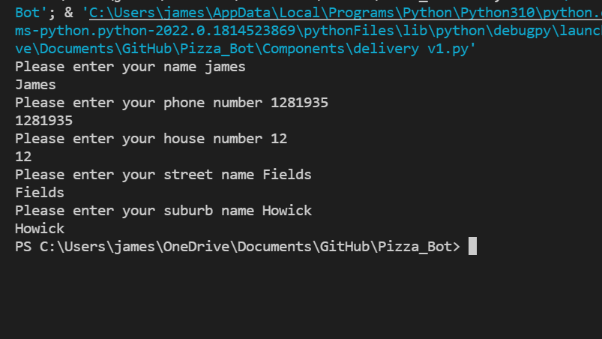
Component 4 v1 - Test Plan (?and screenshot)
Test Case | Expected Values
Input name Input phone number Input house number Input street name Input suburb Left input blank | Printed name correctly Printed phone number Accepted blank and printed blank input Printed street name Printed suburb name Asked for input again

Slide 24
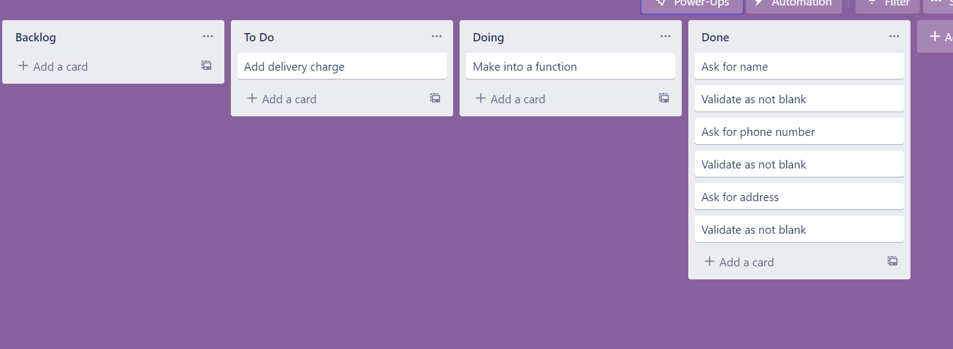
Component 4 v2 Delivery info (Trello screenshot)

Slide 25
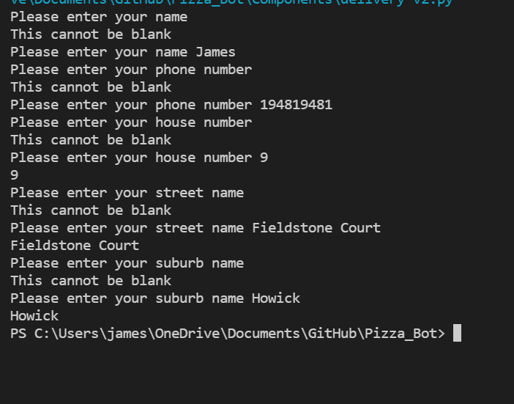
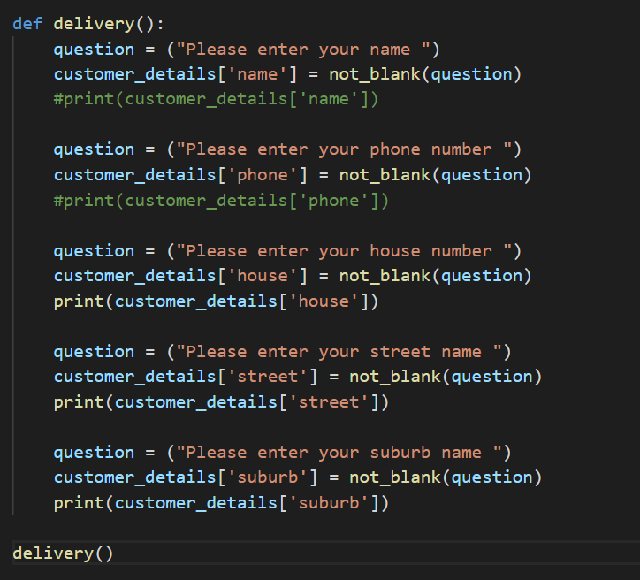
Component 4 v2 - Test Plan (?and screenshot)
Test Case | Expected Values
Input name Input phone number Input house number Input street name Input suburb Left input blank | Printed name correctly Printed phone number Printed house number Printed street name Printed suburb name Asked for input again

Slide 26
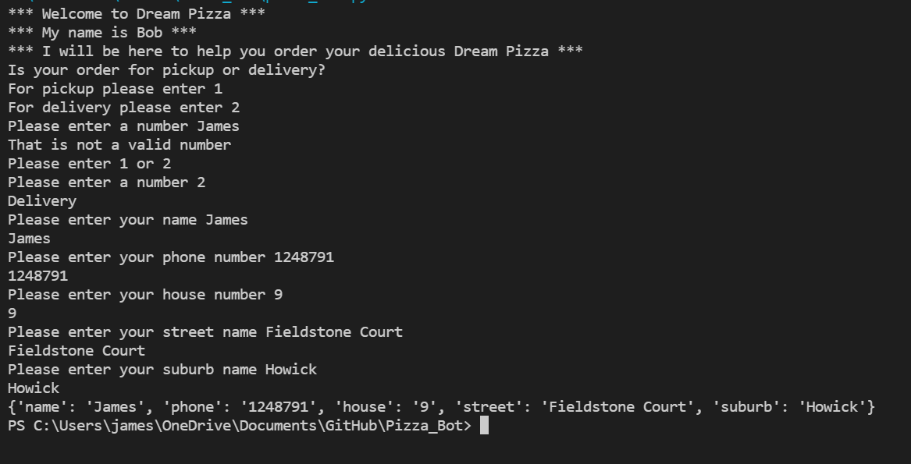
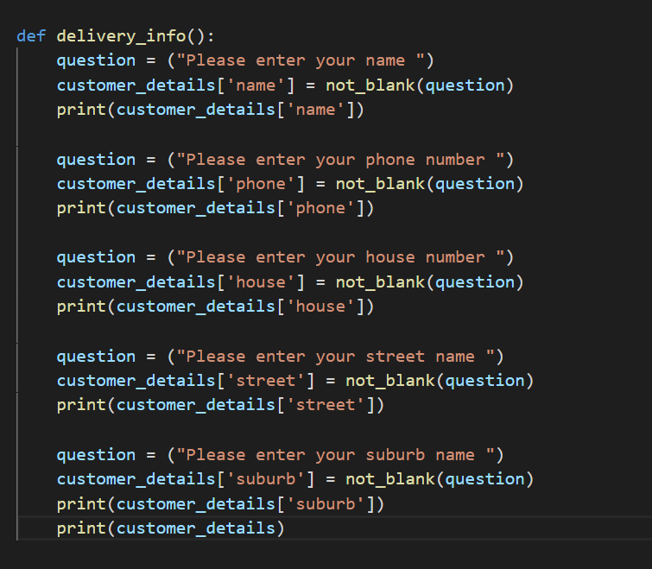
Component 4 v2 - Test Plan (?and screenshot)
Test Case | Expected Values
Input name Input phone number Input house number Input street name Input suburb Left input blank | Printed name correctly Printed phone number Printed house number Printed street name Printed suburb name Asked for input again

Slide 27
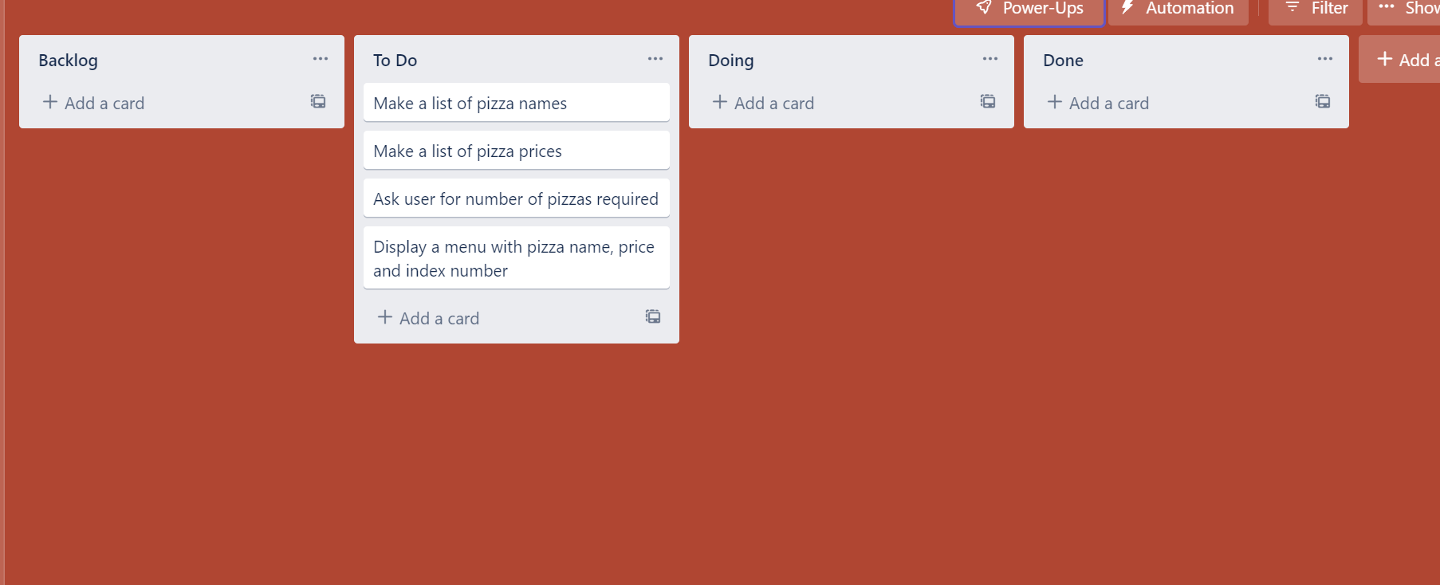
Component 5 Pizza menu (Trello screenshot)

Slide 28
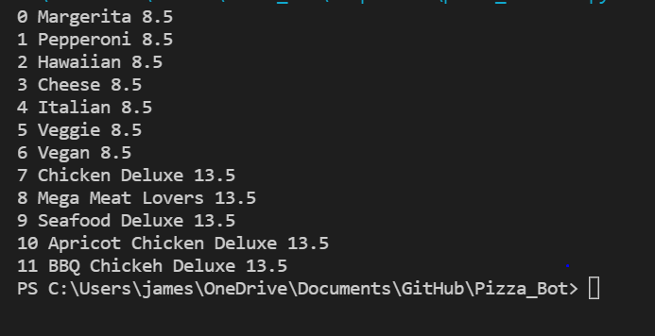
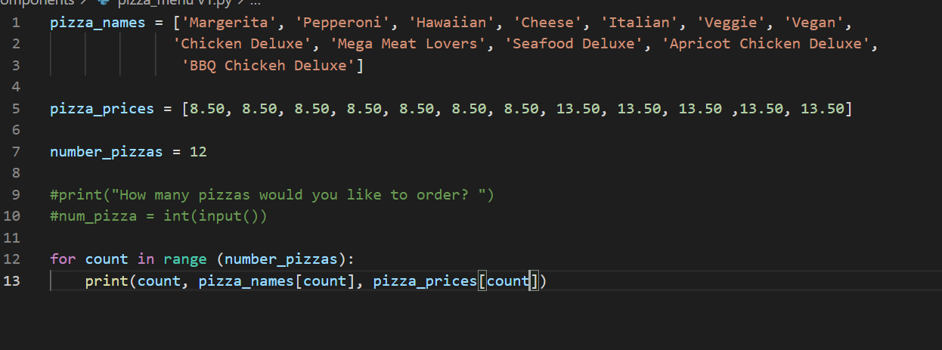
Component 5 v1 - Test Plan (?and screenshot)
Test Case | Expected Values
Run file | Printed a list with index numbers, pizzas and prices

Slide 29
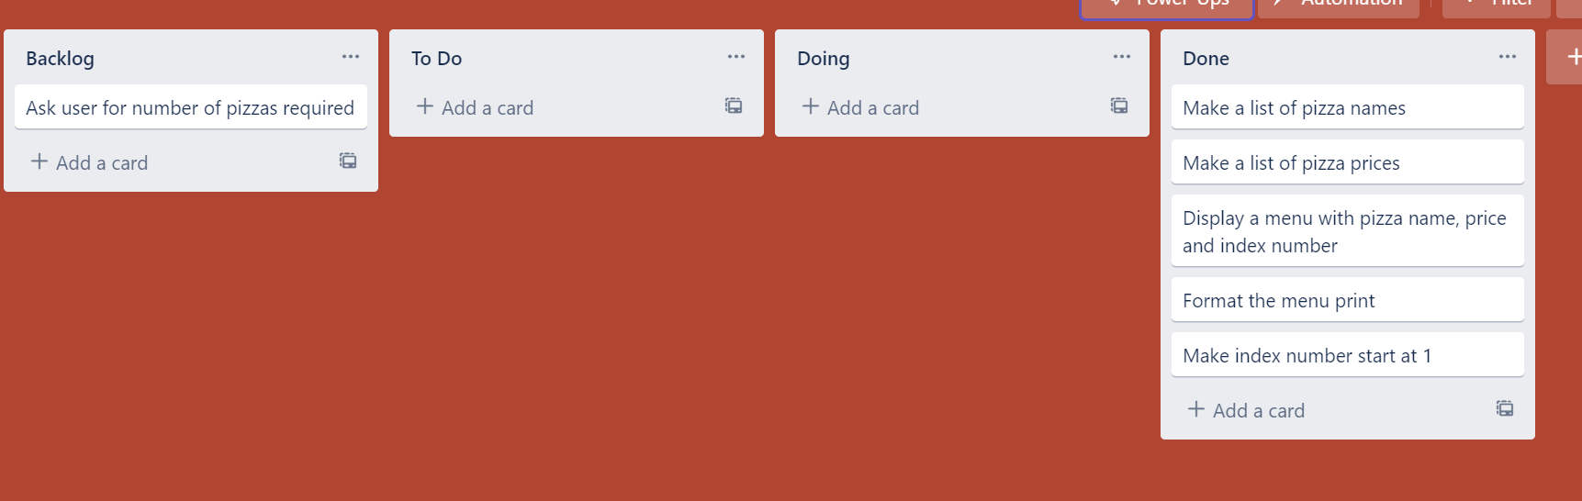
Component 5 v2 Pizza menu (Trello screenshot)

Slide 30
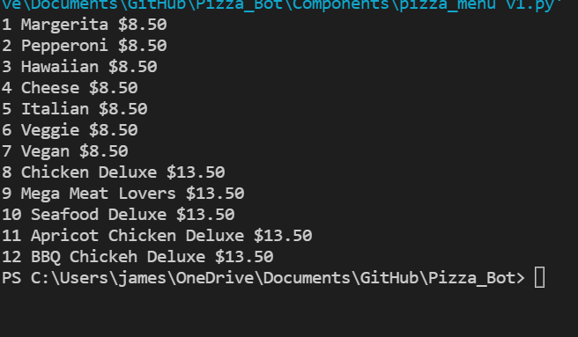
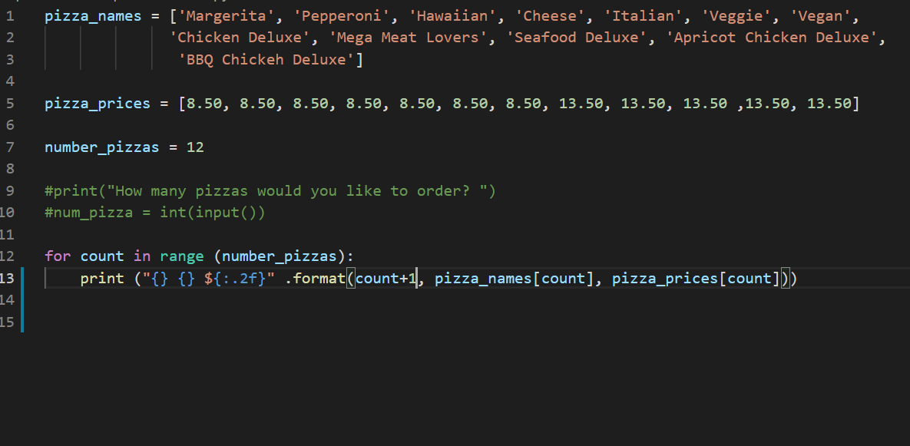
Component 5 v2 - Test Plan (?and screenshot)
Test Case | Expected Values
Run file | Printed a list with index numbers, pizzas and prices With price formatted to 2 decimal places and dollar sign. Menu starts at 1.

Slide 31
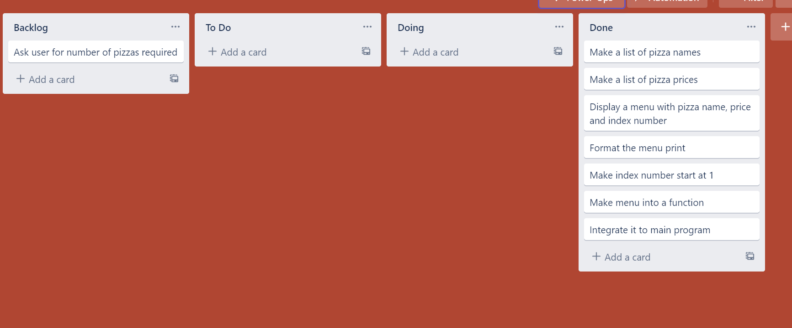
Component 5 v3 Pizza menu (Trello screenshot)

Slide 32
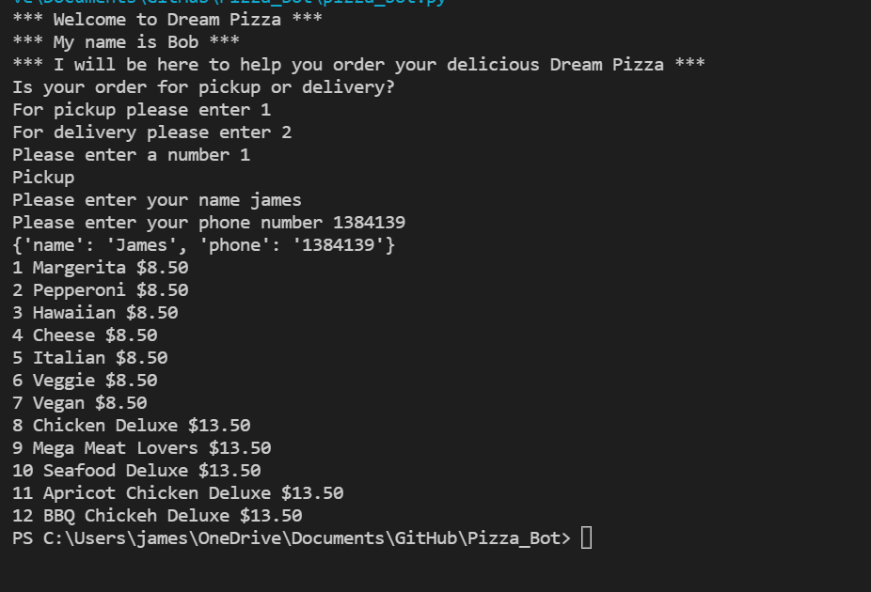
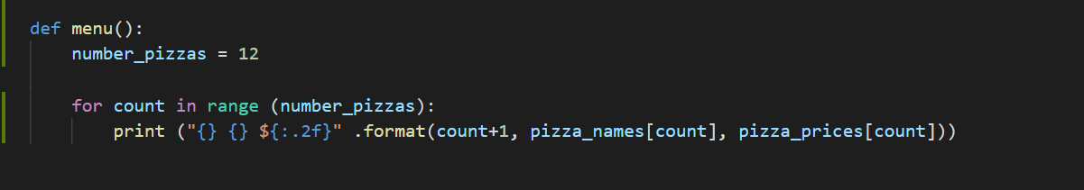
Component 5 integrated into main program - Test Plan (?and screenshot)
Test Case | Expected Values
Run file | Printed a list with index numbers, pizzas and prices With price formatted to 2 decimal places and dollar sign. Menu starts at 1.

Slide 33
Version Control Evidence
Your version control evidence should go here. This could be in the form of annotated screenshots which show you you managed this process or you could make a brief screencast explaining how you implemented version control.
Notes:
Your version control evidence should go here. This could be in the form of annotated screenshots which show you you managed this process or you could make a brief screencast explaining how you implemented version control.

Slide 34
Discusses how the information from planning, testing and trialling of components assisted in the development of a high-quality outcome
Notes:
Discusses how the information from planning, testing and trialling of components assisted in the development of a high-quality outcome

