Slide 1



Coding Challenge 21.10. – 23.10.2020
-
Group 2
Amina Navasudeen, Baris Yilmaz, Jessy Jingru Zhu, Maren Dieterich, James Xinyuan Xu, Yaroslav Ilichenko, Zekun Li

Slide 2
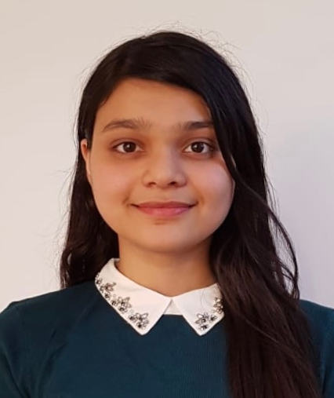
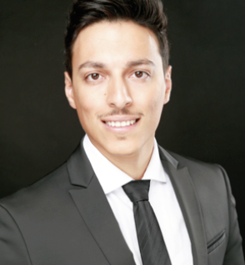
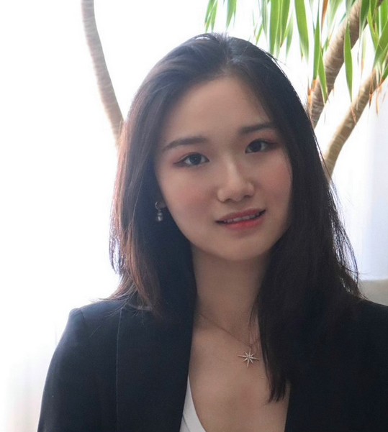
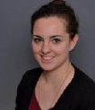
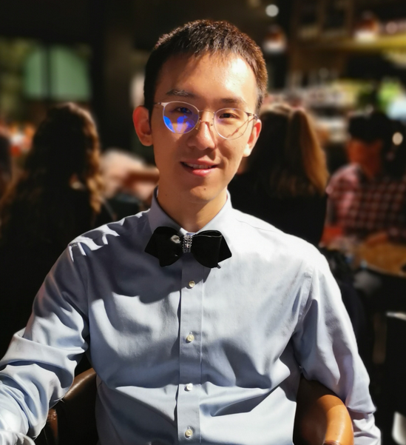
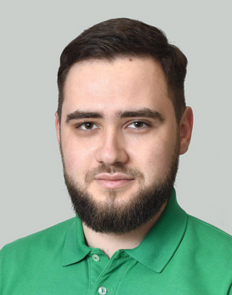
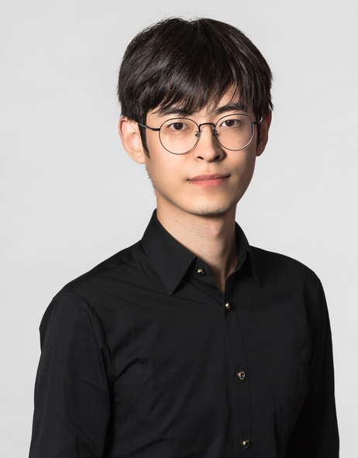
Roles & Assignments
Amina –
Scrum Master &
Frontend Development
Baris –
Backend Development
Jessy Jingru –
Frontend Development
Maren –
Product Owner &
Frontend Development
James Xinyuan –
Backend Development
Yaroslav –
Backend Development
Zekun –
Frontend Development

Slide 3
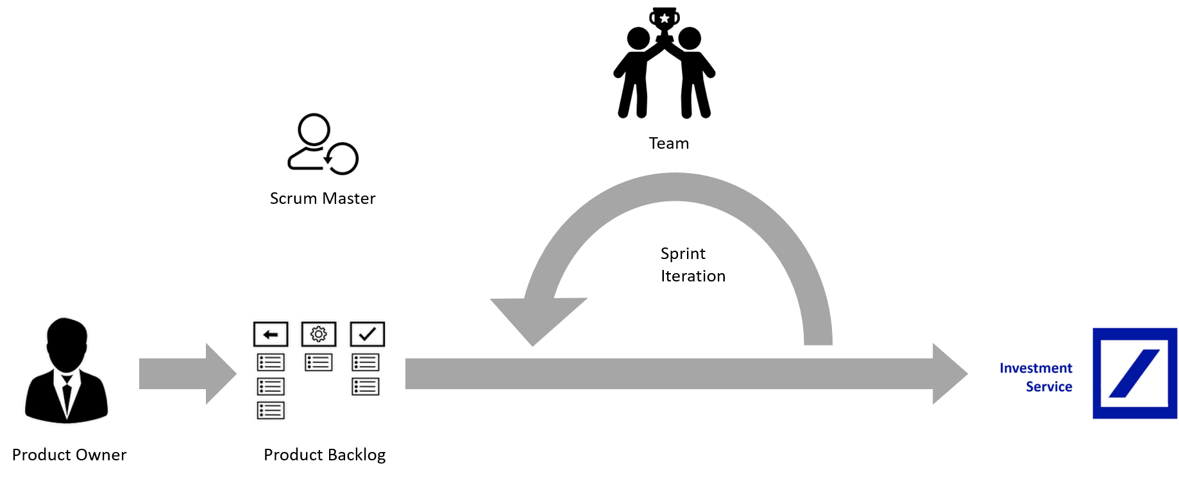
We worked in an agile manner…
… to develop at least the MVP till Thursday evening

Slide 4
Product Backlog: Task Planning and Tracking
Set-up of a Kanban Board in GitHub
Continuous Task tracking and prioritization of the Backlog

Slide 5
Sprint Iteration: Sprints and Continuous Integration
Sprint duration: 3 hours
After every sprint we made a Retrospective
Pushed the code to GitHub to realize Continuous Integration

Slide 6



Achievements
Day 1
Day 2
Day 3
Sprint 1
Sprint 2
Sprint 4
Understand the stream format, how to receive it in Python and how to normalize it
Inject normalize data into mysql-server
Creation of a Login page via HTML & FLASK
Design of the basic UI sketchup
Creation of a Login page via React
Get the Data Generation Tier Code work
Get the Web Tier Code Work work
Connecting Data Tier to the Front end
Build up the Dashboard
Streaming Data to the Database
Set up of a Test Connection button
Data Stream Code Work
Set up of a Test Connection button
Sprint 3

Slide 7
Product Demonstration

