Slide 1



Coding Challenge 21.10. – 23.10.2020
-
Group 2
Amina Navasudeen, Baris Yilmaz, Jessy Jingru Zhu, Maren Dieterich, James Xinyuan Xu, Yaroslav Ilichenko, Zekun Li

Slide 2
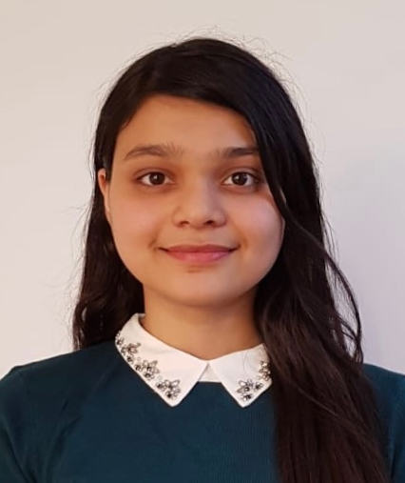
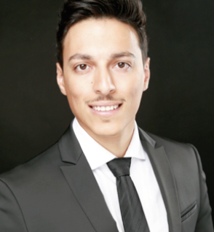
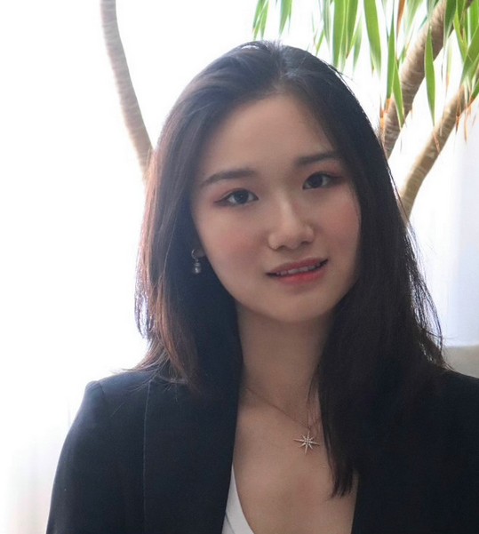
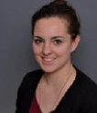
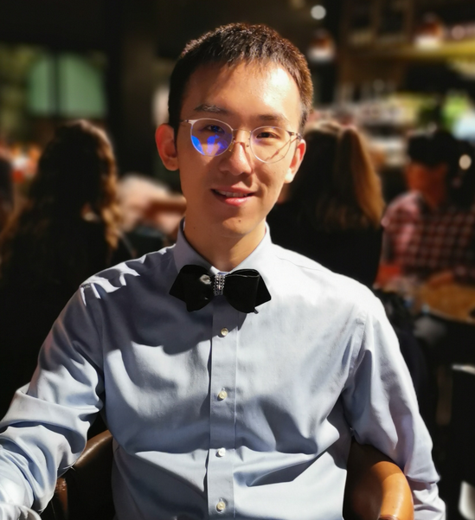
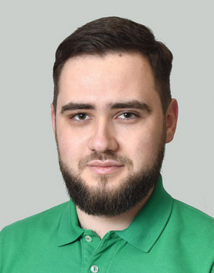
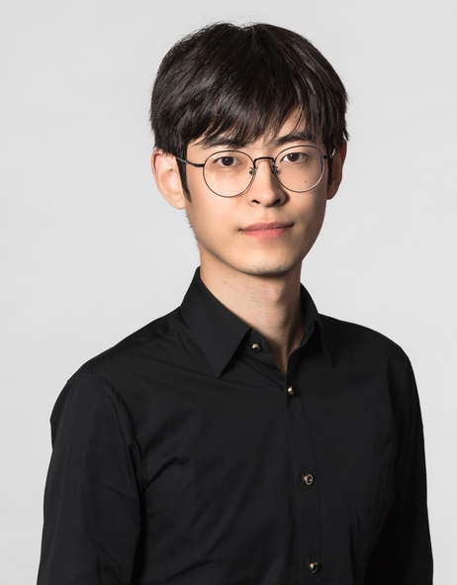
Roles & Assignments
Amina –
Scrum Master &
Frontend Development
Baris –
Backend Development
Jessy Jingru –
Frontend Development
Maren –
Product Owner &
Frontend Development
James Xinyuan –
Backend Development
Yaroslav –
Backend Development
Zekun –
Frontend Development

Slide 3
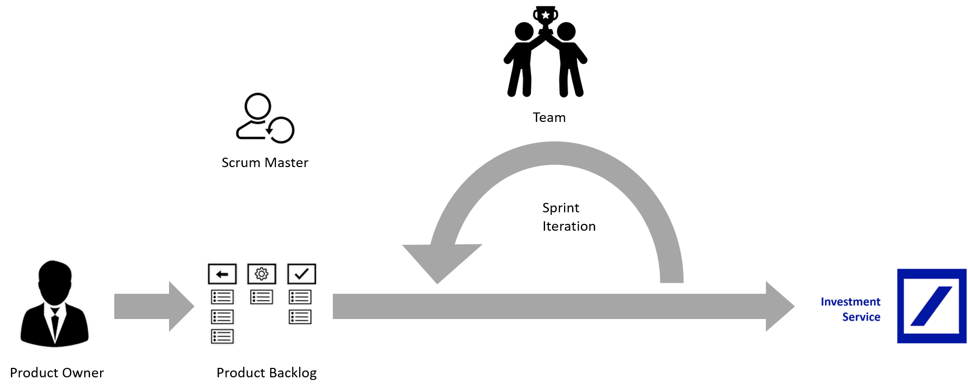
We worked in an agile manner…
… to develop at least the MVP till Thursday evening

Slide 4
Product Backlog: Task Planning and Tracking
Set-up of a Kanban Board in GitHub
Continuous Task tracking and prioritization of the Backlog

Slide 5
Sprint Iteration: Sprints and Continuous Integration
Sprint duration: 3 hours
After every sprint we made a Retrospective
Pushed the code to GitHub to realize Continuous Integration

Slide 6



Achievements
Day 1
Day 2
Day 3
Understand the stream format, how to receive it in Python and how to normalize it
Inject normalize data into mysql-server
Creation of a Login page via HTML & FLASK
Design of the basic UI sketchup
Creation of a Login page via React

Slide 7
Product Demonstration

