Slide 1

Seeing is believing
Presenting By : Pokuong Lao, Alexander Voisan, James Yokley
Notes:
Hi everyone my name is …
We want to discuss and showcase our ideas on how to improve certain people lives on the internet.
We want to introduce an advanced accessibility extension that will make web browsing quite easier for individuals with visual and cognitive impairments such as colorblindness and dyslexia. It is important to get a message across to everyone because seeing is believing and we want to create an extension that will provide common ground for people with and without impairment.

Slide 2


The know it and see it all extension
Cognitive disabilities such as dyslexia
Visual disabilities such as color blind
Notes:
We want to showcase a webpage extension that will accommodate user with cognitive disabilities and visual disabilities.

Slide 3
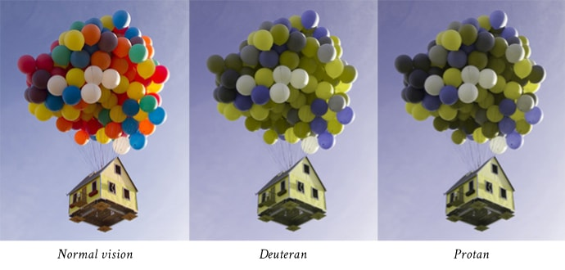
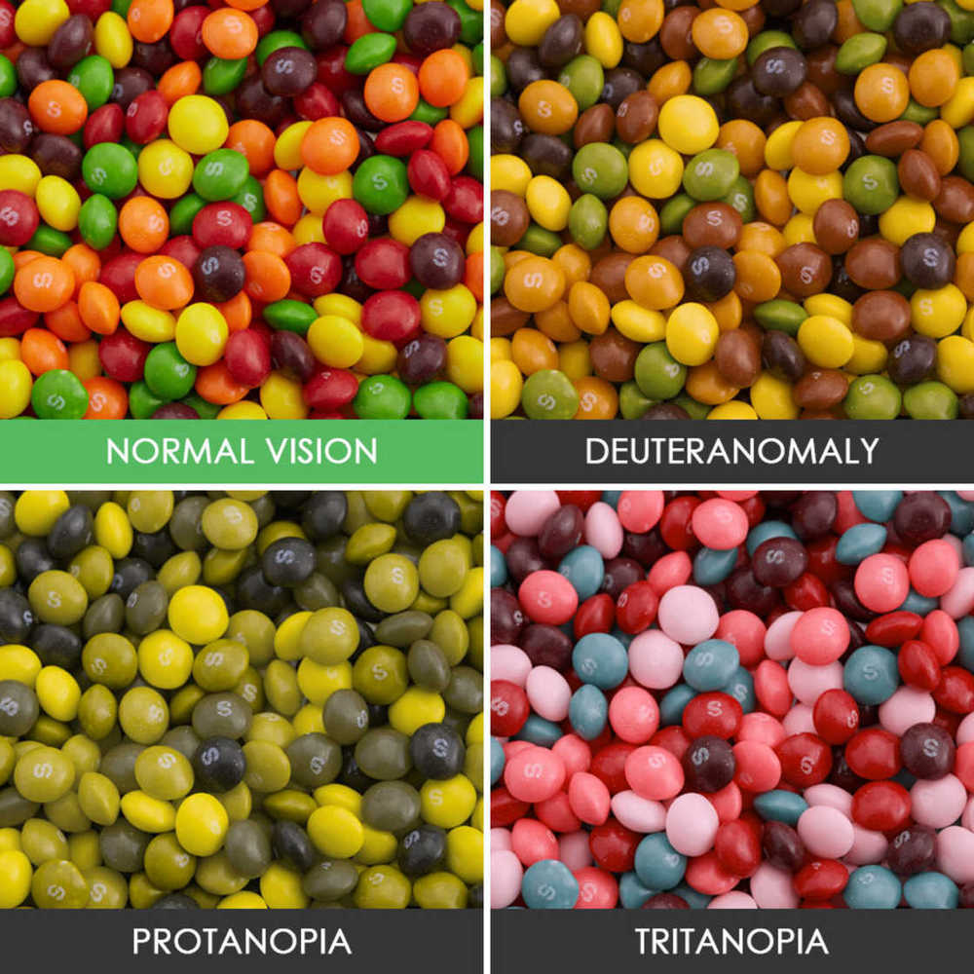
Color blind
Protanopia (red deficiencies)
Deuteranophia and deuteranomaly (green deficiencies)
Tritanopia (blue deficiencies)
Notes:
We want to create a colorblind-friendly environment on the webpage that the colorblind user can toggle on and off in just a second if they cannot see the contents on that page. There will be an adjustable button that the user can set based on their deficiencies. These are the three main deficiencies for color blindness and this picture will is an example of masking a filter on images to accommodate the user.

Slide 4
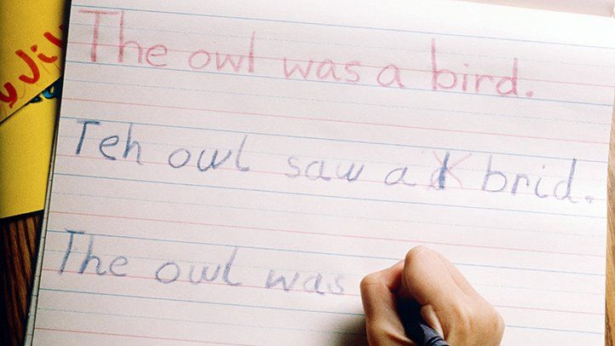
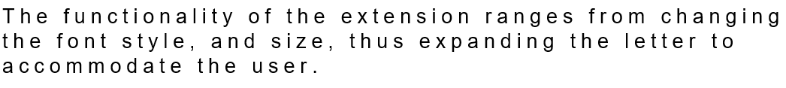
dyslexia
Notes:
In addition, the extension will have another option where an individual with dyslexia can change the style of the web page font to accommodate their yearning. An individual with that kind of condition will have difficulty reading because letters seem to jump around and show up in places that seem wrong. For example, this picture shows this person is having trouble placing the letter in its correct position for that word. Similar thing can happen on the web page and the user will have hard time reading the contents on the page. This is where our extension will change the user’s life by…

Slide 5
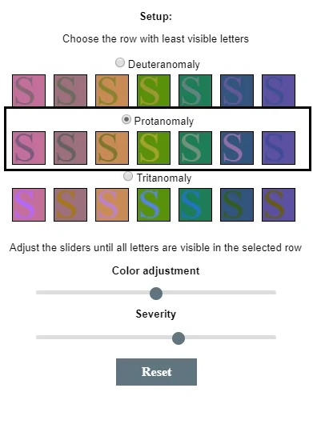
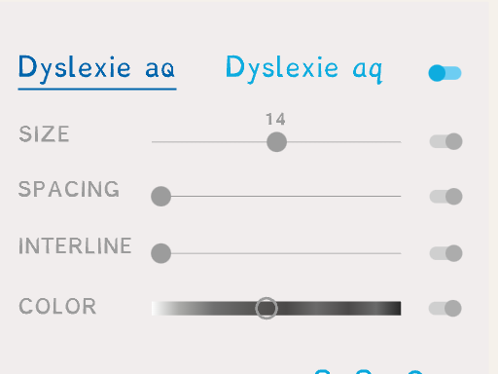
Moving forward
Notes:
As time progress, our extension will progress as well by featuring multiple ways for the user to change the way how they see the contents on their webpage. On top of that, the UI will be more sophisticated and user-friendly. Our vision for this extension is not just for the web page but it can further help users with their writing assignments, drawing, and presentation like this. We envision this will nurture young kids with these disabilities that are starting school and replace the extra cost to hire tutors.

Slide 6
Thank you questions?

