Slide 1
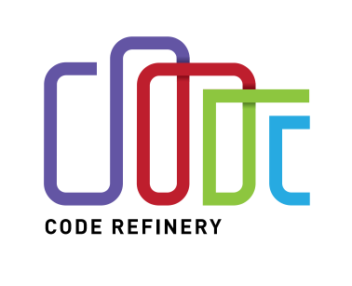
CodeRefinery
Sabry Razick 12/05/2018

Slide 2
The goal of this project is to teach students and researchers how to write better code and provide research groups with software development e-infrastructure tools to collaboratively develop, review, discuss, test, and share their codes.

Slide 3
Goal: “Better research software”

Slide 4
Teaching
Past (8)
Espoo, December 14-16, 2016
Stockholm, February 20-22, 2017
Copenhagen, May 9-11, 2017
Tromsø, June 19-21, 2017
Aarhus, October 24-26, 2017
Linköping, November 7-9, 2017
Espoo, December 12-14, 2017
Trondheim, February 27 - March 1, 2018

Slide 5
Teaching
Planned
Turku, March 20-22, 2018
Lund, May 15-17, 2018
Oslo, June 12-14, 2018

Slide 6
What do we teaching
Lessons
Version control /Git)
Introduction to version control,
Collaborative distributed version control
Archaeology with Git
Git branch design
Documentation
Jupyter notebooks
Managing complexity and modular code development
Automated testing
DevOps, automation, and continuous integration

Slide 7
What do we teaching
Lessons
Building portable code with CMake
Integrated development environments
Mixed Martial Arts: Interfacing Fortran, C, C++, and Python
Software licensing

Slide 8
How do we teach
Software Carpentry inspired training material
Training materials available from Github
Live cording

Slide 9
Demo: how the training materials are managed.
http://coderefinery.org/lessons/
https://github.com/coderefinery

Slide 10
Team
Norway: Radovan Bast, Bjørn Lindi, Sabry Razick
Denmark: Damon Michael Kasacjak, Erland Hochheim
Sweden: Thor Wikfeldt
Finland: Erik Edelmann, Jyry Suvilehto, Nikolai Denissov, Risto Laurikainen, Sri Harsha Vathsavayi

