Slide 1
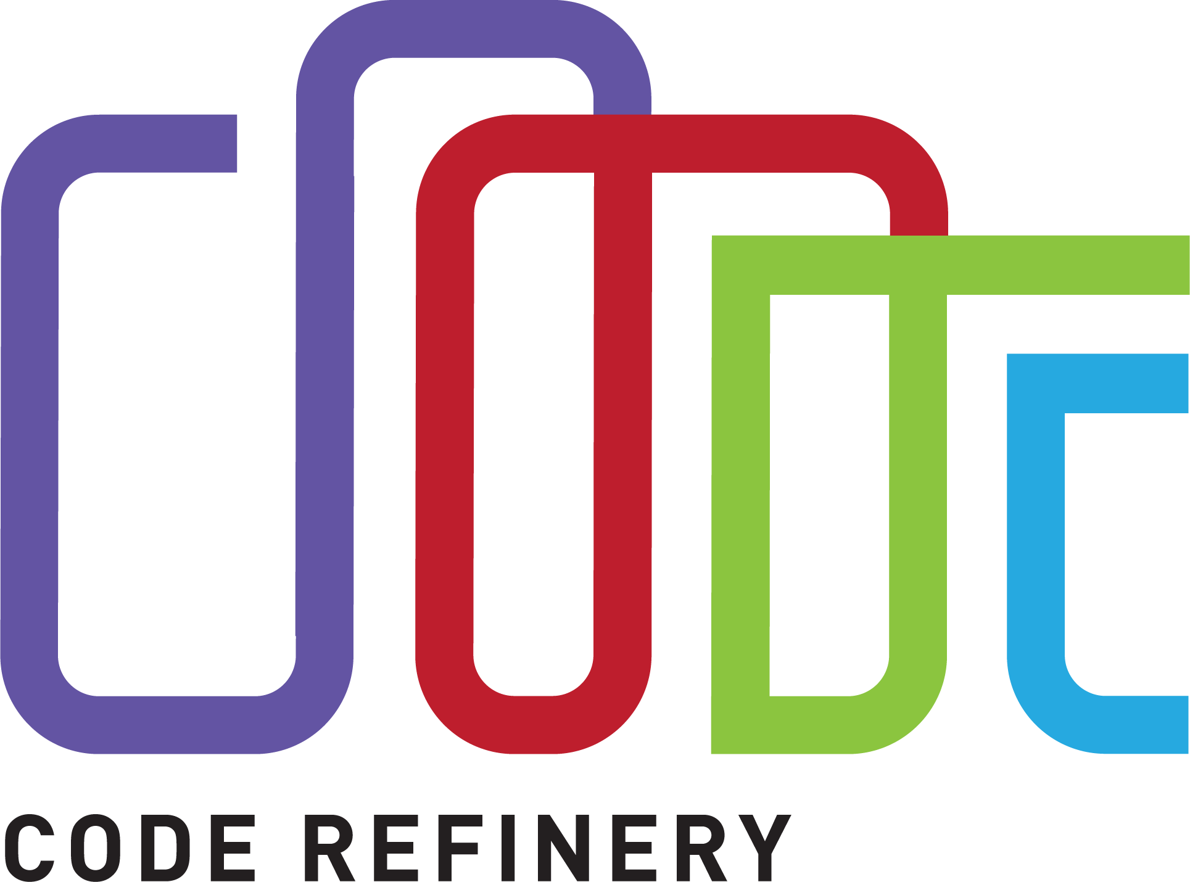
Goals: FAIR software practices, lessons, workshops, community, sustainability
Carpentries-style lessons: coderefinery.org/lessons/
27 workshops, 600 participants
Community chat: coderefinery.zulipchat.com
Post-workshop survey 3-6 months after a workshop
Funded by NeIC and partners until Autumn 2021
Nov 4-7 2019 Stockholm: trainer-the-trainer + hackathon
coderefinery.org
@coderefine

