Slide 1

Goals: FAIR software practices, lessons, workshops, community, sustainability
Carpentries-style lessons: coderefinery.org/lessons/
27 workshops, 600 participants
Community chat: coderefinery.zulipchat.com
Post-workshop survey 3-6 months after a workshop
Funded by NeIC and partners until Autumn 2021
Nov 4-7 2019 Stockholm: trainer-the-trainer + hackathon
Jun 2-4 2020 Oslo: CodeRefinery workshop
coderefinery.org
@coderefine

Slide 2
http://bit.ly/resbaaz2020

Slide 3
https://nordic-rse.org/

Slide 4
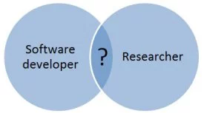
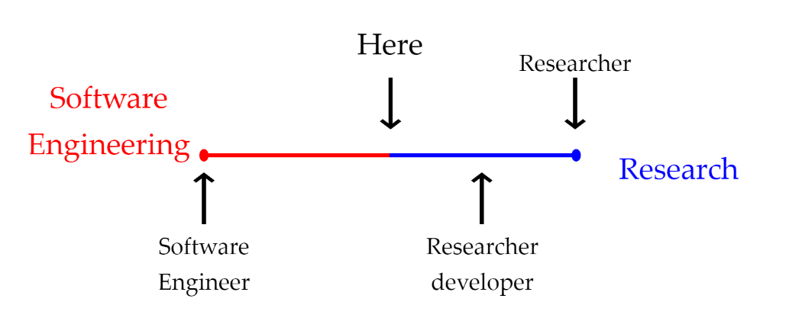
Who is Research Software Engineer?
https://opendreamkit.org/2018/10/29/ODK-RSE/

Slide 5
History of RSEs
In the last 2 decades, there has been a rapid increase in software use across all academic disciplines.
Concerns over the reliability and reproducibility of that software.
Software engineering skills are needed in research groups.
The term “Research Software Engineer” was first coined in 2012 at Queen’s College Oxford
creation of the UK RSE Association, which in January 2018 numbers over 1200 members (growing monthly by 55 new members) https://www.software.ac.uk/blog/2016-11-24-not-so-brief-history-research-software-engineers
UK initiative followed by USA, Canada, Brazil, Australia, New Zealand, Netherlands, Germany, France, Namibia, Sudan
April 2018 Nordic-RSE started at Coderefinery meeting at Stockholm

Slide 6
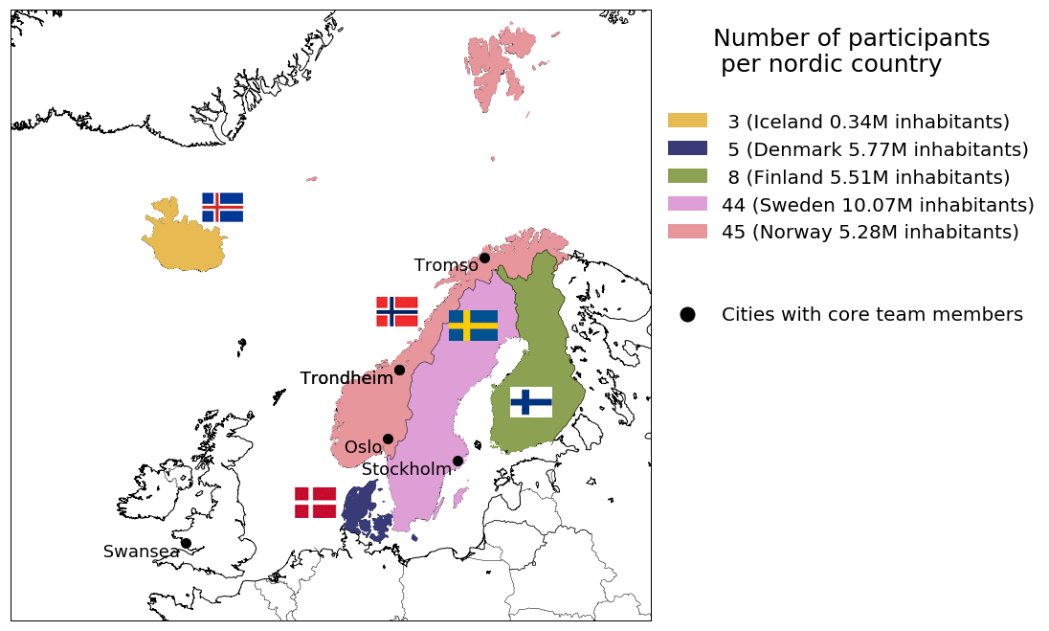
Who are we?
104 participants from the Nordic countries for about 27 millions inhabitants*
Nordic RSE survey 2018 https://github.com/nordic-rse/RSE_intro_survey

Slide 7
Get involved and save the date!
http://nordic-rse.org
The first Research Software Engineering Conference in the Nordics will be held the week of October 19-23, 2020.
Do you know a cool place for having the Nordic-RSE conference?
submit a venue bid: http://bit.ly/nordic-rse2020

