Slide 1
BUILDING AN NLP MODEL FOR ENTITY-LEVEL SENTIMENT ANALYSIS ON TWITTER

Slide 2
DSF-PT08: FINAL PROJECT SUBMISSION
Project Owner: James Wachira Muthee
Technical Mentor: Daniel Ekale

Slide 3
Table of Contents
1. Project Overview
2. Problem Statement
3. Business Objectives
4. Target Audience
5. Data
6. Data Understanding
7. Exploratory Data Analysis
8. Data Preprocessing
9. Modelling & Evaluation
10. Validating the Model
11. Findings
12. Conclusion

Slide 4
Business Problem Statement
Businesses struggle to extract meaningful insights from social media due to the lack of entity-specific sentiment analysis. Traditional sentiment analysis classifies entire messages without focusing on a given entity. This project aims to develop an entity-level sentiment analysis model to classify tweets as Positive, Negative, Neutral or Irrelevant concerning a specific entity, helping businesses track sentiment trends and improve decision-making.

Slide 5
Business Objectives
The purpose of this project is to create an entity-level sentiment analysis model that can accurately classify tweets as Positive, Negative, Neutral or Irrelevant regarding a given entity. This model will help businesses and organizations to:
1. Enhance Brand and Reputation Management
2. Improve Customer Engagement Strategies
3. Support Data-Driven Decision-Making

Slide 6
Data
The Sentiment Analysis dataset used in this project was obtained from Kaggle

Slide 7
Tools used
I used inbuilt libraries in Visual Studio Code tool to:
Load the datasets
Understand the datasets(shape, distribution and summary statistics)
Understand the data
Do exploratory data analysis
Do Data Preprocessing
Build Models
Evaluate Models’ Performance
Validate the Model

Slide 8
Data Understanding
Upon loading the data, the following observations were made:
1. The training dataset had 74681 rows and 4 columns while the validation dataset had 999 rows and 4 columns
2. The training dataset had 686 missing values in the tweet column while the validation dataset had no missing values
3. Both datasets had one column with integer data type and 3 columns with categorical data type
4. Both datasets had 4 unique values on the Sentiment Column
5. The column names were renamed to ID, Entity, Sentiment and Tweet

Slide 9
Data Preprocessing
Raw data was transformed into a structured format suitable for modeling. The following transformations were done to the data:
1. Label Encoding the Target Feature
2. Word Lemmatization
3. Removal of Stopwords
4. Word Tokenization
5. Applying Regular Expressions (Regex)
6. Converting Text to Lowercase

Slide 10
Modelling
For this project, 2 models were developed, namely:
1. Logistic Regression Model(Baseline Model)
4. Random Forest Model(Tuned)

Slide 11
Model Evaluation
The following Metric was used to evaluate the Models developed:
Accuracy Score: It represents the proportion of correct predictions made by the model out of all predictions made.
Model with highest accuracy score was taken as the best model

Slide 12
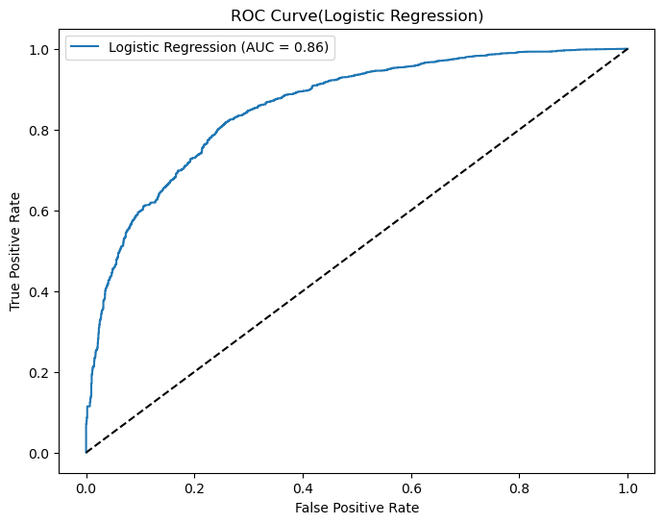
Logistic Regression Model-ROC Curve
Overall Metric Score
1.Accuracy Score = 80%
2. AUC = 0.86

Slide 13
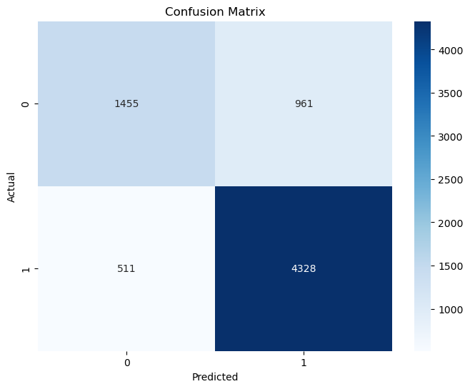
Logistic Regression-Confusion Matrix
Interpretation
4,328 bookings correctly predicted as non-cancellations
1,455 bookings correctly predicted as cancellations

Slide 14
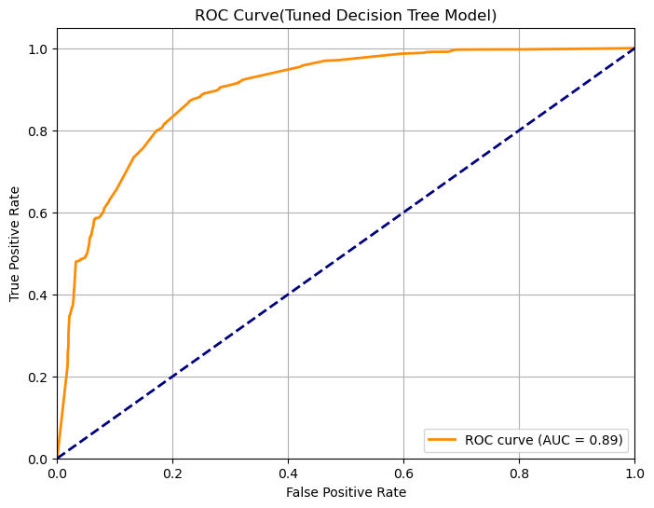
Decision Tree Model(Tuned)-ROC Curve
Overall Metric Score
1.Accuracy Score = 84%
2. AUC = 0.89

Slide 15
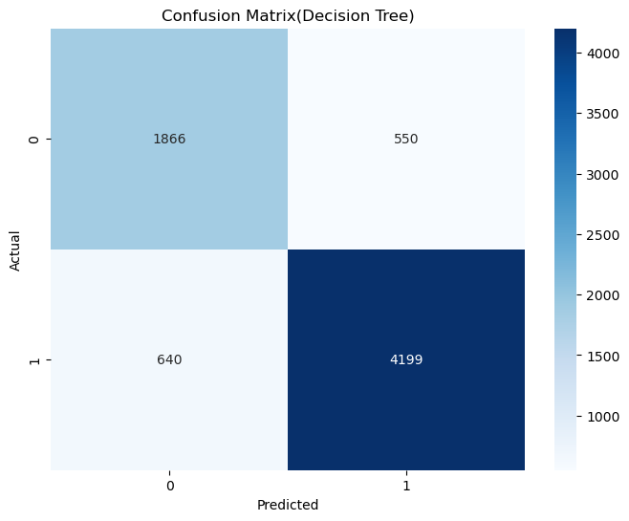
Decision Tree Model(Tuned) - Confusion Matrix
Interpretation
4,199 bookings correctly predicted as non-cancellations
1,866 bookings correctly predicted as cancellations

Slide 16
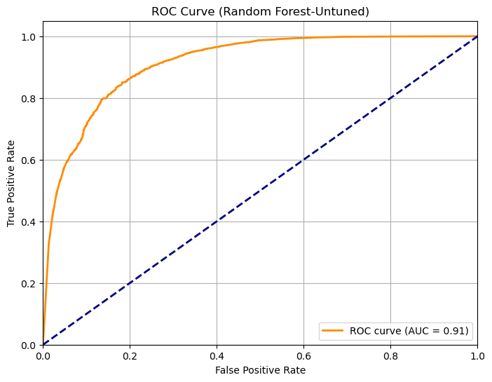
Random Forest(Untuned)-ROC Curve
Overall Metric Score
1.Accuracy Score = 85%
2. AUC = 0.91

Slide 17
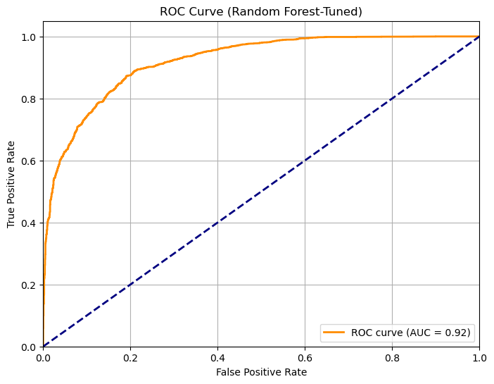
Random Forest(Tuned)-ROC Curve
Overall Metric Score
1.Accuracy Score = 86%
2. AUC = 0.92

Slide 18
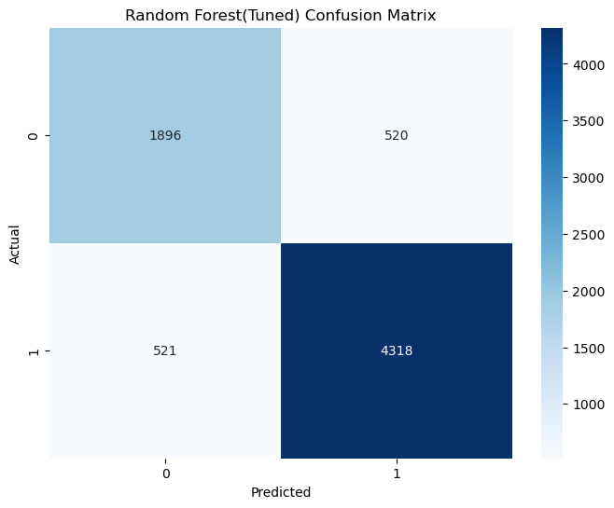
Random Forest(Tuned)-ROC Curve
Interpretation
4,318 bookings correctly predicted as non-cancellations
1,896 bookings correctly predicted as cancellations

Slide 19
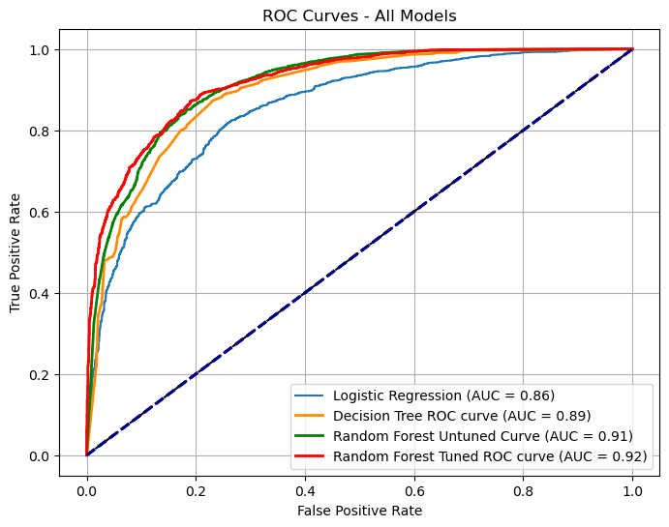
Combined ROC Curves-All Models
Best Performing Model
Tuned Random Forest Model with:
1. Accuracy Score = 86%
2. AUC = 0.92

Slide 20
Insights
Upon developing and evaluating the models, I concluded the following:
1. Tuned Random Forest Model
Outperforms all other models, with the highest Accuracy Score of 86% and the highest AUC of 0.92.
2. Untuned Random Forest Model
Also performed well, achieving an Accuracy Score of 85% and an AUC of 0.91 even without tuning of parameters
3. Tuned Decision Tree Model
Showed a notable improvement over the baseline Logistic Regression Model, with an Accuracy Score of 84% and an AUC of 0.89, suggesting that decision trees, when optimized, are a reliable choice, though slightly less effective than Random Forest.
4. Logistic Regression Model (Baseline)
With an Accuracy Score of 79% and an AUC of 0.86, serves as a solid starting point but demonstrates lower performance compared to more complex models like Random Forest.

Slide 21
Conclusion
I concluded that the tuned Random Forest Model with an Accuracy Score of 86% and an AUC of 0.92 is the best model out of the four models developed.
The overall objective of this project which was to develop a high performing model to predict hotel booking cancellations was therefore met.

Slide 22
Future Improvement Strategies
Feature Engineering: incorporating additional features such as customer demographics, booking patterns could improve model’s performance.
Model Ensemble: Combining the strengths of multiple models through techniques like stacking or boosting could improve performance.
Real-Time Predictions: Implementing this model into a real-time system for predictive booking management could help hotels take proactive measures to minimize cancellations.

Slide 23
Thank You

Slide 24
Q&A

