Slide 1

BUILDING AN NLP MODEL FOR ENTITY-LEVEL SENTIMENT ANALYSIS ON TWITTER

Slide 2
DSF-PT08: FINAL PROJECT SUBMISSION
Project Owner: James Wachira Muthee
Technical Mentor: Daniel Ekale

Slide 3
Table of Contents
1. Project Overview
2. Problem Statement
3. Business Objectives
4. Target Audience
5. Data
6. Data Understanding
7. Exploratory Data Analysis
8. Data Preprocessing
9. Modelling & Evaluation
10. Validating the Model
11. Findings
12. Conclusion

Slide 4
Business Problem Statement
Businesses struggle to extract meaningful insights from social media due to the lack of entity-specific sentiment analysis. Traditional sentiment analysis classifies entire messages without focusing on a given entity. This project aims to develop an entity-level sentiment analysis model to classify tweets as Positive, Negative, Neutral or Irrelevant concerning a specific entity, helping businesses track sentiment trends and improve decision-making.

Slide 5
Business Objectives
The purpose of this project is to create an entity-level sentiment analysis model that can accurately classify tweets as Positive, Negative, Neutral or Irrelevant regarding a given entity. This model will help businesses and organizations to:
Enhance Brand and Reputation Management
Improve Customer Engagement Strategies
Support Data-Driven Decision-Making

Slide 6
Data
The Sentiment Analysis dataset used in this project was obtained from Kaggle

Slide 7
Modelling Tools used
I used inbuilt libraries in Visual Studio Code tool to:
Load the datasets
Understand the datasets(shape, distribution and summary statistics)
Understand the data
Do exploratory data analysis
Do Data Preprocessing
Build Models
Evaluate Models’ Performance
Validate the Model

Slide 8
Data Understanding
Upon loading the data, the following observations were made:
The training dataset had 74681 rows and 4 columns while the validation dataset had 999 rows and 4 columns
The training dataset had 686 missing values in the tweet column while the validation dataset had no missing values
Both datasets had one column with integer data type and 3 columns with categorical data type
Both datasets had 4 unique values on the Sentiment Column
The column names were renamed to ID, Entity, Sentiment and Tweet

Slide 9
Data Preprocessing
Raw data was transformed into a structured format suitable for modeling. The following transformations were done to the data:
1. Converting from categorical to numerical
2. Reducing words to their root form
3. Removing words that do not add meaning to the text
4. Reducing texts to individual words
5. Removing hashtags, commas and other expressions
6. Converting Text to Lowercase

Slide 10
Modelling
For this project, 2 models were developed, namely:
1. Logistic Regression Model(Baseline Model)
2. Random Forest Model

Slide 11
Model Evaluation
The following Metric was used to evaluate the Models developed:
Accuracy Score: It represents the proportion of correct predictions made by the model out of all predictions made.
Model with highest accuracy score was taken as the best model

Slide 12
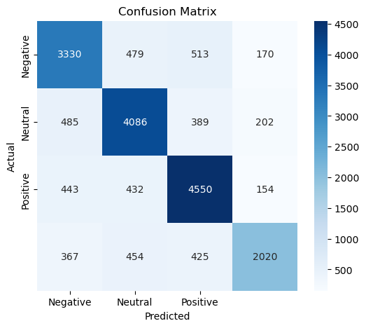
Logistic Regression Model-Confusion Matrix
Overall Metric Score
Accuracy Score = 76%

Slide 13
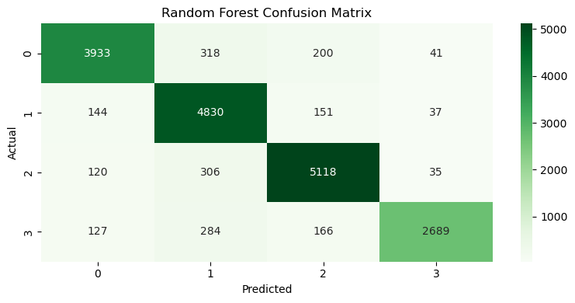
Random Forest Model-Confusion Matrix
Overall Metric Score
Accuracy Score = 89.6%

Slide 14
Insights
1.Logistic Regression Model
Model achieved an accuracy score of 76%
The score indicates the model's effectiveness in sentiment classification.
2. Random Forest Model
Model achieved an accuracy score of 89.6%. This shows its ability to capture complex sentiment patterns in tweets.
It also suggests that the model is more adept at identifying sentiment nuances compared to logistic regression.
3. Business Insights
Random Forest model can serve as a reliable tool for analyzing sentiment toward products, brands, and public figures.
The ability to of the model to classify tweets as Positive, Negative or Neutral will enable businesses to refine their marketing strategies, manage their brand reputation, and enhance customer engagement.

Slide 15
Conclusion
The overall objective of this project which was to develop an entity-level sentiment analysis model that can accurately classify tweets as Positive, Negative, Neutral or Irrelevant was achieved.
I concluded that the Random Forest Model with an Accuracy Score of 89.6% is the best model for this particular Sentiment Analysis Classification task.

Slide 16
Thank You

Slide 17
Q&A

