Slide 1
DSF-PT08: Final Project Submission
Project Owner: JAMES WACHIRA MUTHEE
Technical Mentor: DANIEL EKALE

Slide 2
Content
Business Problem Definition
Business Understanding
Data
Modelling Tools used
Data Understanding
Data Preprocessing
Modelling
Visualizations
Evaluation
Conclusion

Slide 3
Business Problem Statement
Hotels face difficulties in managing their bookings effectively because they cannot foresee which reservations will be canceled. This unpredictability disrupts their ability to allocate resources, plan efficiently, and maintain profitability. If hotels could forecast cancellations, they would be able to refine their booking strategies, reduce financial losses, and improve the overall guest experience.

Slide 4
Business Objectives
The objective of this project is to develop a predictive model to accurately forecast hotel reservation cancellations so as to enable hotels to:
Optimize booking strategies and resource allocation based on cancellation predictions.
Minimize revenue loss by proactively managing overbooking and cancellation policies.
Improve customer satisfaction by offering targeted incentives to reduce cancellations

Slide 5
Data
The Hotel reservations dataset that I used for this project was obtained from Hotel Reservations Classification Dataset

Slide 6
Tools used
I used inbuilt libraries in Visual Studio Code tool to:
Load the dataset
Understand the dataset(shape, distribution and summary statistics)
Do exploratory data analysis
Do Data Preprocessing
Develop Models
Evaluate Model Performance

Slide 7
Data Understanding
Upon loading the data, the following observations were made:
1. The dataset had 36,275 rows and 19 columns
2. Several columns exhibited a significant number of outliers
3. Some columns displayed a heavy skew in their distributions
4. There were no missing values in the dataset
5. The features were not highly correlated with each other

Slide 8
Data Preprocessing
This is the process of preparing the data before modelling. Steps used are:
1. Converting Categorical variables to numeric variables
2. Applying log transformation to some selected numerical variables with a skewed distribution
3. Adjusting some selected numerical features so that they are on a similar scale
4. Converting the target variable from categorical to Numerical

Slide 9
Modelling
Process of creating models to analyze and interpret data, identify patterns, and make predictions. For this project, 4 models were developed, namely:
1. Logistic Regression Model(Baseline Model)
2. Decision Tree Model(Tuned)
3. Random Forest Model(Untuned)
4. Random Forest Model(Tuned)

Slide 10
Model Evaluation
The following Metrics were used to evaluate the Models developed:
1. Accuracy Score: It represents the proportion of correct predictions made by the model out of all predictions made.
2. AUC : Refers to Area under the ROC curve (Receiver Operating Characteristic curve), which plots the True Positive Rate (TPR) against the False Positive Rate (FPR)

Slide 11
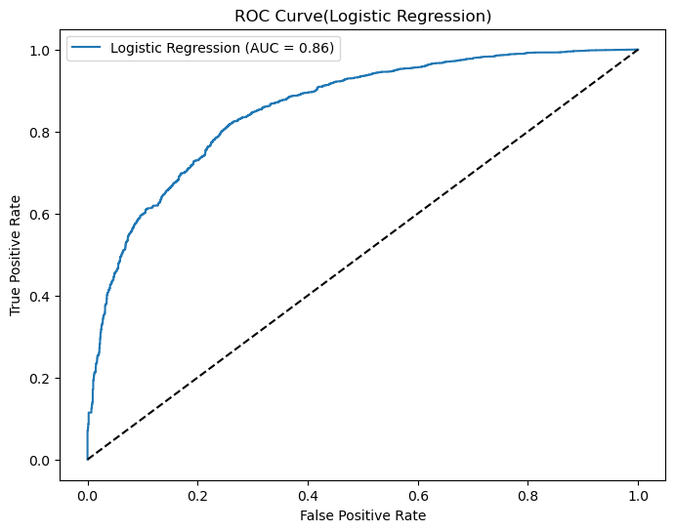
Logistic Regression Model-ROC Curve
Overall Metric Score
1.Accuracy Score = 80%
2. AUC = 0.86

Slide 12
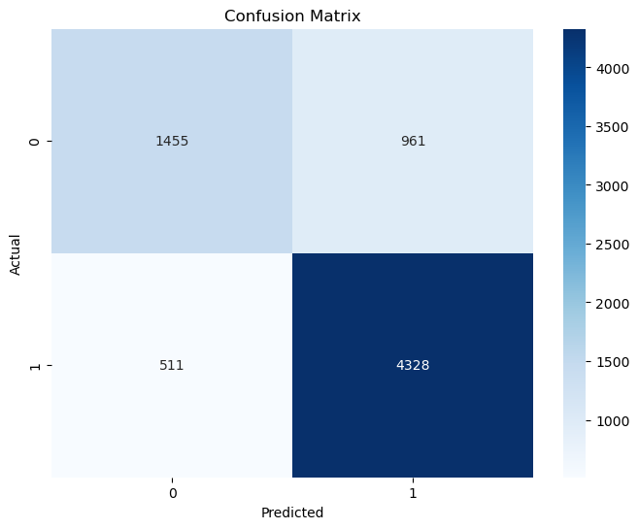
Logistic Regression-Confusion Matrix
Interpretation
4,328 bookings correctly predicted as non-cancellations
1,455 bookings correctly predicted as cancellations

Slide 13
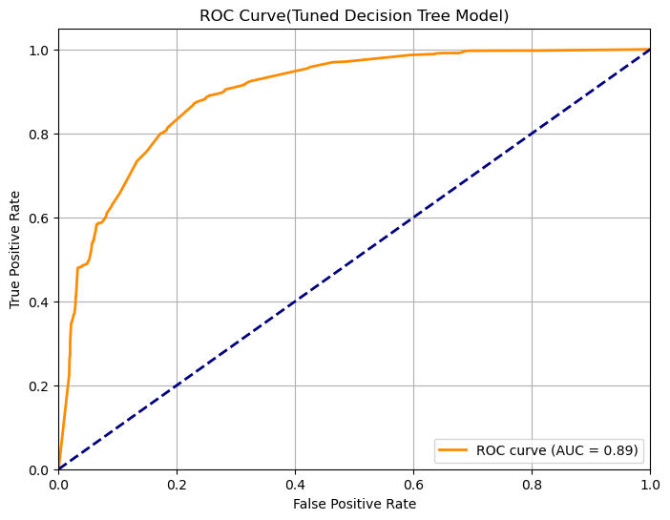
Decision Tree Model(Tuned)-ROC Curve
Overall Metric Score
1.Accuracy Score = 84%
2. AUC = 0.89

Slide 14
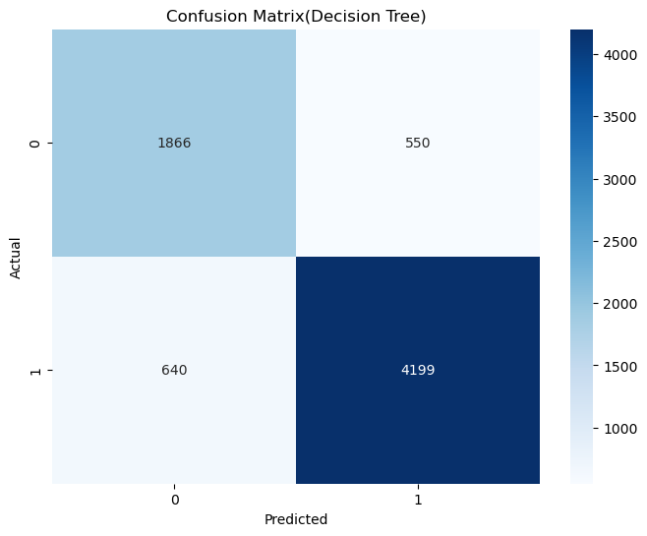
Decision Tree Model(Tuned) - Confusion Matrix
Interpretation
4,199 bookings correctly predicted as non-cancellations
1,866 bookings correctly predicted as cancellations

Slide 15
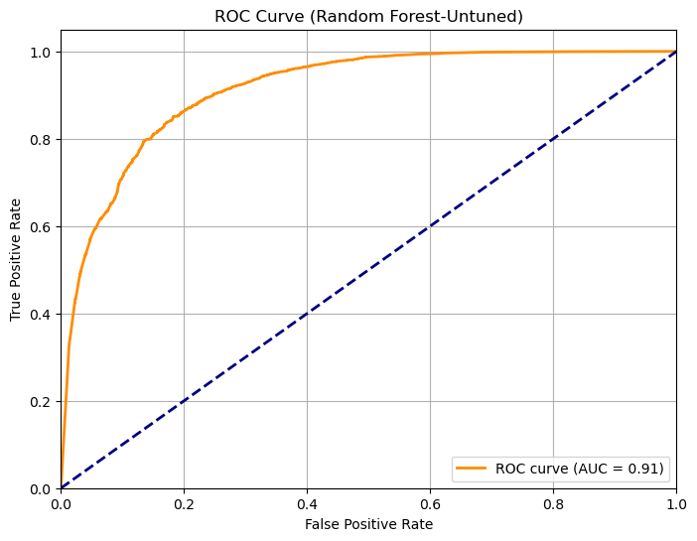
Random Forest(Untuned)-ROC Curve
Overall Metric Score
1.Accuracy Score = 85%
2. AUC = 0.91

Slide 16
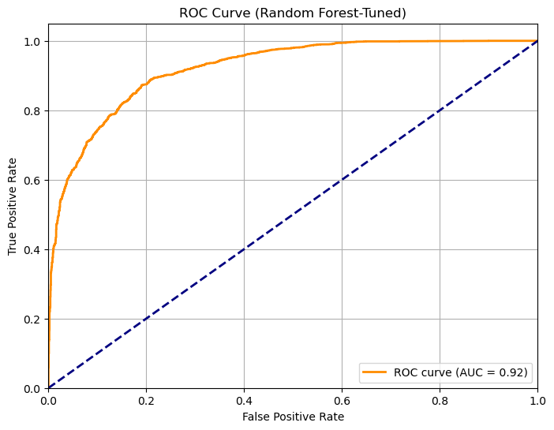
Random Forest(Tuned)-ROC Curve
Overall Metric Score
1.Accuracy Score = 86%
2. AUC = 0.92

Slide 17
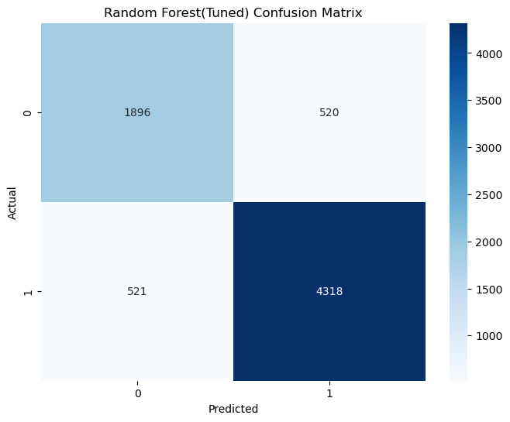
Random Forest(Tuned)-ROC Curve
Interpretation
4,318 bookings correctly predicted as non-cancellations
1,896 bookings correctly predicted as cancellations

Slide 18
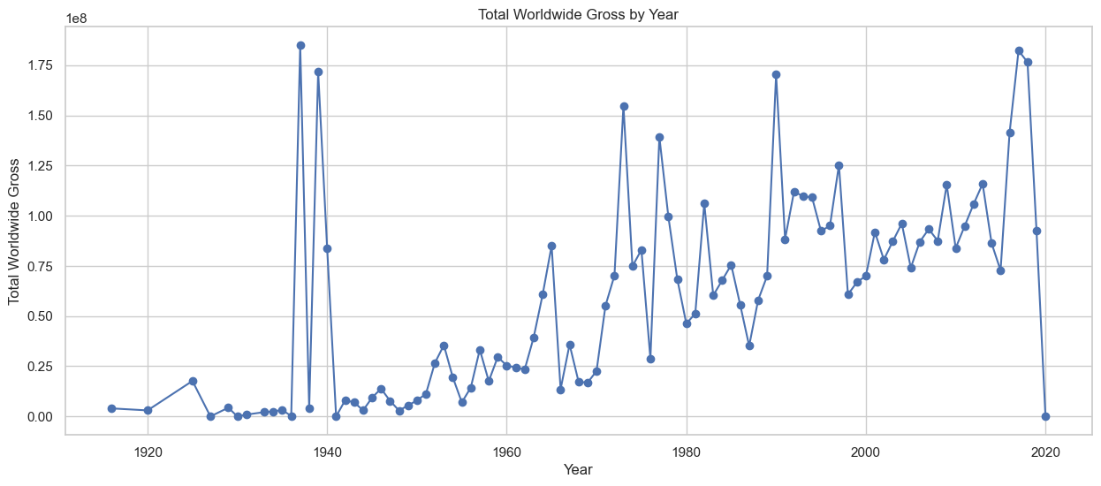
Worldwide gross performance during the review period
The worldwide gross increases over the years.
A plunge during the year of 2020: An event might have happened which needs further research

Slide 19
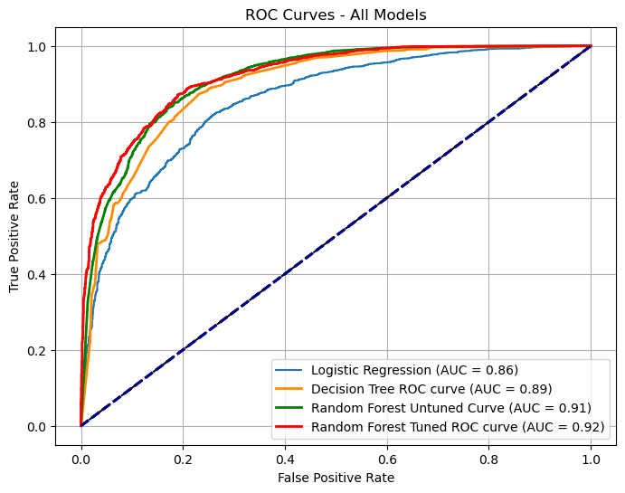
Combined ROC Curves-All Models
Best Performing Model
Tuned Random Forest Model with:
1. Accuracy Score = 86%
2. AUC = 0.92

Slide 20
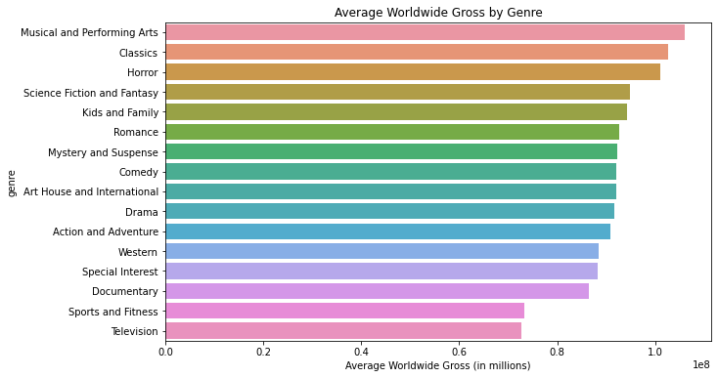
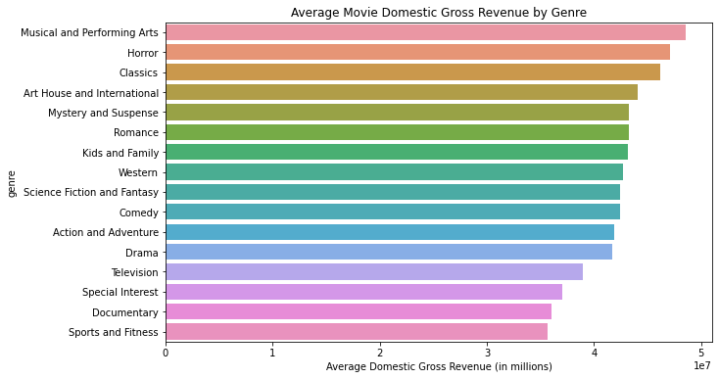
Genre performance by revenue
Musical and Performing Arts consistently outperform other genres in domestic and worldwide gross revenue, while Horror, Science Fiction, and Fantasy show strong performance.

Slide 21
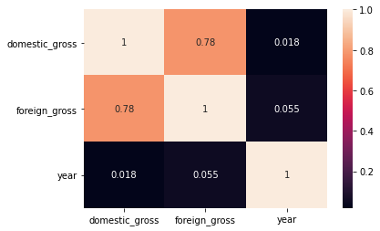
Statistical Analysis – Revenue
Strong Relationship Between Domestic and Foreign Earnings
Domestically successful movies generally may perform well internationally, but the year of release doesn't significantly impact their earnings.
Conclusion
The strong correlation between domestic and international movie earnings is crucial for predicting its global success

Slide 22
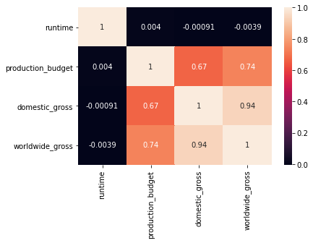
production budget vs domestic gross and worldwide gross
The relationship between the production budget with both domestic gross and worldwide gross indicates that a higher production budget is likely to boost both domestic and worldwide gross revenues for movies

Slide 23
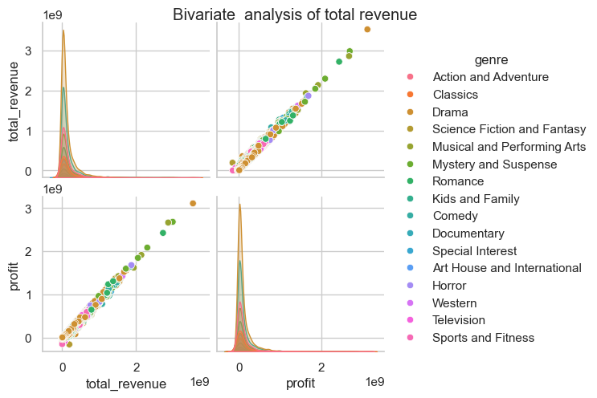
Revenue trends per genre
Revenue and Profit Relationship: As revenue increases, profit tends to rise proportionally
Genre-Based Trends: Certain genres, like Drama, Science Fiction, and Fantasy, often reach higher revenue and profit levels. In contrast, genres like Documentary and Special Interest usually perform on the lower end financially. Action, Adventure, Science Fiction, and Fantasy show high potential for greater profitability and revenue.

Slide 24
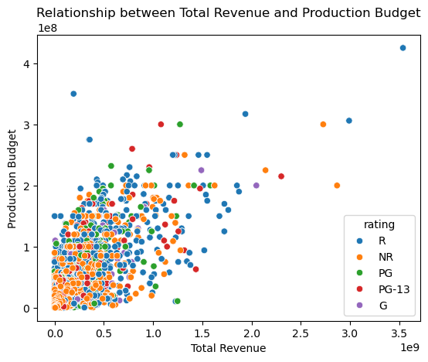
Production Budget vs Total Revenue
Movies with higher production budgets tend to earn more revenue, although most films remain within a lower budget and revenue range
Outliers with high budgets and revenue are exceptional cases, likely representing blockbuster films.
The plot shows that ratings have little correlation with production budgets or revenue

Slide 25
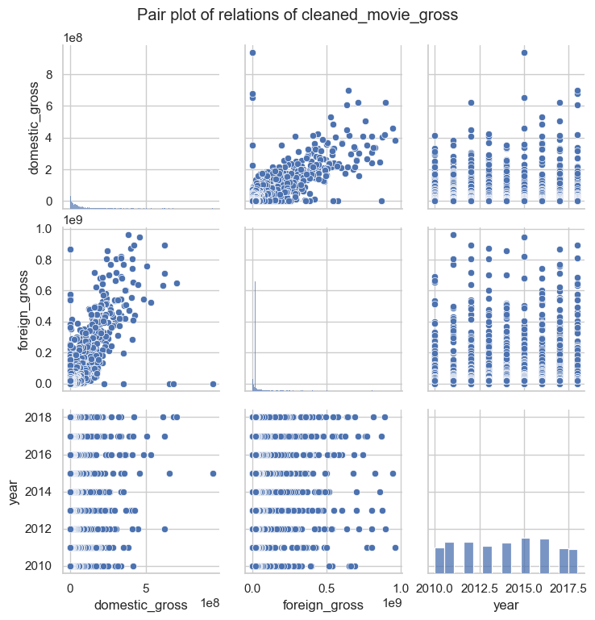
Relationships for the budget data
There is a positive linear relationship between domestic gross and foreign gross.
An increase in domestic gross may lead to a corresponding increase in foreign gross

Slide 26
Data Modelling – Simple Linear Regression
The Ordinary Least Squares(OLS) model was used to determine the relationships between different variables: domestic gross, production budget and worldwide gross, foreign gross.
The model was used to predict various variables on the data.

Slide 27
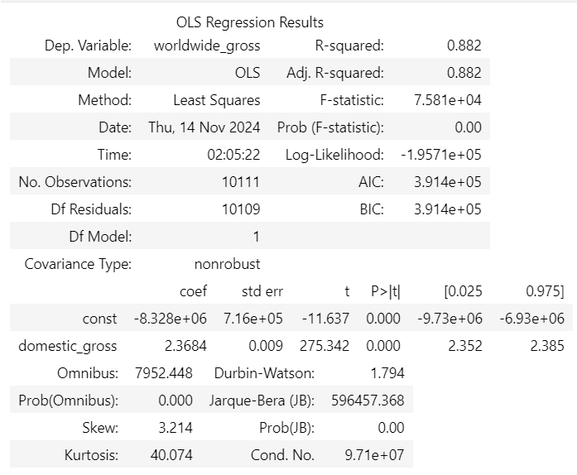
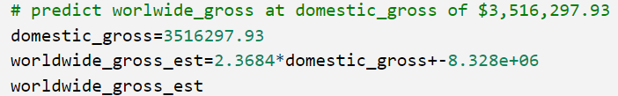
Rainbow test – Domestic gross to predict worldwide gross
Using this model, an R-squared of 88.2% shows that domestic revenue is a very reliable indicator for predicting worldwide revenue.
88.2% of the variability in worldwide gross revenue can be explained by domestic gross revenue.
According to the model, if the company wants to start earning worldwide gross revenue, it should aim to generate at least $3.5 million in domestic gross revenue.

Slide 28
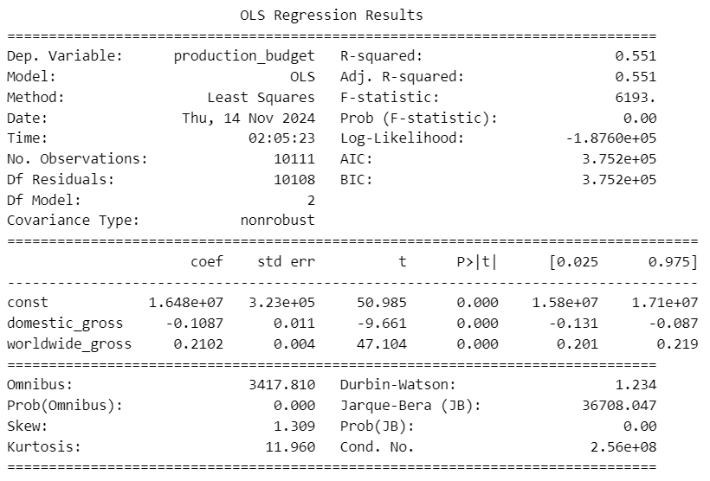
Using Multilinear regression - production cost
An R-squared of 0.551 means that 55.1% of the production budget differences can be predicted based on a movie’s revenue domestically and worldwide. 44.9% of the budget differences are influenced by other factors that weren’t included in this analysis.
Revenue provides a preview into a movie's budget, but they don't reveal the full picture; other factors significantly influence production costs

Slide 29
Recommendations
To maximize revenue, the movie studio should focus on releasing their films in the months with the highest revenue, such as December, June, and July.
They should prioritize releasing high-budget films with a high return on investment (ROI) to ensure their production budgets are not wasted.
They should prioritize releasing their films in the top performing genres, such as Musical, Performing Arts, Horror, Science Fiction, and Fantasy. This will help maximize their box office revenue and attract more viewers.
Months with Lower Revenue: utilize lower budget or experimental films in months like January and September.

Slide 30
Recommendations cont.
Increase marketing efforts leading up to and during January and September to maximize on overall revenue.
Release High-Potential Films in June, July, and December as it shows strong performance in revenue.
Diversify the film portfolio by including more investments in lower-budget projects to enhance overall profitability and mitigate financial risk.

Slide 31
Recommendations cont.
Develop tailored marketing campaigns for lower-budget films, utilizing cost-effective promotional strategies to enhance revenue potential
Consider producing shorter films for wider audience appeal while also investing in select, high-quality longer films that can captivate audiences and drive engagement.
Allocation of more resources to produce a mix of shorter, high-rating-friendly films and select longer, high-quality projects that will meet the expectations of more targeted audiences

Slide 32
Next Steps
Further research to find other factors that will influence the production costs. This will help in prediction on production cost.
Research to be done on an event may have happened in the year 2020 as there was a plunge on gross revenue
Given the higher production budget indicated more gross revenue, the company needs to diversify its funding to sustain the production budget

Slide 33
Q&A

Slide 34
Contact Info
https://www.linkedin.com/in/gilbert-kipkirui-cheruiyot-82387425
https://www.linkedin.com/in/daniel-muigai-358707292/
https://www.linkedin.com/in/millicent-cheptoi-068235221/
https://www.linkedin.com/in/angela-mwanzia-2b993b309
https://www.linkedin.com/in/edwin-george-181b33171/
http://www.linkedin.com/in/reagan-adajo-5a1803103
https://www.linkedin.com/in/james-wachira-a7771644/
https://www.linkedin.com/in/mercy-ayub-774a877b/

Slide 35
Thank You ☺

