Slide 1
Progress
Get fit, make friends, and crush your goals with Progress

Slide 2
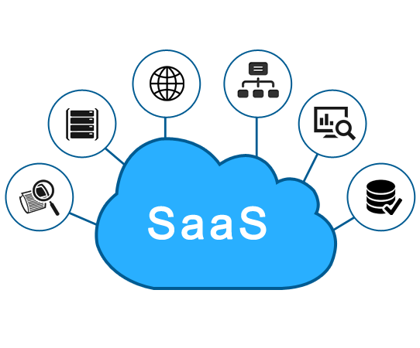
What is Progress
"Progress" is a comprehensive platform designed to provide gyms with an innovative approach to managing and promoting fitness activities. The platform is offered to gyms in a similar way to Canvas, a learning management system, as a software-as-a-service (SaaS) solution.
As a cloud-based platform, "Progress" can be easily accessed from any device with an internet connection, making it an ideal solution for gyms of all sizes. The platform offers a range of features, including user profiles, workout tracking, goal setting, and communication tools, allowing gym users to easily connect and collaborate with each other.

Slide 3

Use Cases
Upload Personal Meal Plan
Respond to Questions Upload Splits
Login | Ask Question Request Workout Partner
Upload Tutorial Videos Advertise Services
Update Gym News, Add Classes
Gym Owner
Certified PT
Advance User
Intermediate User
Beginner User

Slide 4

Why use Progress
"Progress" provides gym owners and managers with powerful tools to manage their gym's operations and marketing activities. With its analytics and reporting features, gym owners can
gain valuable insights into their gym’s
performance, monitor user engagement,
and make data-driven decisions.
"Progress" offers gyms a
comprehensive and user-friendly solution
to managing fitness activities, engaging with gym users, and growing their business. By providing a digital platform that streamlines gym operations and enhances the user experience, "Progress" is a valuable asset for gyms looking to stay ahead of the competition and provide the best possible service to their customers.

