Slide 1
To What Degree can an AI Built With Expert Strategies be Effective Against Competition AI?
James Hellman

Slide 2
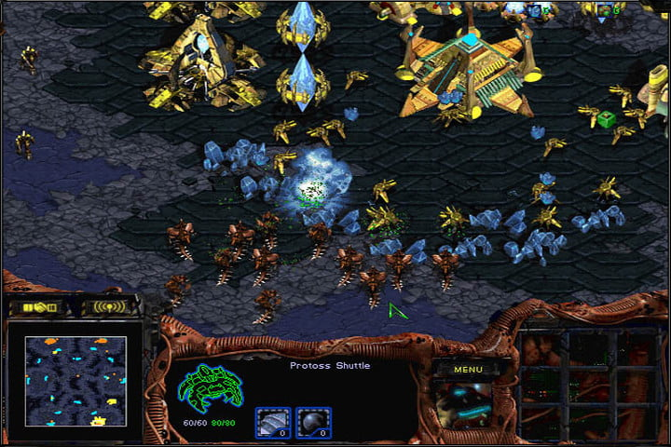
StarCraft
StarCraft is an RTS game released in 1998.
Basic premise:
Gather resources
Build base and army
Destroy your enemy

Slide 3
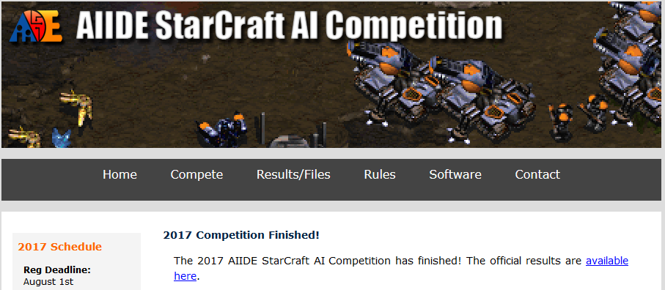
AI in StarCraft
There are many competitions for AI currently being held.
One such competition is the AIIDE StarCraft AI Tournament.

Slide 4
Purpose
To create an AI that models behaviour, translating expert knowledge from domain experts to understand the effectiveness of strategies.

Slide 5
Creating the Bot
Used POSH tools, which is a wrapper to convert C# to C++ to allow the BroodWar API to issue commands ingame.
It uses a collection of behaviours and senses to run, these are triggered by the use of a POSH Plan (A series of triggers, using senses).
3 expert strategies taken from the community and implemented into the Bot.

Slide 6
Hypotheses
Hypothesis 1: The Bot will survive no more than 14 minutes and Win.
Hypothesis 2: The Bot will have a Win rate greater than 0%.
Hypothesis 3: The Bot will have a Win rate of 50% or greater.
Hypothesis 4: The Bot will successfully counter the Rush tactic surviving past the 12-minute mark.

Slide 7
Effectiveness
Average Game Length to Beat The Rush (Average of 12 minutes or above to the defeat the rush if the game is lost.)
Average Game Length (Average of 14 minutes or below on a winning game)
Average Win Rate (Win Rate of above 50%)
Average competition AI times:
Low 13 minutes (With the outlier of the 6 minute Zerg Rush)
High 19 minute
Average competition AI win rates:
Low 11.25%
High 85%
The AI will be considered effective if it achieves a win rate above 50% and a game length of less than 14 minutes on its winning games.

Slide 8
Testing
9 competition AI’s from the 2016 AIIDE competition were chosen for testing:
Three from the top-tier
Three from the mid-tier
Three from the bottom-tier
A game for each bot to face each bot on a total of 10 maps will be carried out using the 9 AI’s, totalling 360 games and the results recorded.

Slide 9
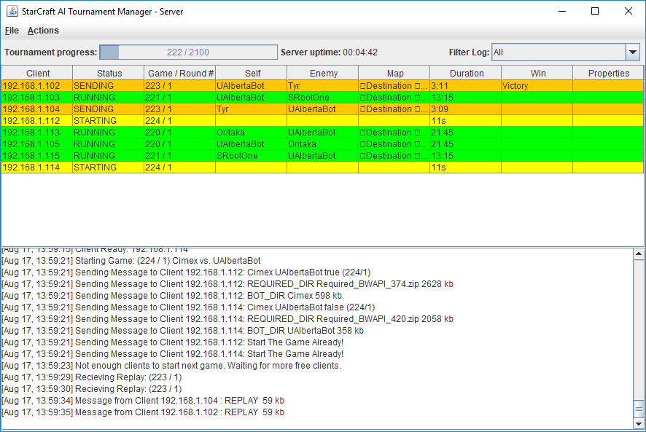
Testing
Using an opensource Tournament Manager for StarCraft alongside a Virtual Machine.
https://github.com/davechurchill/StarcraftAITournamentManager

Slide 10
Results
Output from the tournament manager.
Round/Game | Winner | Loser | Crash | Timeout | Map | Duration | W Score | L Score | (W-L)/Max | W 55 | W 1000 | W 10000 | L 55 | L 1000 | L 10000 | Win Addr | Lose Addr | Start | Finish
0 / 00000 | CruzBot | MegaBot | MegaBot |  | Benzene | 00:12:43 | 16418 | 36763 | -0.55339 | 0 | 0 | 0 | 1 | 0 | 0 | /192.168.1.241 | /192.168.1.55 | 20180310_123538 | 20180310_124107
0 / 00001 | IceBot | CruzBot |  |  | Benzene | 00:18:14 | 80599 | 28911 | 0.64129 | 5 | 0 | 0 | 0 | 0 | 0 | /192.168.1.241 | /192.168.1.55 | 20180310_124117 | 20180310_124426
0 / 00002 | Iron | CruzBot |  |  | Benzene | 00:10:39 | 28224 | 7374 | 0.73871 | 0 | 0 | 0 | 0 | 0 | 0 | /192.168.1.55 | /192.168.1.241 | 20180310_124436 | 20180310_124616
0 / 00003 | CruzBot | Oritaka |  |  | Benzene | 00:05:24 | 8926 | 2900 | 0.67503 | 0 | 0 | 0 | 0 | 0 | 0 | /192.168.1.55 | /192.168.1.241 | 20180310_124627 | 20180310_124738
0 / 00004 | LetaBot | CruzBot |  |  | Benzene | 00:17:18 | 71943 | 26213 | 0.63563 | 0 | 0 | 0 | 0 | 0 | 0 | /192.168.1.241 | /192.168.1.55 | 20180310_124747 | 20180310_125051
0 / 00005 | CruzBot | Cimex |  |  | Benzene | 00:40:45 | 141653 | 122636 | 0.13425 | 0 | 0 | 0 | 0 | 0 | 0 | /192.168.1.55 | /192.168.1.241 | 20180310_125100 | 20180310_130006
0 / 00006 | Xelnaga | CruzBot |  |  | Benzene | 00:59:31 | 11744 | 11299 | 0.03789 | 0 | 0 | 0 | 0 | 0 | 0 | /192.168.1.55 | /192.168.1.241 | 20180310_130015 | 20180310_130630
0 / 00007 | ZZZKBot | CruzBot |  |  | Benzene | 00:04:18 | 5312 | 2451 | 0.53849 | 0 | 0 | 0 | 0 | 0 | 0 | /192.168.1.241 | /192.168.1.55 | 20180310_130640 | 20180310_130737
0 / 00008 | IceBot | MegaBot |  |  | Benzene | 00:17:05 | 67883 | 28925 | 0.57389 | 0 | 0 | 0 | 1 | 0 | 0 | /192.168.1.55 | /192.168.1.241 | 20180310_130749 | 20180310_131035
0 / 00009 | Iron | MegaBot |  |  | Benzene | 00:11:44 | 30424 | 11303 | 0.62846 | 0 | 0 | 0 | 1 | 0 | 0 | /192.168.1.55 | /192.168.1.241 | 20180310_131044 | 20180310_131234
0 / 00010 | MegaBot | Oritaka |  |  | Benzene | 00:08:30 | 23178 | 7514 | 0.67578 | 0 | 0 | 0 | 0 | 0 | 0 | /192.168.1.241 | /192.168.1.55 | 20180310_131243 | 20180310_131447
0 / 00011 | LetaBot | MegaBot |  |  | Benzene | 00:18:51 | 94908 | 42213 | 0.55522 | 0 | 0 | 0 | 0 | 0 | 0 | /192.168.1.241 | /192.168.1.55 | 20180310_131458 | 20180310_131734
0 / 00012 | MegaBot | Cimex |  |  | Benzene | 00:07:51 | 17516 | 7346 | 0.58058 | 0 | 0 | 0 | 0 | 0 | 0 | /192.168.1.241 | /192.168.1.55 | 20180310_131744 | 20180310_131949
0 / 00013 | Xelnaga | MegaBot |  |  | Benzene | 00:22:00 | 89542 | 50705 | 0.43372 | 0 | 0 | 0 | 112 | 0 | 0 | /192.168.1.241 | /192.168.1.55 | 20180310_131959 | 20180310_132640
0 / 00014 | ZZZKBot | MegaBot |  |  | Benzene | 00:03:55 | 5123 | 2240 | 0.56265 | 0 | 0 | 0 | 0 | 0 | 0 | /192.168.1.241 | /192.168.1.55 | 20180310_132650 | 20180310_132743
0 / 00015 | Iron | IceBot |  |  | Benzene | 00:16:35 | 76340 | 27815 | 0.63563 | 0 | 0 | 0 | 0 | 0 | 0 | /192.168.1.241 | /192.168.1.55 | 20180310_132752 | 20180310_133114
0 / 00016 | IceBot | Oritaka |  |  | Benzene | 00:18:29 | 103731 | 38901 | 0.62498 | 1 | 0 | 0 | 0 | 0 | 0 | /192.168.1.241 | /192.168.1.55 | 20180310_133125 | 20180310_133451
0 / 00017 | LetaBot | IceBot |  |  | Benzene | 00:05:02 | 3534 | 1148 | 0.67496 | 0 | 0 | 0 | 0 | 0 | 0 | /192.168.1.241 | /192.168.1.55 | 20180310_133500 | 20180310_133556
0 / 00018 | IceBot | Cimex |  |  | Benzene | 00:15:15 | 63715 | 22688 | 0.6439 | 0 | 0 | 0 | 0 | 0 | 0 | /192.168.1.55 | /192.168.1.241 | 20180310_133606 | 20180310_133856
0 / 00019 | IceBot | Xelnaga |  |  | Benzene | 00:23:00 | 118016 | 52950 | 0.55133 | 7 | 0 | 0 | 0 | 0 | 0 | /192.168.1.241 | /192.168.1.55 | 20180310_133906 | 20180310_134224
0 / 00020 | ZZZKBot | IceBot |  |  | Benzene | 00:04:18 | 4746 | 2103 | 0.55677 | 0 | 0 | 0 | 0 | 0 | 0 | /192.168.1.241 | /192.168.1.55 | 20180310_134234 | 20180310_134329
0 / 00021 | Iron | Oritaka |  |  | Benzene | 00:09:47 | 25142 | 6662 | 0.735 | 0 | 0 | 0 | 0 | 0 | 0 | /192.168.1.241 | /192.168.1.55 | 20180310_134339 | 20180310_134515

Slide 11
Data Collection + Results
Bot | Games | Win | Loss | Win % | AvgTime | Game Timeout | Crash | Frame Timeout
ZZZKBot | 80 | 73 | 7 | 91.25 | 06:25 | 0 | 0 | 0
Iron | 79 | 69 | 10 | 87.34 | 13:13 | 1 | 0 | 0
LetaBot | 81 | 60 | 21 | 74.07 | 11:58 | 0 | 0 | 0
Xelnaga | 80 | 48 | 32 | 60 | 16:11 | 4 | 1 | 0
MegaBot | 80 | 45 | 35 | 56.25 | 14:31 | 5 | 10 | 2
IceBot | 80 | 37 | 43 | 46.25 | 14:31 | 2 | 1 | 0
Cimex | 79 | 27 | 52 | 34.18 | 15:56 | 5 | 2 | 0
CruzBot | 80 | 18 | 62 | 22.5 | 18:02 | 9 | 0 | 0
Oritaka | 81 | 15 | 66 | 18.52 | 17:22 | 9 | 0 | 0
POSH-core | 80 | 8 | 72 | 10 | 16:24 | 7 | 0 | 0
Total | 400 | 400 | 400 | 50 | 14:27 | 21 | 14 | 2

Slide 12
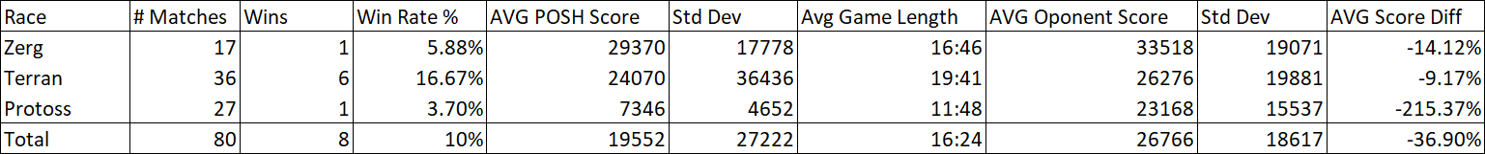
Results
Showed that the NULL hypothesis for obtaining a 50% win ratio was supported.
The top table shows that the Bot has a weakness for mirror matches (when both races are the same).
Average game time of above 12-minutes supports the hypothesis that the Bot beats the rush.

Slide 13
Results
Shows that on winning matched the Bot did not achieve a game time of below 14-minutes, supporting the NULL hypothesis.

Slide 14
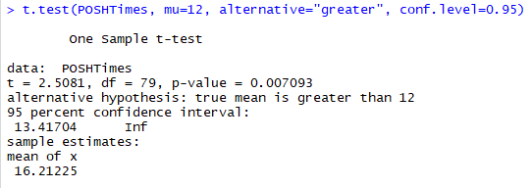
Results
Looking at individual Bots it seemed there was some variation on the average game lengths, so a left-sided T-test was performed on all of the Bots game times.
The p-value was near zero which indicates that the null hypothesis could be rejected, in this case, it was to filter out the matches against Iron, by setting the ‘Mµ’ to 12 for the time that a game transits into mid game.

Slide 15
Conclusion
The Bot presented was not effective in its use of expert strategies, that being said, the Bot did achieve a greater than 0% win rate.
Plus the initial rushes were countered, supporting two of the hypothesis presented, showing that there is potential for improvement.
For any future work, it would be recommended that strategies are kept as simple as possible while maintaining an effective strategy or employ the use of parallel plans to make the Bot more efficient in carrying out that strategy.

Slide 16
Future Work
Use of parallel plans.
Implement the use of neural networks.
The Possibility of correlation between game length and win rate.

Slide 17
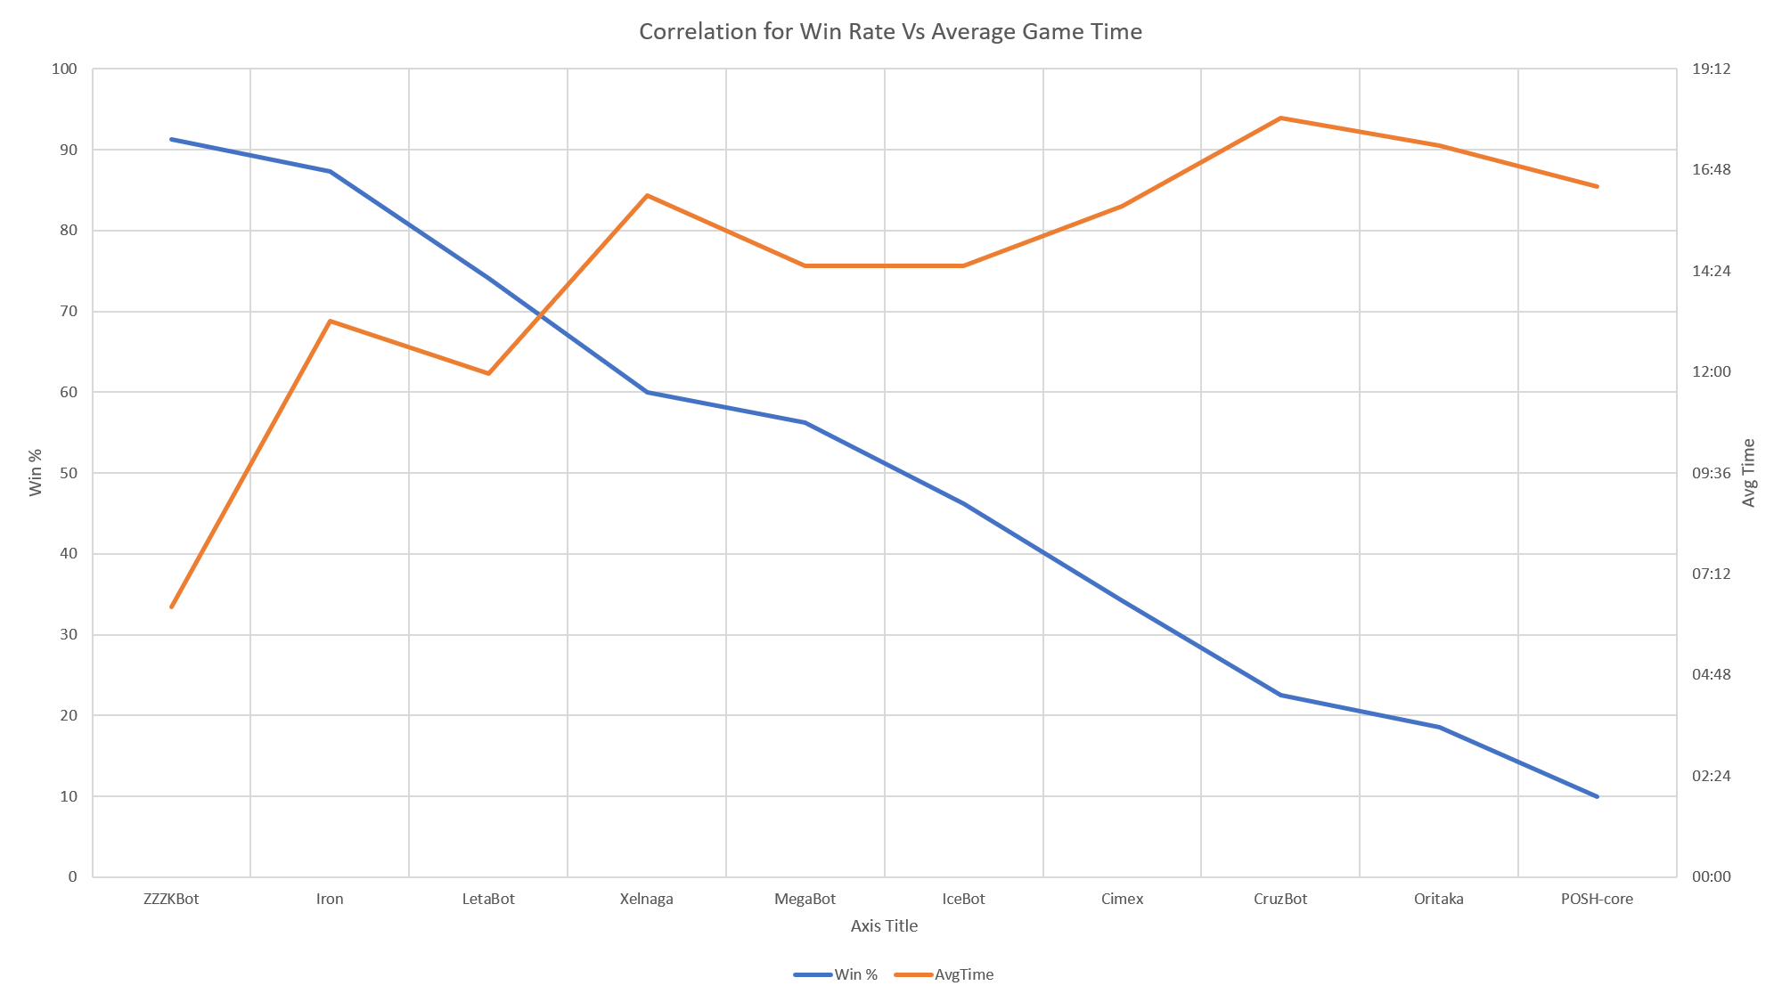
Results

Slide 18
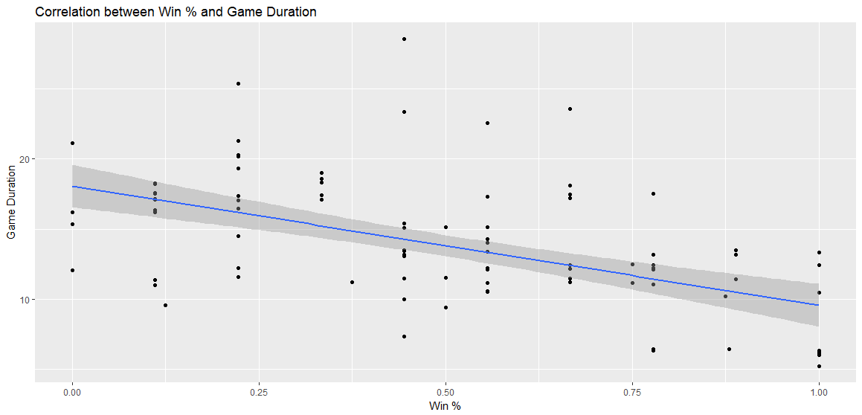
Results

Slide 19
Thank You For Listening

