Slide 1
StarCraft AI
James Hellman

Slide 2
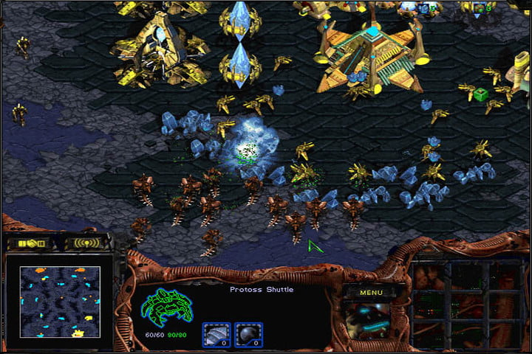
StarCraft
StarCraft is a RTS game released in 1998.
Basic premise:
Gather resources
Build base and army
Destroy your enemy

Slide 3
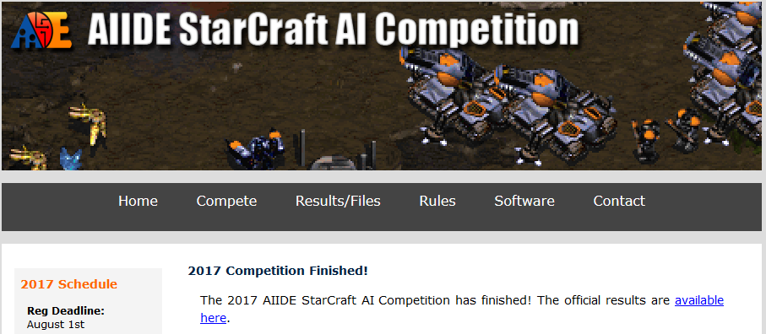
AI in StarCraft
There are many competitions for AI currently being held.
One of the biggest ones is the AIIDE StarCraft AI Tournament.

Slide 4
To What Degree can an AI Built With Expert Strategies be Effective Against Competition AI?
Modelling behaviour, translating expert knowledge from domain experts to understand effectiveness of strategies.

Slide 5
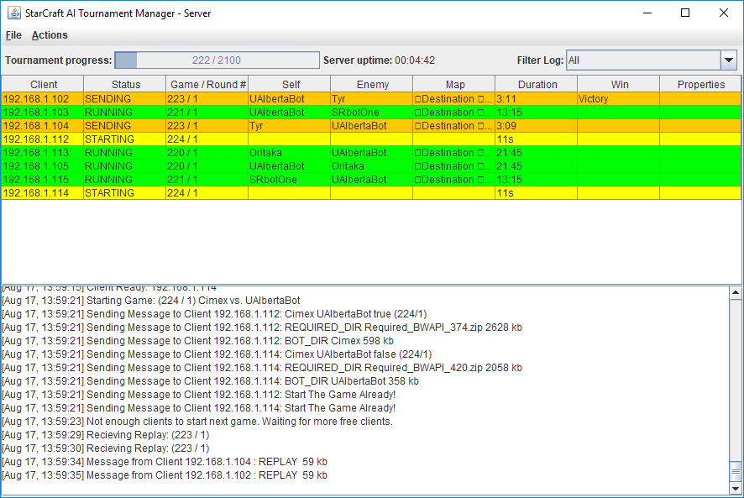
Method
Using an opensource Tournament Manager for StarCraft
https://github.com/davechurchill/StarcraftAITournamentManager

Slide 6
Testing
Instead of presenting how my bot is doing so far, I will present how the other bots that I will be testing do against each other, to justify my criteria.
9 competition AI’s form the 2016 AIIDE competition have been chosen for testing:
Three from the top-tier
Three from the mid-tier
Three from the bottom-tier

Slide 7
Testing
A game for each bot to face each bot on a total of 10 maps will be carried out using the 9 AI’s, totalling at 360 games and the results recorded.
Round/Game | Winner | Loser | Crash | Timeout | Map | Duration | W Score | L Score | (W-L)/Max | W 55 | W 1000 | W 10000 | L 55 | L 1000 | L 10000 | Win Addr | Lose Addr | Start | Finish
0 / 00000 | CruzBot | MegaBot | MegaBot |  | Benzene | 00:12:43 | 16418 | 36763 | -0.55339 | 0 | 0 | 0 | 1 | 0 | 0 | /192.168.1.241 | /192.168.1.55 | 20180310_123538 | 20180310_124107
0 / 00001 | IceBot | CruzBot |  |  | Benzene | 00:18:14 | 80599 | 28911 | 0.64129 | 5 | 0 | 0 | 0 | 0 | 0 | /192.168.1.241 | /192.168.1.55 | 20180310_124117 | 20180310_124426
0 / 00002 | Iron | CruzBot |  |  | Benzene | 00:10:39 | 28224 | 7374 | 0.73871 | 0 | 0 | 0 | 0 | 0 | 0 | /192.168.1.55 | /192.168.1.241 | 20180310_124436 | 20180310_124616
0 / 00003 | CruzBot | Oritaka |  |  | Benzene | 00:05:24 | 8926 | 2900 | 0.67503 | 0 | 0 | 0 | 0 | 0 | 0 | /192.168.1.55 | /192.168.1.241 | 20180310_124627 | 20180310_124738
0 / 00004 | LetaBot | CruzBot |  |  | Benzene | 00:17:18 | 71943 | 26213 | 0.63563 | 0 | 0 | 0 | 0 | 0 | 0 | /192.168.1.241 | /192.168.1.55 | 20180310_124747 | 20180310_125051
0 / 00005 | CruzBot | Cimex |  |  | Benzene | 00:40:45 | 141653 | 122636 | 0.13425 | 0 | 0 | 0 | 0 | 0 | 0 | /192.168.1.55 | /192.168.1.241 | 20180310_125100 | 20180310_130006
0 / 00006 | Xelnaga | CruzBot |  |  | Benzene | 00:59:31 | 11744 | 11299 | 0.03789 | 0 | 0 | 0 | 0 | 0 | 0 | /192.168.1.55 | /192.168.1.241 | 20180310_130015 | 20180310_130630
0 / 00007 | ZZZKBot | CruzBot |  |  | Benzene | 00:04:18 | 5312 | 2451 | 0.53849 | 0 | 0 | 0 | 0 | 0 | 0 | /192.168.1.241 | /192.168.1.55 | 20180310_130640 | 20180310_130737
0 / 00008 | IceBot | MegaBot |  |  | Benzene | 00:17:05 | 67883 | 28925 | 0.57389 | 0 | 0 | 0 | 1 | 0 | 0 | /192.168.1.55 | /192.168.1.241 | 20180310_130749 | 20180310_131035
0 / 00009 | Iron | MegaBot |  |  | Benzene | 00:11:44 | 30424 | 11303 | 0.62846 | 0 | 0 | 0 | 1 | 0 | 0 | /192.168.1.55 | /192.168.1.241 | 20180310_131044 | 20180310_131234
0 / 00010 | MegaBot | Oritaka |  |  | Benzene | 00:08:30 | 23178 | 7514 | 0.67578 | 0 | 0 | 0 | 0 | 0 | 0 | /192.168.1.241 | /192.168.1.55 | 20180310_131243 | 20180310_131447
0 / 00011 | LetaBot | MegaBot |  |  | Benzene | 00:18:51 | 94908 | 42213 | 0.55522 | 0 | 0 | 0 | 0 | 0 | 0 | /192.168.1.241 | /192.168.1.55 | 20180310_131458 | 20180310_131734
0 / 00012 | MegaBot | Cimex |  |  | Benzene | 00:07:51 | 17516 | 7346 | 0.58058 | 0 | 0 | 0 | 0 | 0 | 0 | /192.168.1.241 | /192.168.1.55 | 20180310_131744 | 20180310_131949
0 / 00013 | Xelnaga | MegaBot |  |  | Benzene | 00:22:00 | 89542 | 50705 | 0.43372 | 0 | 0 | 0 | 112 | 0 | 0 | /192.168.1.241 | /192.168.1.55 | 20180310_131959 | 20180310_132640
0 / 00014 | ZZZKBot | MegaBot |  |  | Benzene | 00:03:55 | 5123 | 2240 | 0.56265 | 0 | 0 | 0 | 0 | 0 | 0 | /192.168.1.241 | /192.168.1.55 | 20180310_132650 | 20180310_132743
0 / 00015 | Iron | IceBot |  |  | Benzene | 00:16:35 | 76340 | 27815 | 0.63563 | 0 | 0 | 0 | 0 | 0 | 0 | /192.168.1.241 | /192.168.1.55 | 20180310_132752 | 20180310_133114
0 / 00016 | IceBot | Oritaka |  |  | Benzene | 00:18:29 | 103731 | 38901 | 0.62498 | 1 | 0 | 0 | 0 | 0 | 0 | /192.168.1.241 | /192.168.1.55 | 20180310_133125 | 20180310_133451
0 / 00017 | LetaBot | IceBot |  |  | Benzene | 00:05:02 | 3534 | 1148 | 0.67496 | 0 | 0 | 0 | 0 | 0 | 0 | /192.168.1.241 | /192.168.1.55 | 20180310_133500 | 20180310_133556
0 / 00018 | IceBot | Cimex |  |  | Benzene | 00:15:15 | 63715 | 22688 | 0.6439 | 0 | 0 | 0 | 0 | 0 | 0 | /192.168.1.55 | /192.168.1.241 | 20180310_133606 | 20180310_133856
0 / 00019 | IceBot | Xelnaga |  |  | Benzene | 00:23:00 | 118016 | 52950 | 0.55133 | 7 | 0 | 0 | 0 | 0 | 0 | /192.168.1.241 | /192.168.1.55 | 20180310_133906 | 20180310_134224
0 / 00020 | ZZZKBot | IceBot |  |  | Benzene | 00:04:18 | 4746 | 2103 | 0.55677 | 0 | 0 | 0 | 0 | 0 | 0 | /192.168.1.241 | /192.168.1.55 | 20180310_134234 | 20180310_134329
0 / 00021 | Iron | Oritaka |  |  | Benzene | 00:09:47 | 25142 | 6662 | 0.735 | 0 | 0 | 0 | 0 | 0 | 0 | /192.168.1.241 | /192.168.1.55 | 20180310_134339 | 20180310_134515

Slide 8
Data Collection + Results
Bot | Games | Win | Loss | Win % | AvgTime | Game Timeout | Crash | Frame Timeout
Iron | 80 | 68 | 12 | 85 | 13:03 | 0 | 0 | 0
ZZZKBot | 80 | 68 | 12 | 85 | 06:05 | 0 | 0 | 0
LetaBot | 80 | 55 | 25 | 68.75 | 14:09 | 2 | 0 | 0
Xelnaga | 80 | 45 | 35 | 56.25 | 15:53 | 3 | 3 | 0
IceBot | 80 | 43 | 37 | 53.75 | 14:33 | 0 | 7 | 0
MegaBot | 80 | 38 | 42 | 47.5 | 13:28 | 2 | 8 | 7
Cimex | 80 | 20 | 60 | 25 | 17:10 | 5 | 2 | 0
CruzBot | 80 | 14 | 66 | 17.5 | 19:24 | 10 | 0 | 1
Oritaka | 80 | 9 | 71 | 11.25 | 15:20 | 4 | 0 | 0
Total | 360 | 360 | 360 | N/A | N/A | 13 | 20 | 8

Slide 9
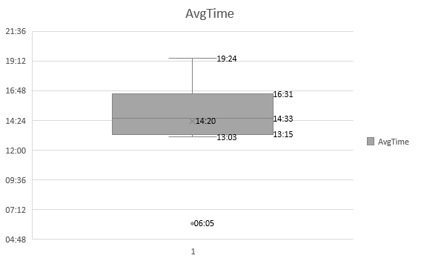
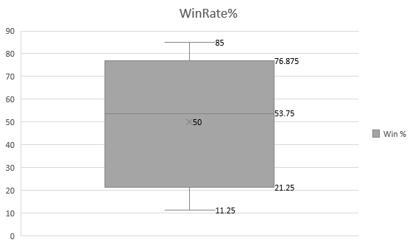
Results

Slide 10
Results

Slide 11
Results
Bot | Round 1 | Round 2 | Round 3 | Round 4 | Round 5 | Round 6 | Round 7 | Round 8 | Round 9 | Round 10
Iron | 1.00 | 0.94 | 0.92 | 0.84 | 0.88 | 0.90 | 0.88 | 0.88 | 0.85 | 0.85
 | 12.28 | 12.58 | 16.22 | 13.29 | 11.14 | 12.16 | 13.37 | 11.45 | 13.38 | 12.40
ZZZKBot | 0.75 | 0.88 | 0.92 | 0.91 | 0.88 | 0.85 | 0.86 | 0.84 | 0.86 | 0.85
 | 5.40 | 5.12 | 5.02 | 5.52 | 6.18 | 5.28 | 6.00 | 8.40 | 7.14 | 5.20
LetaBot | 0.88 | 0.69 | 0.63 | 0.69 | 0.70 | 0.73 | 0.75 | 0.73 | 0.68 | 0.69
 | 14.33 | 12.26 | 11.06 | 11.57 | 12.49 | 14.14 | 11.45 | 14.03 | 25.52 | 12.44
Xelnaga | 0.50 | 0.56 | 0.54 | 0.59 | 0.53 | 0.50 | 0.50 | 0.53 | 0.54 | 0.56
 | 21.29 | 16.57 | 19.04 | 13.43 | 12.57 | 15.02 | 15.06 | 18.04 | 12.00 | 14.29
IceBot | 0.63 | 0.63 | 0.58 | 0.53 | 0.55 | 0.54 | 0.52 | 0.53 | 0.54 | 0.54
 | 14.45 | 13.35 | 14.13 | 12.59 | 13.06 | 12.40 | 14.05 | 17.31 | 14.39 | 17.56
MegaBot | 0.25 | 0.31 | 0.33 | 0.38 | 0.43 | 0.44 | 0.48 | 0.45 | 0.49 | 0.48
 | 12.50 | 13.41 | 15.15 | 11.53 | 13.13 | 19.19 | 11.55 | 11.51 | 11.59 | 12.45
Cimex | 0.13 | 0.13 | 0.17 | 0.22 | 0.23 | 0.23 | 0.23 | 0.23 | 0.25 | 0.25
 | 19.20 | 12.24 | 16.04 | 19.05 | 19.53 | 14.23 | 18.21 | 14.12 | 18.58 | 18.55
CruzBot | 0.38 | 0.38 | 0.38 | 0.31 | 0.25 | 0.21 | 0.20 | 0.19 | 0.19 | 0.18
 | 21.06 | 13.57 | 18.14 | 18.04 | 16.00 | 26.46 | 18.49 | 14.09 | 29.04 | 17.52
Oritaka | 0.00 | 0.00 | 0.04 | 0.03 | 0.08 | 0.10 | 0.09 | 0.11 | 0.10 | 0.11
 | 15.07 | 11.48 | 9.42 | 12.49 | 14.54 | 17.26 | 10.23 | 19.21 | 25.16 | 16.37

Slide 12
Results

Slide 13
Effectiveness
Game Length (Average of 14- minutes or below)
Endgame Condition (Whether the AI wins the game or looses)
Average competition AI times:
Low 13 minutes (With the exception of the 6 minute Zerg Rush)
High 19 minute
Average competition AI win rates:
Low 11.25%
High 85%
The AI will be considered effective if it achieves a win rate above 50% and a game length of less than 14 minutes.

Slide 14
Race

Slide 15
Conclusion
Surprising correlation between game length and win rate, which means there is another possible research question there.
Supports my criteria for an effective Bot.

Slide 16
Thank You For Listening

