Slide 1
StarCraft AI
James Hellman

Slide 2
To What Degree can an AI Built With Expert Strategies be Effective Against Competition AI?
Modelling behaviour, translating expert knowledge from domain experts to understand either:
Effectiveness of strategies.
How to create new strategies which are competitive.

Slide 3
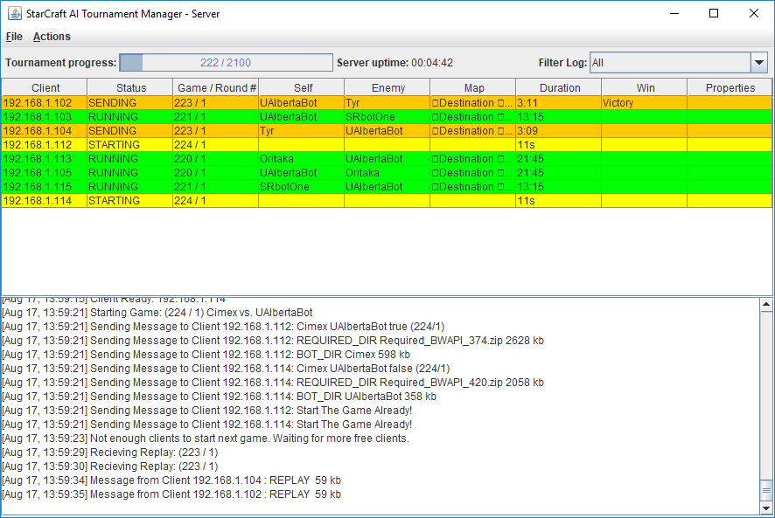
Method
Using an opensource Tournament Manager for StarCraft

Slide 4
Testing
Instead of presenting how my bot is doing so far, I will present how the other bots that I will be testing do against each other, to justify my criteria.
9 competition AI’s form the 2016 AIIDE competition have been chosen for testing:
Three from the top-tier
Three from the mid-tier
Three from the bottom-tier
A game for each bot to face each bot on a total of 10 maps will be carried out using the 9 AI’s, totalling at 360 games and the results recorded.

Slide 5
Testing
I then picked one bot from each tier and observed their strategies.
ZZZBot: Uses a Zergling rush, with a sunken colony defence.
Iron: Mecha focus, builds Vultures, Siege Tanks and Wraiths.
These strategies were then compared to their win/loss and game length.

Slide 6
Results
Bot | Games | Win | Loss | Win % | AvgTime | Game Timeout | Crash | Frame Timeout
Iron | 80 | 68 | 12 | 85 | 13:03 | 0 | 0 | 0
ZZZKBot | 80 | 68 | 12 | 85 | 06:05 | 0 | 0 | 0
LetaBot | 80 | 55 | 25 | 68.75 | 14:09 | 2 | 0 | 0
Xelnaga | 80 | 45 | 35 | 56.25 | 15:53 | 3 | 3 | 0
IceBot | 80 | 43 | 37 | 53.75 | 14:33 | 0 | 7 | 0
MegaBot | 80 | 38 | 42 | 47.5 | 13:28 | 2 | 8 | 7
Cimex | 80 | 20 | 60 | 25 | 17:10 | 5 | 2 | 0
CruzBot | 80 | 14 | 66 | 17.5 | 19:24 | 10 | 0 | 1
Oritaka | 80 | 9 | 71 | 11.25 | 15:20 | 4 | 0 | 0
Total | 360 | 360 | 360 | N/A | N/A | 13 | 20 | 8

Slide 7
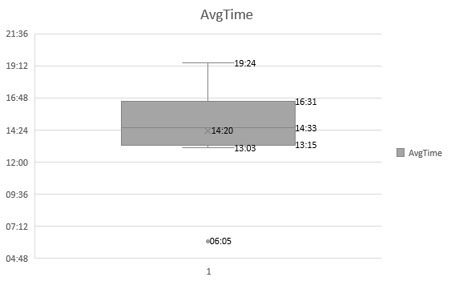
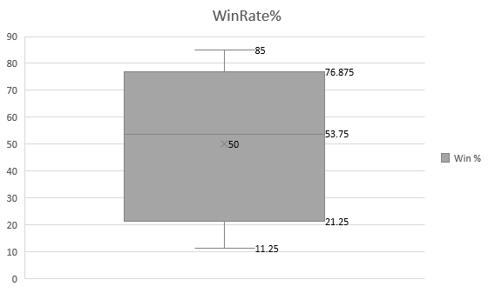
Results

Slide 8
Results

Slide 9
Results
Bot | Round 1 | Round 2 | Round 3 | Round 4 | Round 5 | Round 6 | Round 7 | Round 8 | Round 9 | Round 10
Iron | 1.00 | 0.94 | 0.92 | 0.84 | 0.88 | 0.90 | 0.88 | 0.88 | 0.85 | 0.85
 | 12.28 | 12.58 | 16.22 | 13.29 | 11.14 | 12.16 | 13.37 | 11.45 | 13.38 | 12.40
ZZZKBot | 0.75 | 0.88 | 0.92 | 0.91 | 0.88 | 0.85 | 0.86 | 0.84 | 0.86 | 0.85
 | 5.40 | 5.12 | 5.02 | 5.52 | 6.18 | 5.28 | 6.00 | 8.40 | 7.14 | 5.20
LetaBot | 0.88 | 0.69 | 0.63 | 0.69 | 0.70 | 0.73 | 0.75 | 0.73 | 0.68 | 0.69
 | 14.33 | 12.26 | 11.06 | 11.57 | 12.49 | 14.14 | 11.45 | 14.03 | 25.52 | 12.44
Xelnaga | 0.50 | 0.56 | 0.54 | 0.59 | 0.53 | 0.50 | 0.50 | 0.53 | 0.54 | 0.56
 | 21.29 | 16.57 | 19.04 | 13.43 | 12.57 | 15.02 | 15.06 | 18.04 | 12.00 | 14.29
IceBot | 0.63 | 0.63 | 0.58 | 0.53 | 0.55 | 0.54 | 0.52 | 0.53 | 0.54 | 0.54
 | 14.45 | 13.35 | 14.13 | 12.59 | 13.06 | 12.40 | 14.05 | 17.31 | 14.39 | 17.56
MegaBot | 0.25 | 0.31 | 0.33 | 0.38 | 0.43 | 0.44 | 0.48 | 0.45 | 0.49 | 0.48
 | 12.50 | 13.41 | 15.15 | 11.53 | 13.13 | 19.19 | 11.55 | 11.51 | 11.59 | 12.45
Cimex | 0.13 | 0.13 | 0.17 | 0.22 | 0.23 | 0.23 | 0.23 | 0.23 | 0.25 | 0.25
 | 19.20 | 12.24 | 16.04 | 19.05 | 19.53 | 14.23 | 18.21 | 14.12 | 18.58 | 18.55
CruzBot | 0.38 | 0.38 | 0.38 | 0.31 | 0.25 | 0.21 | 0.20 | 0.19 | 0.19 | 0.18
 | 21.06 | 13.57 | 18.14 | 18.04 | 16.00 | 26.46 | 18.49 | 14.09 | 29.04 | 17.52
Oritaka | 0.00 | 0.00 | 0.04 | 0.03 | 0.08 | 0.10 | 0.09 | 0.11 | 0.10 | 0.11
 | 15.07 | 11.48 | 9.42 | 12.49 | 14.54 | 17.26 | 10.23 | 19.21 | 25.16 | 16.37

Slide 10
Results

Slide 11
Effectiveness
Game Legnth (Average of 14- minutes or below)
Endgame Condition (Whether the AI wins the game or looses)
Average competition AI times:
Low 13 minutes (With the exception of the 6 minute Zerg Rush)
High 19 minute
Average competition AI win rates:
Low 11.25%
High 85%
The AI will be considered effective if it achieves a win rate above 50% and a game length of less than 14 minutes.
All figures where found at AIIDE StarCtaft AI Competition results page [Online] Accessed 08/01/2018 http://www.cs.mun.ca/~dchurchill/starcraftaicomp/

Slide 12
Race

Slide 13
Thank You For Listening

