Slide 1

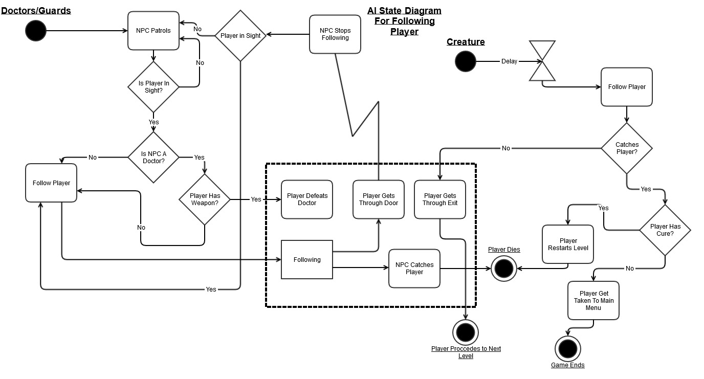
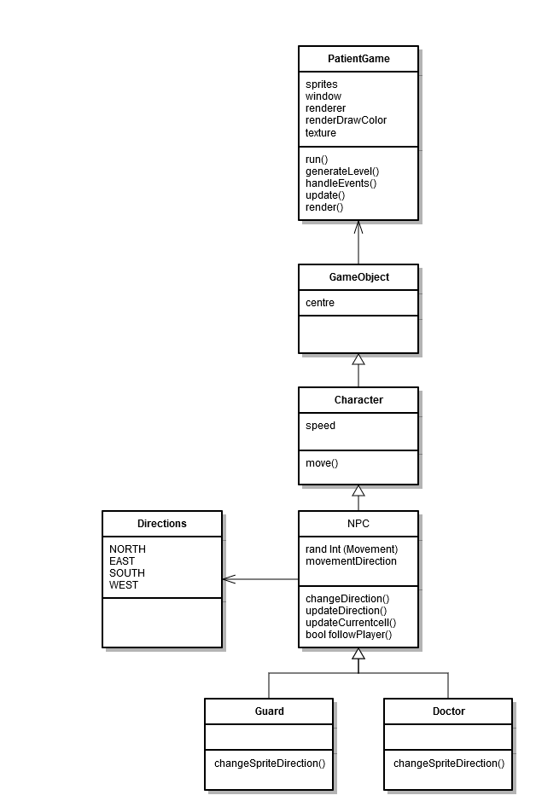
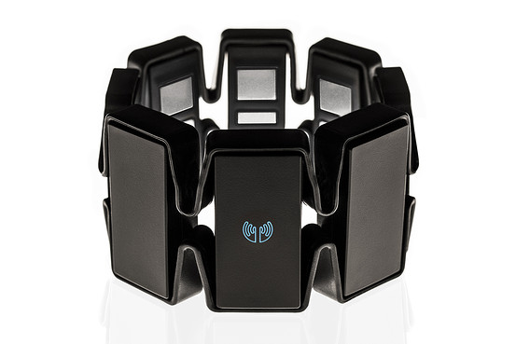
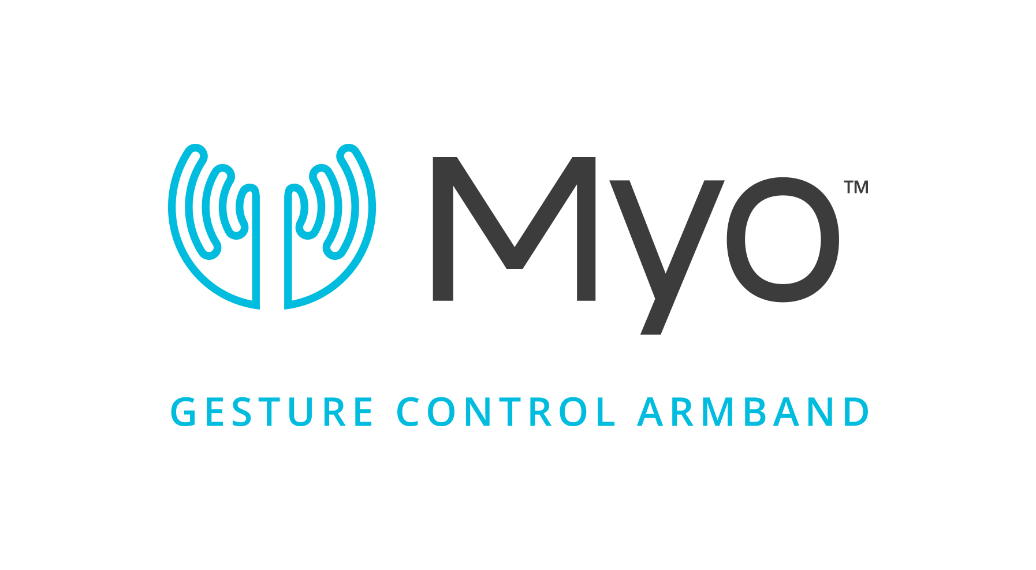
A.I.
Written By James Hellman
Navigated By Harriet Moore
The Definition of AI.
Computational intelligence is the study of the design of intelligent agents. An agent is something that acts in an environment—it does something. Agents include worms, dogs, thermostats, airplanes, humans, organizations, and society. An intelligent agent is a system that acts intelligently: What it does is appropriate for its circumstances and its goal, it is ﬂexible to changing environments and changing goals, it learns from experience, and it makes appropriate choices given perceptual limitations and ﬁnite computation. The central scientiﬁc goal of computational intelligence is to understand the principles that make intelligent behaviour possible, in natural or artiﬁcial systems. The main hypothesis is that reasoning is computation. The central engineering goal is to specify methods for the design of useful, intelligent artefacts.
What I intended to create.
I tried taking on the aspect of learning from experience, the NPC will see something react to it and learn from it. When the NPC sees the player it will give chase, one of two things can happen:-
The player is caught thus a game over is displayed END.
Or
The Player gets away, this will cause the NPC to go into high alert and revisit the places where the player was seen and got away more frequently.
Possible stretch goal will be if the player is seen again the NPC will anticipate where the player is going and will try to head there first unless the player goes in a completely new direction.
AI Pseudocode
While (false) player is not in sight do
Patrol
If player in sight
Return true
End if
If (True) player is in sight do
Follow player
For each NPC following player do
If NPC is doctor and player has weapon
Doctor to run
Else if NPC is doctor and X,Y == player
Player dies and effect is placed
End if
If NPC is guard and X,Y == player
Player dies
End if
End for
If player goes through door
Return False
End while
AI Class Diagram For Final Implementation
Myo api
What Was Implemented.
After some consideration it was decided to condense the AI system. This was due to time and skill constraints. We decided to remove the Creature and the NPC’s unique functions.
We were left with just having the Guards and Doctors that follow the Player if the distance is too small.
The MYO is and armband that slips around your forearm, and using motion and muscle sensors, is able to track your movements and gestures into input commands. The result is a hands-free control system that will work with your computer, smartphone, tablet, television, or robot
void NPC::isPlayerClose()
{
if (closeToPlayer())
{
followPlayer();
}
}
bool NPC::closeToPlayer()
{
return (findDistance() < DETECTION_DISTANCE);
}
void NPC::followPlayer()
{
std::vector<Directions::Direction> clearDirections = currentCell->getPassageDirections();
double shortest = MAXINT;
Directions::Direction shortestDirection;
for each (Directions::Direction clearDirection in clearDirections)
{
std::shared_ptr<LevelCell> adjacentCell = game->level.getCell(currentCell->getCoordinates() + Directions::getDirectionVector(clearDirection));
if (adjacentCell)
{
double distance = findDistanceVector(adjacentCell->getCoordinates());
// If first is true, other one won't be checked
if ((distance <= shortest) || shortest == MAXINT)
{
shortest = distance;
shortestDirection = clearDirection;
}
}
}
nextDirection = shortestDirection;
}
There were several possibilities for a game for the API:-
StarCraft
Age of Empires
Battle for Middle Earth
The component
An RTS themed API, I wanted to try to make an external executable that can be used for a basic gameplay interface for most of these games.
This will control the camera and use basic mouse and keyboard input to execute some basic commands. This should allow the user to play simple games against the computer.
The Tech
I wanted to utilize the capabilities of the Myo gesture control system. This uses a standard C++ coding language with a Myo library for gesture recognition, or possibly Lua scripting as this is the language that the Myo developers decided to use for their SDK. There is already a mouse and keyboard input software available, but through my research I have not found a combination of the two.
This is a good opportunity to combine them to create a basic RTS control system.
AI Code Snippet For Following The Player
--Here the controls are set up for each button.
function leftClick(edge)
notifyUser(edge)
myo.mouse("left",edge)
end
function rightClick(edge)
notifyUser(edge)
myo.mouse("right",edge)
end
function builder(edge)
notifyUser(edge)
myo.keyboard("f1",edge)
end
function army(edge)
notifyUser(edge)
myo.keyboard("f2",edge)
end
Lua Script Snippet For Assigning Controls To the Myo
--The locking mechanism is set up.
function lockMyo(edge)
if (myo.getTimeMilliseconds() - timeSinceLastPose
> LOCK_THRESHOLD) then
myo.controlMouse(false)
myo.lock()
end
end
--Binding of the poses to the set-up functions.
STANDARD_BINDINGS = {
fist = leftClick,
fingersSpread = rightClick,
waveOut = army,
waveIn = builder,
doubleTap = lockMyo
}

