Slide 1
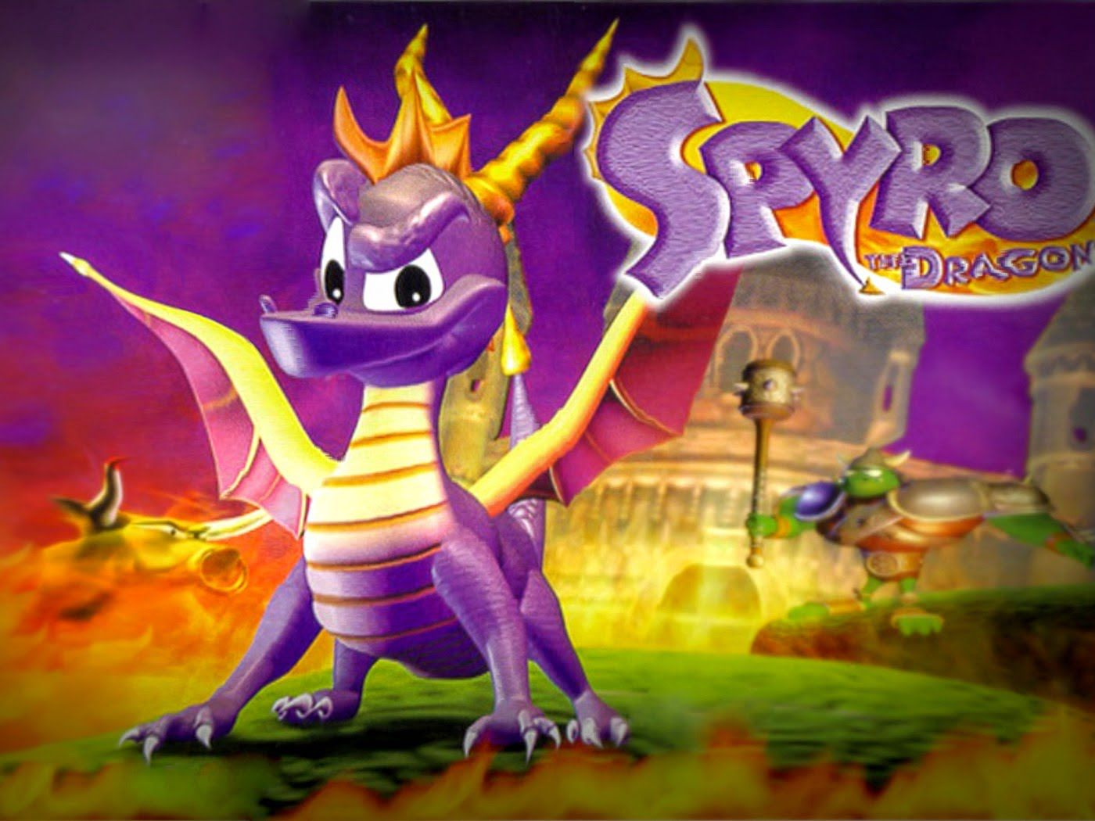
Spyro De-Make
James Hellman

Slide 2
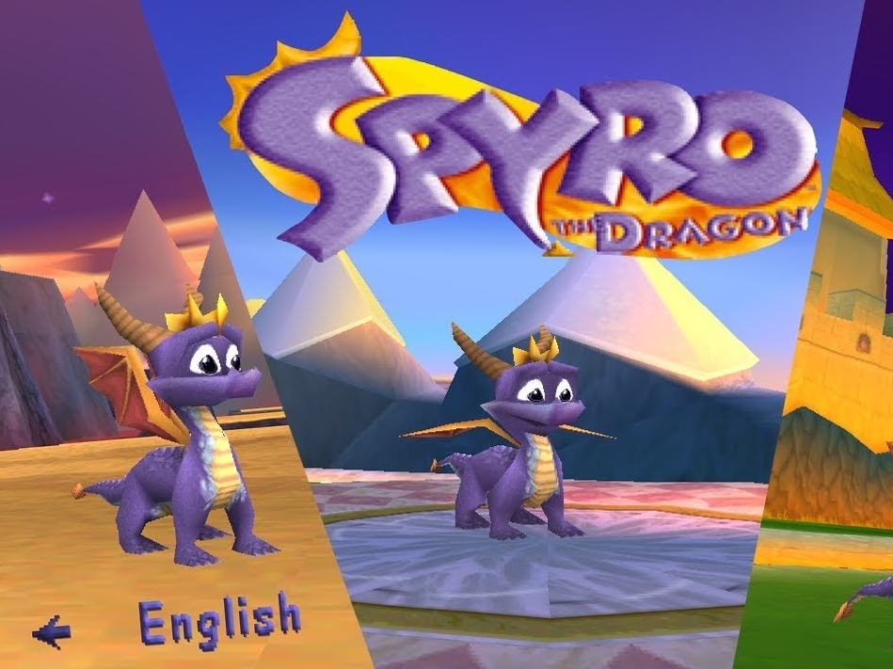
What is Spyro?
If I need to tell you then get out.
Spyro is a 3D adventure platformer where you play as a dragon trying to save the world from an evil tyrant that has turned all the other dragons into stone.

Slide 3
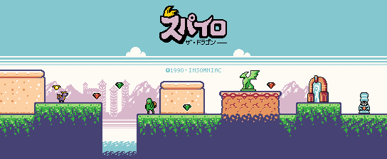
How will I de-make Spyro?
I will be turning Spyro into a 2D platform adventure.
I will be keeping the core mechanics:
Collecting Gems
Jumping
Breathing Fire
Gliding (Stretch Goal)

Slide 4
Feasibility
It has been done before so I know its possible.
The technical challenge here will be to allow the Spyro to breath fire.
Only one level will be made.
The art will also be a challenge.

Slide 5
Sources
Picture 1/2: Insomniac Games
Picture 3: Unknown Reddit user.

