Slide 1
20231026

Slide 2
This Week Progress
Show the system to FL and reply to query messages.
Read last year’s FL project.
The CHT competition has ended.

Slide 3
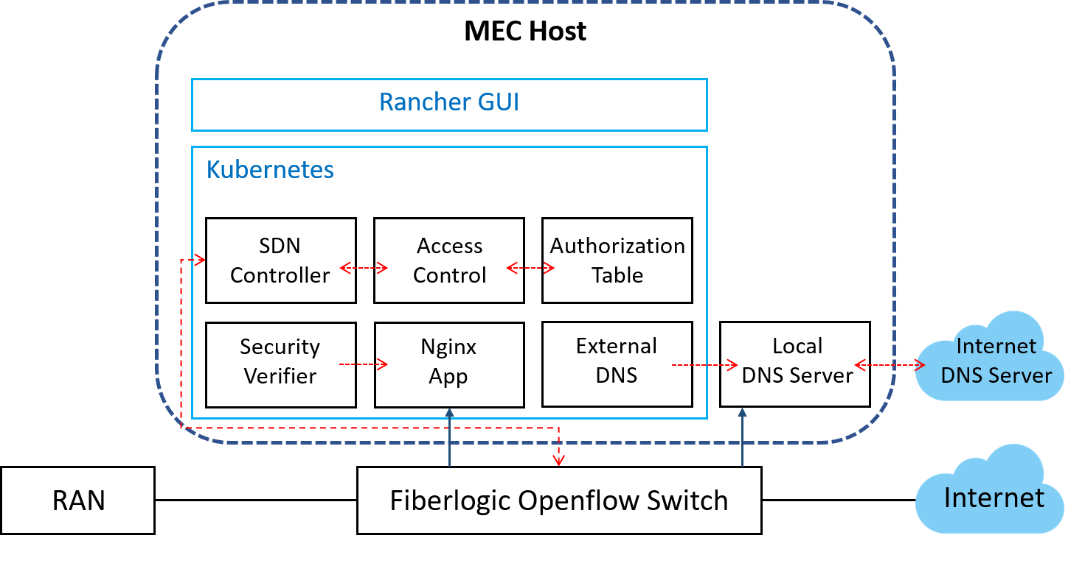
The Last Year FL Project
UE

Slide 4
What Do FL Want to Do Next in My Project?
Let local DNS server work.
Let APP connect to the Internet.

Slide 5
About FL Problem
Is the current pace okay now? They've been stuck at a certain issue for quite a while.

Slide 6
重點模組
AC：讀取AT以確定該流量是否可使用MEC，若可則透過ＳＣ設置flow rules；否則丟棄。
SV：流向MEC的封包會被這個元件檢查憑證是否過期或是使用較弱的加密演算法
ＥＤ：更新ＤＮＳ紀錄至ＬＤＳ
ＬＤＳ：儲存本地ＤＮＳ表，若是外網就往ＩＤＳ送

Slide 7
TODO List
Finish 3 HWs (Queueing、SDN and DL)
Reply to FL query messages.

Slide 8
Feedback
燒錄SIM卡
智通回訊息頻率約為一天
問智通是否能遠端連線

