Slide 1
20240215

Slide 2
This Week Progress
Do the experiment about bandwidth limiting.

Slide 3
GTP Processor
DynamicACL
Redis
Nginx
(APP1)
Bind9
(APP2)
ONOS
Controller
QoS
Iperf Server
6
5
7
OVS-DPDK
2
1
UE/GNB
CN
Physical
machine
Internet
Iperf Client

Slide 4
QoS Settings
Meter ID
0： 10000 Mbps
1： 1000 Mbps
2： 100 Mbps
3： 10 Mbps

Slide 5
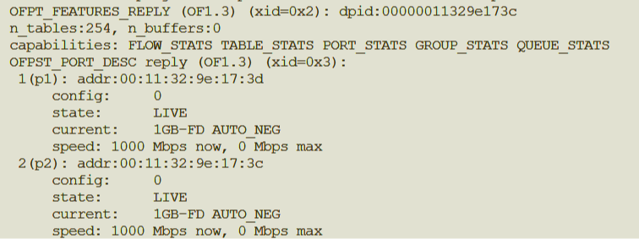
QoS Settings
OVS shows that p1 and p2 have only the bandwidth of 1 Gbps.
Theoretically, we just can verify the cases for ID 2 and ID 3.

Slide 6
GTP Processor
DynamicACL
Redis
Nginx
(APP1)
Bind9
(APP2)
ONOS
Controller
6
5
7
OVS-DPDK
K8S NAT
p2
2
1
p1
UE/GNB
CN
Physical
machine
Internet

Slide 7
The Other Problem
Bandwidth limiting function is on GTP processor, is that acceptable?

Slide 8
TODO List
Finish bandwidth limiting experiment.
Discuss with 任呈 about HA arch without 5G.

Slide 9
Feedback
跟Ren討論
智通提到的拓樸，黑線有存在的必要？
確認switch是否要SDN switch還是OVS。
QoS 數字改成500, 200, 100, 10 Mbps測看看。

Slide 10
Feedback
和任呈討論HA的5G環境。
HA感覺可以透過OVS設flow rules完成。

Slide 11
Feedback
Bandwidth management 的button改成action
ACL的APP IP、APP Port改成一個欄位APP IP/Port
然後老師覺得ACL的呈現下面會比較好。
Access Control List Table
UE IP | APP IP:Port | Button
10.60.0.1 | 172.16.0.56:80
 | 172.16.0.56:443
ADD
MODIFY
DELETE
MODIFY
DELETE

Slide 12
HA Architecture Design II

Slide 13
Phy
FL PC
5g Core
GNB
FL PC
FL PC

Slide 14
Phy
FL PC
5g Core
OVS-DPDK
GNB
FL PC
FL PC
OVS-DPDK
OVS-DPDK

Slide 15
Phy
FL PC
Weave CNI
Multus CNI
5g Core
GRE tunnel
Others
OVS-DPDK
GNB
FL PC
FL PC
OVS-DPDK
OVS-DPDK

Slide 16
Phy
FL PC
Weave CNI
Redis
Multus CNI
DPDK
ONOS
5g Core
GRE tunnel
Others
OVS-DPDK
GNB
K8S pods
FL PC
FL PC
OVS-DPDK
OVS-DPDK

Slide 17
Phy
FL PC
Weave CNI
Redis
Multus CNI
DPDK
ONOS
ExtDns
5g Core
GRE tunnel
Bind9
Others
OVS-DPDK
GNB
Nginx
K8S pods
FL PC
FL PC
OVS-DPDK
OVS-DPDK
Nginx
Bind9
ExtDns
Nginx
Bind9
ExtDns

Slide 18
Comparison
Design I
Pros: Architecture is easier than Design II.
Design II
Pros: Architecture is fancy.
Cons: Functions like Design I, and OVS-DPDK may cause additional latency.

Slide 19
Phy
FL PC
Weave CNI
Redis
Multus CNI
DPDK
ONOS
ExtDns
5g Core
GRE tunnel
Bind9
Others
OVS-DPDK
GNB
Nginx
FL PC
FL PC
OVS-DPDK
OVS-DPDK
Nginx
Bind9
ExtDns
Nginx
Bind9
ExtDns

