Slide 1
20240229

Slide 2
This Week Progress
Improve my SDN APP, dynamicACL.
Find the bottleneck in the system.
Discuss with 之謙, 任呈 about the architecture FiberLogic proposed.

Slide 3
Architecture

Slide 4
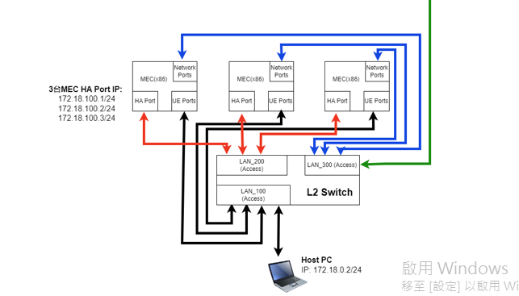
network
Notes:
FL之所以把紅、黑分開畫，是為了清楚說明這個系統要有兩種類型的traffic。
但不代表我們一定要按照這個圖做。

Slide 5
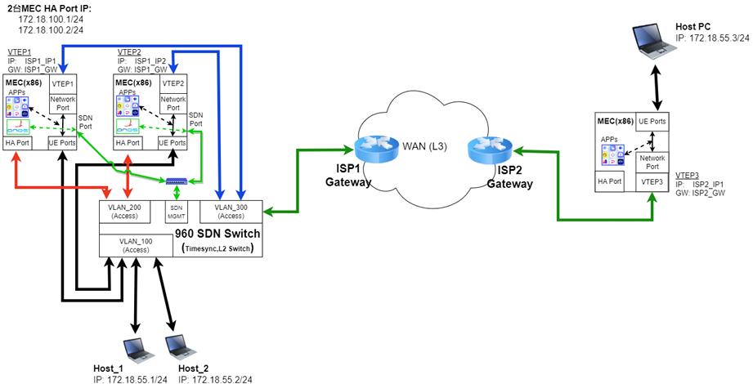
VXLAN L2 VPN Network

Slide 6
APPs Architecture in K8S
APP1
APP2
APP3
Network
HA
Path for K8S APP Traffic
Host
192.168.0.7
OVS-DPDK
Network
HA
ACL
QoS
Notes:
如果透過VIP，可能還是要先經過host。

Slide 7
HA Architecture
APPs
MEC
APPs
MEC
APPs
MEC
Network
OVS-DPDK
OVS-DPDK
OVS-DPDK
HA
ACL
ACL
ACL
Internet
QoS
QoS
QoS
SDN APP
L2 switch
Internet
UE 1
UE 2
UE 3
Notes:
他們是開L2 switch需求，那QoS就只能做在OVS-DPDK。
如果QoS做在OVS，那麼上半年計劃的QoS實驗要繼續做嗎？

Slide 8
QoS Experiment Progress

Slide 9
UE → CN
Component | Choice
GTP Processor | V | V
OVS-DPDK | V
Bandwidth (Mbps) | 909.33 | 903.16
GTP Processor
DynamicACL
ONOS Controller
APP1
6
5
7
OVS-DPDK
APP2
2
1
3
UE/GNB
CN
APP3

Slide 10
UE → CN
Component | Choice
GTP Processor | V | V
OVS-DPDK | V
Bandwidth (Mbps) | 909.33 | 903.16
GTP Processor
DynamicACL
ONOS Controller
APP1
UE → APP1
6
5
7
OVS-DPDK
Component | Choice
GTP Processor | V | V
OVS-DPDK | V | V
DynamicACL | V
Bandwidth (Mbps) | 10.99 | 11.3
APP2
2
1
3
UE/GNB
CN
APP3

Slide 11
UE → CN
Component | Choice
GTP Processor | V | V
OVS-DPDK | V
Bandwidth (Mbps) | 909.33 | 903.16
GTP Processor
DynamicACL
ONOS Controller
APP1
UE → APP1
6
5
7
OVS-DPDK
Component | Choice
GTP Processor | V | V
OVS-DPDK | V | V
DynamicACL | V
Bandwidth (Mbps) | 10.99 | 11.3
APP2
2
1
3
UE/GNB
CN
APP3
Possible problems:
MEC port on GTP processor
OVS-DPDK
Container performance
Notes:
可能的問題有這三個環節

Slide 12
GTP Processor
DynamicACL
ONOS Controller
UE → APP3
Component | Choice
GTP Processor | V | V
OVS-DPDK | V
Bandwidth (Mbps) | 8.81 | 11.8
APP1
6
5
7
OVS-DPDK
APP2
2
1
3
Possible problems:
MEC port on GTP processor
OVS-DPDK
Container performance
UE/GNB
CN
APP3
Notes:
把APP實體化。應不是容器效能不足的問題

Slide 13
GTP Processor
DynamicACL
ONOS Controller
UE → APP3
Component | Choice
GTP Processor | V | V
OVS-DPDK | V
Bandwidth (Mbps) | 8.81 | 11.8
APP1
6
5
7
OVS-DPDK
APP2
2
1
3
Possible problems:
MEC port on GTP processor
OVS-DPDK
Container performance
UE/GNB
CN
APP3
Notes:
把OVS-DPDK拔掉，頻寬沒有改善，所以也不是OVS-DPDK的問題
最後剩下GTP processor，在處理MEC封包的時候出現瓶頸

Slide 14
GTP Processor
DynamicACL
ONOS Controller
UE → APP3
Component | Choice
GTP Processor | V | V
OVS-DPDK | V
Bandwidth (Mbps) | 8.81 | 11.8
APP1
6
5
7
OVS-DPDK
APP2
2
1
3
Possible problems:
MEC port on GTP processor
OVS-DPDK
Container performance
→ Ask Tai, we will try i350 NIC.
UE/GNB
CN
APP3
Notes:
把OVS-DPDK拔掉，頻寬沒有改善，所以也不是OVS-DPDK的問題
最後剩下GTP processor，在處理MEC封包的時候出現瓶頸

Slide 15
很怪的是，如果是QoS出問題，那麼CN也要有問題才對，怎麼只有MEC出問題呢？
Notes:
OVS支援ACL、QoS。然後做一個以我們視角的slice，禮拜四討論。

Slide 16
APP1 → APP2
GTP Processor
DynamicACL
ONOS Controller
Component | Choice
DynamicACL | V
Bandwidth (Mbps) | 1134 | 1146
APP1
6
5
7
OVS-DPDK
APP2
2
1
3
UE/GNB
CN
APP3

Slide 17
APP1 → APP2
GTP Processor
DynamicACL
ONOS Controller
Component | Choice
DynamicACL |  | V
Bandwidth (Mbps) | 1146 | 1134
APP1
6
5
7
OVS-DPDK
Possible problems:
MEC port on GTP processor
OVS-DPDK
Container performance
APP2
2
1
3
UE/GNB
CN
APP3

