Slide 1

DigData Project
Presentation By
James, Eric Iniobong

Slide 2
Flow of Presentation
Clinical Dataset
Introduction
Methodology
Summary & conclusion
Project in its entirety
Scope of presentation
Steps Taken.
Changes Effected.
Recap of Presentation.
Conclusion

Slide 3

Introduction
The scope of the project is to compare miraculon-B with the current available care
The scope of this presentation is the presentation of results obtained
Using the insights from the data deduce if the response to the new drug

Slide 4
Methodology
Data Reading:
Firstly I imported the needed libraries which are pandas and numpy then stored the dataset in a variable using the code
Data cleaning:
After readung the data the next step was examinig and cleaning the data. I first ran the .info() operator on the dataset

Slide 5
Methodology (Steps Taken)
.isna() or isnull()
.describe()
.unique()
This was used to check for missing values
As its name implies this was used to get description of the column
This was used to get unique values of the column

Slide 6
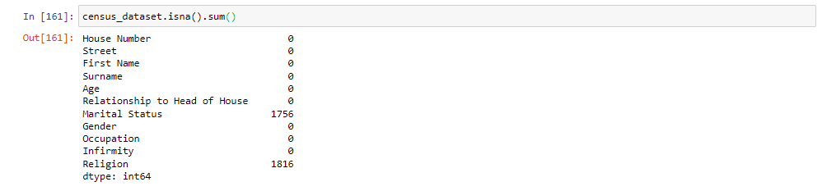
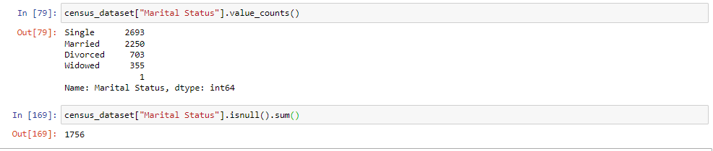
Methodology (Changes Effected)
After calling .info() i Performed isna().sum() on the data frame to check for NaN values
.unique() was called to ensure no empty string was present
.Describe() to get the statistics of the values in the column
Value_counts() to get a look at the distribution
From these I noted down areas I needed to work on

Slide 7
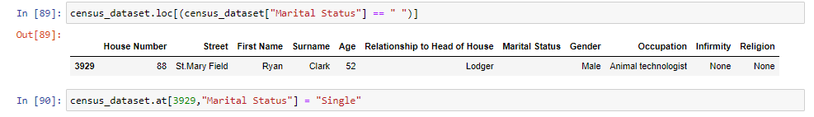
Methodology (Changes Effected)
Changes made were Document and are as follows:
Age column was formatted from string object to an integer. census_dataset["Age"] = census_dataset["Age"].astype(int)
children below 16 years with no relationship to head of house families were traced and the correct data inputted.
census_dataset[(census_dataset["Relationship to Head of House"] == "None") & (census_dataset["Age"] <= 17)]
Children with Marital status of NaN which where Aged < less than 16 where changed to Single
Empty strings in Infirmity, Gender and Marital status where replaced with the appropriate values.
The religions Agnostic and sith where joined together with None as they aren’t recognized in the UK
The 1816 NaN Values in religion were Majorly children Aged 15years and Lower which are being replaced to those of the Head of their Family till they are able to decide themselves.
The others aged 16 and over were replaced to None as these are old enough to decide

Slide 8
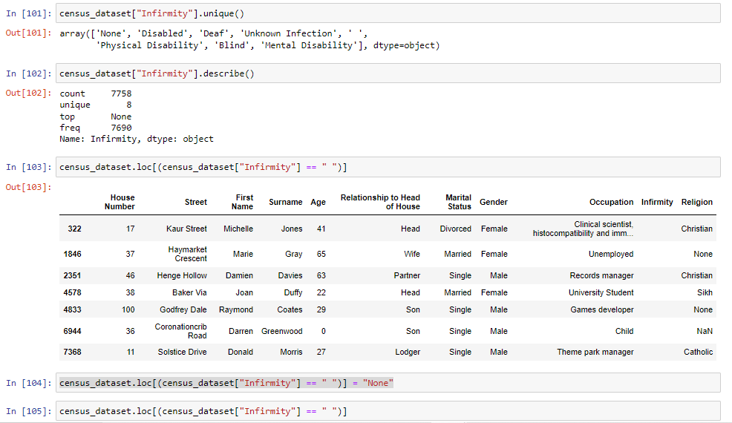
Summary

Slide 9
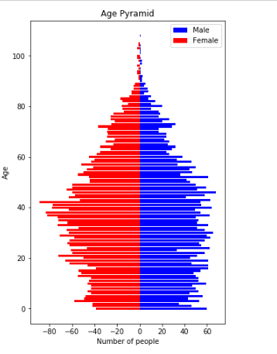
Conclusion

Slide 10

Thank You

