Slide 1
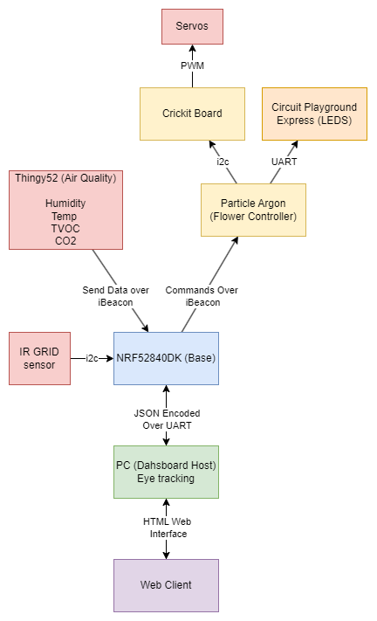
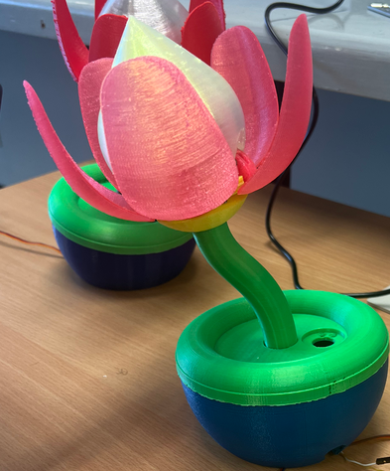
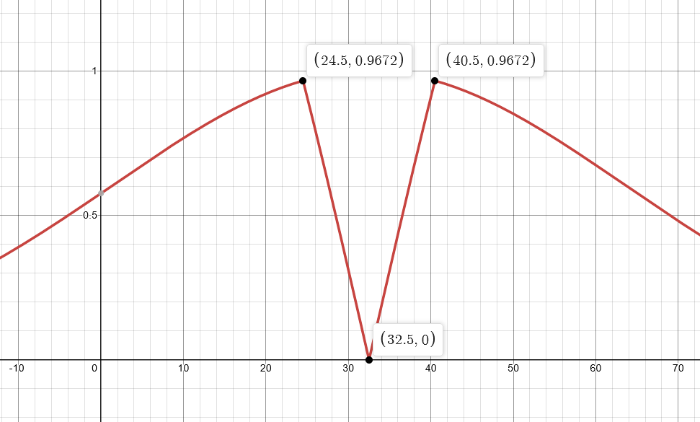
PROVIDENTIA BLUE – MECHANICAL FLOWER
James Wood – 46387727 & Steph Li – 46823177
SYSTEM OVERVIEW
Base Node – Nordic nRF52840DK
Zephyr RTOS, Multithreaded
GridEYE 8x8 IR sensor over i2c
Transmit commands over iBeacon
Receive data over iBeacon
JSON encode and decode over UART with PC dashboard
Sensor Node – Nordic Thingy:52
Zephyr RTOS, Single Threaded
Transmit sensor data over iBeacon
Air quality Sensors
Controller Node – Particle Argon
Zephyr RTOS, Single Threaded
Receive commands over iBeacon
Transmit servo commands to Crickit via i2c
Transmit commands to LEDs via UART
LED Board – Circuit Playground
CircuitPython
Receive Commands over UART
Dashboard
Python
Eye Tracking
Receive Sensor data over UART in JSON format
Transmit Controls over UART in JSON fomat
HTML Web interface
RESULTS
Mechanical Flower
Poor Air Quality results in closing of the flowers petals
The closer someone is to the IR sensor (and hence the flower) the brighter the bulb
When screen is looked at for too long, the bulb begins to flash
When the bulb is flashing, and the user looks away from the screen the bulb stops flashing
Dashboard
All current sensor readings easily accessible
Central graph displaying data change over time
Currentt output state visible
IR Grid visible as color coded grid
Countdown of screen time left visible
Kalman Filtering and data fusion to compensate for temperature sensor change over time
AIMS
Communications <5s Latency
Consistent data reading
Flower Behaves Expectedly
Dashboard simple to use
Sensor Values within 10% of true value
CONCLUSIONS
All data is received within 5s of initial transmission, even though multiple nodes cumulative
Almost no fluctuations in data visible on graph for all sensors
Flower Exceeds expectations visibly changing as per sensor readings
Dashboard very simple to read and provides all necessary information
Sensor values after calibrations are within 10% of the true values in surrounding. Temperature reading is fused with IR Grid values chosen probabilistically based on likelihood of background temperature (shown column 2).

