Slide 1
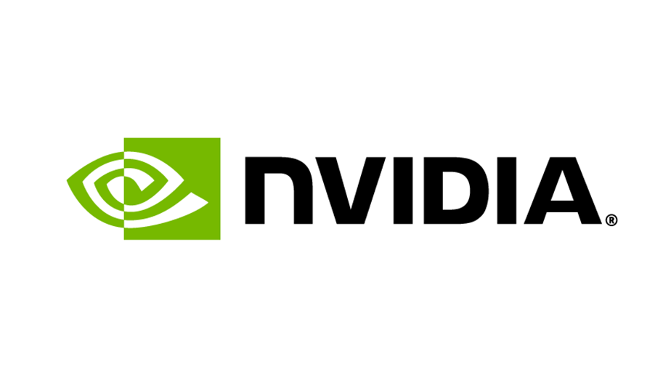
Nvidia Code Fest
Application of LLM’s to extract key themes from unstructured text

Slide 2



Application: Unstructured to Structured
Problem the team is trying to solve.
Governments and businesses struggle to cut through and synthesize the key themes and messages hidden in structured data. We will demonstrate the value of using Generative AI for turning unstructured data into structured data, visualising and making it accessible for greater insights.
Key limitations of existing solution (if any)
Integration between outputs of LLMs to python data structures was difficult. The conversion between prompts (strings) to continuously match data structures within python was difficult to maintain.
What’s the real world motivation
On 3 October 2024, the Australian Government ended its consultation on the safe and responsible use of AI in high-risk settings, it received more than 300 of which 279 have been made publicly available. We recently undertook a review for a client who used Generative AI to summarise surveys in an unstructured way. Our approach will demonstrate how to achieve greater transparency, testability, reliability and flexibility.
What parts are you focused on?
Our focus was on extracting key concerns raised and visualizing these to create insights.

Slide 3
Evolution and Strategy
What was your goal for coming here?
What was your initial strategy?
How did this strategy change?
To explore and learn how to leverage NVIDIA’s platform for implementing Large Language Models (LLMs) in real-world cases
Approach: Combine vector search and retrieval-augmented generation (RAG) with clustering and dimensionality reduction techniques
Challenge: Limited time to fully implement our planned deliverable
Objective: Extract key insights from public submissions, identify common themes and present findings through an interactive dashboard
Adaptation: shifted focus from building a full dashboard (e.g. Streamlit or power BI) to showcasing an interactive UMAP visualization
Impact: Maintained core insights and interactively while narrowing the scope for timely completion
Outcome (Preview): An interactive UMAP visualization that highlights key insights and thematic clusters from public submissions, demonstrating the potential of NVIDIA’s platform and LLMs for scalable analysis

Slide 4
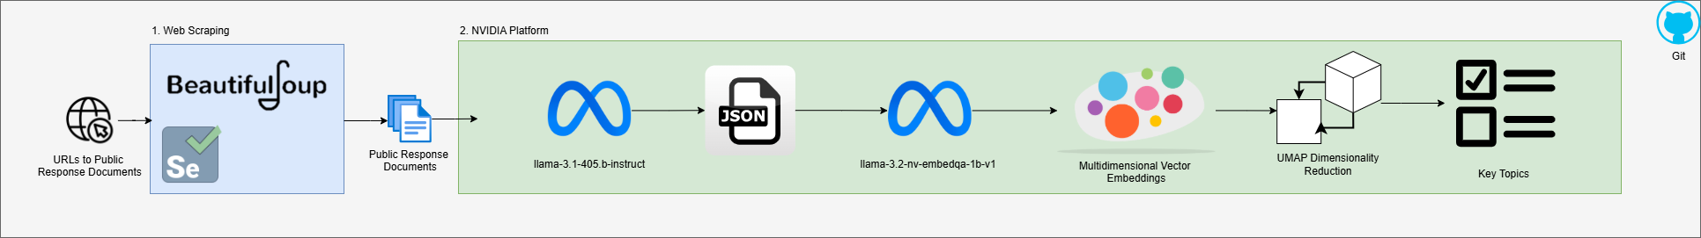
Results and Final Profile
Accomplished:
Web-scraped submissions for mandatory guardrails for AI in high-risk settings documents from various entities (226 documents)
Topic modelling using LLM to extract topics, concerns, risks, and proposals expressed in the submission text, output to structured JSON.
Assessed alternative models to pick the one that provided the most accurate and desired outputs
We used NVIDIA SDKs where possible, the API endpoint via Python was sufficient for our use case for inference, embeddings, and UMAP visualisation.
  Learned how to setup and run NVIDIA NIMs using docker (not used)

Slide 5
What problems have you encountered?
Issues with algorithms – Issues running NeMo Curator for removing personal data such as names, companies. Overcome using out main prompt.
Tool lacking features – Nvidia model does not contain an active parameter to set output response_format to json_schema when using with OpenAI library. So that we had to specify the output format in our prompt, still worked ok.

Slide 6
Wishlist
What do you wish existed to make your life easier?
Tools
  LLM to support response_format to json_schema with JSON validation
Documentation
  Different models outputted vastly different results for the same prompt. High level documentations on the use cases of each model would be beneficial

Slide 7
Final Thoughts
Was this Open Hackathon worth it?
  Absolutely! It was a fun, fast-paced experience that pushed us to learn LLMs and deliver a minimum viable product using an agile approach.
Will you continue development?
  Yes! We aim to refine what we’ve built into a working product to offer as a service to our customers.
What resources or support are critical after the event?
  Access to model API keys and continued investment in platforms like NVIDIA for diverse LLMs will be key.

Slide 8
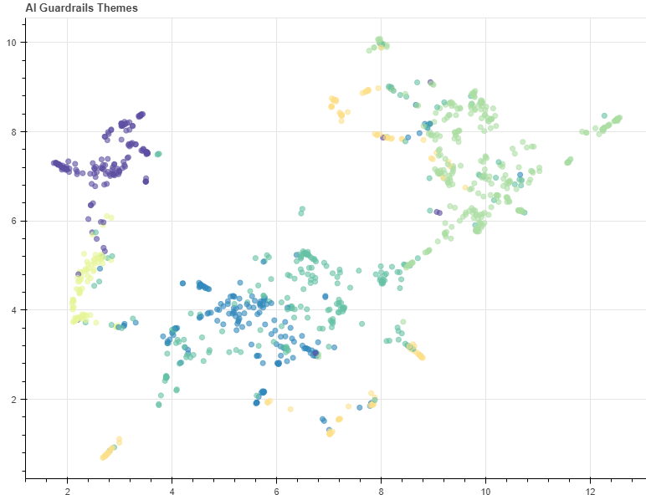
Application Background
Develop an application which provides insight analysis over unstructured text.
Our Application: Extract key concerns from public submissions regarding mandatory guardrails for AI in high-risk settings'
Hackathon Objectives and Approach
Technical Accomplishments and Impact
Test larger models than previously used
Extracting key topics from submissions using Nvidia Models
Clustering Key Topics via Vector Embeddings & K-means clustering
Familiarized with using Nvidia models, enabling future usage.
Identified key concerns from the responses.

Slide 9
Insights
Key Concerns: 6 Clusters
Cluster 0: Regulation policy – regulatory frameworks, international alignment
Cluster 1: Risks – transparency, bias, data quality, model use
Cluster 2: Ethics, society and legal – human rights, privacy, cultural vulnerabilities
Cluster 3: Regulatory enforcement – standards, requirements, protections
Cluster 4: Harms - bias, misuse, impacts
Cluster 5: Regulatory burden – over regulation, cost of compliance

Slide 10
Project Summary
Please summarize your team’s achievements during the Open Hackathon (100 words).
Our team successfully analyzed 226 documents detailing mandatory AI guardrails in high-risk settings through advanced topic modeling using LLMs. We extracted key topics, concerns, risks, and proposals, structuring the output into JSON for actionable insights. After evaluating alternative models, we selected one providing optimal accuracy and outputs. Leveraging NVIDIA SDKs, we efficiently utilized APIs for inference, embeddings, and UMAP visualization. Additionally, we explored NVIDIA NIMs setup and deployment via Docker, enhancing our technical capabilities, though it was not applied in this case. This project reflects our expertise in AI model evaluation, structured data extraction, and leveraging advanced visualization techniques.

Slide 11

PROMOTING YOUR WORK: AVAILABLE OPPORTUNITIES
Papers and Talks: Please acknowledge the Open Hackathons program and OpenACC Organization in any planned or upcoming papers, presentations, or talks.
“This work was completed in part at the Generative AI Codefest, Australia, part of the Open Hackathons program. The authors would like to acknowledge OpenACC-Standard.org for their support.”
Social Media Support: Please feel free to promote your participation across your social media channels. Tag @OpenACCorg and #OpenHackathons and we are happy to amplify.
Blogs and Technical Write-ups: Create a blog post or technical article that highlights the work being done and results achieved.
Quotes and Testimonials: Highlight your quote or feedback on our channels (i.e. social, website, etc.).
***Please reach out to Rachel Tan (rachaelt@nvidia.com) to discuss marketing options and opportunities.

