Slide 1


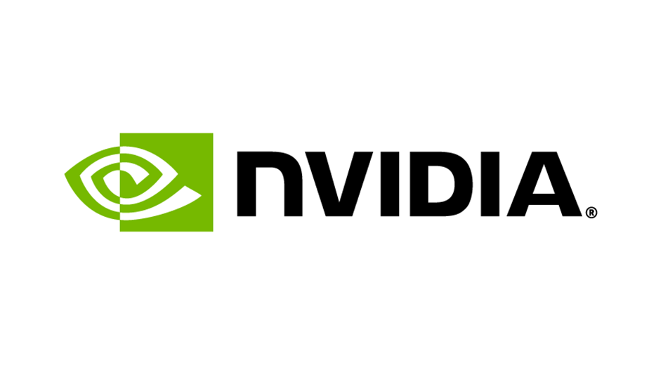

Your Code/Application
What is the algorithmic motif?
1. Web scraping and data collection
  Algorithmic Motif: Data Collection Pipelines
  Automated data collection using web scrapers
Application here: Web scraping is the initial step to gather public submissions from websites
2. Large Language Model (LLM) Utilisation
  Algorithmic Motif: Generative and Pretrained Models
  Creating structure from unstructured data: topic mining, sentiment analysis
Application here: Identify key concerns and ideas from scraped data
Notes:
Module/function = rag

Slide 2
Your Code/Application
What is the algorithmic motif?
3. Vector Database and Retrieval-Augmented Generation (RAG)
  Algorithmic Motif: Vector Similarity Search
  Vector databases → stores embeddings (numerical representations) of text or data
  RAG → retrieves relevant information by finding similar vectors
Application here: Used for clustering analysis and UMAP visualisation
4. Clustering analysis
  Algorithmic Motif: Clustering Algorithms
  Grouping data points into subsets (clusters) based on similarity – e.g. K-means, DBSCAN or hierarchical clustering
Application here: Clustering is employed to identify common themes in the data extracted by the LLM (documents) – to synthesise key messages and improve data accessibility
Notes:
Module/function = rag

Slide 3
Your Code/Application
What is the algorithmic motif?
5. Dimensionality Reduction with UMAP
  Algorithmic Motif: Dimensionality Reduction
  Reduce high-dimensional data to lower dimensions for visualisation or easier processing
Application here: Used to visualise cluster relationships and make sense of complex, high-dimensional vector data from the RAG process
6. Dashboards for visualisation
  Algorithmic Motif: Data Visualisation
  Visual representation of data insights using tools or frameworks to enhance understanding and decision-making
Application here: Dashboards synthesise themes and insights identified by clustering to improve data accessibility
Notes:
Module/function = rag

Slide 4
Your Code/Application
Language and libraries
Python: Core language for web scraping (Selenium, PyPDF2, docx, BeautifulSoup), LLM integration (OpenAI), vector databases (sentence_transformers, FAISS, Pinecone), clustering (scikit-learn), UMAP visualisation (UMAP-learn), and dashboard development (Dash, Streamlit)
SQL: For querying vector databases and managing structured data pipelines
NVIDIA Tools: NVIDIA AI Foundry (NeMo, RAG)
Which application module/function are you focusing on?
Combining the vector search and RAG with clustering and dimensionality reduction techniques, allowing extraction of key insights from public submissions, identifying common themes, and present the results in an interactive dashboard.
GPU port path
Our GPU port path primarily leverages CUDA for acceleration, as we are using NVIDIA’s ecosystem for model optimisation (NIM) and deployment. This will simplify the use of generative AI across various environments, allowing for seamless AI inferencing at scale
Notes:
Module/function = rag

Slide 5
Goals
What would you like to achieve by the end of the week?
  Finalise the analysis and clustering of public submissions using our vector database and clustering algorithms to identify key themes and concerns
  Validate and refine the visualisations created through UMAP to ensure the insights are clear and actionable
  Prepare a preliminary version of the interactive dashboard to present the identified themes and messages, making the data accessible for stakeholders

