Slide 1

Guru’s Travel Blog
Live Event @ Step8Up, Thursday 21st August
Headline Act: Guru’s of the Apocalypse (the original and best)
Support Acts Include: The other Guru’s of the Apocalypse and many, many more
James
Notes:
Good evening and welcome to our final project in the Skill Boot camp course
This presentation will cover the design and implementation of our Full Stack Web Application, built using React. We will cover the team members and their roles, the project outline, along with challenges and key achievements.
We are Guru’s of the Apocalypse (Or simply ‘Guru’s), not to be confused with imposters (the other Gurus of the Apocalypse) , (know simply as Apocalypse).

Slide 2

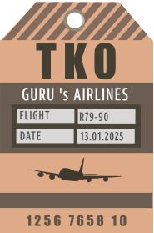
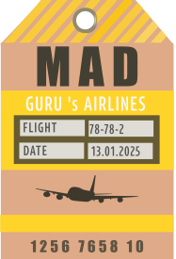

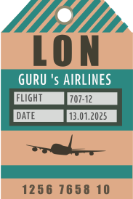
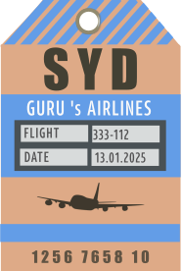
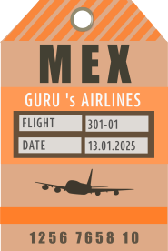
Key Requirement
Requirements: Design and build a Travel Blog, using all the skills learnt during the 12 week boot camp course. The blog must use ‘Long Form’ (1000+ words) use CRUD operations and allow images to be added.
James
Notes:
Read Above

Slide 3
User Story
As a user I want to be able to view a travel blog page for inspiration and ideas. I’d like to be able to contribute to the blog, being able to create, read, update and delete my own posts. I also like to be able to view and comment on other bloggers posts.
As well as being able to view all blogs, I’d like to be able to select blogs by category so I can narrow down my search criteria to find exactly what I'm looking for.
James
Notes:
Read Above

Slide 4
Team Roles
Name | Roles
Rafia | Database Models– Login and Logout – Edit and Delete – Categories Filter
Sravya | Seeding – Connections & Middleware - Login Logic – Blog Logic
Jigna | Routes – Server Connectivity – Fetching Blogs / Details - Seeding – Front End Enhancements
James | Front End – Branding – Github – Multer file uploads – Documentation
All team members contributed to the delivery of the final project, summary of our tasks are above
James
Notes:
All team members contributed to the delivery of the final project, this slide provides a summary of our tasks allocation.

Slide 5
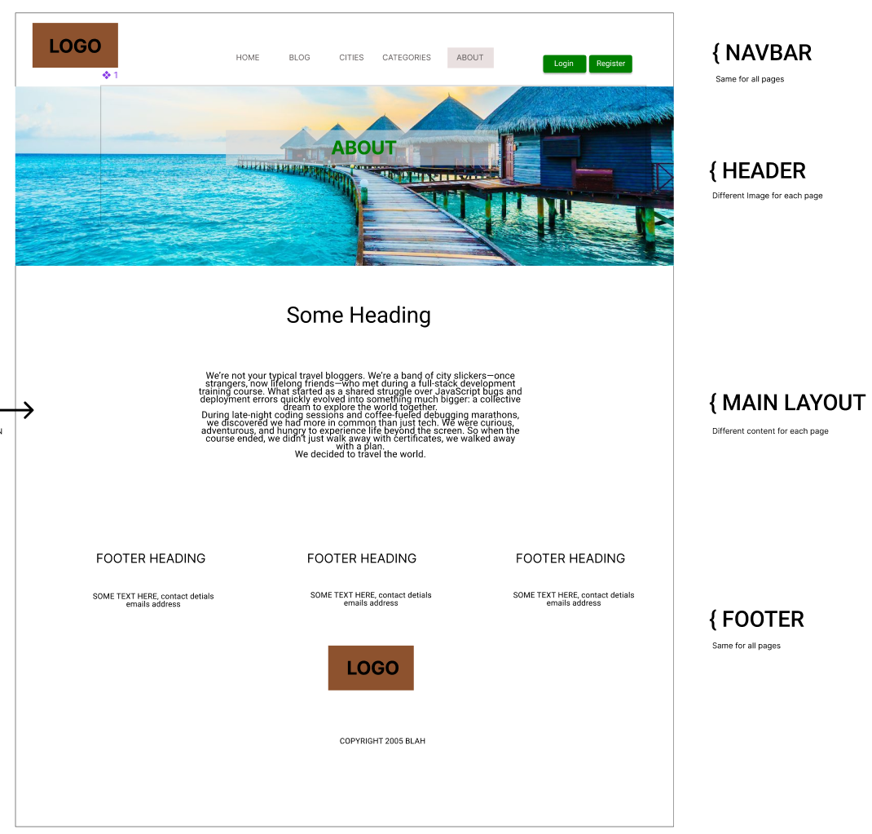
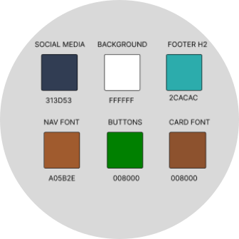
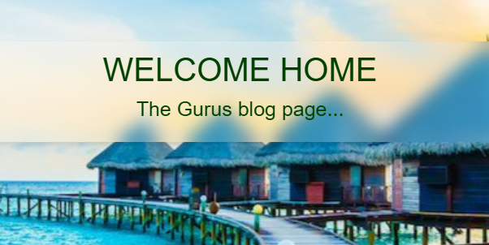


Design
Logo and images
Colour Palette
We didn’t use a counter
Glass effect
Blended edges
Wire frame
James
Notes:
We started on a design using Figma to wireframe out a basic structure.
For our colour scheme was decided to use earthy based colours , green, brown and blue, all of which are key colour in the world round us. Fitting for a Travel blog
We created our own branding logo and graphics, including a series of travel tags.
We also want to make our images in the header, blend into the page without using clean edges.
The goal was to avoid our page being broken up into clear obvious sections, it should blend. A white background covers the whole page, we wanted to avoid using different colours for footer or navbar to help with this concept of blending.
We wanted to implement a Navbar and a Footer which would add consistency through out the application.
We decided that the header should contain an image with a floating glass effect overlay, adding depth to the page
And there some small animations added to various elements throughout to keep the user engaged.
The main layout should be where all the changes take place, depending on which link in the navbar is selected. The idea was to keep the interface simple, not too cluttered and as consistent as possible throughout.
I will now hand you over to Rafia, who will cover the Technologies, Challenges, Achievements and Product Features.

Slide 6
Technologies
React
Sequelize
Bootstrap
CSS
HTML
Multer
Node Js
Express
MY SQL
RAFIA

Slide 7
Challenges
Github – We started off working with Gitbub really well, zero merge conflicts but as the project progressed we hit multiple issues with conflicts and at times this slowed us down dramatically.
Multer – Using this package to save files to file system and storing the data and the link to the image in the DB was complicated. It was a new concept and took a lot of time to get working.
Working on a strategy for the login, register and create blog, we had to really stop and think about the best strategy for the UX. Deciding if it flowed correctly
RAFIA

Slide 8
Achievements
Working together, collaborating and completing the project was a huge achievement, we hit many issues but over come them all to complete the task.
Creating and modifying our own images and creating our own branding, made the project more unique. It added more work to the project but was worth it.
Getting Multer to work
RAFIA

Slide 9
Product Features
Visitor to website will be able to see all blogs and filter by category
If visitor wants to create a blog, he or she will be prompted to register/login
Registered users can create blogs, edit and delete own blogs, add comments to any blog and can delete their own comments (only).
Login, Register and Create Blog features all work as intended. Users can register and account, then login and perform crud operations on their blogs for ‘edit and ‘delete’
RAFIA

Slide 10
Application Demo
Home Page
About
Blog Page
Register
Login
Categories
CRUD
Comments
Logout
Sravya / Jigna

Slide 11
Future developments
Create pages that provide travel advise.
Pet friendly, family friendly
Blog owner able to delete any comments
Add advertising features
Create detailed profile of the user and links to their own blogs
Sravya / Jigna

Slide 12
Q&A
Suggestions
What’s our favorite colour ?
James / Rafia / Sravya / Jigna

Slide 13
Thank you
We hope you enjoyed our demo.
If you want to employ any of us, please contact us directly.

