Slide 1
Getting Started with TDD
James Bender
Application Development Practice Lead
ICC – Columbus, Ohio
@JamesBender

Slide 2

TDD as…
… a development practice.
… a design methodology.
Notes:
Some of you have heard of this acronym, most probably know what it stands for.
In my experience many developers like the idea of TDD, but don’t really know how to get stared with _true_ TDD.
Today we are going to talk about the TDD workflow, some characteristics of unit tests, the benefits of unit tests and how to bring management around

Slide 3
TDD as a Development Practice: Workflow
Specifications
Code
Tests

Slide 4
TDD as a Development Practice: Workflow
Specifications
Code
Tests

Slide 5
TDD as a Development Practice: Workflow Summary
Write a test
Write JUST enough code to make that test pass
Repeat
Refactor as needed

Slide 6

Red, Green, Refactor
Red – Start by writing a failing test
Green – Write just enough code to make test pass
Refactor – Optimize your code for readability, maintainability and quality

Slide 7
TDD as a Design Methodology
Cleaner, simpler code
Forces you to be inline with the business
You are the first consumer of your interface, makes you think about how others will interact with your code/library
Keeps you focused on doing one thing at a time and doing it well

Slide 8

The Benefits of TDD
Notes:
http://www.flickr.com/photos/dieselbug2007/414348333/sizes/l/in/photostream/

Slide 9

The Benefits of TDD
Notes:
http://www.flickr.com/photos/marklincoln/5435427346/sizes/o/in/photostream/

Slide 10

The Benefits of TDD

Slide 11

The Benefits of TDD

Slide 12
What is a Unit Test?

Slide 13

Characteristics of a unit test

Slide 14

Characteristics of a unit test

Slide 15

Characteristics of a unit test

Slide 16
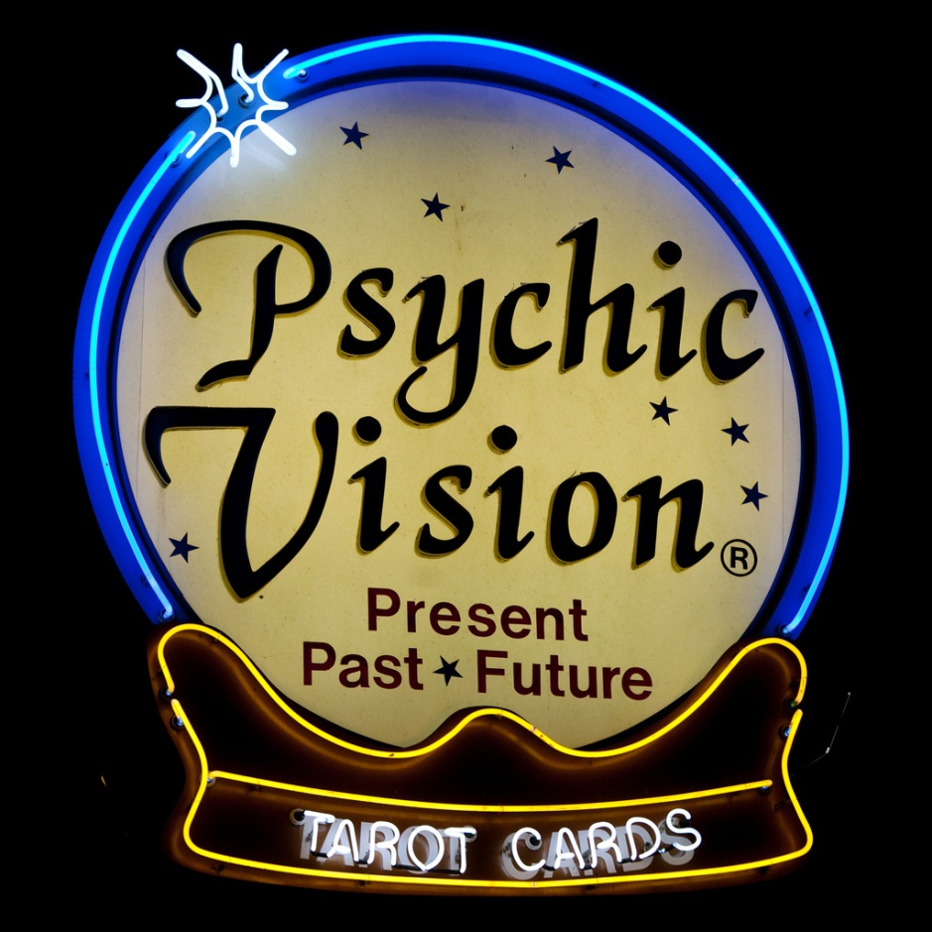
Characteristics of a unit test

Slide 17

Traits to avoid in your Unit Tests

Slide 18
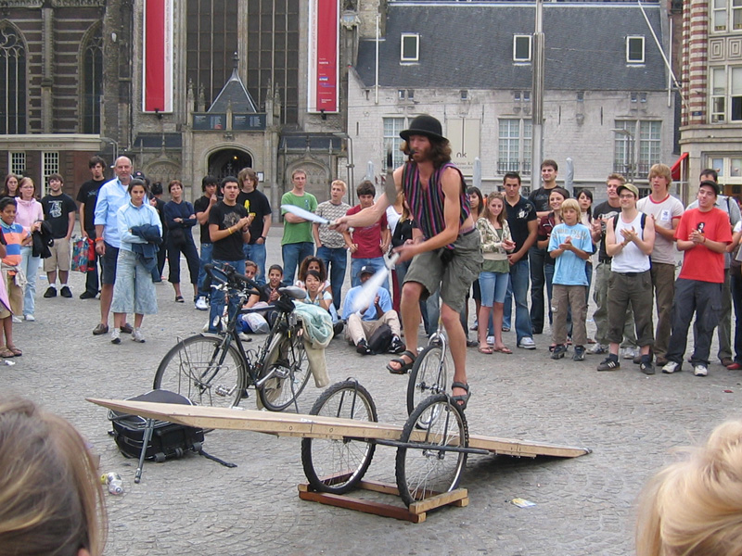
Traits to avoid in your Unit Tests

Slide 19

Traits to avoid in your Unit Tests

Slide 20
NOT Unit Test, but still important…
User Interface Tests
Integration Tests
Performance/Stress Tests
Deployment Tests
Security Tests
User Acceptance Tests

Slide 21
Demo: Tic-Tac-Toe
Create a library to determine the winner of a Tic-Tac-Toe game
Input is a multidimensional (3 X 3) array of string
Returns the winner token (X || O) as a string or a space (as a string) if no winner. If the game is a stalemate return an “S”

Slide 22
Supporting Concepts
Mocking
Dependency Injection

Slide 23
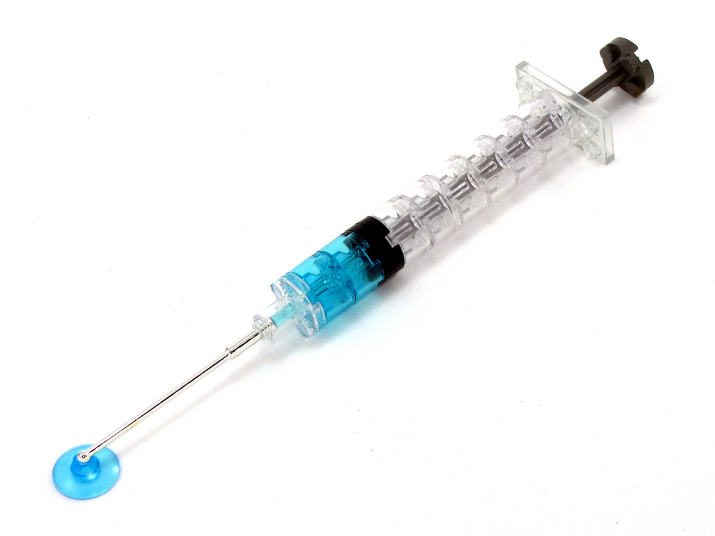
Dependency
Injection

Slide 24
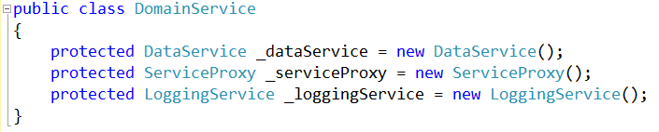
Basic Entity-Based Architecture
Database Access Service
Domain Service
Database Access Service
Service Proxy
Logging Service
Etc..
Service Proxy
Logging Service
Tightly coupled services!

Slide 25
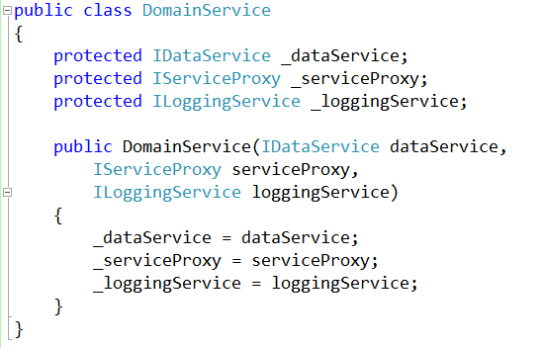
With Dependency Injection

Slide 26
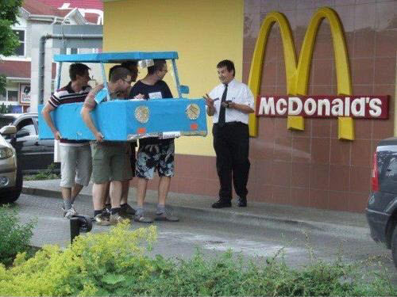
Mocking

Slide 27
Business
Library
External
Resource
Mocked
External
Resource

Slide 28
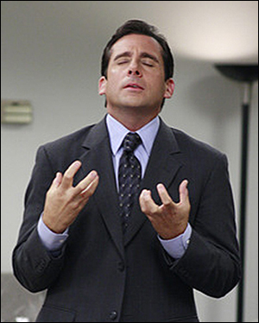
Something for the managers

Slide 29
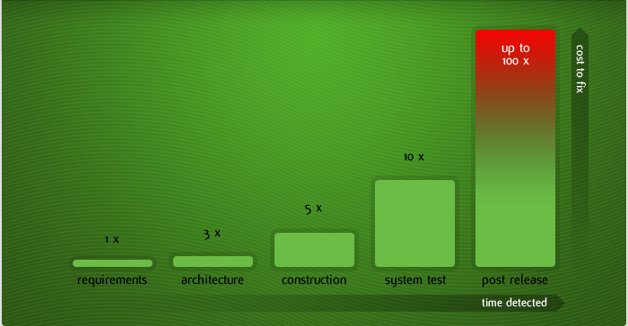
Cost of fixing a defect and when

Slide 30
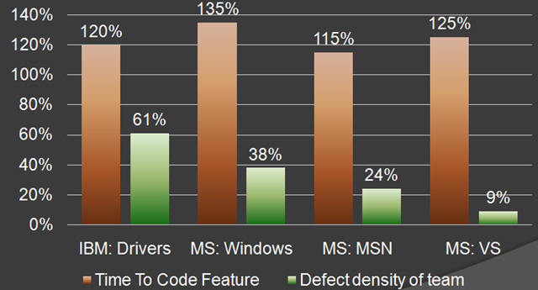
MS & IBM

Slide 31
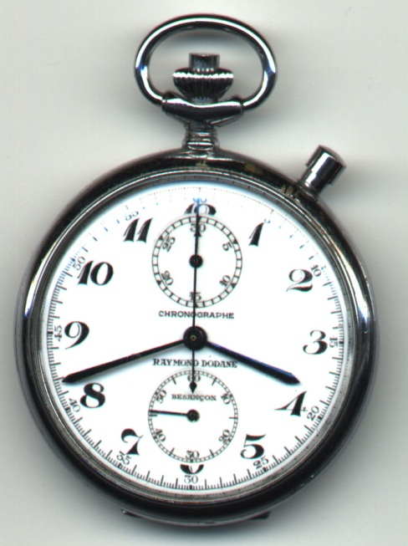
Overall time is shorter

Slide 32
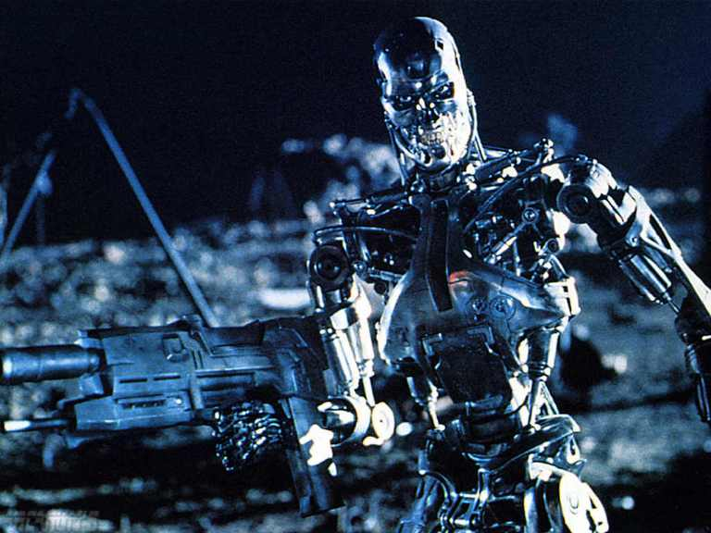
Working with the QA department

Slide 33
Unit Testing Frameworks
MS Test (Microsoft)
MbUnit
xUnit
NUnit

Slide 34
Mocking Frameworks
JustMock
Moq
Rhino Mocks

Slide 35
Dependency Injection Frameworks
Ninject
Structure Map
Unity
Castle

Slide 36
Next Actions..
Test drive a few unit test frameworks
Look at a the different mocking frameworks and dependency injection frameworks
Start by writing tests for new features and defects
Be a software janitor
Share your code

Slide 37
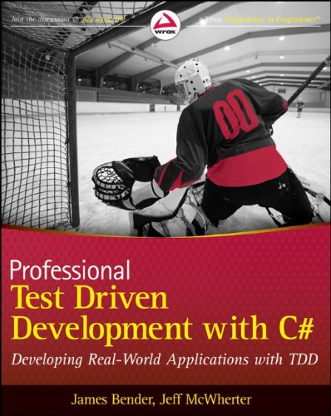
Thank you!
Want to learn more?
www.JamesCBender.com
github.com/JamesBender
james@jamescbender.com
Twitter: @JamesBender
hallwayconversations.com

