Slide 1
How to Make Your Application AWESOME with REST, JSON and Web API
James Bender
Developer Evangelist
Telerik
Notes:
Visual Studio Live! Las Vegas 2011MGB 2003
© 2003 Microsoft Corporation. All rights reserved.
This presentation is for informational purposes only. Microsoft makes no warranties, express or implied, in this summary.

Slide 2

REST is an arhitecural style

Slide 3

Representational State Transfer (REST)

Slide 4
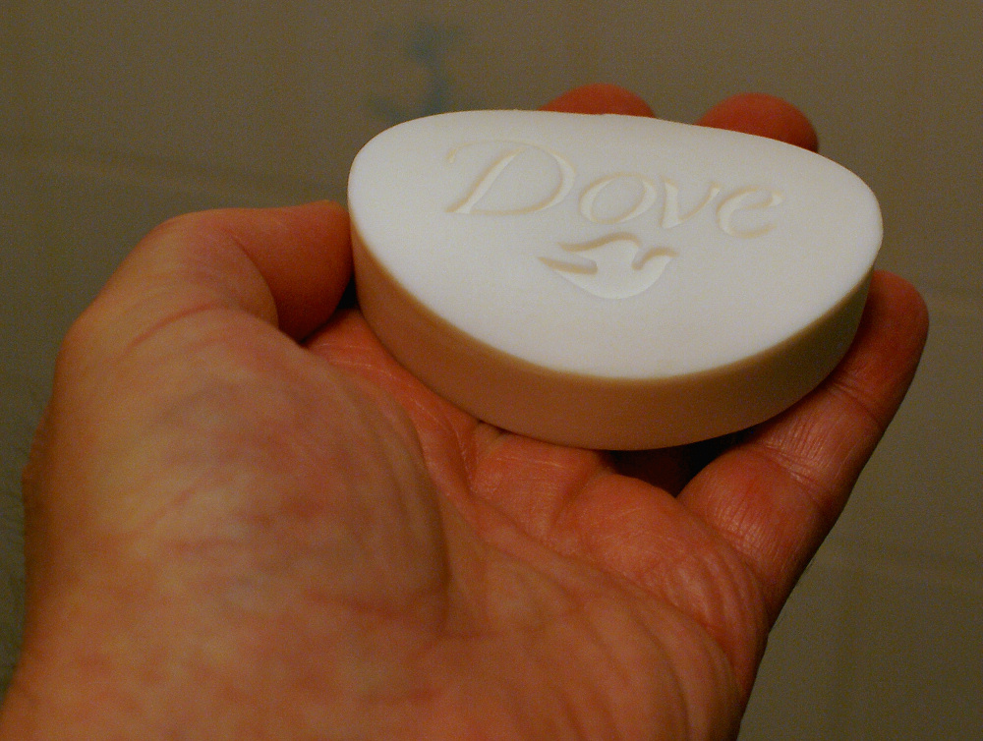

Slide 5
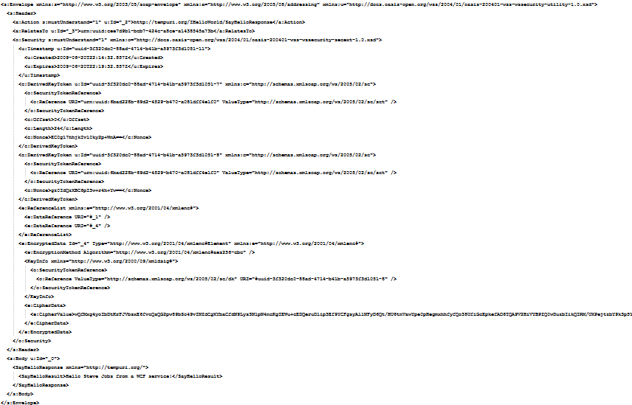
Part 1: REST – Getting data back
Notes:
SOAP can be cumbersome, bloated and difficult to work with. REST services are not SOAP based services, and as such do not generally return SOAP messages.
Visual Studio Live! Las Vegas 2011MGB 2003
© 2003 Microsoft Corporation. All rights reserved.
This presentation is for informational purposes only. Microsoft makes no warranties, express or implied, in this summary.

Slide 6
How do we get this?
Representational State Transfer (REST) based Web Services
Windows Communication Foundation (WCF)
Asynchronous JavaScript and XML (AJAX)
Notes:
By leveraging a few technolgoies such as REST services , Asynchronous (AJAX) and WCF
Visual Studio Live! Las Vegas 2011MGB 2003
© 2003 Microsoft Corporation. All rights reserved.
This presentation is for informational purposes only. Microsoft makes no warranties, express or implied, in this summary.

Slide 7
What will we be looking at today?
REST
  Brief explanation of REST goes here
AJAX
  A means to call server side logic from your web page and receive information back
Windows Communication Foundation
  THE framework for writing REST based services in .NET quickly and easily
Notes:
Representational State Transfer (REST) is a style of web service that enable you to expose your data on the Internet in an open, light weight and heirarchial manner. It is ideal for AJAX services as it uses the same web request paradigm that web pages themselves use and do not have the messageing overhead of SOAP.
AJAX is a method for calling web servcies from a web page that has been rendered in a browser with JavaScript. Jquery (what is Jquery) provides several easy to use method to consume service via AJAX calls.
WCF provides a framework that enables .NET developers to quickly and easily write and deply REST based services.
Visual Studio Live! Las Vegas 2011MGB 2003
© 2003 Microsoft Corporation. All rights reserved.
This presentation is for informational purposes only. Microsoft makes no warranties, express or implied, in this summary.

Slide 8

Part 1: REST - Overview
Notes:
REST has been around as long as the web. It’s the method used by browsers to get HTML from web services, which it then uses to render the web page. It is the basis of the world wide web
Picture: http://www.flickr.com/photos/lucias_clay/2595582135/
Visual Studio Live! Las Vegas 2011MGB 2003
© 2003 Microsoft Corporation. All rights reserved.
This presentation is for informational purposes only. Microsoft makes no warranties, express or implied, in this summary.

Slide 9
Part 1: REST – URI
http://finance.portal.com/quote?tkr=MSFT
http://stuff.org/articles/WCF
http://weatherdude.com/local/43081/sevenday
Notes:
There are two major components of a REST service call. The first is the Universal Resource Identifier (URI). This is the location of your resource. It looks a lot like a web page address. For good reason; web pages are just resources that are delivered via a REST call.
URI’s start with the name of the server where the resources is located, which is followed by the path to where that particular resource exits in the heirarchy.
URI’s are desireable as they are more open that calls to SOAP actions, human readable and like web pages, the results of the service can be cached for subsequent calls
Visual Studio Live! Las Vegas 2011MGB 2003
© 2003 Microsoft Corporation. All rights reserved.
This presentation is for informational purposes only. Microsoft makes no warranties, express or implied, in this summary.

Slide 10

Part 1: REST – VERB
Notes:
The other component of a REST service call is the verb. The URI specifies the location of the resource, but the verb indicates what action should be taken on that resource.
There are several verbs defined in the REST standard, but 99% of the time you will only use one of these four…
Visual Studio Live! Las Vegas 2011MGB 2003
© 2003 Microsoft Corporation. All rights reserved.
This presentation is for informational purposes only. Microsoft makes no warranties, express or implied, in this summary.

Slide 11

Part 1: REST – GET
Notes:
The most commonly used verb is GET. GET simply returns the resource located at the specified URI
Picture: http://www.flickr.com/photos/stuartpilbrow/2887408253/
Visual Studio Live! Las Vegas 2011MGB 2003
© 2003 Microsoft Corporation. All rights reserved.
This presentation is for informational purposes only. Microsoft makes no warranties, express or implied, in this summary.

Slide 12

Part 1: REST – POST
Notes:
POST creates a new resorurce at the specified URI. When using the POST verb you need to provide a message body.
Picture: http://www.flickr.com/photos/jphussey/5354484778/
Visual Studio Live! Las Vegas 2011MGB 2003
© 2003 Microsoft Corporation. All rights reserved.
This presentation is for informational purposes only. Microsoft makes no warranties, express or implied, in this summary.

Slide 13

Part 1: REST – PUT
Notes:
Use the PUT verb to update the contents of an existing resource. Like the GET verb, you need to specify a resource location in the URI, and like POST you need to supply a message body with the updated data
Picture: http://www.flickr.com/photos/orbitaljoe/18429034/
Visual Studio Live! Las Vegas 2011MGB 2003
© 2003 Microsoft Corporation. All rights reserved.
This presentation is for informational purposes only. Microsoft makes no warranties, express or implied, in this summary.

Slide 14
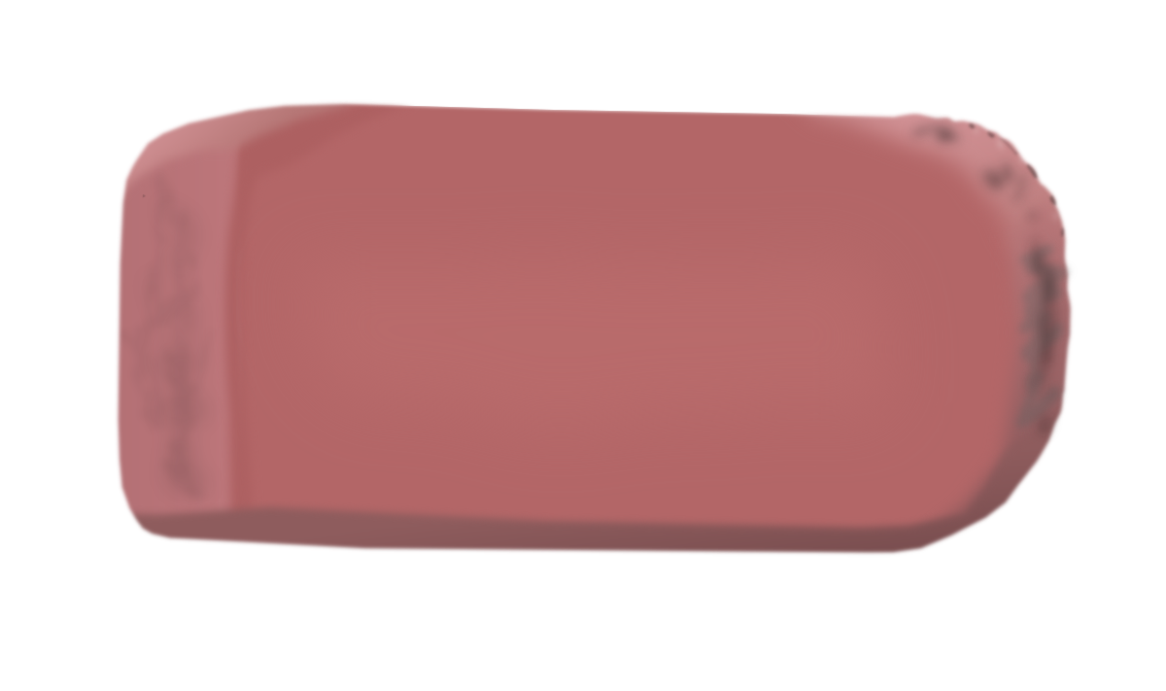
Part 1: REST – DELETE
Notes:
Probably pretty selfexplanitory, but the DELETE verb deletes the resource at the specified URI
Picture: http://www.flickr.com/photos/cookieater2009/4644872599/
Visual Studio Live! Las Vegas 2011MGB 2003
© 2003 Microsoft Corporation. All rights reserved.
This presentation is for informational purposes only. Microsoft makes no warranties, express or implied, in this summary.

Slide 15
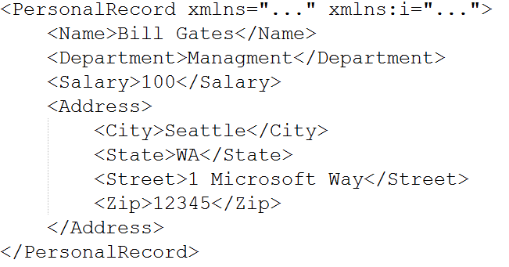
Part 1: REST – POX
Notes:
POX stands for “Plain Old XML” and is one of the two most common ways to get data back from a REST service. POX is great because it is lean, efficient and human readable. Most modern languages have easy to use libraries for working with XML, which makes it an ideal for consumption by non-JavaScript clients.
Visual Studio Live! Las Vegas 2011MGB 2003
© 2003 Microsoft Corporation. All rights reserved.
This presentation is for informational purposes only. Microsoft makes no warranties, express or implied, in this summary.

Slide 16
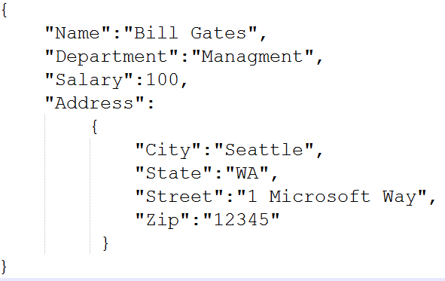
Part 1: REST – JSON
Notes:
JSON stands for JavaScript Object Notation. JSON is a means of returning data encoded as a JavaScript object. This makes it ideal as an encoding scheme for returning data to web browsers from AJAX calls
Like POX, JSON is lightweight, open and human readable.
Visual Studio Live! Las Vegas 2011MGB 2003
© 2003 Microsoft Corporation. All rights reserved.
This presentation is for informational purposes only. Microsoft makes no warranties, express or implied, in this summary.

Slide 17
So… is REST better than SOAP?
Notes:
SOAP is never going away. And it shouldn’t. SOAP services still have a place within an enterpirses architecture to support complex or long running business processes. REST services are more useful on the finges where the abilities SOAP provides are not needed and a more open service architecute is needed
Visual Studio Live! Las Vegas 2011MGB 2003
© 2003 Microsoft Corporation. All rights reserved.
This presentation is for informational purposes only. Microsoft makes no warranties, express or implied, in this summary.

Slide 18
So… is REST better than SOAP?
Notes:
SOAP is never going away. And it shouldn’t. SOAP services still have a place within an enterpirses architecture to support complex or long running business processes. REST services are more useful on the finges where the abilities SOAP provides are not needed and a more open service architecute is needed
Visual Studio Live! Las Vegas 2011MGB 2003
© 2003 Microsoft Corporation. All rights reserved.
This presentation is for informational purposes only. Microsoft makes no warranties, express or implied, in this summary.

Slide 19
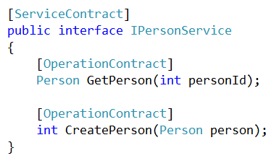
Part 2: REST with WCF
Notes:
WCF is the standard for creating service in .NET. Stating with version 3.5 of the .NET framework, WCF had the capability to provide REST endpoint and routing for services.
A normal SOAP based WCF service contract uses the ServiceContract and OperationContract attributes to identify the corresponding methods of the interface as actions of a service.
Visual Studio Live! Las Vegas 2011MGB 2003
© 2003 Microsoft Corporation. All rights reserved.
This presentation is for informational purposes only. Microsoft makes no warranties, express or implied, in this summary.

Slide 20
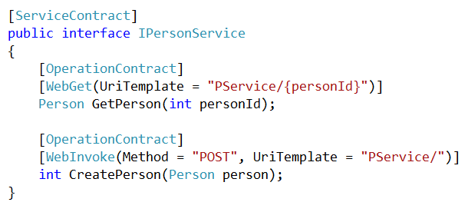
Part 2: REST with WCF
Notes:
To add REST capability to a WCF service contract you need to add another attribute to your operation; either WebGet or WebInvoke.
WebGet causes your method to respond to a REST GET verb. WebInvoke enables your operation to repond to any other REST verb, by but you must specify which verb you are responding to in your attribute.
Visual Studio Live! Las Vegas 2011MGB 2003
© 2003 Microsoft Corporation. All rights reserved.
This presentation is for informational purposes only. Microsoft makes no warranties, express or implied, in this summary.

Slide 21
Part 2: REST with WCF
Notes:
To add REST capability to a WCF service contract you need to add another attribute to your operation; either WebGet or WebInvoke.
WebGet causes your method to respond to a REST GET verb. WebInvoke enables your operation to repond to any other REST verb, by but you must specify which verb you are responding to in your attribute.
Visual Studio Live! Las Vegas 2011MGB 2003
© 2003 Microsoft Corporation. All rights reserved.
This presentation is for informational purposes only. Microsoft makes no warranties, express or implied, in this summary.

Slide 22
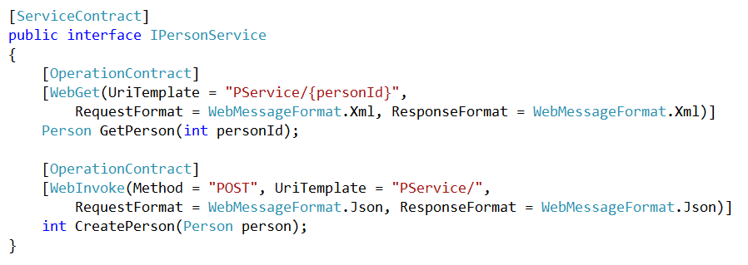
Part 2: REST with WCF
Notes:
By default your REST methods will expect and return data as POX. It’s easy to change your WebGet/WebInvoke attribute to expect and return data as JSON by specifying the Request/Response (as appropriate) in the WebGet/WebInvoke attribute.
Visual Studio Live! Las Vegas 2011MGB 2003
© 2003 Microsoft Corporation. All rights reserved.
This presentation is for informational purposes only. Microsoft makes no warranties, express or implied, in this summary.

Slide 23
Part 2: REST with WCF
DEMO TIME!
Notes:
Visual Studio Live! Las Vegas 2011MGB 2003
© 2003 Microsoft Corporation. All rights reserved.
This presentation is for informational purposes only. Microsoft makes no warranties, express or implied, in this summary.

Slide 24
Part 3: AJAX
Request issued from the browser to a REST based web service
Notes:
AJAX, which stands for Asynchronous JavaScript and XML is a means for calling REST based web serivces and receiving the data back as POX, but in recent years JSON has become a far more popular means of sending/recieveing data due to that fact that JSON is simply JavaScript objects.
Visual Studio Live! Las Vegas 2011MGB 2003
© 2003 Microsoft Corporation. All rights reserved.
This presentation is for informational purposes only. Microsoft makes no warranties, express or implied, in this summary.

Slide 25
Part 3: AJAX
Server responds to request with a POX or JSON response
Notes:
AJAX, which stands for Asynchronous JavaScript and XML is a means for calling REST based web serivces and receiving the data back as POX, but in recent years JSON has become a far more popular means of sending/recieveing data due to that fact that JSON is simply JavaScript objects.
Visual Studio Live! Las Vegas 2011MGB 2003
© 2003 Microsoft Corporation. All rights reserved.
This presentation is for informational purposes only. Microsoft makes no warranties, express or implied, in this summary.

Slide 26
Part 3: AJAX
Browser on client uses JavaScript to handle and act upon the result
Notes:
AJAX, which stands for Asynchronous JavaScript and XML is a means for calling REST based web serivces and receiving the data back as POX, but in recent years JSON has become a far more popular means of sending/recieveing data due to that fact that JSON is simply JavaScript objects.
Visual Studio Live! Las Vegas 2011MGB 2003
© 2003 Microsoft Corporation. All rights reserved.
This presentation is for informational purposes only. Microsoft makes no warranties, express or implied, in this summary.

Slide 27

Part 3: AJAX
JavaScript Library
Makes JavaScript easy, if not fun!
Get it at jquery.com
Notes:
The easiest way to perform AJAX calls in JavaScript is to use Jquery. Jquery is a JavsScript library that makes all facets of working with JavaScript much eaiser, faster and less prone to errors
Visual Studio Live! Las Vegas 2011MGB 2003
© 2003 Microsoft Corporation. All rights reserved.
This presentation is for informational purposes only. Microsoft makes no warranties, express or implied, in this summary.

Slide 28
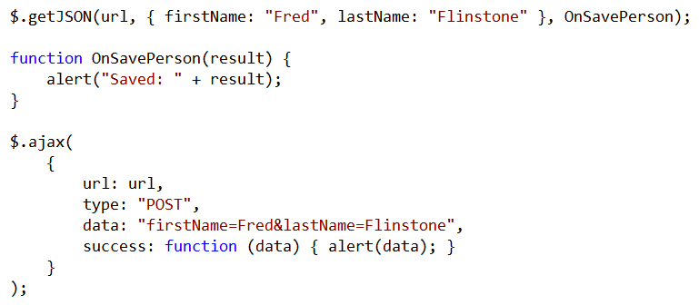
Part 3: AJAX
Notes:
Jquery provides two methods to call AJAX services. The Jquery ajax enables you to provide more options for you call to the REST based service. One thing to keep in mind with the ajax method is that the default behavior is to call the REST service asynchronously, meaning that your callback method may execute before the service has responded. This behavior can be changed by specifying that you want to call the REST service synchronously via a parameter in your call to the Jquery ajax method.
In my practice, I prefer the GetJson method. This is because the method itself is simpler to use (there aren’t as many options), it’s build to assume JSON, which is more efficient, and it’s synchronous by default.
Visual Studio Live! Las Vegas 2011MGB 2003
© 2003 Microsoft Corporation. All rights reserved.
This presentation is for informational purposes only. Microsoft makes no warranties, express or implied, in this summary.

Slide 29
Putting it all together
DEMO TIME!

Slide 30
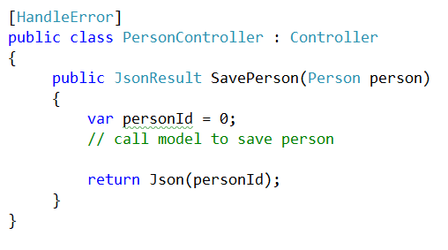
Shhh… don’t tell the other WCF guys about this part…
Notes:
WCF services are great for REST based services as they offer a great deal of easy customization and can be deployed as part of a larger web service deployment.
But, if your application is based on ASP.NET MVC, and you just need a simple way to deploy a REST based service to be used by that appliation, You can use the JSON Result return type for actions in your controller. This method (assuming you have the proper routing defined) will return a JSON object when called.
From a clients point of view, this works the exact same way as a call to a WCF based REST service
Visual Studio Live! Las Vegas 2011MGB 2003
© 2003 Microsoft Corporation. All rights reserved.
This presentation is for informational purposes only. Microsoft makes no warranties, express or implied, in this summary.

Slide 31
What’s next?
Learn more about REST services in WCF:
  Picture of book
Download Jquery
  www.jquery.com
Practice, practice, practice!
Notes:
These are some resources you can use to learn more
Visual Studio Live! Las Vegas 2011MGB 2003
© 2003 Microsoft Corporation. All rights reserved.
This presentation is for informational purposes only. Microsoft makes no warranties, express or implied, in this summary.

Slide 32

Professional Test Driven Development with C#
Notes:
Visual Studio Live! Las Vegas 2011MGB 2003
© 2003 Microsoft Corporation. All rights reserved.
This presentation is for informational purposes only. Microsoft makes no warranties, express or implied, in this summary.

Slide 33
Thank you!
www.JamesCBender.com
www.ImprovingEnterprises.com
james@jamescbender.com
Twitter: @JamesBender
Notes:
Visual Studio Live! Las Vegas 2011MGB 2003
© 2003 Microsoft Corporation. All rights reserved.
This presentation is for informational purposes only. Microsoft makes no warranties, express or implied, in this summary.

