Slide 1
Write Better JavaScript with TDD
James Bender
@JamesBender

Slide 2


Slide 3
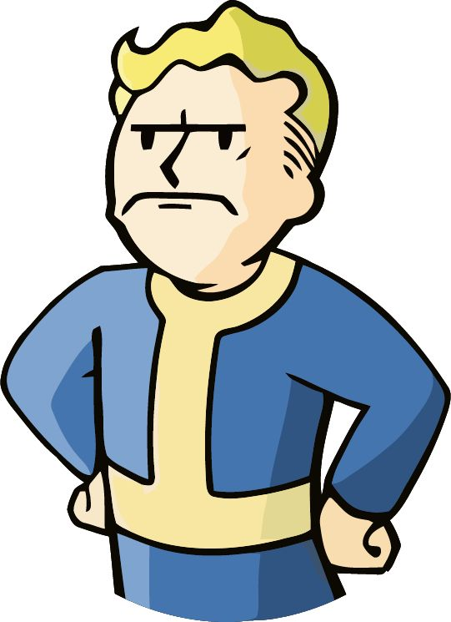

Slide 4

+TDD =

Slide 5


Slide 6
TDD in one poorly drawn picture
Specifications
Code
Tests

Slide 7
TDD in one poorly drawn picture
Specifications
Code
Tests
Specifications
Tests
Code

Slide 8

Characteristics of a unit test

Slide 9
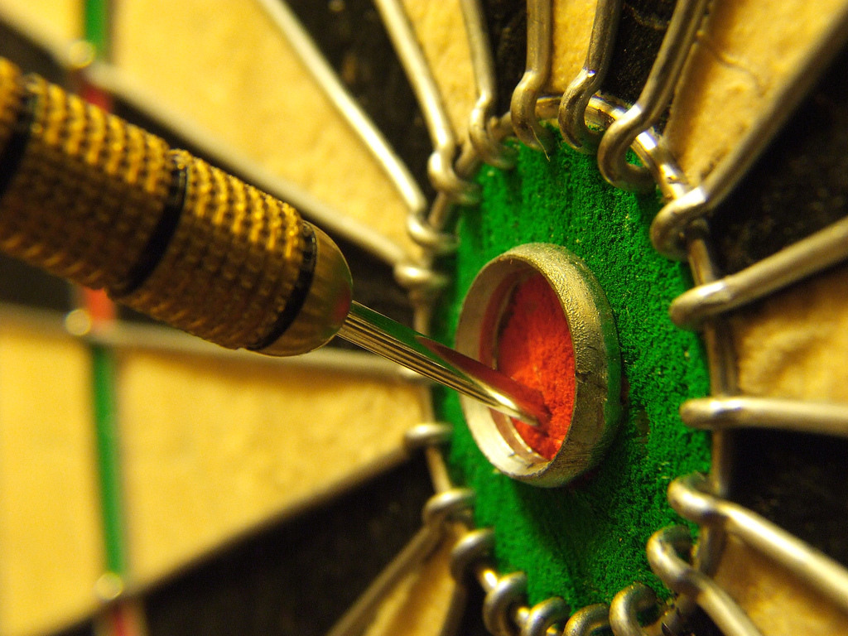
Characteristics of a unit test

Slide 10

Characteristics of a unit test

Slide 11
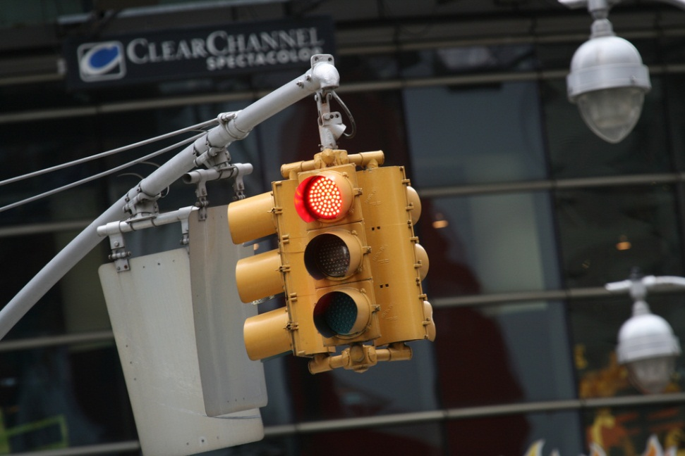
Red, Green, Refactor
Red – Start by writing a failing test
Green – Write just enough code to make test pass
Refactor – Optimize your code for readability, maintainability and quality

Slide 12

http://facebook.github.io/jest/

Slide 13

Jest

Slide 14
Demo: Tic-Tac-Toe
Create a library to determine the winner of a Tic-Tac-Toe game
Input is a multidimensional (3 X 3) array of string
Results
Returns the winner token (X || O) as a string
Returns an empty String if no winner but moves still available
If the game is a stalemate return an ‘S’

Slide 15
Next Steps
Check out Jasmine and/or Jest
Show the other developers on your team
Try adding test for new features and defects
Watch your code coverage numbers
Practice, practice, practice!

Slide 16
Five Good Reasons Not to Test Your Code
There
Are
No
Good
Reasons

Slide 17

Thank you!
Want to learn more?
www.JamesCBender.com
github.com/JamesBender
james@jamescbender.com
Twitter: @JamesBender
hallwayconversations.com
New Book on Angular/React/ASP.NET 5 coming in 2018!

