Slide 1
Getting Started with TDD
James Bender
Application Development Practice Manager
ICC – Columbus, Ohio
@JamesBender

Slide 2
Agenda
[Brief] Introduction
Basics of TDD
Workshop One
DI Concepts
Mocking
Workshop Two

Slide 3
Agenda
DI Frameworks
Integration and Other Types of Tests
Workshop Three
Getting Management and QA on Board
Q&A

Slide 4

TDD as…
… a development practice.
… a design methodology.
Notes:
Some of you have heard of this acronym, most probably know what it stands for.
In my experience many developers like the idea of TDD, but don’t really know how to get stared with _true_ TDD.
Today we are going to talk about the TDD workflow, some characteristics of unit tests, the benefits of unit tests and how to bring management around

Slide 5
TDD as a Development Practice: Workflow
Specifications
Code
Tests

Slide 6
TDD as a Development Practice: Workflow
Specifications
Code
Tests

Slide 7

Red, Green, Refactor
Red – Start by writing a failing test
Green – Write just enough code to make test pass
Refactor – Optimize your code for readability, maintainability and quality

Slide 8

The Benefits of TDD
Notes:
http://www.flickr.com/photos/dieselbug2007/414348333/sizes/l/in/photostream/

Slide 9
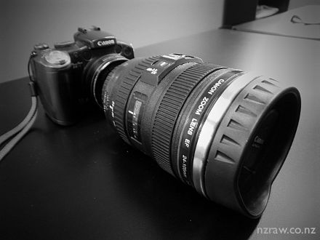
The Benefits of TDD
Notes:
http://www.flickr.com/photos/marklincoln/5435427346/sizes/o/in/photostream/

Slide 10

The Benefits of TDD

Slide 11

The Benefits of TDD

Slide 12
What is a Unit Test?

Slide 13

Characteristics of a unit test

Slide 14

Characteristics of a unit test

Slide 15

Characteristics of a unit test

Slide 16
NOT Unit Test, but still important…
User Interface Tests
Integration Tests
Performance/Stress Tests
Deployment Tests
Security Tests
User Acceptance Tests

Slide 17
Demo: Tic-Tac-Toe
Create a library to determine the winner of a Tic-Tac-Toe game
Input is a multidimensional (3 X 3) array of char
Returns the winner token (X || O) as a char or a space (as a char) if no winner. If the game is a stalemate return an ‘S’

Slide 18
Supporting Concepts
Mocking
Dependency Injection

Slide 19
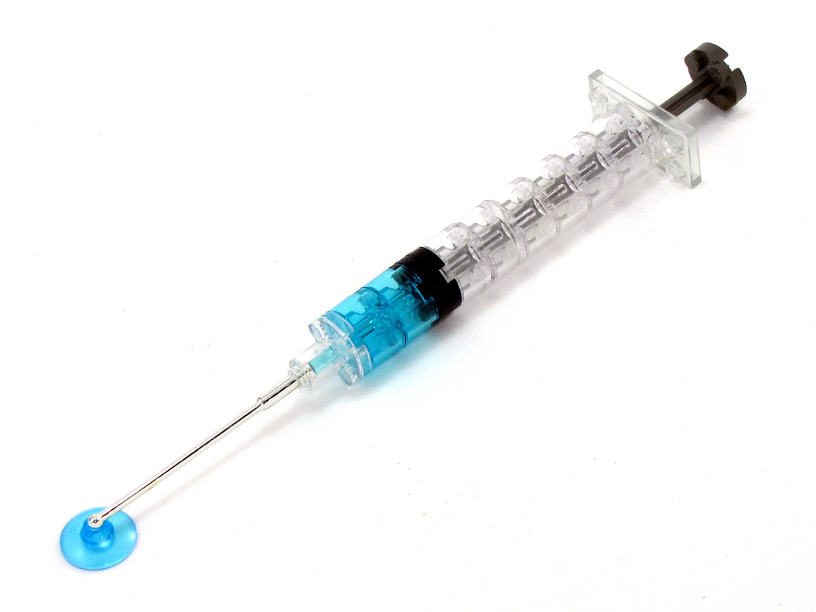
Dependency
Injection

Slide 20
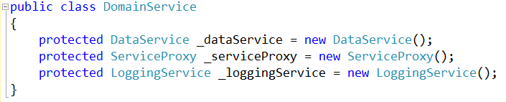
Basic Entity-Based Architecture
Database Access Service
Domain Service
Database Access Service
Service Proxy
Logging Service
Etc..
Service Proxy
Logging Service
Tightly coupled services!

Slide 21
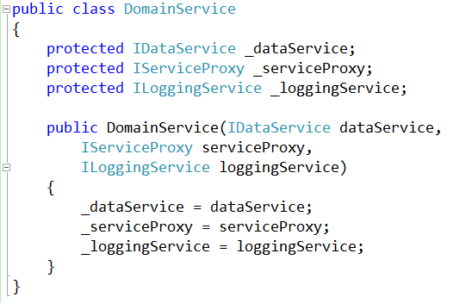
With Dependency Injection

Slide 22
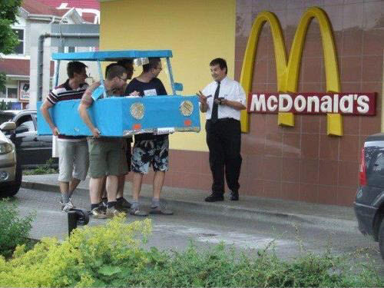
Mocking

Slide 23
Business
Library
External
Resource
Mocked
External
Resource

Slide 24
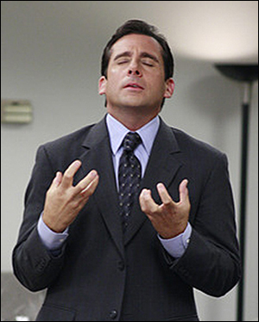
Something for the managers

Slide 25
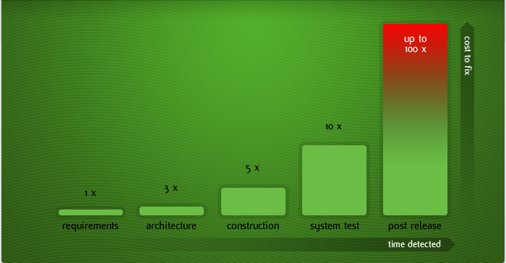
Cost of fixing a defect and when

Slide 26
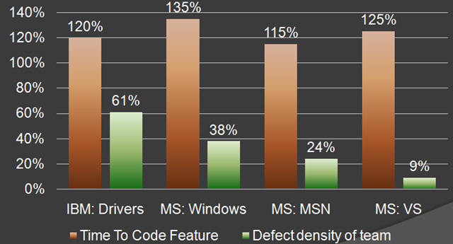
MS & IBM

Slide 27
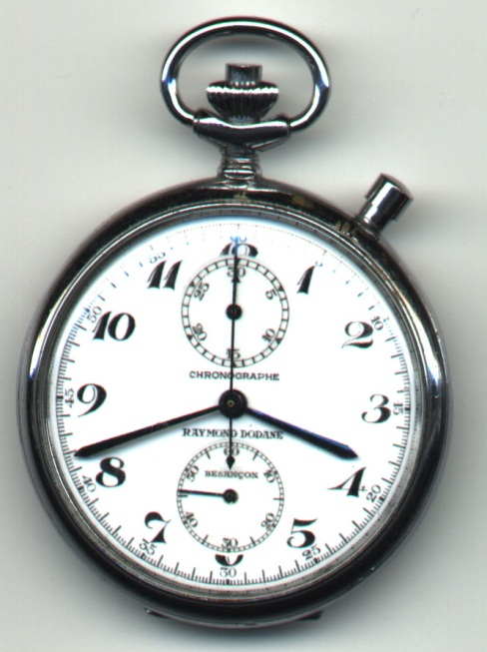
Overall time is shorter

Slide 28
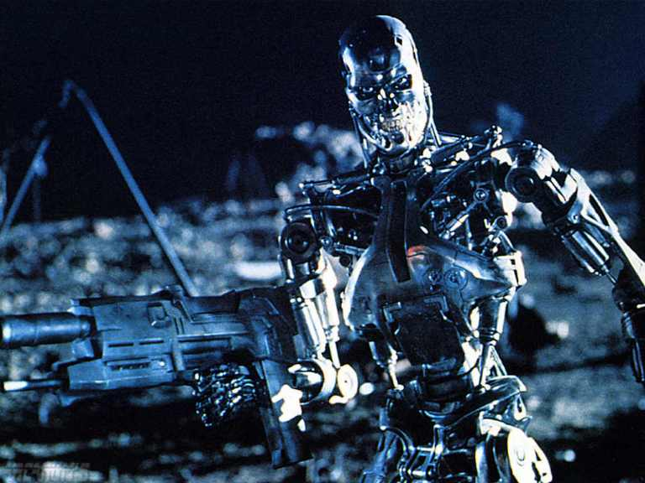
Working with the QA department

Slide 29
Unit Testing Frameworks
MS Test (Microsoft)
MbUnit
xUnit
NUnit

Slide 30
Mocking Frameworks
JustMock
Moq
Rhino Mocks

Slide 31
Dependency Injection Frameworks
Ninject
Structure Map
Unity
Castle

Slide 32
Next Actions..
Test drive a few unit test frameworks
Look at a the different mocking frameworks and dependency injection frameworks
Start by writing tests for new features and defects
Be a software janitor
Share your code

Slide 33

Thank you!
Want to learn more?
www.JamesCBender.com
github.com/JamesBender
james@jamescbender.com
Twitter: @JamesBender
hallwayconversations.com

