Slide 1
NOT Unit Test, but still important…
User Interface Tests
Integration Tests
Performance/Stress Tests
Deployment Tests
Security Tests
User Acceptance Tests

Slide 2

Something for the managers

Slide 3
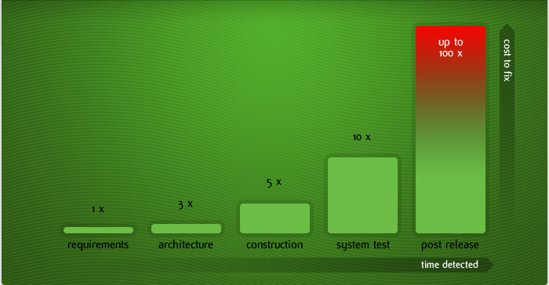
Cost of fixing a defect and when

Slide 4
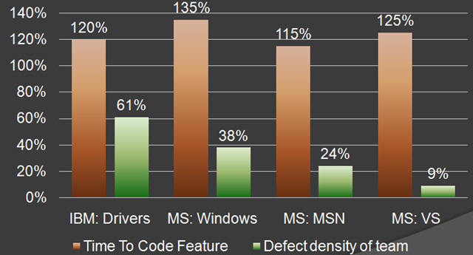
MS & IBM

Slide 5

Overall time is shorter

Slide 6

Working with the QA department

Slide 7
Unit Testing Frameworks
MS Test (Microsoft)
MbUnit
xUnit
NUnit

Slide 8
Mocking Frameworks
Moq
Rhino Mocks
Typemock
Just Mock

Slide 9
Dependency Injection Frameworks
Ninject
Structure Map
Unity
AutoFac

Slide 10

Thank you!
Want to learn more?
www.JamesCBender.com
github.com/JamesBender
james@jamescbender.com
Twitter: @JamesBender
hallwayconversations.com

