Slide 1
Write Better JavaScript with TDD
James Bender
Product Manager, Infragistics
@JamesBender

Slide 2


Slide 3


Slide 4

+TDD =

Slide 5


Slide 6
TDD in one poorly drawn picture
Specifications
Code
Tests

Slide 7
TDD in one poorly drawn picture
Specifications
Code
Tests
Specifications
Tests
Code

Slide 8

Characteristics of a unit test

Slide 9
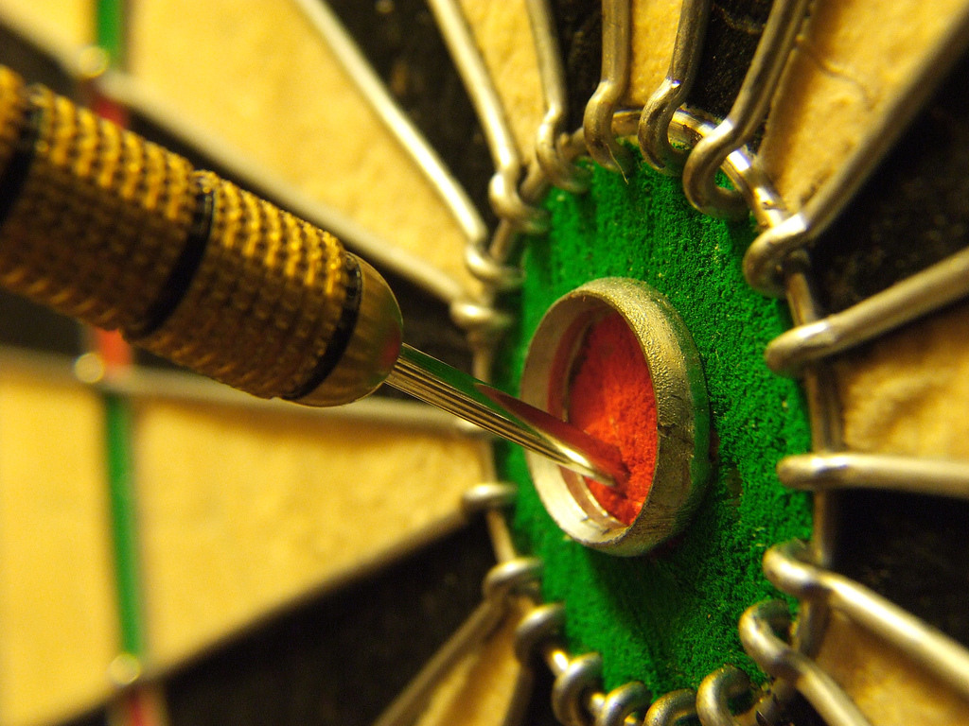
Characteristics of a unit test

Slide 10
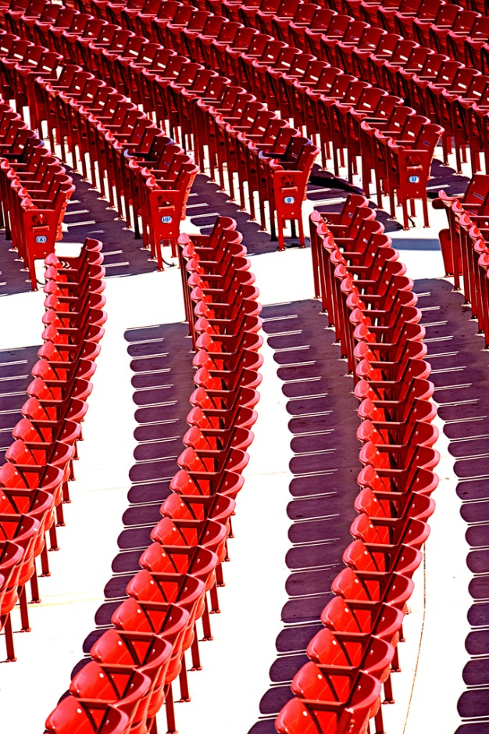
Characteristics of a unit test

Slide 11
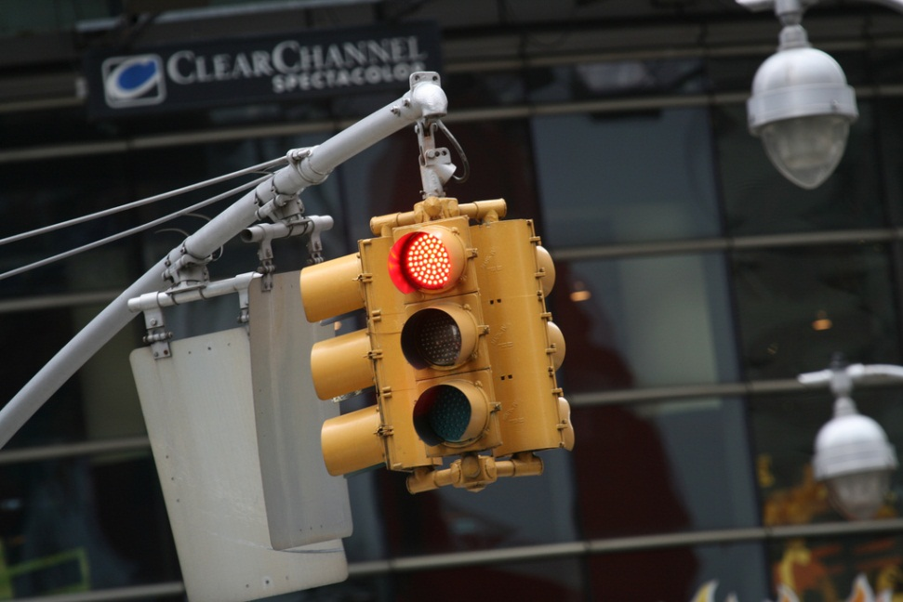
Red, Green, Refactor
Red – Start by writing a failing test
Green – Write just enough code to make test pass
Refactor – Optimize your code for readability, maintainability and quality

Slide 12

http://facebook.github.io/jest/

Slide 13
Demo: Tic-Tac-Toe
Create a library to determine the winner of a Tic-Tac-Toe game
Input is a multidimensional (3 X 3) array of string
Results
Returns the winner token (X || O) as a string
Returns an empty String if no winner but moves still available
If the game is a stalemate return an ‘S’

Slide 14

Thank you!
Want to learn more?
www.JamesCBender.com
github.com/JamesBender
james@jamescbender.com
Twitter: @JamesBender
hallwayconversations.com
New Book on Angular/ASP.NET 5 coming in 2017!

