Slide 1
Just* Productivity Tools
2013 Q3 Release

Slide 2
Roadmap for Today
Introductions
Schedule and Housekeeping
JustCode
JustMock
JustTrace
JustDecompile
Resources / Q&A

Slide 3

Introduction
James Bender
Microsoft MVP
Developer Evangelist
Email: james.bender@telerik.com
Twitter: @jamesbender
Blog: http://www.jamescbender.com
Blog: http://blogs.telerik.com/jamesbender

Slide 4

Introduction
Phil Japikse
Microsoft MVP, MCSD, MCDBA, CSM, CSP
Evangelism Lead-DevTools, Telerik
Email: phil@telerik.com
Twitter: @skimedic
Blog: http://www.skimedic.com/blog
Blog: http://blogs.telerik.com/skimedic

Slide 5

Introduction
Lohith Goudagere Nagaraj
Microsoft MVP, MCP
Developer Evangelist
Email: Lohith.nagaraj@telerik.com
Twitter: @kashyapa
Blog: http://www.kashyapas.com
Blog: http://www.telerikhelper.net

Slide 6
Schedule
October 28th– Monday | 11:00am EDT | New for ASP.NET AJAX: Audio, Video, and Cloud Capabilities
October 29th– Tuesday | 11:00am EDT | Tuning into XAML - What's New in RadControls for WPF/SL, Windows Phone and Windows 8 Q3 2013
October 30th– Wednesday | 11:00am EDT | Sneak Peek into the New Test Studio: Load Test Your UI and Web Services
October 30th– Wednesday | 1:00pm EDT | What’s New in RadControls for WinForms Q3 2013
October 31th– Thursday | 11:00am EDT | Telerik Just* Tools – What Every Developer Needs
October 31th– Thursday | 1:00pm EDT | What’s New for the HTML/JavaScript Developer in RadControls for Windows HTML and the HTML5 Report Viewer
November 1st– Friday | 11:00am EDT | Your PM Tool Shouldn’t Get in Your Way: Introducing the New TeamPulse Integration with Git and GitHub
November 1st– Friday | 1:00pm EDT | Icenium Introduces Visual Studio Extension

Slide 7
JustCode

Slide 8
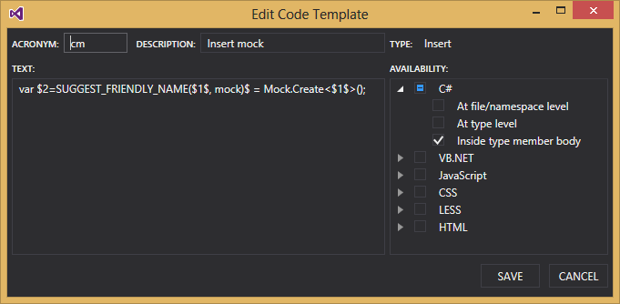
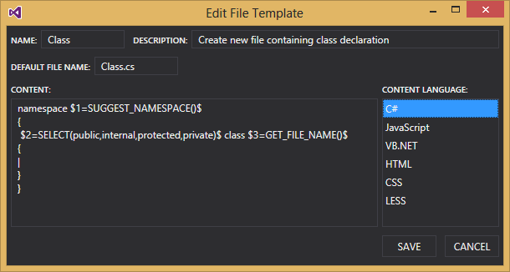
What’s new in JustCode
Improved Code and File Templates
Ability to provide a description of the template
You can define a scope for your template

Slide 10
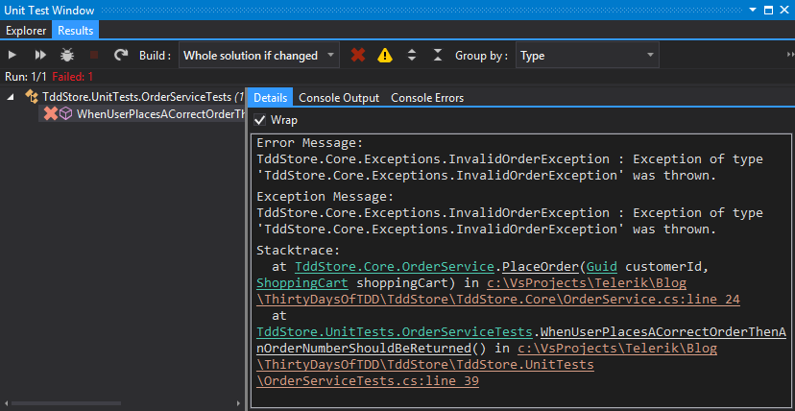
What’s new in JustCode
Improved Test Runner
Faster!
Ability to navigate to code from the stack trace

Slide 12
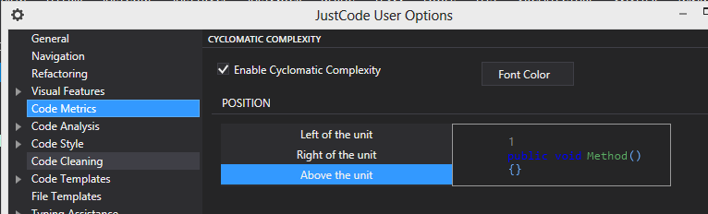

What’s new in JustCode
Cyclomatic Complexity
Helps keep your code simple

Slide 13
JustMock

Slide 14
Some of What’s Awesome in JustMock
Future Mocking
Helps when legacy code doesn’t use Dependency Injection
Automocking
Helps ever changing code bases to make tests less brittle
Mock by Example
Significantly reduced code needed for complex testing scenarios

Slide 16
What's New in 2013 Q3
JustCode Integration
Creating and Arranging Mocks
Improved Workflow
Immediate failure on
InOrder
Upper Bounds violations with Occurs
Better Messaging in Assert()
Notes:
b) New: Better exception messages
c) Show new mocking type/feature – Recursive Loose Fakes
d) Introspection API
e) Ability to mock DLLImport

Slide 17
What's New in 2013 Q3
Introspection API
Know what's happening under the hood
Use Telerik.JustMock.DebugView
Instrumentation of DLL Import
Quickly and easily mock calls involving DllImport
Recursive Loose Mocking
Now the default
Notes:
b) New: Better exception messages
c) Show new mocking type/feature – Recursive Loose Fakes
d) Introspection API
e) Ability to mock DLLImport

Slide 19
JustTrace

Slide 20
What’s new in JustTrace
Event Handler Leak Analysis
Misused event handlers are a common cause or memory leaks
New analysis type helps you find potential event handler leaks quickly

Slide 22
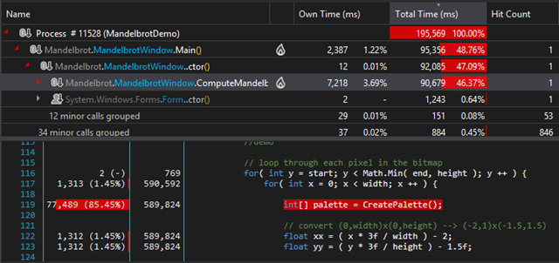
What’s new in JustTrace
Source Level Profiling
Helps you find performance issues in code faster

Slide 24
What’s new in JustTrace
SQL Profiling
Helps find where your SQL is causing a bottleneck
Shows entire query
Works with any database that has an ADO.NET driver

Slide 25
What’s new in JustTrace
HTTP Request Profiling
You can see incoming and outgoing requests
Works with your existing ASP.NET apps!

Slide 27
JustDecompile

Slide 28
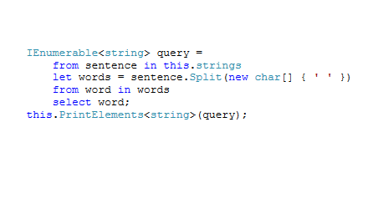
What’s new in JustDecompile
LINQ Queries
Can reconstruct LINQ queries

Slide 30
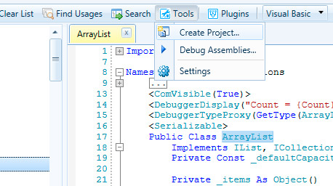
What’s new in JustDecompile
VB.NET Improvements
Create Project for VB.NET
Projects out of VB.NET code as well
Improved VB.NET decompilation

Slide 32
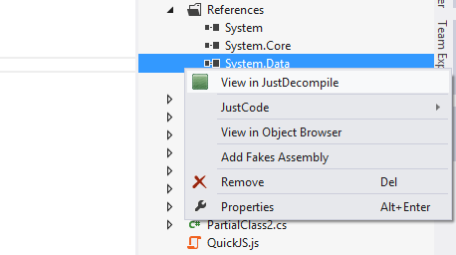
What’s new in JustDecompile
Visual Studio Extension
Decompile referenced assemblies from VS
JustDecompile Context Command

Slide 34
Resources
Visit the Just Product pages and download the trial versions
http://www.telerik.com/products/justcode
http://www.telerik.com/products/mocking
http://www.telerik.com/products/memory-performance-profiler.aspx
http://www.telerik.com/products/decompiler.aspx

Slide 35
Resources
Read the new release blog posts
JustCode: http://bit.ly/1f4bI3h
JustMock: http://bit.ly/17t3SAR
JustTrace: http://bit.ly/19bmC5K
JustDecompile: http://bit.ly/17xudvs

Slide 36
Resources
Check out these other interesting posts…
Top 5 Reasons to Use a Mocking Framework
http://bit.ly/17XY1xw
30 Days of TDD
Day 1: http://bit.ly/1cqWuHR
Check out Telerik TV!
http://tv.telerik.com

Slide 37
Q & A
Download Just* Productivity Tools at
http://www.telerik.com/developer-productivity-tools.aspx
Email | Twitter
Phil@Telerik.com | @skimedic
James.Bender@Telerik.com | @jamescbender
Lohith.Nagaraj@Telerik.com | @kashyapa

