Slide 1
From Zero to TDD in a Day!!!
James Bender
Columbus, Ohio
@JamesBender
WiFi Password: 1L0v3KCDC!

Slide 2













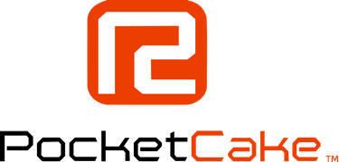















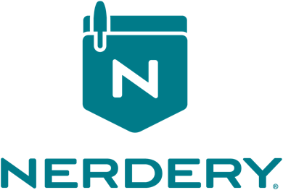
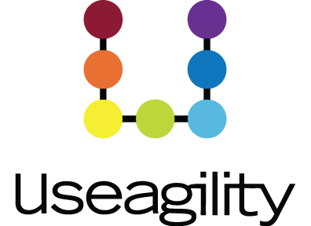






TITANIUM SPONSORS
Platinum Sponsors
Gold Sponsors

Slide 3
Agenda
[Brief] Introduction
Basics of TDD
Workshop One
DI Concepts
Mocking
Workshop Two

Slide 4
Agenda
DI Frameworks
Integration and Other Types of Tests
Getting Management and QA on Board
Q&A

Slide 5

TDD as…
… a development practice.
… a design methodology.
Notes:
Some of you have heard of this acronym, most probably know what it stands for.
In my experience many developers like the idea of TDD, but don’t really know how to get stared with _true_ TDD.
Today we are going to talk about the TDD workflow, some characteristics of unit tests, the benefits of unit tests and how to bring management around

Slide 6
TDD as a Development Practice: Workflow
Specifications
Code
Tests

Slide 7
TDD as a Development Practice: Workflow
Specifications
Code
Tests

Slide 8
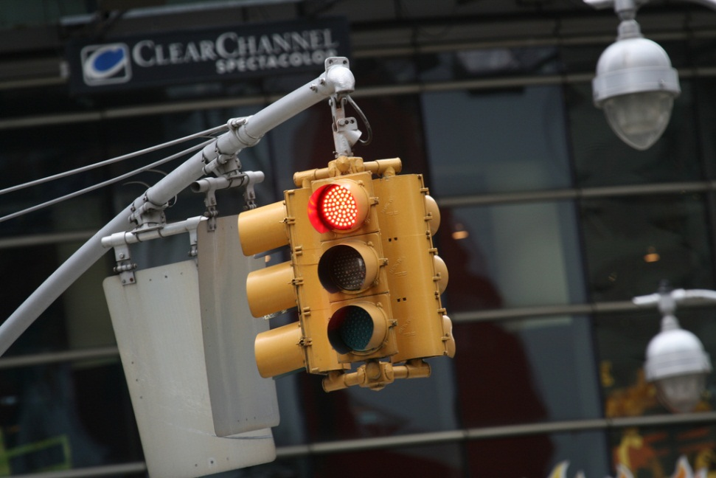
Red, Green, Refactor
Red – Start by writing a failing test
Green – Write just enough code to make test pass
Refactor – Optimize your code for readability, maintainability and quality

Slide 9

The Benefits of TDD
Notes:
http://www.flickr.com/photos/dieselbug2007/414348333/sizes/l/in/photostream/

Slide 10

The Benefits of TDD
Notes:
http://www.flickr.com/photos/marklincoln/5435427346/sizes/o/in/photostream/

Slide 11

The Benefits of TDD

Slide 12

The Benefits of TDD

Slide 13
What is a Unit Test?

Slide 14

Characteristics of a unit test

Slide 15

Characteristics of a unit test

Slide 16

Characteristics of a unit test

Slide 17
Demo: Tic-Tac-Toe
Create a library to determine the winner of a Tic-Tac-Toe game
Input is a multidimensional (3 X 3) array of char
Returns the winner token (X || O) as a char or a space (as a char) if no winner. If the game is a stalemate return an ‘S’

Slide 18
http://bit.ly/28NA83W http://bit.ly/28TF9s7 http://bit.ly/1QvOMhC http://bit.ly/28PDXKg WiFi Password: 1L0v3KCDC!

