Slide 1
Write Better JavaScript with TDD
@JamesBender

Slide 2






















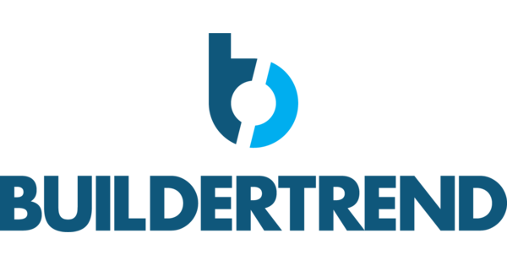











Titanium Sponsors
Platinum Sponsors
Gold Sponsors

Slide 3
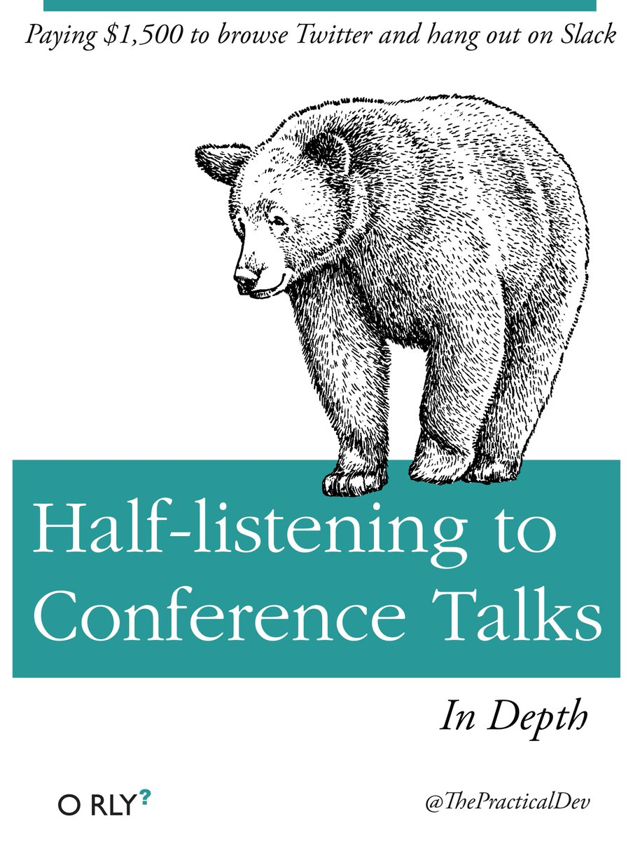

Slide 4

Not everything in JavaScript makes sense…
...not everything has to.

Slide 5


Slide 6


Slide 7

+TDD =

Slide 8


Slide 9
TDD in one poorly drawn picture
Specifications
Code
Tests

Slide 10
TDD in one poorly drawn picture
Specifications
Code
Tests
Specifications
Tests
Code

Slide 11

Characteristics of a unit test

Slide 12
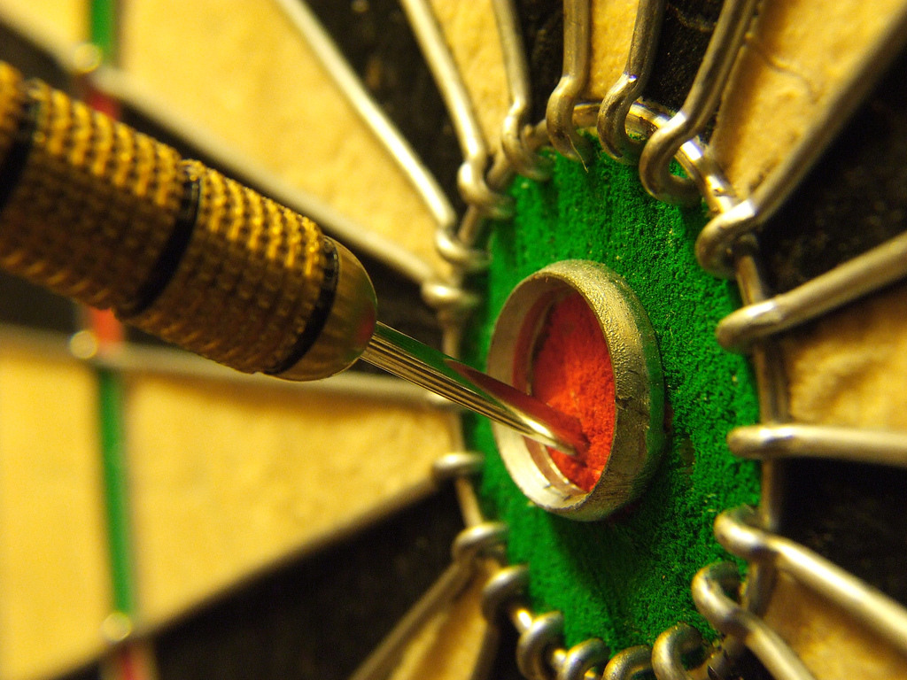
Characteristics of a unit test

Slide 13

Characteristics of a unit test

Slide 14
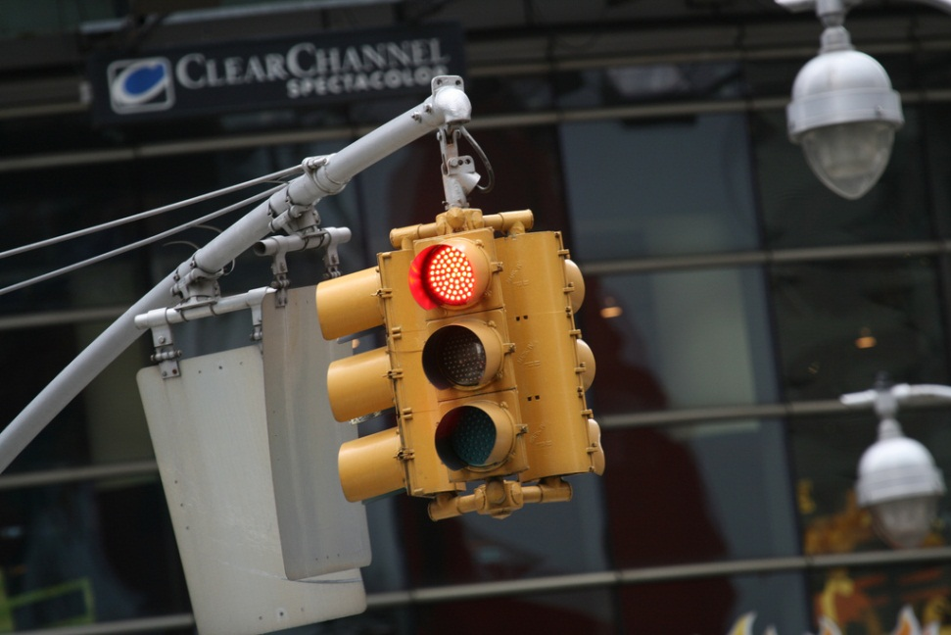
Red, Green, Refactor
Red – Start by writing a failing test
Green – Write just enough code to make test pass
Refactor – Optimize your code for readability, maintainability and quality

Slide 15
When doing TDD, development is slower…
… for the first few sprints.
When not writing tests, development is faster…
… for the first few sprints.

Slide 16

http://facebook.github.io/jest/

Slide 17

Jest

Slide 18
Demo: Tic-Tac-Toe
Create a library to determine the winner of a Tic-Tac-Toe game
Input is a multidimensional (3 X 3) array of string
Results
Returns the winner token (X || O) as a string
Returns an empty String if no winner but moves still available
If the game is a stalemate return an ‘S’

Slide 19
Next Steps
Check out Jasmine and/or Jest
Show the other developers on your team
Try adding test for new features and defects
Watch your code coverage numbers
Practice, practice, practice!

Slide 20
Five Good Reasons Not to Test Your Code
There
Are
No
Good
Reasons

Slide 21

Thank you!
Want to learn more?
github.com/JamesBender
james@jamescbender.com
Twitter: @JamesBender

