Slide 1
Dependency Injection with Ninject

Slide 2
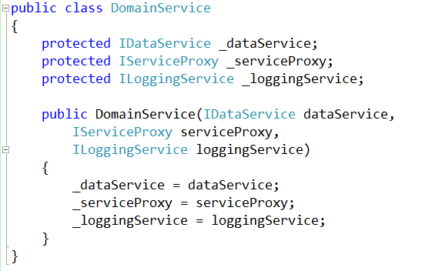
With Dependency Injection

Slide 3

Better….
… but still a lot of work
There are so many dependencies in this system, how do I manage them all?

Slide 8
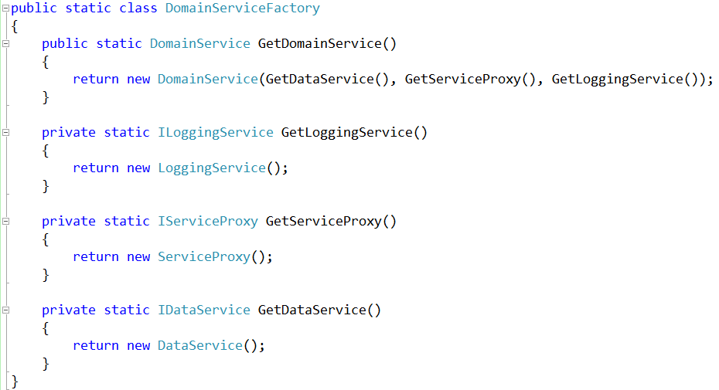
Dependency Injection With a Factory Pattern
Domain Service
“I need to be created, including have all my services crated and given to me.”
Create a
Concrete instance
Object Factory
“ I know how to build all of this stuff.”
Create an
Entity for me
Instance for
application
Application
“I need an Domain Service but I don’t how to create it.”

Slide 9
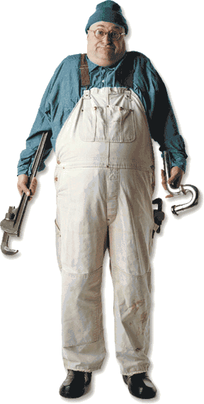
I want to spend my day writing functional business code, NOT being a plumber…

Slide 10
Dependency Injection Frameworks to the Rescue!

Slide 11
With a Dependency Injection Framework
Application
“I need a concrete instance of a Service…”
Domain Service
Database Access Service
Service Proxy
Logging Service
Etc..
Provider
“You tell me what type of object you want, I give you the object you need:”
Kernel
“You ask me for objects, I create them based on the provided mappings and rules”

Slide 12
Some Popular .NET Dependency Injection Frameworks
Structure Map
Ninject
AutoFac
Microsoft Unity

Slide 13
DEMO TIME!

