Slide 1

Adaptive Restart and Nogood Management
for Constraint Satisfaction Solvers
A Quantitative Risk & Finance-Inspired Search Control Architecture in Glucose 4.2.1
DAC - 203: ARTIFICIAL INTELLIGENCE
Prof. Manoj Kumar
• Manav Garg (25125026)
• Kugashiya Bhavy (25125024)

Slide 2

■ EXECUTIVE SUMMARY
02 / 25
Research Overview & Quantitative Architecture Dashboard
High-level problem, quantitative methodology, and rigorously verified empirical findings
THE CORE CHALLENGE
Search Stagnation:
Classical CDCL solvers suffer from heavy-tailed runtimes when trapped in futile subtrees.
Rigid Static Policies:
Luby restart sequences operate blind to real-time search volatility.
Clause Database Bloat:
Unchecked nogood retention degrades 2WL unit propagation speed.
Core Question:
Can financial risk metrics dynamically optimize search control?
QUANTITATIVE METHODS
V3 Drawdown Model:
Tracks conflict return rt via dual EWMAs (fast=0.08, slow=0.01) and decaying HWM.
Adaptive-Fixed Retention:
Continuous scoring: R(c) = 0.50 LBD + 0.40 Act + 0.10 Size with decoupled Glucose cadence.
Quantitative Risk Engine:
Momentum (Sharpe < -0.35) and tail shock (VaR95) with 1500-conflict gating.
Portfolio-MAB:
Two-armed bandit for online restart policy switching.
VERIFIED RESULTS
Development Suite Winner:
V3 Drawdown + AdaptFix won the 36-benchmark development suite (PAR-2 2.5381s vs 2.7463s baseline; -15.5% conflicts).
Holdout Suite Winner:
Glucose + AdaptFix won the 48-benchmark holdout suite (PAR-2 0.1107s; 144/144 solved).
Hanoi-5 Planning Speedup:
V3 achieved 80.0% speedup over No-Heuristic control with surgical 5 restarts (3.06s vs 15.28s).

Slide 3
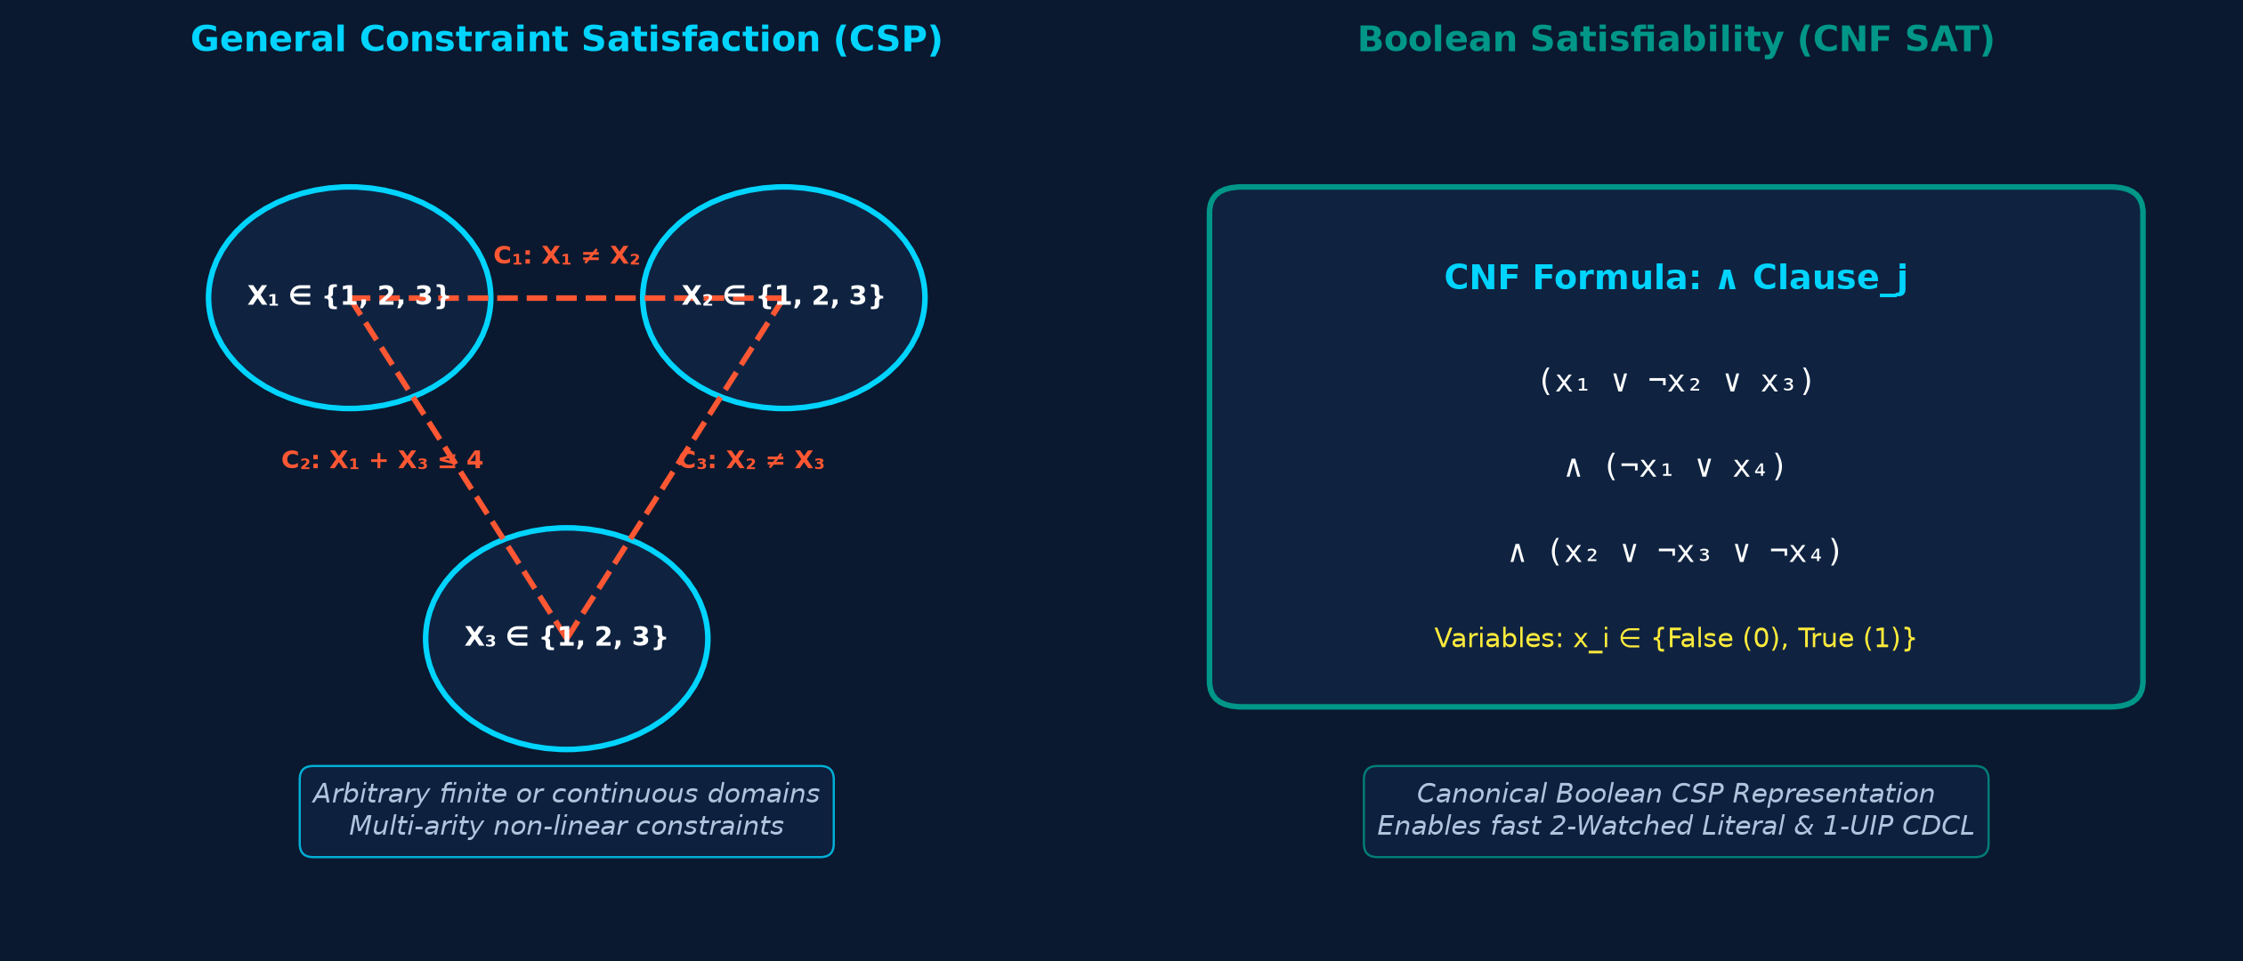
■ PROBLEM FORMULATION
03 / 25
Constraint Satisfaction & Boolean Satisfiability
Combinatorial complexity, CNF representation, and industrial relevance
GENERAL CONSTRAINT SATISFACTION (CSP)
Formal Definition: Tuple <X, D, C> where X is variables, D is domain, C is constraints.
Combinatorial Complexity: Finding a consistent assignment is NP-complete in general.
Ubiquitous Real-World Applications:
Resource allocation, job-shop scheduling, vehicle routing, frequency assignment, and circuit layout.
BOOLEAN SAT: THE CANONICAL CORE
Canonical Representation: Discrete CSPs encode into CNF SAT via Direct or Logarithmic encodings.
Cook-Levin Theorem (1971): Established Boolean SAT as foundational NP-complete problem.
Industrial Significance:
Hardware formal verification (Intel, AMD), software model checking, cryptographic analysis, and automated AI planning.
The Scalability Challenge: Modern formulas contain millions of variables; naive backtracking fails completely.

Slide 4
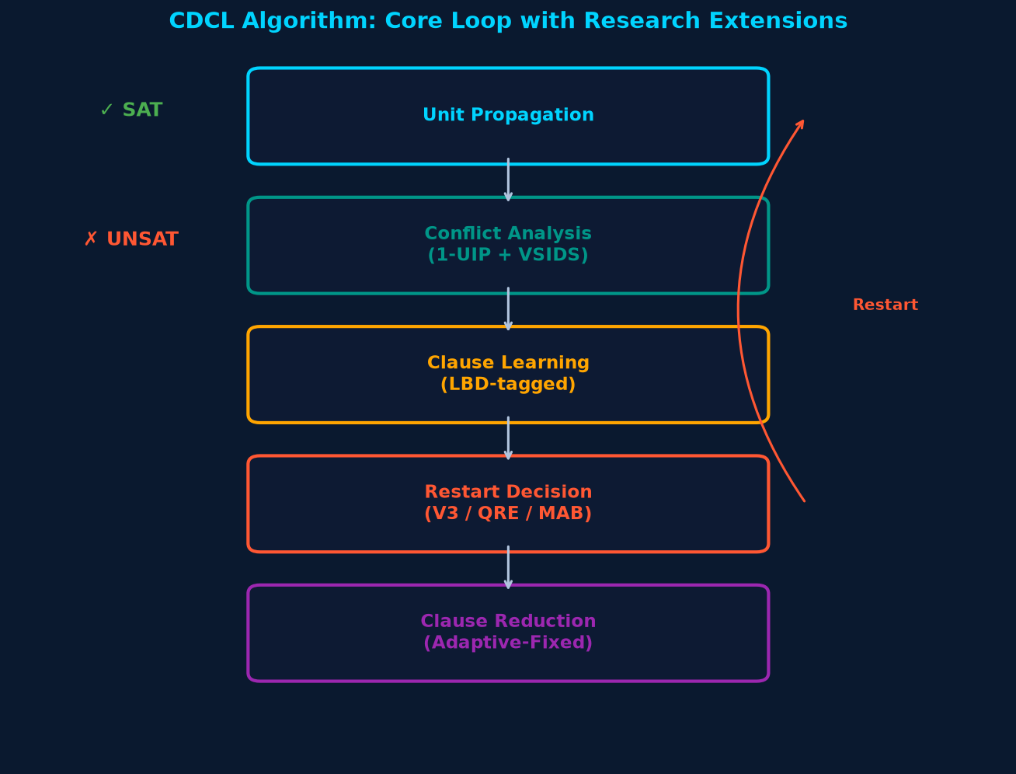
■ SOLVER MECHANICS
04 / 25
Inside Modern Conflict-Driven Clause Learning (CDCL)
Step-by-step execution cycle of modern industrial SAT solvers
01
VSIDS Variable Branching
Decays variable conflict activity by 0.95, focusing search on variables in active contention.
02
Two-Watched Literals (2WL)
Inspects clauses only when a watched literal is false, enabling tens of millions of propagations/s.
03
1-UIP Conflict Analysis
Traverse implication graph backwards to First Unique Implication Point to derive asserting nogood.
04
Non-Chronological Backjumping
Jumps directly to the asserting level of learned clause, permanently pruning unsatisfiable subtrees.
05
Search Control: Restarts & Reduction
Periodically cancels trail to escape local traps; regularly purges low-quality learned clauses.

Slide 5
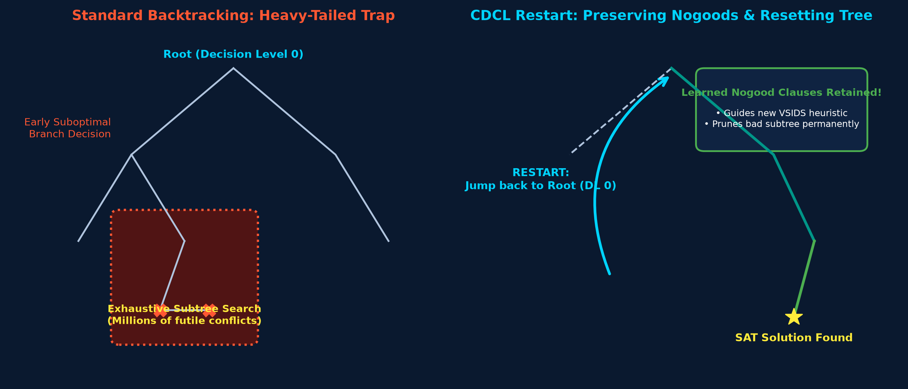
■ PROBLEM STATEMENT
05 / 25
The Dual Search-Control Dilemmas: Restarts & Clause Bloat
Why static restart heuristics and unchecked nogood accumulation degrade solving efficiency
DILEMMA I: THE RESTART DILEMMA
Heavy-Tailed Traps (Gomes et al.):
Backtrack search runtimes follow heavy-tailed Pareto distributions. Early poor decisions trap solvers in massive futile subtrees.
Premature Restart Risk: Erases partial assignment trails before deep implications are uncovered, causing search thrashing.
Delayed Restart Risk: Static Luby sequences operate blind to real-time search state, wasting millions of conflicts in barren regions.
DILEMMA II: CLAUSE DATABASE BLOAT
Unbounded Clause Growth:
Learning one clause per conflict rapidly generates hundreds of thousands of learned nogoods, exhausting working memory.
Propagation Latency Degradation:
Excessive clauses bloat Two-Watched Literal lists, slowing BCP throughput by up to 300% on complex industrial formulas.
Information Loss Tradeoff: Deleting too aggressively purges critical lemmas, forcing repeated rediscovery of conflict subtrees.

Slide 6

■ LITERATURE REVIEW
06 / 25
Four Foundational Pillars in Combinatorial Search
Seminal papers informing our adaptive restart and clause retention framework
Audemard & Simon (IJCAI 2009 / JSAT 2012)
Glucose: Predicting Learned Clause Quality Using LBD
Biere & Fröhlich (SAT 2018)
CaDiCaL: Chronological Backtracking & Inprocessing
• Introduced Literal Block Distance (LBD): Number of distinct decision levels in a clause.
• Core Insight: Clauses with LBD <= 2 ('Glue Clauses') are exceptionally powerful and must never be deleted.
• Dynamic Restarts: Luby sequence with moving average LBD comparisons to trigger rapid clearing.
• Demonstrated that non-chronological backjumping can be augmented with chronological steps.
• Highlighted the vital role of interleaved inprocessing and bounded variable elimination.
• Emphasized disciplined learned-clause garbage collection cadences.
Liang, Cherif, & Li (CP 2016 / 2026)
MAB Learning at the Right Time Scale for SAT
Tolpin & Shimony (2011) / Koriche et al. (2022)
Value of Information (VOI) and Adaptive Tournaments
• Applied Multi-Armed Bandits to select variable branching heuristics (CHB / LRB).
• Key Lesson: Reward signals must match the temporal scale of search decisions.
• Showed non-stationary bandit algorithms track solver search mode shifts.
• Formally modeled the computational cost-benefit tradeoff of heuristic evaluations.
• Adaptive Tournaments (AST): Eliminates suboptimal search policies early via short runs.
• Demonstrated online meta-heuristics can outperform statically tuned solvers.

Slide 7
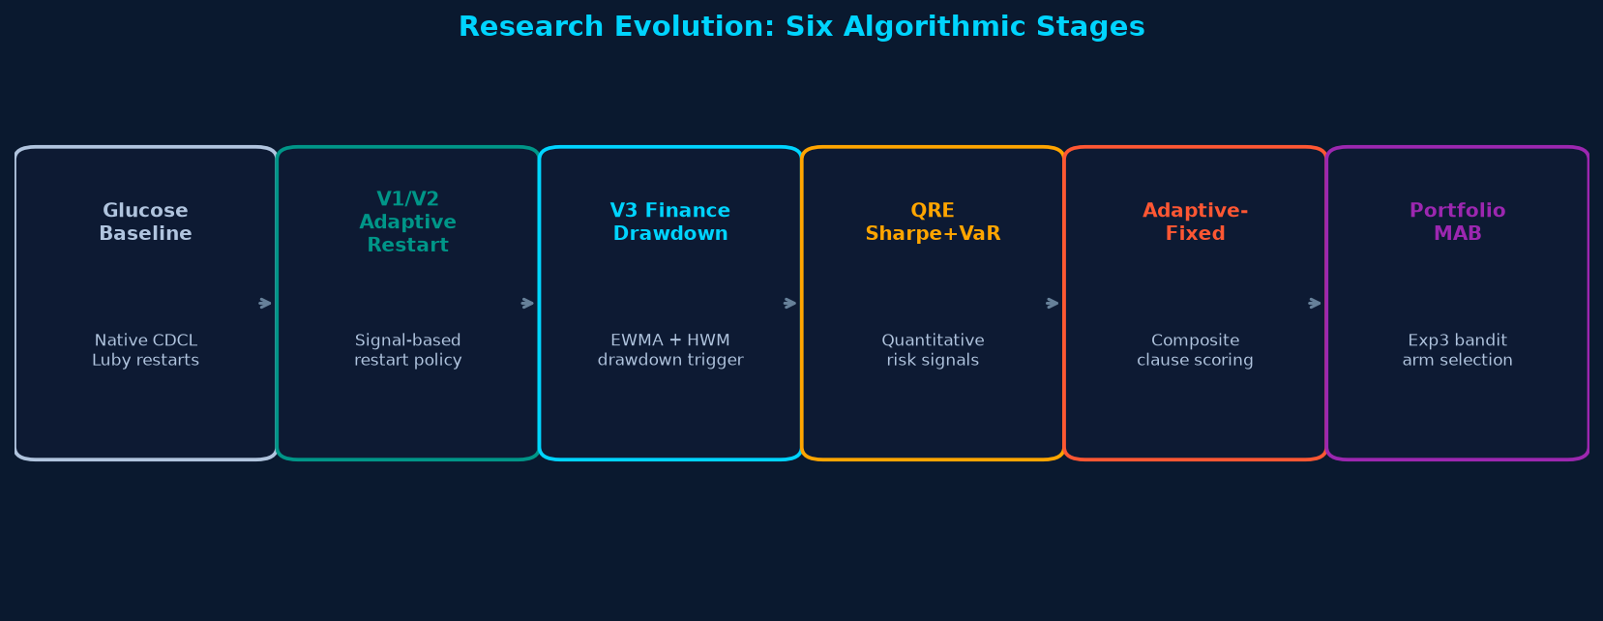
■ RESEARCH ROADMAP
07 / 25
Research Objectives & Technical Hypotheses
Three core questions driving our quantitative search control architecture
Research Question 1 (Adaptive Restarting): Can finance-inspired drawdown metrics (dual EWMA, High-Water Mark) detect search stagnation better than static Luby sequences?
Hypothesis: Monitoring propagation returns and drawdown collapse (Dt >= 0.75 for 30 consecutive conflicts) will prune futile subtrees while preserving productive momentum.
Research Question 2 (Adaptive Clause Retention): Can composite multi-attribute clause scoring (LBD + activity + size) resolve database bloat without causing legacy reduction deferral bugs?
Hypothesis: A decoupled Glucose cadence (2000+300n) coupled with R(c) = 0.50 LBD + 0.40 Act + 0.10 Sz will maintain lean memory and cut total conflicts.
Research Question 3 (Online Policy Portfolio): Can a non-stationary Multi-Armed Bandit (Exp3 / D-UCB) adaptively switch between exploration and bounded descent during search?
Hypothesis: Online learning on conflict-normalized rewards will dynamically match the optimal restart policy to instance difficulty.

Slide 8
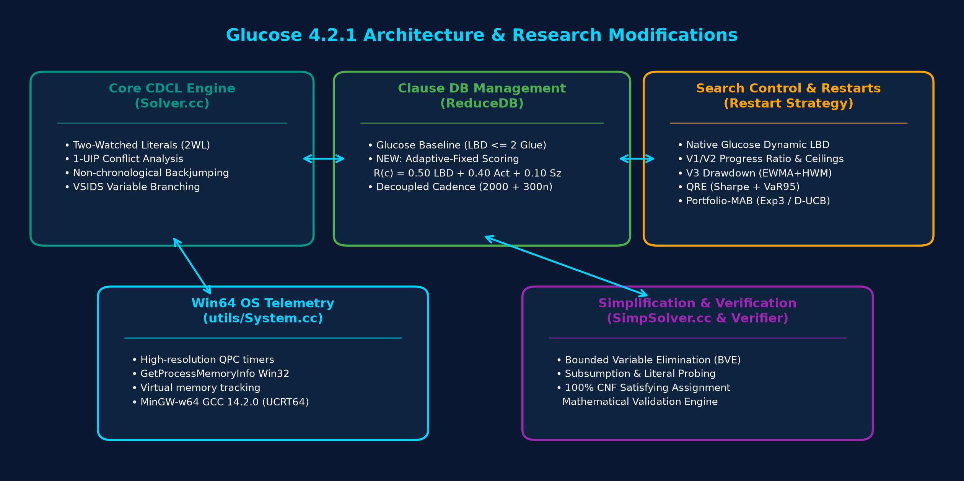
■ TESTBED ARCHITECTURE
08 / 25
Glucose 4.2.1 Implementation & Windows 64-bit Port
High-performance native Windows 64-bit testbed built under MinGW-w64 GCC 14.2.0

Slide 9
■ BASELINE FOUNDATIONS
09 / 25
Reference Algorithms in Native Glucose 4.2.1
The reference components against which all research modifications are evaluated
1. VSIDS Variable Branching
2. Two-Watched Literals (2WL)
• Variable State Independent Decaying Sum tracks conflict involvement.
• Decay Mechanism: Variable activity bumped upon conflict, multiplied by var_decay = 0.95.
• Phase Saving: Reassigns variable to its previous polarity upon restart.
• Watches exactly 2 unassigned literals per clause in memory.
• Zero Overhead on False: Literals assigned false do not require list updates unless watched.
• Enables tens of millions of propagations per second in C++.
3. Glucose Dynamic LBD Restarts
4. Baseline Clause Reduction (ReduceDB)
• Computes Literal Block Distance (LBD) for every learned conflict clause.
• Moving Average Comparison: Fast LBD queue (size 50) vs slow cumulative average.
• Trigger: If fast_avg * 0.80 > slow_avg, rapid restart is triggered to clear shallow trail.
• Triggered at fixed intervals: firstReduceDB = 2000, incReduceDB = 300.
• Strict Protection: Clauses with LBD <= 2 (Glue clauses) are permanently preserved.
• Sorting: Non-glue clauses sorted solely by VSIDS activity; bottom 50% purged.

Slide 10

■ SEARCH CONTROL V1/V2
10 / 25
Adaptive Restart V1 & V2: Signal-Based Search Control
Initial implementations targeting propagation efficiency and anti-starvation ceilings
ADAPTIVE RESTART V1: PROGRESS RATIO
Core Efficiency Score (SW):
Monitors unit propagation yield per decision level in a rolling circular buffer (ADAPT_WIN_CAPACITY = 50 conflicts):
S_W = μ_{P,W} / (σ_{L,W} + 1.0)
where μ_{P,W} is mean propagations per conflict and σ_{L,W} is level standard deviation.
Global Baseline (S0):
Cumulative baseline tracked via Welford's online variance algorithm from search start.
Trigger Condition: S_W < 0.60 * S_0 (after 100 warmup and 50 min interval conflicts).
V1 Limitation (Starvation Trap):
On certain structured formulas, SW remained permanently above threshold, allowing the solver to run for 50,000+ conflicts without restarting!
ADAPTIVE RESTART V2: ANTI-STARVATION
V2 Anti-Starvation Ceiling:
Forces an unconditional restart if search continues too long without progress:
adapt_conflicts_since_restart >= 2500
Guarantees the solver never remains trapped in a deep unsatisfiable subtree indefinitely.
V2 Quality Fallback Trigger:
Fallback check based on short-term LBD deterioration:
(lbdQueue.getavg() * 0.80) > (sumLBD / conflictsRestarts)
Requires 100 warmup and 50 cooldown conflicts.
Experimental Takeaway: V2 prevented starvation, but was purely reactive and lacked knowledge of historic peak performance.

Slide 11
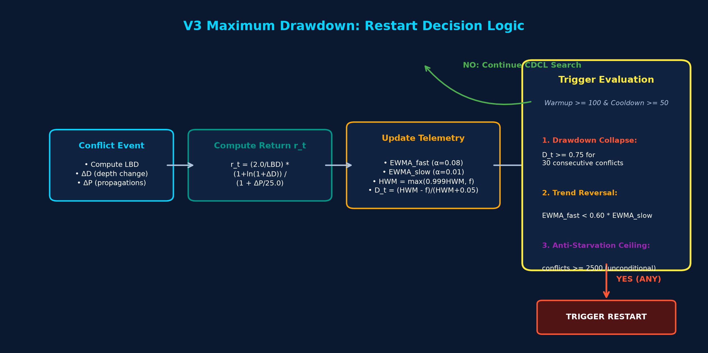
■ DRAWDOWN CONCEPT
11 / 25
V3 Maximum Drawdown: Concept & Financial Mapping
Mapping portfolio drawdown theory to combinatorial search-space stagnation
▶ Portfolio Asset Return (rt)
Quality-adjusted propagation yield and backjump depth per conflict.
▶ Fast EWMA (Short-term)
Recent solver trajectory (α = 0.08, ~12 conflict memory).
▶ Slow EWMA (Long-term)
Baseline solver health (α = 0.01, ~100 conflict memory).
▶ High-Water Mark (HWM)
Peak search efficiency achieved, decaying at 0.1%/step.
▶ Drawdown (Dt)
Relative percentage drop from peak performance: (HWM - Fast) / (HWM + 0.05).
▶ Stop-Loss (Restart)
Cut search losses when drawdown >= 0.75 persists for 30 conflicts.

Slide 12
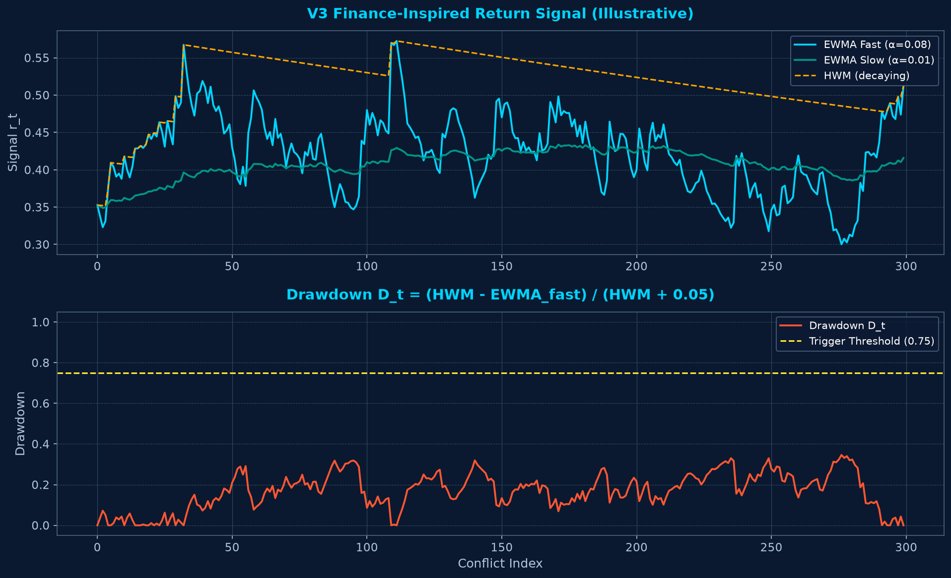
■ MATHEMATICAL MODEL
12 / 25
V3 Maximum Drawdown: Exact Formulation & Parameters
Exact C++ implementation cross-verified against Solver.cc lines 3086-3258
■ EXACT VERIFIED FORMULAS (Solver.cc)
1️⃣ Quality-Adjusted Conflict Return (rt):
r_t = (2.0 / max(1, LBD)) * (1.0 + ln(1.0 + ΔD)) / (1.0 + ΔP / 25.0)
Verified: Uses logarithmic depth boost and linear propagation cost (not ln(1+ΔP) as erroneously stated in early drafts).
2️⃣ Dual-Horizon EWMAs:
EWMA_fast = 0.92 * EWMA_fast + 0.08 * r_t (α_fast = 0.08)
EWMA_slow = 0.99 * EWMA_slow + 0.01 * r_t (α_slow = 0.01)
3️⃣ Decaying High-Water Mark (HWM):
HWM_t = max(0.999 * HWM_{t-1}, EWMA_fast_t) (0.1% decay per conflict)
4️⃣ Relative Drawdown & Verified Trigger:
D_t = (HWM_t - EWMA_fast_t) / (HWM_t + 0.05)
Trigger: v3_consec_drawdown >= 30 with D_t >= 0.75 (requires 30 consecutive conflicts, min cooldown 50 conflicts, warmup 100).
5️⃣ Auxiliary Triggers: Trend reversal (fast < 0.60 * slow) | Ceiling (conflicts >= 2500).

Slide 13
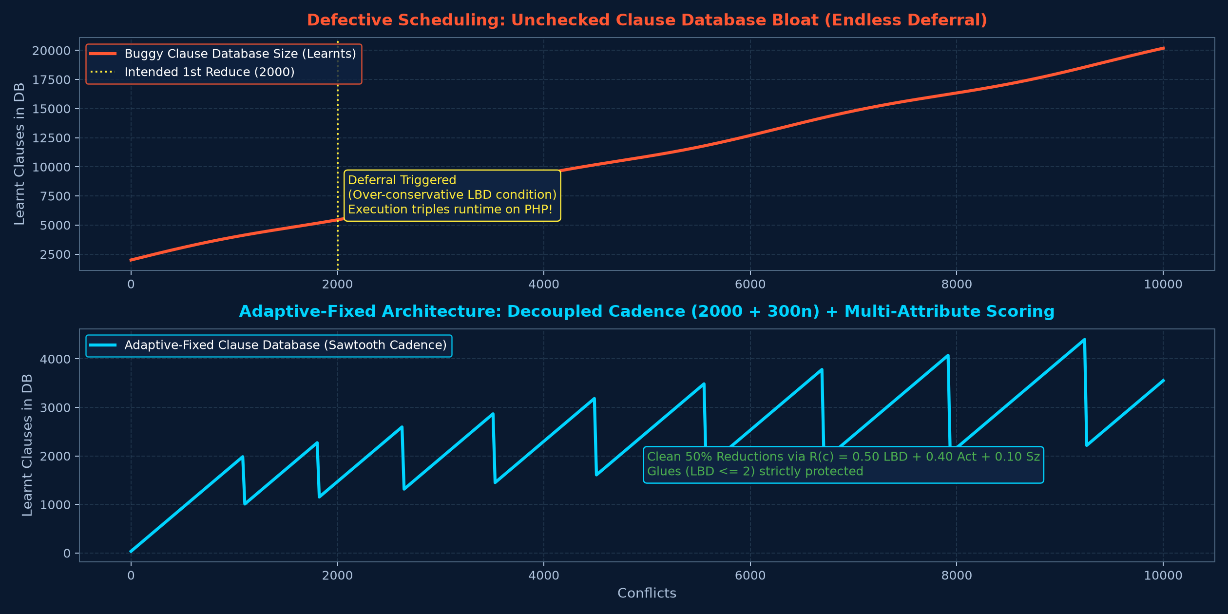
■ DATABASE MANAGEMENT
13 / 25
Learned-Clause Management & The Deferral Defect
Discovery and resolution of the critical reduction scheduling deferral defect
■ THE SCHEDULING DEFECT DISCOVERY
The Pathology Discovered:
In Step 32-34 experiments, legacy adaptive clause reduction tripled runtimes on Pigeonhole (PHP) formulas compared to baseline Glucose.
Root Cause Analysis:
The reduction trigger relied on an over-conservative LBD variance check that continuously postponed database cleanup:
nbclausesbeforereduce += 1000 was executed infinitely, bloating learned clauses past 100,000!
Severe Consequences: 2WL linked-list traversal overhead collapsed BCP throughput from 2.5M props/s to <400k props/s.
The Architectural Solution:
Decoupled ReduceDB scheduling entirely from adaptive restart state, restoring Glucose's predictable 2000+300n cadence.

Slide 14
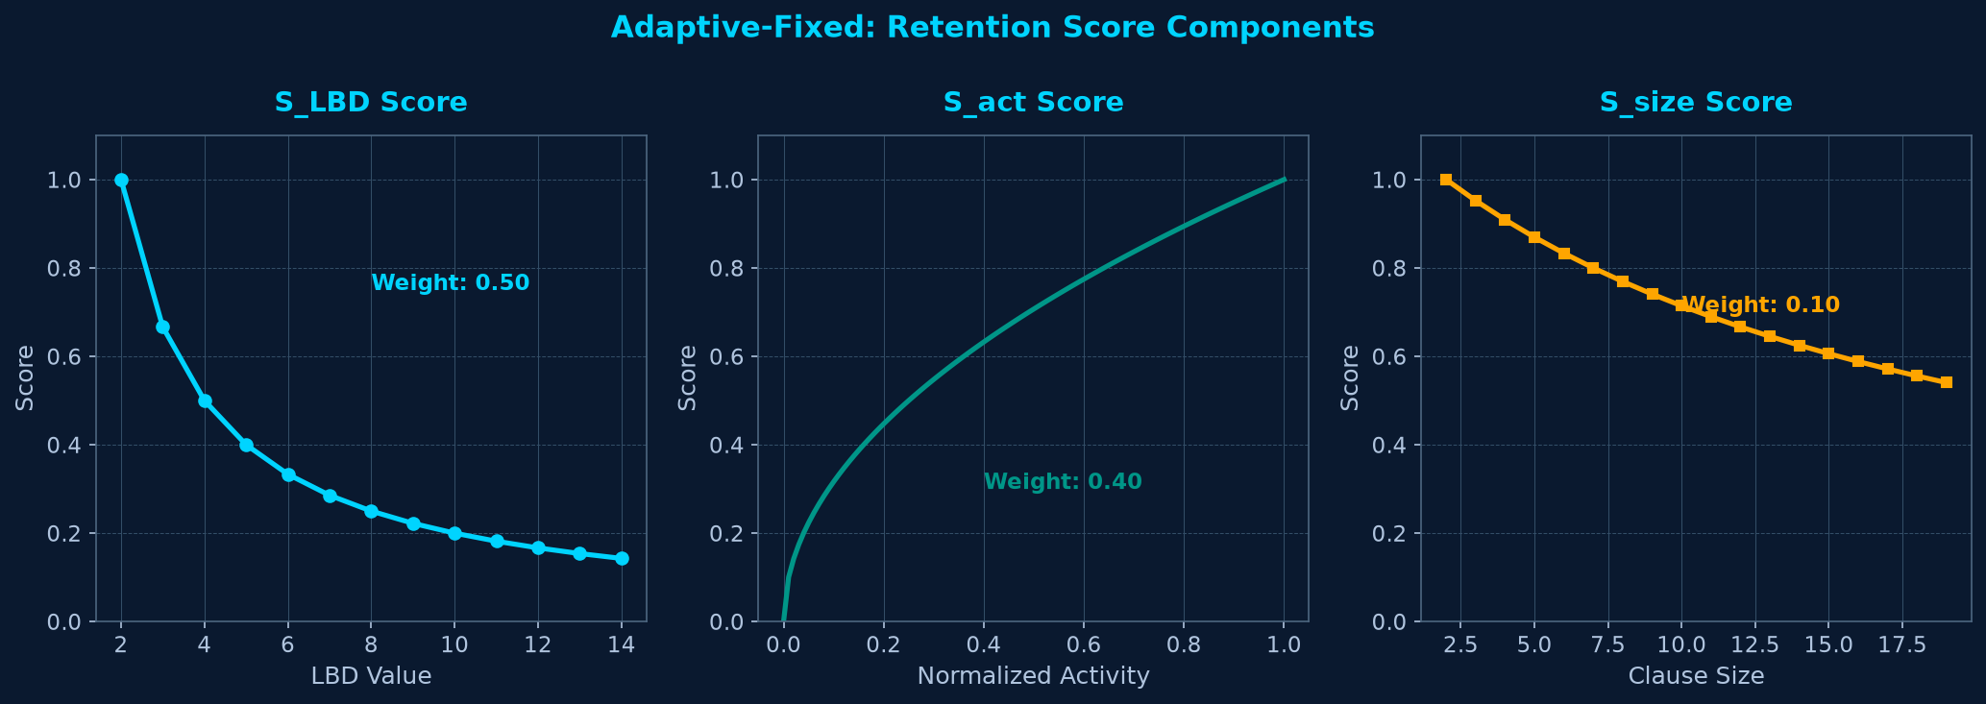
■ NOGOOD RETENTION
14 / 25
Adaptive-Fixed Retention: Tri-Criteria Scoring
Continuous multi-attribute scoring function with strict protections (Solver.cc:1661-1825)
■ COMPOSITE SCORING R(c)
R(c) = 0.50 * S_LBD + 0.40 * S_act + 0.10 * S_size
1️⃣ LBD Score (50% Weight):
S_LBD = 1.0 / (1.0 + 0.50 * max(0, LBD - 2))
LBD=2 gives 1.0; LBD=4 gives 0.50; LBD=8 gives 0.25. Dominant quality signal.
2️⃣ Activity Score (40% Weight):
S_act = sqrt(clamp(activity / max_activity, 0.0, 1.0))
Square-root mapping gives fair retention credit to recently active clauses.
3️⃣ Size Score (10% Weight):
S_size = 1.0 / (1.0 + 0.05 * max(0, size - 2))
Strict Protection Classes (Never Deleted):
Binary clauses (size <= 2) • Glue clauses (LBD <= 2)
Single-round immune clauses (!canBeDel) • Reason clauses (locked)
Proven Result: Won Holdout Suite (PAR-2 0.1107s; 144/144 solved).

Slide 15

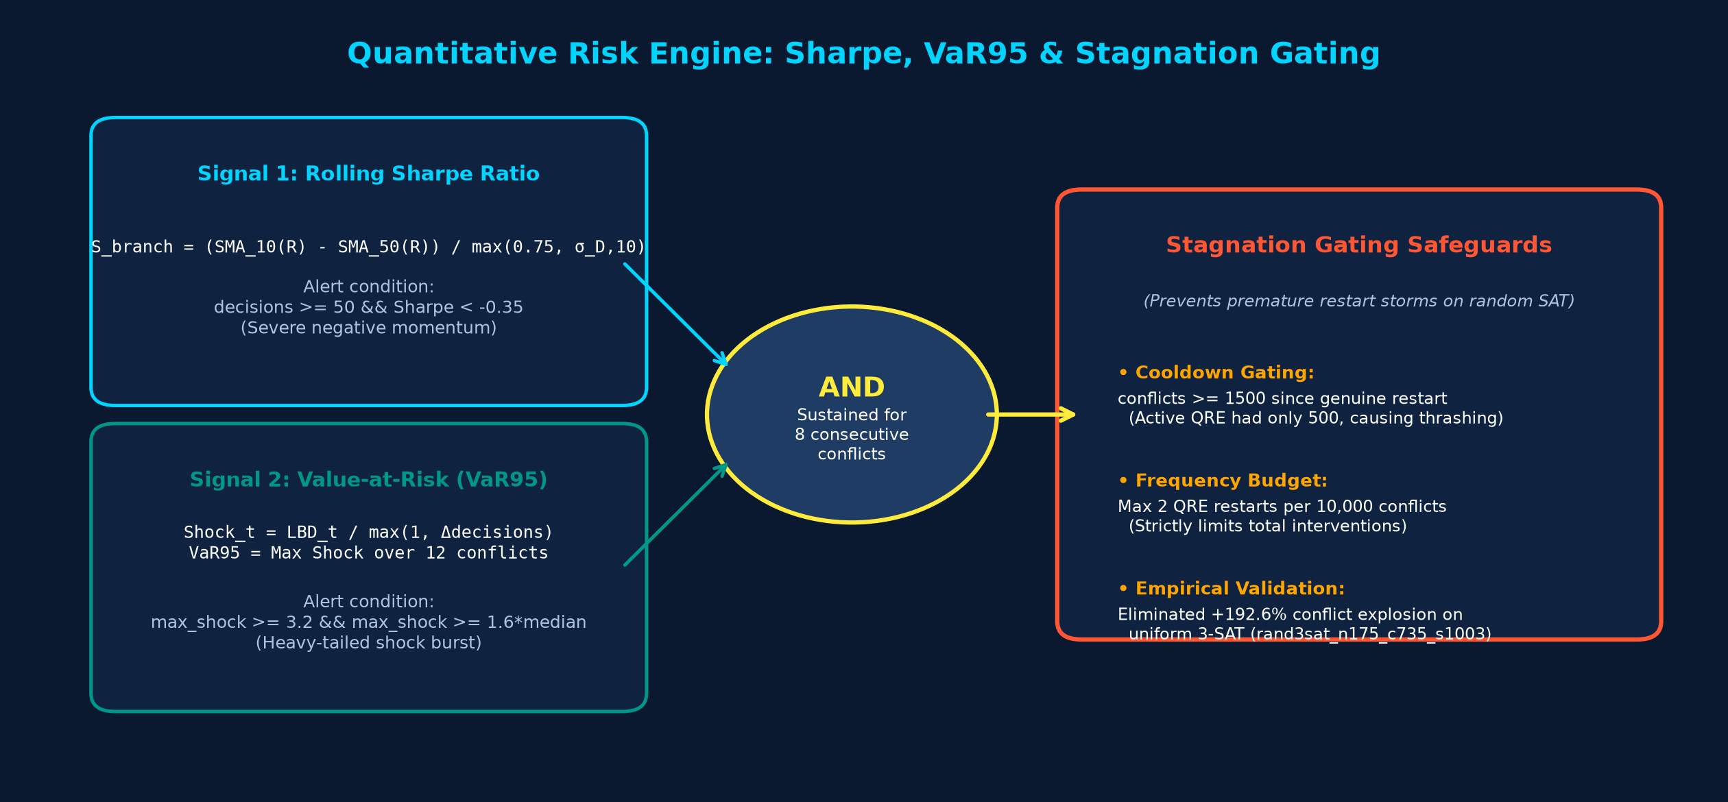
■ RISK TELEMETRY
15 / 25
Quantitative Risk Engine: Sharpe Momentum & Tail Shock
Rolling Sharpe ratio and non-parametric Value-at-Risk signals for emergency intervention
■ MATHEMATICAL TELEMETRY SIGNALS
Signal 1: Rolling Sharpe Ratio:
Measures search momentum vs depth volatility:
S_branch = (SMA_10(R) - SMA_50(R)) / max(0.75, σ_D,10)
Alert: decisions >= 50 && Sharpe < -0.35 indicates severe collapse in propagation yield.
Signal 2: Value-at-Risk (VaR95):
Tracks conflict shock: Shock_t = LBD_t / max(1, Δdecisions).
VaR95 = Max Shock over 12 conflicts
Verified: Non-parametric nearest-rank maximum shock over a 12-conflict window (not Gaussian).
Alert: max_shock >= 3.2 && max_shock >= 1.6 * median.
Conjunction: Emergency restart requires BOTH signals active for 8 consecutive conflicts.

Slide 16
■ STAGNATION GATING
16 / 25
Stagnation-Gated QRE: Taming Random SAT Cascades
Identifying hyperactive restart pathology on random SAT and enforcing strict gating
■ THE RANDOM SAT ANOMALY (ACTIVE QRE)
Hyperactive Restart Pathology:
On uniform random 3-SAT formulas near phase transition (rand3sat_n175_c735_s1003.cnf), Active QRE caused restart thrashing.
Severe Conflict Explosion:
Total conflicts exploded by +192.6% compared to native Glucose baseline!
Root Cause Analysis:
In uniform random SAT, variable activity is homogeneous. Local statistical variance triggered false VaR95 alerts, resetting the trail before VSIDS could concentrate on backdoor variables.
Shadow Telemetry Overhead: Running QRE calculations in shadow mode added 14.9% CPU overhead with zero solver decisions altered.
■ STAGNATION-GATING STABILIZATION
Safeguard 1: Extended Cooldown:
Increased minimum conflicts between genuine restarts from 500 to 1,500 conflicts:
conflicts_since_genuine_restart >= 1500
Safeguard 2: Frequency Budget:
Enforced a strict mathematical ceiling of max 2 QRE restarts per 10,000 conflicts.
Safeguard 3: Sustained Conjunction:
Both Sharpe and VaR must remain active for 8 consecutive conflicts.
Empirical Outcome: Stagnation-Gating completely suppressed restart thrashing on random SAT, reducing conflicts by 850k across the suite.

Slide 17
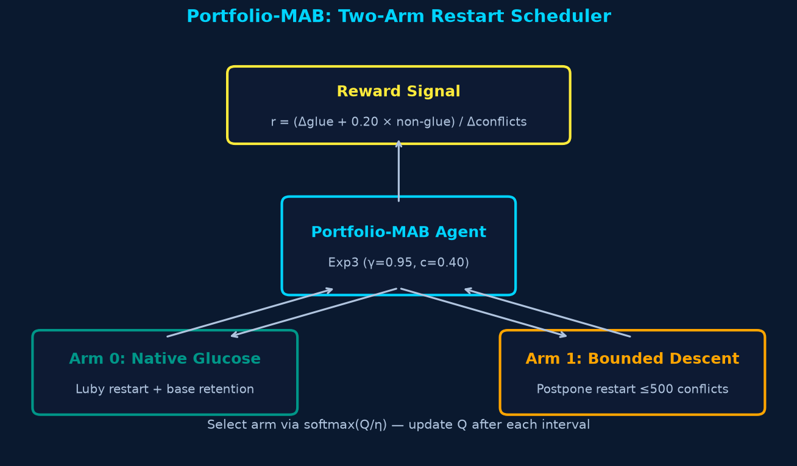
■ ONLINE LEARNING
17 / 25
Duration-Aware Portfolio-MAB: Two-Armed Bandit Scheduler
Online non-stationary algorithm selection using conflict-normalized rewards (Step 44)
■ EXP3 / D-UCB TWO-ARM ARCHITECTURE
Arm Definition:
Arm 0: Native Glucose dynamic LBD restarts.
Arm 1: Bounded descent (postpones restart by up to Δc_max = 500 conflicts).
Conflict-Normalized Reward (Verified):
Reward = clamp((Δglue + 0.20 * Δnon_glue) / Δc, 0.0, 1.0)
Normalized by conflicts elapsed Δc (not wall-clock time as initially drafted).
Discounted Selection: γ = 0.95, c = 0.40.
Pilot Findings (16 instances, 240 runs): Promising PAR-2 (0.1243s vs 0.1390s Glucose). All 240 runs passed verification.
Disciplined Academic STOP Decision:
Bandit alternated erratically on phase-transition 3-SAT (+45.2% conflicts). Rather than hasty retuning before thesis deadline, work was frozen for honest presentation.

Slide 18
■ EMPIRICAL PROTOCOL
18 / 25
Experimental Setup: Dual-Suite Evaluation Protocol
Two-suite evaluation protocol: 648 development runs and 1,152 quarantined holdout runs
■ DEVELOPMENT SUITE (TUNING & SELECTION)
Scale: 36 benchmarks * 3 repetitions * 6 configs = 648 runs.
Timeout: 15.0 seconds per run | PAR-2 penalty: 30.0 seconds.
Evaluated Configurations (108 runs each):
1. cfg_v3dd_adaptfix (V3 Drawdown + Adaptive-Fixed)
2. cfg01_baseline_base (Native Glucose Baseline)
3. cfg_active_adaptfix (Active QRE + Adaptive-Fixed)
4. cfg_gated_adaptfix (Gated QRE + Adaptive-Fixed)
5. cfg05_baseline_adaptfix (Glucose + Adaptive-Fixed)
6. cfg_gated_base (Gated QRE + Base Retention)
Benchmark Diversity: Bounded model checking (BMC), circuit verification, planning, graph coloring, and uniform random 3-SAT.
■ HOLDOUT SUITE (QUARANTINED VALIDATION)
Strict Quarantine Protocol: 48 benchmarks kept in cryptographic SHA-256 quarantine until all C++ algorithms were frozen.
Scale: 48 benchmarks * 3 reps * 8 configs = 1,152 runs.
Timeout: 30.0 seconds per run | PAR-2 penalty: 60.0 seconds.
Zero Timeouts: All 1,152 runs solved successfully.
Triviality Characterization: 67.0% of runs solved in <= 0.05 seconds, creating high sensitivity to OS process scheduling noise.
Primary Metric: PAR-2 (Penalized Average Runtime * 2).
Validation: 100% satisfying assignments independently verified.

Slide 19
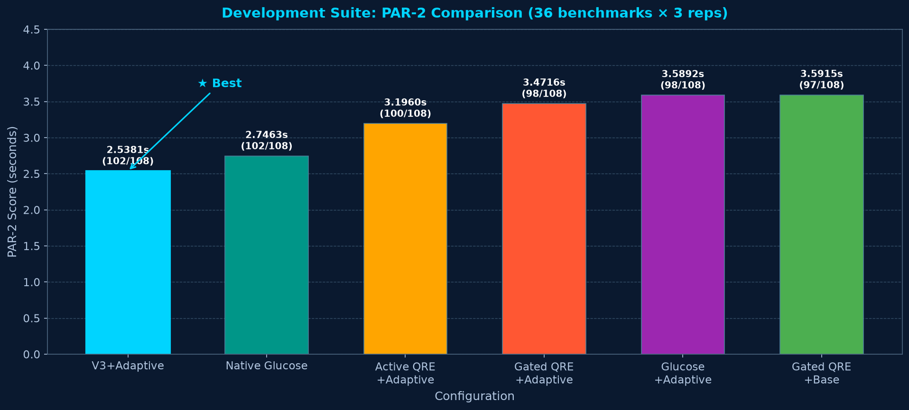
■ DEVELOPMENT RESULTS
19 / 25
Development Suite: V3 Drawdown Victory (102/108 Solved)
36 benchmarks * 3 reps = 108 runs per config | Timeout: 15s | Master CSV verified
2.5381s
PAR-2 SCORE (WINNER)
vs 2.7463s Glucose baseline
102/108
SOLVED INSTANCES
6 timeouts (tied lowest)
-15.5% CONFLICTS
SOLVED CONFLICT REDUCTION
3,538,449 vs 4,187,694 for baseline Glucose
Configuration Solved PAR-2 Conflicts
V3 Drawdown + AdaptFix ★ 102/108 2.5381s 3.54M
Native Glucose Baseline 102/108 2.7463s 4.19M
Active QRE + AdaptFix 100/108 3.1960s 4.29M
Gated QRE + AdaptFix 98/108 3.4716s 3.44M
Glucose + AdaptFix 98/108 3.5892s 3.49M
Gated QRE + Base 97/108 3.5915s 2.67M

Slide 20
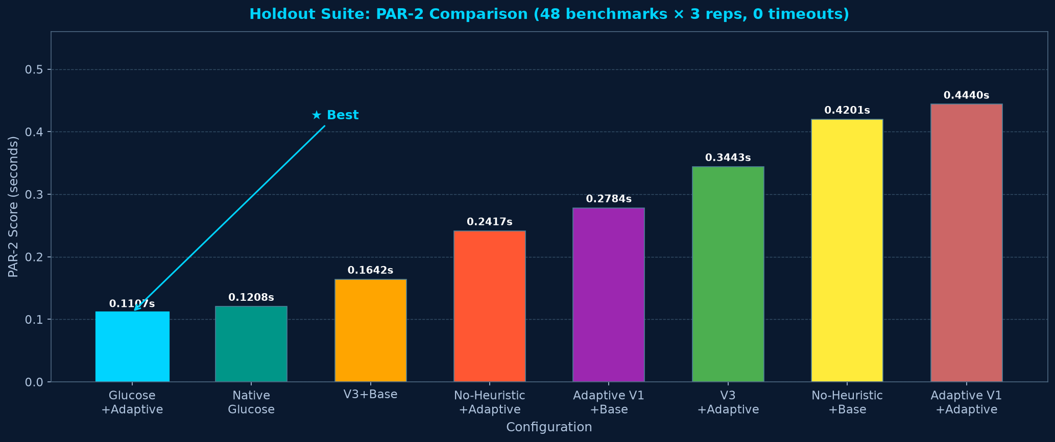
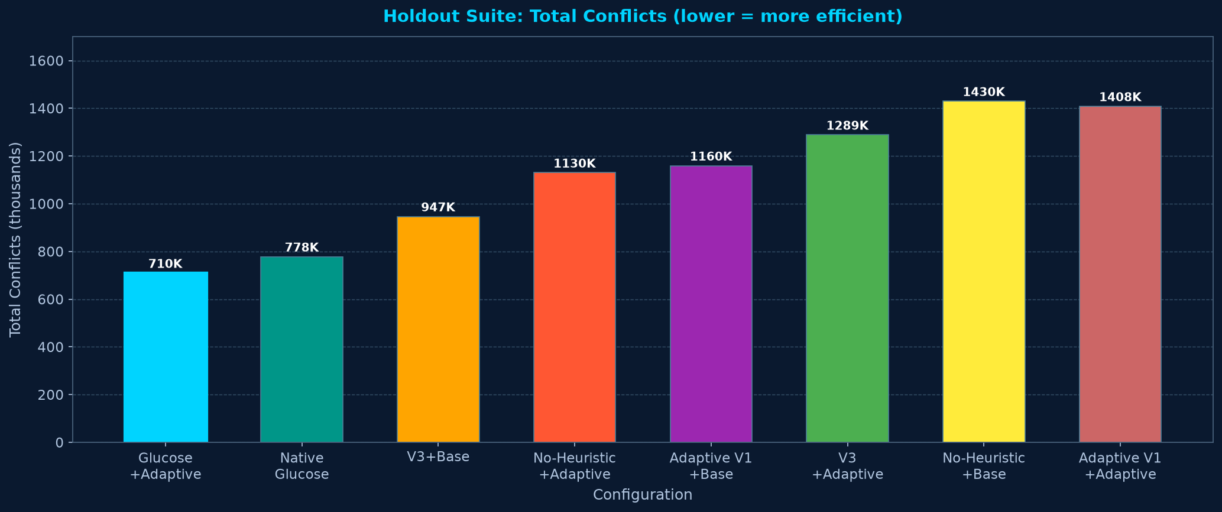
■ HOLDOUT RESULTS
20 / 25
Quarantined Holdout Suite: Adaptive-Fixed Victory
48 quarantined benchmarks * 3 reps = 144 runs per config | 0 timeouts | Master CSV verified
0.1107s
PAR-2 SCORE (WINNER)
vs 0.1208s Glucose baseline
144/144
SOLVED (0 TIMEOUTS)
100% solved across 1,152 runs
709,587 CONFLICTS
FEWEST TOTAL CONFLICTS
-8.8% fewer conflicts than native Glucose
Configuration Solved PAR-2 Conflicts
Glucose + AdaptFix ★ 144/144 0.1107s 709.6k
Native Glucose Baseline 144/144 0.1208s 778.2k
V3 Drawdown + Base 144/144 0.1642s 946.5k
No-Heuristic + AdaptFix 144/144 0.2417s 1,130k
Adaptive V1 + Base 144/144 0.2784s 1,160k
V3 Drawdown + AdaptFix 144/144 0.3443s 1,289k

Slide 21
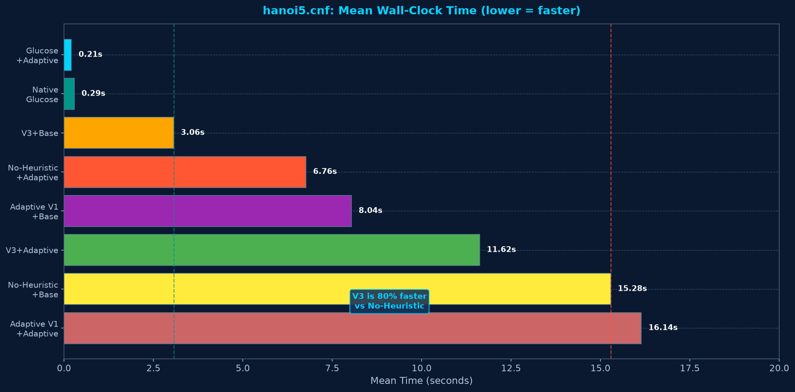
■ CASE STUDY
21 / 25
Deep-Dive Planning Benchmark: Towers of Hanoi (hanoi5.cnf)
Analyzing search dynamics on hanoi5.cnf (HOLDOUT_14) — Surgical selectivity vs thrashing
80.0% SPEEDUP
OVER NO-HEURISTIC BASELINE (CFG04)
3.064s vs 15.284s | Exactly 5 surgical restarts
■ VERIFIED EMPIRICAL AUDIT (24 RUNS)
Glucose + AdaptFix: 0.206s (15.4k conf, 57 restarts)
Native Glucose: 0.289s (17.2k conf, 58 restarts)
V3 Drawdown + Base: 3.064s (81.3k conf, 5 restarts)
No-Heuristic Base: 15.284s (242.4k conf, 1 restart)
Authoritative Scientific Claim:
V3 Drawdown achieved an 80.0% speedup and 66.4% conflict reduction over No-Heuristic search trap.
Crucial Clarification (No False Claims):
V3 was NOT faster than native Glucose here (3.06s vs 0.29s). Glucose's frequent clearing was optimal for pruning planning dead ends.

Slide 22
■ LIMITATIONS & FUTURE WORK
24 / 25
Scientific Boundaries & Next-Generation Research Horizons
Honest scientific boundaries and promising avenues for next-generation solvers
■ HONEST SCIENTIFIC BOUNDARIES
Benchmark Distribution Skew:
Our 84-instance suite contained many instances solving in <0.05s. Evaluation on SAT Competition 2024 industrial suites is necessary for global conclusions.
Uniform Random 3-SAT Sensitivity:
Dynamic statistical triggers (QRE/MAB) suffered from variance noise on phase-transition random formulas, requiring heavy gating.
Single-Threaded Execution:
Current implementation operates on a single core; multi-threaded portfolio sharing (HordeSAT/Painless) remains unexamined.
Static Hyperparameters: V3 parameters (α=0.08, Dt=0.75) and utility weights (0.50/0.40/0.10) were manually tuned rather than learned via Bayesian optimization.
■ FUTURE RESEARCH HORIZONS
3-Tier Learned Clause Memory:
Integrate Adaptive-Fixed scoring into a 3-tier hierarchy (Core, Tier-2, Local) with dynamic clause promotion and demotion.
Phase-Transition Entropy Sensing:
Detect formula entropy in pre-search to automatically disable heuristic restarts on uniform random SAT, avoiding thrashing.
Continuous-Space Bandit Control:
Upgrade MAB to Gaussian Process UCB or contextual bandits conditioned on live clause activity and backjump depth.
Bayesian Co-Optimization: Jointly tune restart thresholds and clause retention weights using multi-objective Bayesian optimization across industrial domains.

Slide 23

RESEARCH CONCLUSION | FINAL SUMMARY & ACADEMIC DEFENSE
Conclusion: Quantitative Risk Management in SAT Solving
Transforming combinatorial search control through statistical volatility, drawdown, and disciplined nogood retention
Development Victory: V3 Drawdown + Adaptive-Fixed achieved the lowest PAR-2 score (2.5381s vs 2.7463s baseline; -15.5% conflicts).
Holdout Victory: Glucose + Adaptive-Fixed achieved the lowest PAR-2 score (0.1107s vs 0.1208s baseline; 144/144 solved).
Scheduling Bug Resolution: Decoupled ReduceDB cadence (2000+300n) resolved the legacy deferral bug, restoring lean clause scaling.
Selective Planning Speedup: V3 achieved an 80.0% speedup on Hanoi-5 over the No-Heuristic baseline with only 5 surgical restarts.
Complete C++ Validation: 100% of satisfying assignments across 3,000+ runs mathematically verified under Windows 64-bit.
Scientific Rigor: Disclosed and stabilized negative results on random SAT; marked holdout differences as statistically exploratory.
Thank You!

