Slide 1
AI Compiler
From Graph IR to Hardware Binary
2026

Slide 2
Agenda
Part 1 — IR Fundamentals
Part 2 — Production Deployment
• Computation Graph & DAG
• Shape Inference
• Constant Folding
• Algebraic Simplification
• Common Subexpression Elimination (CSE)
• Dead Code Elimination (DCE)
• Pass Summary
• W8A16 Quantization (motivation + math)
• Operator Fusion
• Code Generation (FP32 & W8A16)
• Two-Stage AOT Compilation
– Stage 1: Target-Independent Passes
– Stage 2: Target-Dependent Passes
• Industry Case Studies
• Toy → Production Mapping

Slide 3
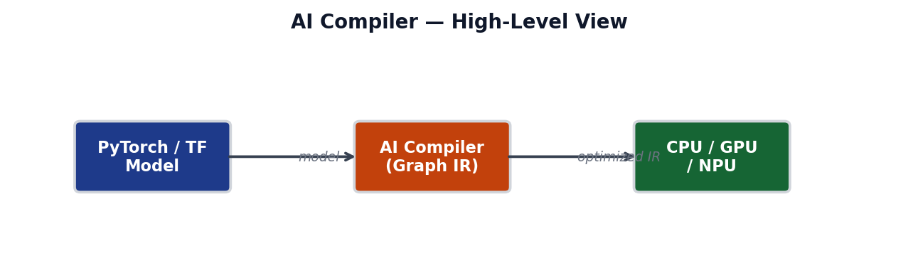
AI Compiler — Overview
Analogy: C Compiler Pipeline
Stage | C Compiler | AI Compiler
Frontend | C source (.c) | PyTorch / TF model
Mid-end IR | LLVM IR | Computation Graph (DAG)
Passes | Mem2Reg, DCE, … | Fusion, Quant, DCE, …
Backend | x86 / ARM asm | CUDA PTX / TFLite binary

Slide 4
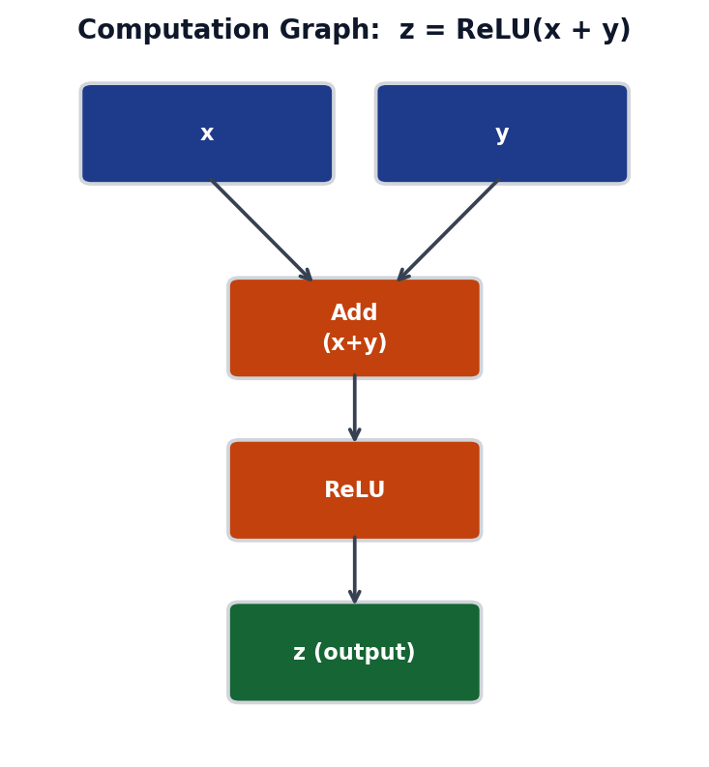
Computation Graph — Directed Acyclic Graph (DAG)
DAG Properties:
• Directed — data flows one way
• Acyclic — no cycles (no loops in graph)
• Nodes = operations (Add, ReLU, …)
• Edges = tensor data dependencies
Benefits:
• Enables lazy evaluation
• Supports automatic differentiation
• Safe to reorder / optimize passes
• Foundation for all compiler passes

Slide 5
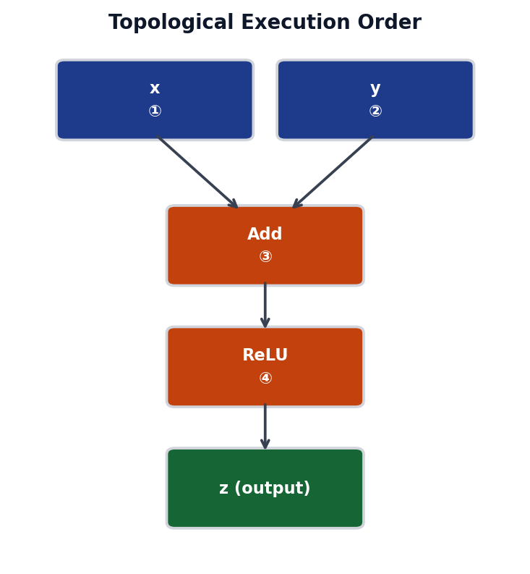
Topological Execution Order
Order | Node | Type | Inputs | Output Shape
① | x | Input | — | [B, 128]
② | y | Input | — | [B, 128]
③ | Add | Binary | x, y | [B, 128]
④ | ReLU | Unary | Add | [B, 128]
⑤ | z (out) | Output | ReLU | [B, 128]
Rule: a node can only execute after ALL its predecessors.

Slide 6
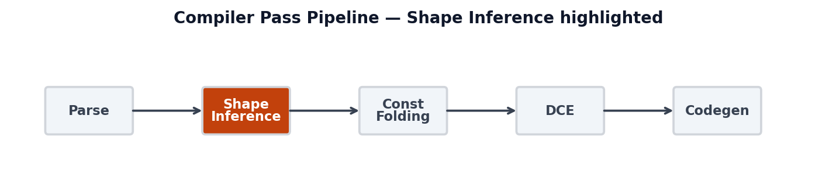
Shape Inference Pass
Node | Op | Shape (before) | Shape (after)
x | Input | unknown | [32, 128]
y | Input | unknown | [32, 128]
Add | Binary | unknown | [32, 128]
ReLU | Unary | unknown | [32, 128]
z | Output | unknown | [32, 128]
Shape propagation rules: each op knows output shape from input shapes.

Slide 7
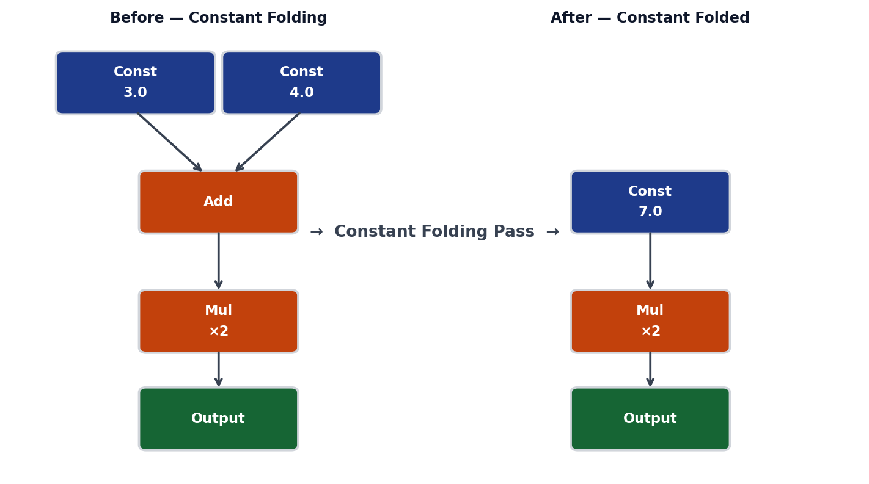
Constant Folding
Key insight: if all inputs to a node are compile-time constants, evaluate the node at compile time and replace it with a single Const node.

Slide 8
Algebraic Simplification
Rule | Before | After | Saving
Identity | x + 0 | x | Remove Add node
Identity | x × 1 | x | Remove Mul node
Annihil. | x × 0 | 0 (const) | Remove sub-tree
Double neg | −(−x) | x | Remove 2 nodes
Idempotent | ReLU(ReLU(x)) | ReLU(x) | Remove one ReLU
# Pattern-matching algebraic simplification (Python pseudocode)
def simplify(node):
if node.op == "Add" and node.inputs[1].is_const(0.0):
return node.inputs[0] # x + 0 → x
if node.op == "Mul" and node.inputs[1].is_const(1.0):
return node.inputs[0] # x * 1 → x
if node.op == "Mul" and node.inputs[1].is_const(0.0):
return ConstNode(0.0) # x * 0 → 0
if node.op == "Neg" and node.inputs[0].op == "Neg":
return node.inputs[0].inputs[0] # -(-x) → x
if node.op == "ReLU" and node.inputs[0].op == "ReLU":
return node.inputs[0] # ReLU(ReLU(x)) → ReLU(x)
return node # no match → unchanged

Slide 9
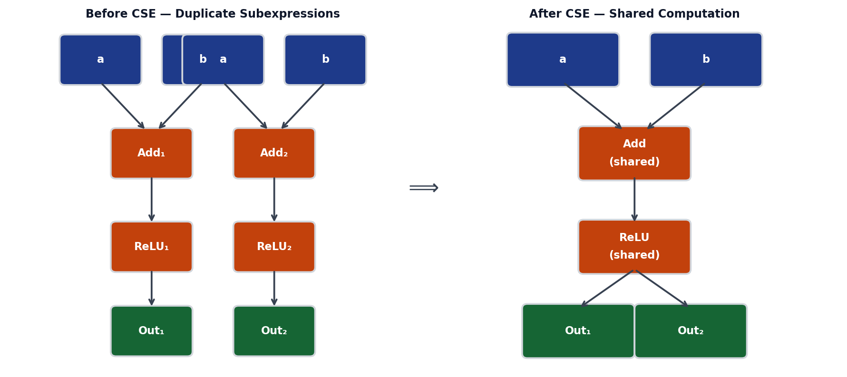
Common Subexpression Elimination (CSE)
CSE detects identical subgraphs and replaces duplicates with a single shared node. Reduces both FLOPs and memory bandwidth.

Slide 10
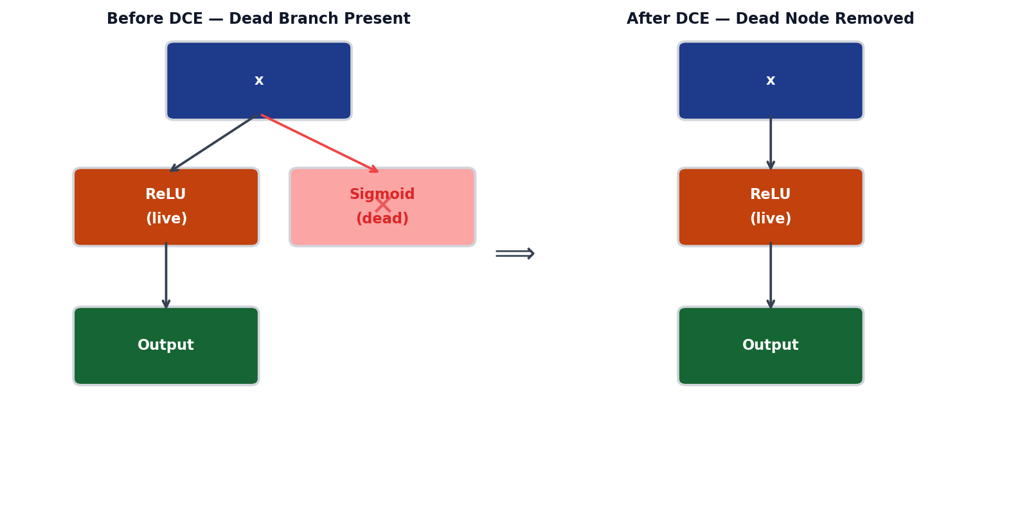
Dead Code Elimination (DCE)
Algorithm: BFS/DFS backward from all output nodes. Any node not reachable from an output is dead — remove it.

Slide 11
Pass Summary
Pass | Category | What it does | When useful
Shape Inference | Analysis | Propagates tensor shapes through graph | Always — prerequisite for other passes
Constant Folding | Optimization | Evaluates const sub-graphs at compile time | When model has fixed parameters
Alg. Simplif. | Optimization | Applies algebraic identities (x+0=x, …) | Ubiquitous — virtually free
CSE | Optimization | Deduplicates identical subexpressions | Models with shared encoder layers
DCE | Optimization | Removes unreachable nodes (no output path) | After other passes create dead nodes
Quantization | Transform | Lowers FP32 weights to INT8/INT4 | Edge deployment, memory-constrained
Operator Fusion | Transform | Merges adjacent ops into one kernel | GPU/NPU with high memory BW cost

Slide 12
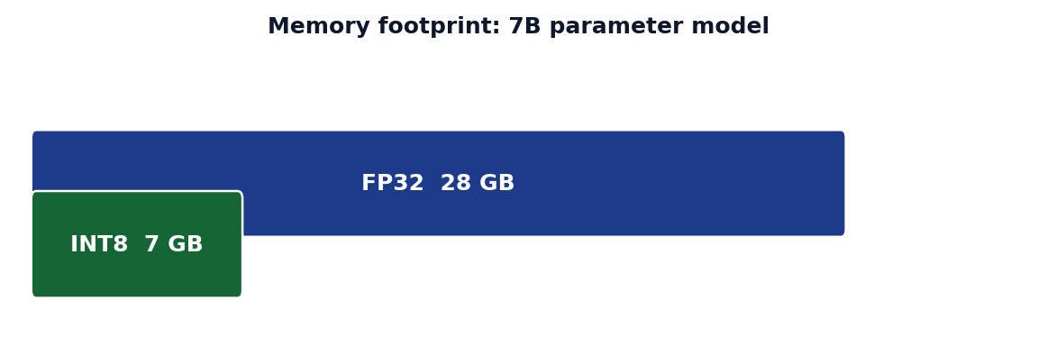
W8A16 Quantization — Motivation
FP32 Weight 4 bytes per param 7B model = 28 GB
INT8 Weight 1 byte per param 7B model = 7 GB
→
W8A16: Weights stored as INT8 | Activations computed in FP16

Slide 13
Quantization Mathematics
W_int8 = round( W_fp32 / scale ) where scale = max(|W|) / 127
Dequantize: W_fp16 = W_int8 × scale
# Numeric example — single weight value
W_fp32 = 3.14
max_abs = 3.14 # = max(|W_tensor|)
scale = 3.14 / 127 # = 0.024724...
W_int8 = round(3.14 / 0.02472) # = round(127.0) = 127
W_dequant = 127 * 0.02472 # = 3.1394 (error = 0.0006)
# Tensor-level quantization
def quantize_weight(W_fp32):
scale = W_fp32.abs().max() / 127.0
W_int8 = (W_fp32 / scale).round().clamp(-127, 127).to(torch.int8)
return W_int8, scale
def dequantize(W_int8, scale):
return W_int8.float() * scale # → FP32 for MatMul
Property | FP32 | INT8 (W8A16)
Storage / param | 4 bytes | 1 byte
Dynamic range | ~1.2×10⁻³⁸ … 3.4×10³⁸ | −127 … 127
Accuracy loss | — | < 0.5% on most LLM benchmarks

Slide 14
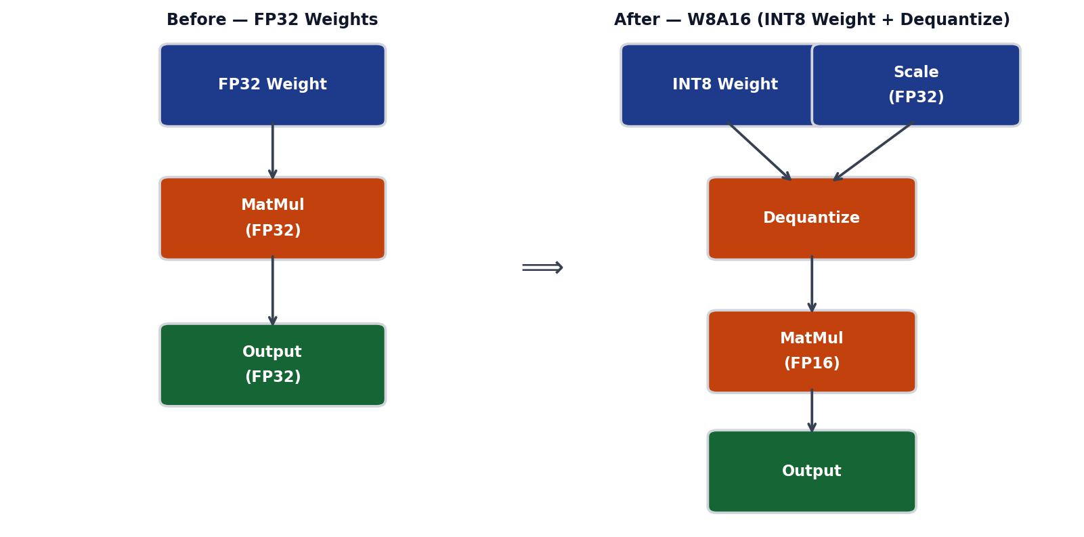
Quantization Graph Transform
The pass inserts a Dequantize node after each INT8 weight, converting it back to FP16 before the MatMul. Only weights are quantized (W8); activations remain FP16 (A16).

Slide 15
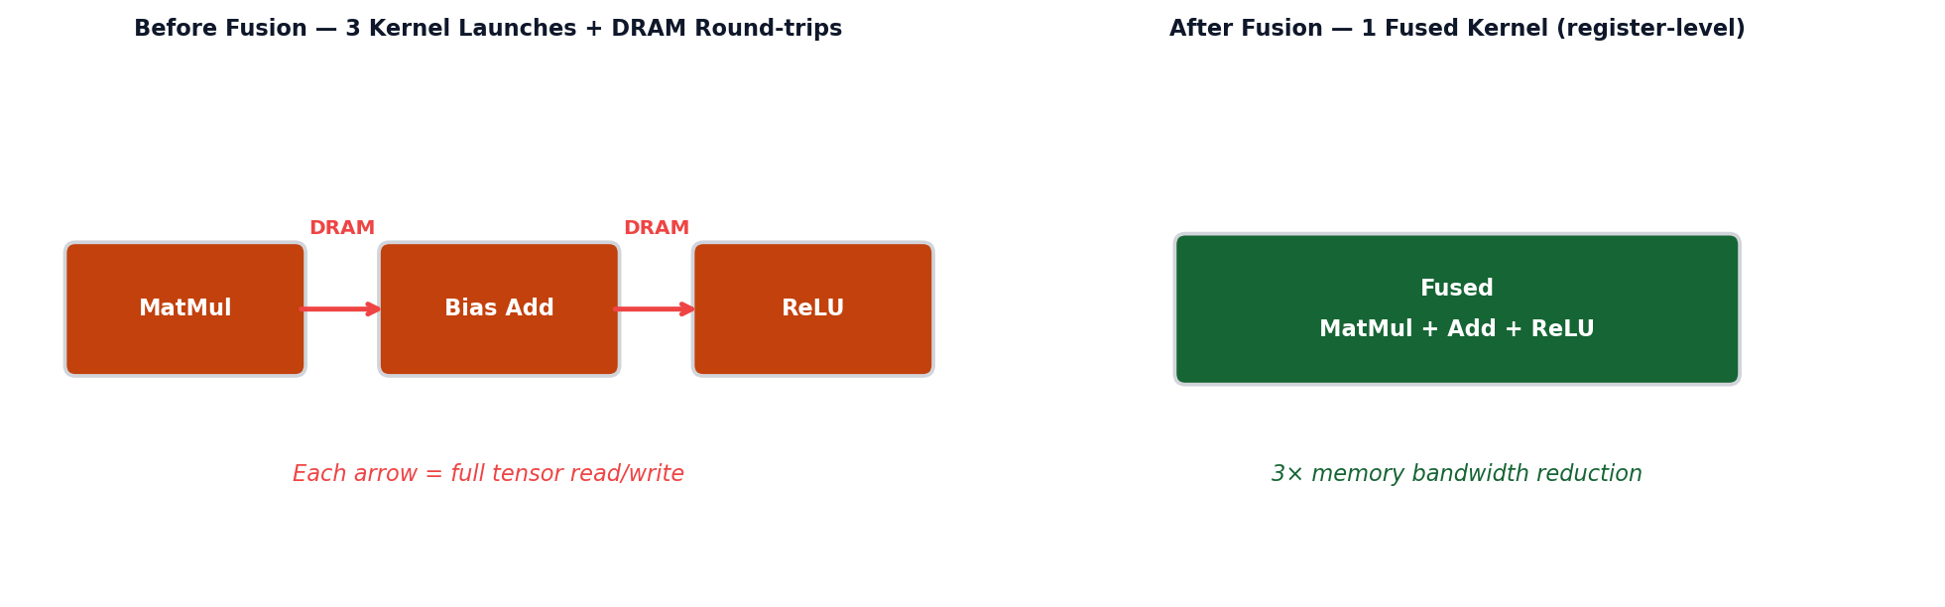
Operator Fusion — Motivation
Metric | Before Fusion | After Fusion
Kernel launches | 3 | 1
DRAM read/write | 3× full tensor I/O | 1× input + 1× output
Register reuse | None (evicted) | Full (stays in registers)
Latency (A100 example) | ~0.9 ms | ~0.3 ms

Slide 16
Operator Fusion — Implementation Detail
# Before fusion — three separate CUDA kernels
out1 = matmul_kernel(A, B) # kernel launch 1 → writes to DRAM
out2 = bias_add_kernel(out1, bias) # kernel launch 2 → reads from DRAM
out3 = relu_kernel(out2) # kernel launch 3 → reads from DRAM
# After fusion — single kernel, all ops in registers
@cuda.jit
def fused_matmul_add_relu(A, B, bias, out):
# Compute tile of MatMul result
acc = 0.0
for k in range(K):
acc += A[row, k] * B[k, col]
# Apply bias and ReLU in-register (no DRAM write)
val = acc + bias[col]
out[row, col] = val if val > 0 else 0.0 # ReLU
Fusion Conditions:
Condition | Details
Element-wise chains | Add, Mul, ReLU, Sigmoid can always be fused
Single consumer | Output of node A is used only by node B
Same shape | All ops operate on the same tensor shape

Slide 17
Code Generation — Visitor Pattern
The code generator traverses the graph in topological order and emits a string of code for each node via a visitor/dispatch table.
# Generic graph traversal for code generation
def codegen(graph):
code_lines = []
for node in topological_sort(graph):
code_lines.append(emit(node))
return "\n".join(code_lines)
def emit(node):
dispatch = {
"Input": emit_input,
"Add": emit_add,
"MatMul": emit_matmul,
"ReLU": emit_relu,
"Output": emit_output,
}
handler = dispatch.get(node.op, emit_generic)
return handler(node)
# Example emitter
def emit_add(node):
a, b = node.inputs[0].name, node.inputs[1].name
return f"float* {node.name} = vector_add({a}, {b}, N);"
Output: a self-contained C / CUDA / assembly file that implements the entire inference graph without any framework dependency.

Slide 18
Code Generation — FP32 vs W8A16
FP32 Emitted Code
W8A16 Emitted Code
// FP32 MatMul kernel
void matmul_fp32(
float* A, // [M, K] activation
float* B, // [K, N] fp32 weight
float* C, // [M, N] output
int M, int K, int N)
{
for (int i = 0; i < M; i++)
for (int j = 0; j < N; j++) {
float acc = 0.f;
for (int k = 0; k < K; k++)
acc += A[i*K+k] * B[k*N+j];
C[i*N+j] = acc;
}
}
// W8A16 MatMul: INT8 weight, FP16 activation
void matmul_w8a16(
__fp16* A, // [M, K] fp16 activation
int8_t* B, // [K, N] int8 weight
float scale, // per-tensor scale
__fp16* C, // [M, N] output
int M, int K, int N)
{
for (int i = 0; i < M; i++)
for (int j = 0; j < N; j++) {
float acc = 0.f;
for (int k = 0; k < K; k++)
acc += (float)A[i*K+k]
* (float)B[k*N+j] * scale;
C[i*N+j] = (__fp16)acc;
}
}
Key difference: B is int8_t (1 byte) and multiplied by per-tensor scale during accumulation.

Slide 19
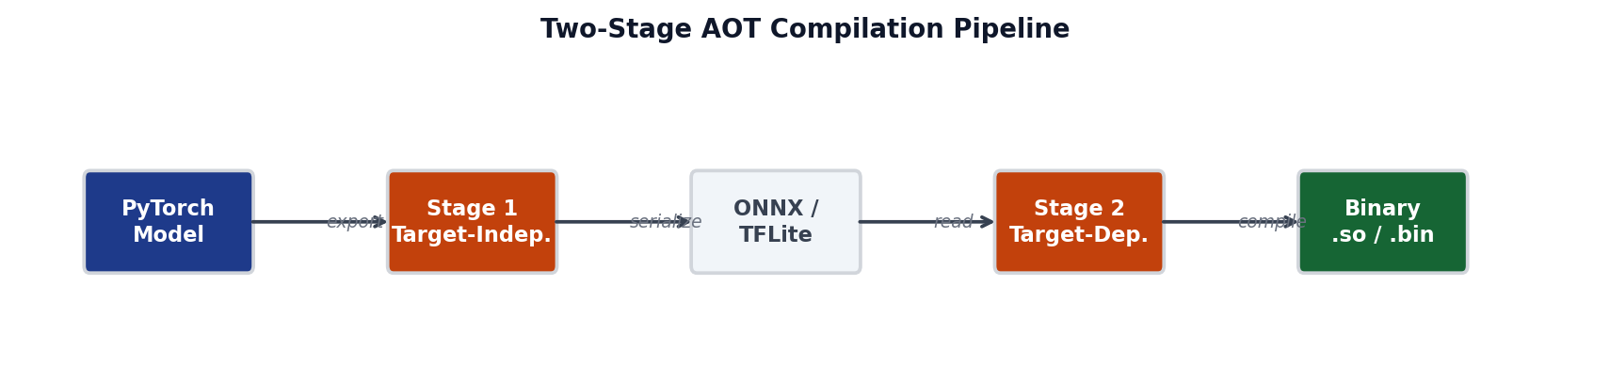
Two-Stage AOT Compilation — Overview
 | Stage 1 — Target-Independent | Stage 2 — Target-Dependent
Input | ONNX / PyTorch model | .tflite / serialized IR
Passes | Fusion, Quantization, Simplif. | Memory plan, Tiling, Emit
Output | .tflite / .mlir | .so / .bin binary
Runs on | Any machine (CI server) | Cross-compiler for target HW
Reuse | One model → many targets | One target → many models

Slide 20
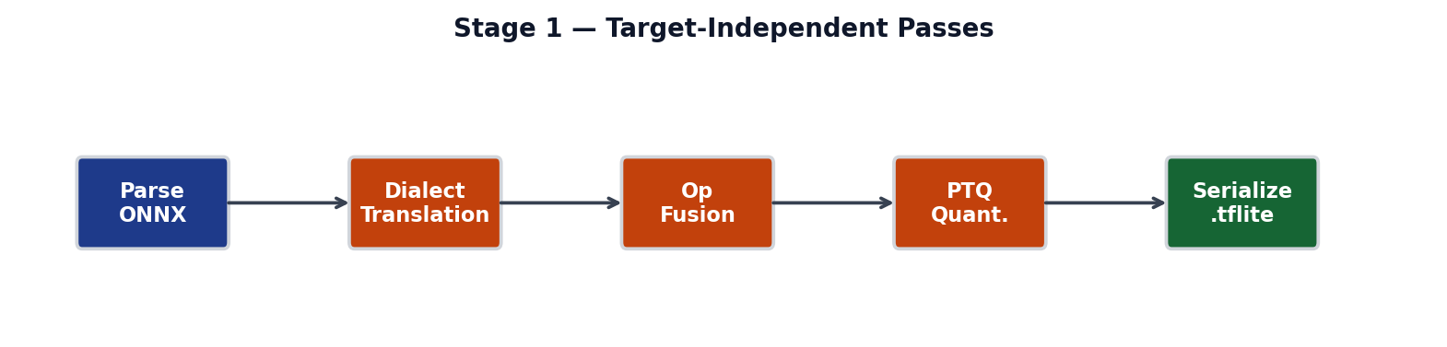
Stage 1 — Target-Independent Passes
Pass | Input | Output | Purpose
Parse ONNX | ONNX protobuf | Internal DAG | Deserialize model
Dialect Translation | Internal DAG | TFLite dialect | Map ONNX ops → TFLite
Op Fusion | TFLite dialect | Fused ops | Merge Conv+BN+ReLU
PTQ Quantization | FP32 weights | INT8 weights | Reduce model size
Serialize | Optimized DAG | .tflite flatbuf. | Portable format

Slide 21
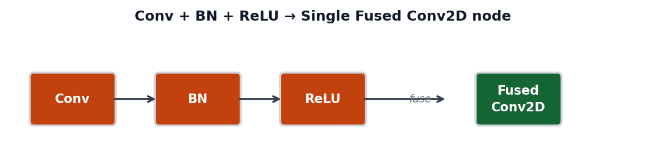
Stage 1 — Dialect Translation: ONNX → TFLite
ONNX Op | TFLite Op | Notes
Conv + BatchNormalization + Relu | CONV_2D (fused) | BN folded into Conv weights
Gemm | FULLY_CONNECTED | Bias always included
Add | ADD | Direct 1-to-1 mapping
Reshape | RESHAPE | Direct 1-to-1 mapping
Softmax | SOFTMAX | axis parameter mapped
GlobalAveragePool | MEAN | keepdims preserved

Slide 22
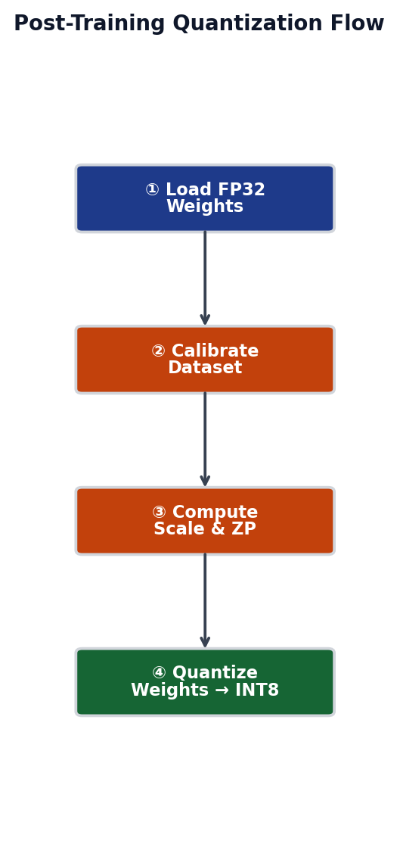
Stage 1 — Post-Training Quantization (PTQ) Flow
① Load FP32 Weights
Load the pre-trained floating-point model.
All weights are in float32 format.
② Calibrate on Representative Dataset
Forward-pass ~100-1000 samples.
Record min/max activation ranges.
③ Compute Scale and Zero-Point
scale = max(|W|) / 127
zero_point = 0 (for symmetric)
④ Quantize Weights → INT8
W_int8 = round(W / scale)
Store .tflite with int8 tensors.

Slide 23
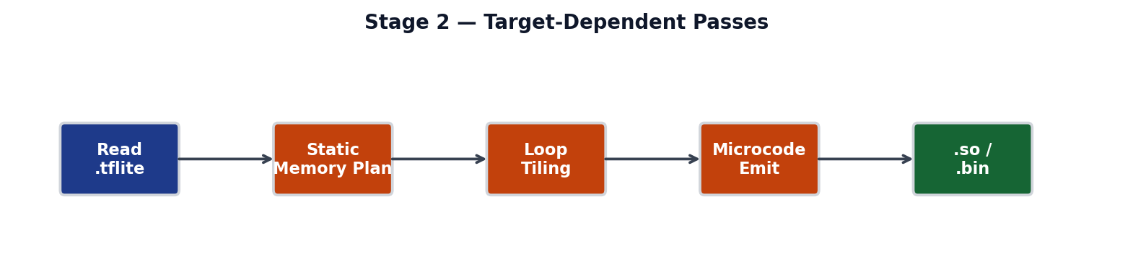
Stage 2 — Target-Dependent Passes
Pass | What it does | HW impact
Read .tflite | Deserialize flatbuffer → internal DAG | None — IR only
Static Memory Plan | Assign tensors to non-overlapping offsets | Minimizes SRAM
Loop Tiling | Split loops into cache-friendly tile sizes | Cache hit rate ↑
Microcode Emit | Emit C / RISC-V / NPU microcode per op | Final binary
Link .so | Bundle all kernels into shared library | Deployable artifact

Slide 24
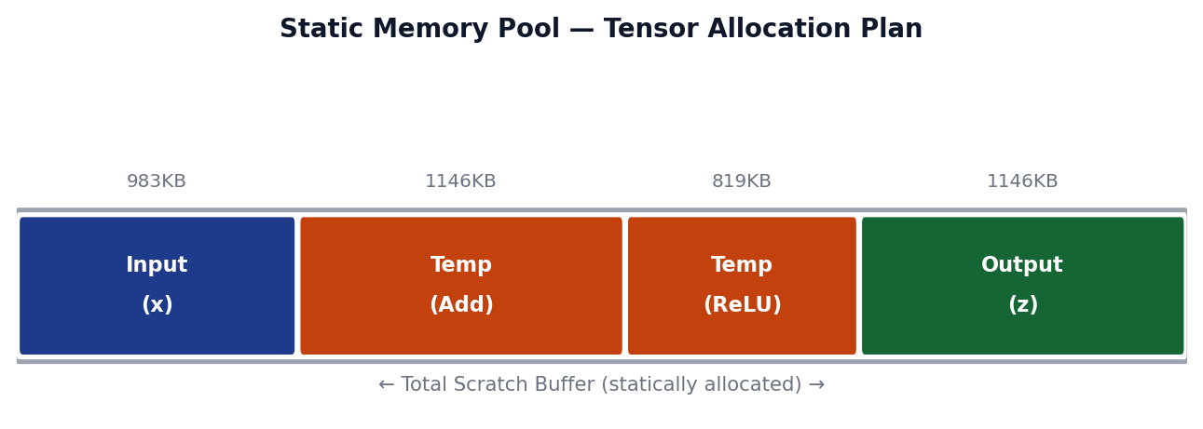
Stage 2 — Static Memory Planning
Tensor | Lifetime (ops) | Offset | Size
Input x | 1 → 3 | 0 KB | 256 KB
Temp Add | 3 → 4 | 256 KB | 256 KB
Temp ReLU | 4 → 5 | 512 KB | 256 KB
Output z | 5 → end | 768 KB | 256 KB
Tensors with non-overlapping lifetimes can share memory (liveness-based allocation).

Slide 25
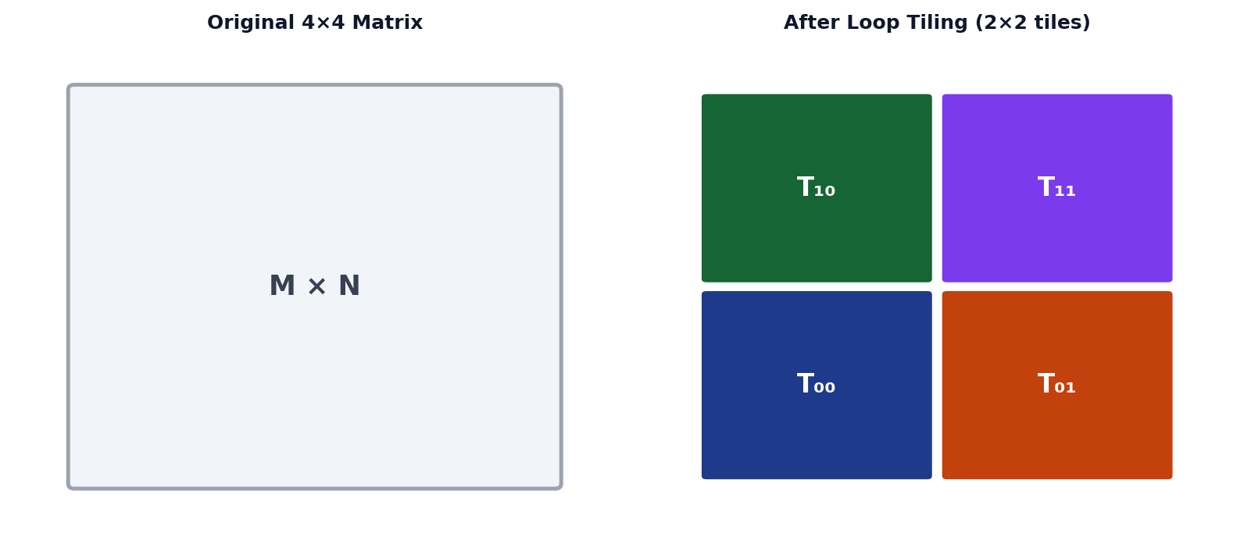
Stage 2 — Loop Tiling
# Before tiling
for i in range(M):
for j in range(N):
C[i,j] = sum(A[i,k]*B[k,j] for k in range(K))
# After tiling (tile size = T)
for ii in range(0, M, T): # tile row
for jj in range(0, N, T): # tile col
for kk in range(0, K, T): # tile K
for i in range(ii, min(ii+T, M)):
for j in range(jj, min(jj+T, N)):
C[i,j] += sum(A[i,k]*B[k,j] for k in range(kk, min(kk+T,K)))

Slide 26
Industry Case Studies
Edge TPU (Google)
Apache TVM
torch.compile (PyTorch 2.0)
Two-stage compilation:
edgetpu_compiler (Stage 1)
on-device loader (Stage 2)
All ops must be quantized
to INT8 before deployment.
Uses our exact pipeline:
ONNX → TFLite → binary
Open-source ML compiler
Relay IR = computation graph
TIR = tensor IR (low-level)
AutoTVM / MetaSchedule:
auto-tunes tile sizes,
unroll factors per target.
Targets: CPU, CUDA, Vulkan,
RISC-V, custom accelerators
Just-in-time, single-stage
AOT Autograd captures ops
TorchInductor codegen
torch.fx Graph = our DAG
Passes: fusion, layout opt.
1.5–4× speedup on A100
with zero code changes.

Slide 27
Toy Compiler → Production System Mapping
Concept | Our Toy Compiler | Production (TVM / MLIR)
IR format | Python dict/class graph | MLIR dialect / Relay IR
Shape inference | manual per-op rules | Type system + inference pass
Const folding | if node.is_const() | ConstantFolding pass (C++)
Quantization | per-tensor symmetric INT8 | Per-channel, asymmetric, mixed
Code gen | emit Python string → .c | LLVM IR → PTX / ARM / RISC-V
Memory planning | greedy offset assignment | Liveness analysis + ILP solver
Loop tiling | manual tile loops | AutoTVM / Ansor search
Operator fusion | pattern match + merge | FusionPlanner with cost model
The same concepts — DAG passes, quantization, memory planning, tiling — are used verbatim in production compilers. Scale differs; ideas are identical.

Slide 28
Summary — Key Takeaways
1. Computation Graph = DAG
All ML frameworks represent models as directed acyclic graphs. Every optimization pass operates on this universal representation.
2. Passes are graph rewrites
Shape inference, const folding, CSE, DCE, quantization — each is a graph traversal that transforms the DAG in a well-defined way.
3. W8A16 Quantization = 4× weight compression
INT8 weights + FP16 activations. One scale per tensor. Less than 0.5% accuracy loss on most LLM benchmarks.
4. Two-stage AOT separates concerns
Stage 1 is target-independent (run once); Stage 2 is target-dependent. Same .tflite can be compiled to CPU, GPU, or NPU without re-running S1.
5. Production compilers use the same ideas
TVM, MLIR, torch.compile all build on DAG passes + codegen. The toy compiler is a faithful miniature of real systems.
Further Reading

