Slide 1
Birdie
Minigolf Ball Collection Manager
James Bullin
Software Development Engineer in Test

Slide 2
Birdie
Project Goals
Minigolf
Demonstration
Tools and Technologies
Kanban Board
Future Work
Lessons Learned
Three-Tier Application
WPF User Interface
Business Logic
Data Models
Database Access
SQL Server
Entity Framework
Testing
Unit Tests
Manual Testing

Slide 3
Birdie
Project Goals
Minigolf
Demonstration
Tools and Technologies
Kanban Board
Future Work
Lessons Learned
Competitive Minigolf
Tournaments
Different Minigolf Balls
Bounce
Weight
Size

Slide 4
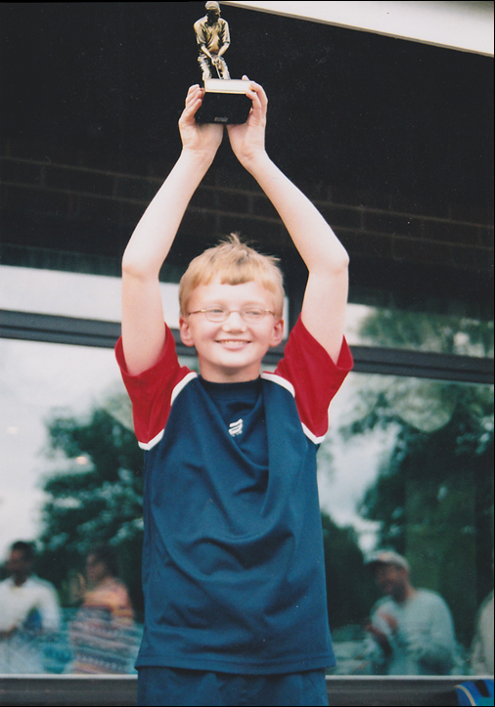


Slide 5
Demonstration

Slide 6
Birdie
Project Goals
Minigolf
Demonstration
Tools and Technologies (1/2)
Kanban Board
Future Work
Lessons Learned
Application
Visual Studio: C#
WPF (Windows Presentation Foundation)
Caliburn.Micro
Database
SQL Server
Entity Framework

Slide 7
Birdie
Project Goals
Minigolf
Demonstration
Tools and Technologies (2/2)
Kanban Board
Future Work
Lessons Learned
Version Control
Git
Github
Unit Testing
NUnit

Slide 8
Kanban board

Slide 9
Birdie
Project Goals
Minigolf
Demonstration
Tools and Technologies
Kanban Board
Future Work
Lessons Learned
Refactor User Interface
isEnabled and Visibility Toggles
Reduce Database Access
More Minigolf Ball Properties
Manufacturer
Bounce, Weight, Size, etc.
More Features
Ball Comparison
Search Functionality
API Integration
User Accounts / Collections

Slide 10
Birdie
Project Goals
Minigolf
Demonstration
Tools and Technologies
Kanban Board
Future Work
Lessons Learned
Minimum Viable Product
Limit Project Scope
Rewrite and Refactor
Don’t be Afraid to Restart
Rewriting Code is Super Fast
Testing is Key
Red-Green-Refactor
Tests can be Misleading
Don’t use Heavy Mocking
Good Tests are Difficult to Write

Slide 11
Thanks for listening! Any Questions?
github.com/JamesBullin
james.bullin@spartaglobal.com

