Slide 1
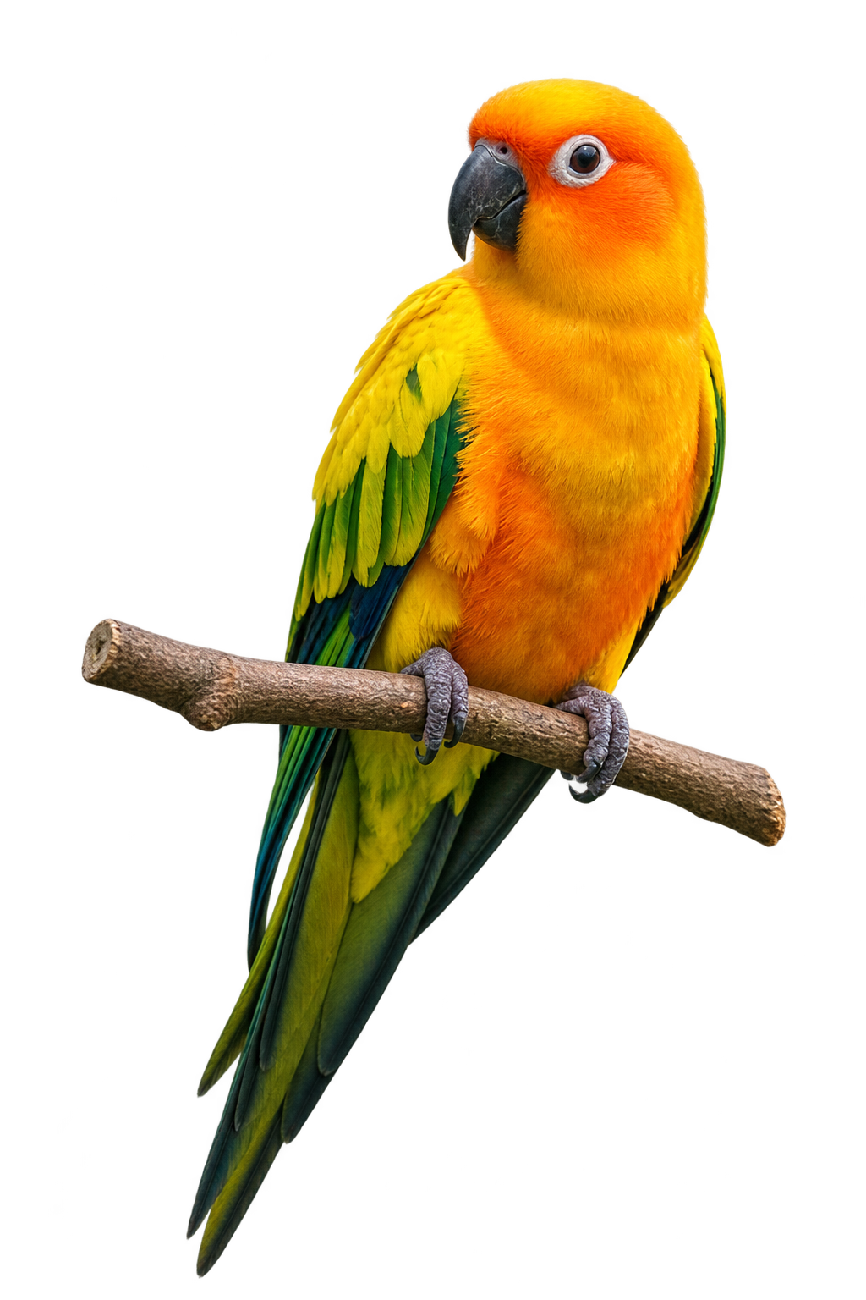
PerpParrot
Several traders.
One plan you can
understand.
Combines selected Hyperliquid traders’ positions
into one portfolio plan.
See who contributes and how the plan changes.
For traders watching several accounts
QuantFun / Read-only paper demo
01
Notes:
Spoken pitch:
PerpParrot helps you understand what several traders’ positions mean together. Instead of checking accounts separately and reconciling conflicting positions, you see one combined plan, who contributes, and how it changes. Today, you can explore our read-only paper demo.
Evidence and interpretation:
PerpParrot combines selected Hyperliquid accounts into an inspectable portfolio plan. This guided demo explains the public read-only experience. The bird is brand imagery. No funded trading result is claimed. Mirror reference inspired editorial pacing and typography only. The forest and conure represent PerpParrot branding; no reference business, health or fundraising facts are reused.
Source baseline: 7c05d74. Earlier authentic captures:7October2026,last displayed run15:30SGT. Source review is separate from deployed-build verification.
https://github.com/JamesBurnsBacon/PerpParrot-Onchain-Trading-Agent-by-QuantFun/blob/7c05d74/packages/shared/copy.ts
https://perpparrot.vercel.app/

Slide 2
The question
Three accounts.
The combined position is still unclear.
A position is how much a trader holds long or short on an asset.
Trader A
Trader B
Trader C
BTC
BTC
BTC
+$600
−$200
+$400
Long: benefits if BTC rises
Short: benefits if BTC falls
Long: benefits if BTC rises
A portfolio plan combines these positions across assets.
Illustrative contributions after weighting and normalization.
02
Notes:
Spoken pitch:
You are watching three traders. Their contributions point in different directions: six hundred dollars long, two hundred short, four hundred long. Looking at each account separately does not tell you the combined position.
Evidence and interpretation:
The three fictional traders illustrate weighted and normalized Bitcoin contributions, not raw wallet balances. A positive contribution is long and a negative contribution is short. The dollar amounts describe exposure, not profits. A portfolio plan repeats this combination across assets.
Source baseline: 7c05d74. Earlier authentic captures:7October2026,last displayed run15:30SGT. Source review is separate from deployed-build verification.
https://github.com/JamesBurnsBacon/PerpParrot-Onchain-Trading-Agent-by-QuantFun/blob/7c05d74/packages/shared/copy.ts
https://perpparrot.vercel.app/

Slide 3
The answer
One combined Bitcoin position
A
+$600
+$800
B
−$200
Planned Bitcoin
position
C
+$400
$600 − $200 + $400 = $800
The short offsets part of the two long positions.
Illustration, not current account data. A plan is not a filled trade.
03
Notes:
Spoken pitch:
They add up to eight hundred dollars long. The short offsets part of the longs. One planned Bitcoin position replaces three conflicting contributions. These numbers illustrate the calculation; they are not actual trades. Now, the real demo.
Evidence and interpretation:
The two long contributions total $1,000. The short contribution offsets $200, leaving a planned $800 Bitcoin exposure. These illustrative numbers do not reproduce the dashboard snapshot shown next. A target is an intended position rather than a confirmed filled order.
Source baseline: 7c05d74. Earlier authentic captures:7October2026,last displayed run15:30SGT. Source review is separate from deployed-build verification.
https://github.com/JamesBurnsBacon/PerpParrot-Onchain-Trading-Agent-by-QuantFun/blob/7c05d74/packages/shared/copy.ts
https://perpparrot.vercel.app/

Slide 4
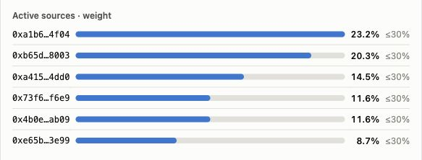
The real demo
The plan shows its contributors
6 selected sources
Largest share: 23.2%
A share weights a trader’s positions before the plan is combined.
Actual earlier paper capture. 7 October, run 15:30 SGT. Read-only demo.
04
Notes:
Spoken pitch:
A final number hides where it came from. Here the contributors stay visible. This capture has six selected sources. The largest share is twenty-three point two percent. A share weights a trader’s positions before they are combined. You can see whose positions shape the plan, rather than only seeing its final total.
Evidence and interpretation:
This authentic earlier screenshot shows six selected sources. The largest frozen allocation weight is 23.2%. A weight is an input to contribution calculations, not necessarily the final fraction of portfolio exposure after leverage normalization and caps. The public demo is read-only and does not demonstrate visitor selection controls. The capture predates the latest source policy.
Source baseline: 7c05d74. Earlier authentic captures:7October2026,last displayed run15:30SGT. Source review is separate from deployed-build verification.
https://github.com/JamesBurnsBacon/PerpParrot-Onchain-Trading-Agent-by-QuantFun/blob/7c05d74/packages/shared/copy.ts
https://perpparrot.vercel.app/

Slide 5
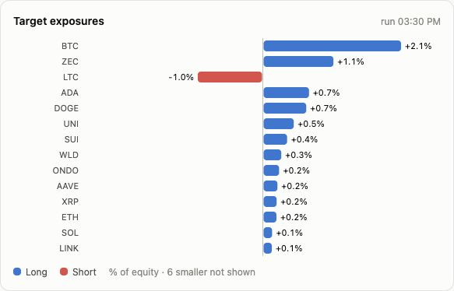
Read the combined plan
Direction and size, in one view
BTC +2.1%
LTC −1.0%
Positive means long.
Negative means short.
Percentages show planned
positions as a share of
portfolio value.
Positions, not returns.
7 October, run 15:30 SGT. Earlier paper capture. Planned exposure, not funded fills.
05
Notes:
Spoken pitch:
Two questions matter: which direction, and how much? This view answers both in one place. Bitcoin is planned long at two point one percent of portfolio value; Litecoin is short at one percent. Blue and red show direction. The percentages show exposure, not expected returns. You can understand both direction and size.
Evidence and interpretation:
The authentic chart shows planned exposures relative to portfolio equity. Bitcoin is long 2.1% and LTC is short 1.0%. These are exposure percentages, not predicted or achieved returns. The chart preserves its Long/Short legend and disclosure that six smaller targets are not shown. These actual targets are separate from the preceding fictional $800 example.
Source baseline: 7c05d74. Earlier authentic captures:7October2026,last displayed run15:30SGT. Source review is separate from deployed-build verification.
https://github.com/JamesBurnsBacon/PerpParrot-Onchain-Trading-Agent-by-QuantFun/blob/7c05d74/packages/shared/copy.ts
https://perpparrot.vercel.app/

Slide 6
Source review
The questions behind selection
Fit
Risk
Challenge
Does this trader
fit the portfolio?
What could
go wrong?
What may have
been missed?
Selected traders and their recorded shares
Three specialist AI contexts on one provider. Basic fallback differs from strict review.
06
Notes:
Spoken pitch:
Why those sources? The review asks three questions: does the trader fit, what could go wrong, and what might have been missed? Three AI contexts use one provider. They support source review; they do not guarantee protection or profitable copying.
Evidence and interpretation:
The implementation asks specialist AI contexts about fit, risk and possible omissions, and records chosen sources and allocations. The contexts use one observed provider and do not constitute independent model consensus. A basic fallback can activate without all strict fields or Red Team veto, so these questions do not prove that every active selection passed strict review.
Source baseline: 7c05d74. Earlier authentic captures:7October2026,last displayed run15:30SGT. Source review is separate from deployed-build verification.
https://github.com/JamesBurnsBacon/PerpParrot-Onchain-Trading-Agent-by-QuantFun/blob/7c05d74/packages/shared/copy.ts
https://perpparrot.vercel.app/

Slide 7
Understand a change
When a trader exits, the plan changes
Before
After A exits
A
+$600
A
0
B
−$200
B
−$200
C
+$400
C
+$400
+$800
+$200
You can see which contribution changed.
Illustration. B/C inputs unchanged, gross cap not binding. Held closes follow separate rules.
07
Notes:
Spoken pitch:
Return to our example. Trader A exits. The plan drops from eight hundred to two hundred dollars long. A’s share is not reassigned to the others. With B and C unchanged and no cap adjustment, you can explain why the plan changed.
Evidence and interpretation:
The illustration preserves A, B and C from the opening example. When A becomes flat, its contribution falls to zero. The new combined plan is zero minus $200 plus $400, or $200. B and C inputs, including their weights, prices and normalization, are unchanged. The gross cap is nonbinding. Frozen seat weights are not redistributed. Held full closes require three consecutive zero-target runs, so the diagram describes the computed plan rather than immediate funded execution.
Source baseline: 7c05d74. Earlier authentic captures:7October2026,last displayed run15:30SGT. Source review is separate from deployed-build verification.
https://github.com/JamesBurnsBacon/PerpParrot-Onchain-Trading-Agent-by-QuantFun/blob/7c05d74/packages/shared/copy.ts
https://perpparrot.vercel.app/

Slide 8
Read the run activity
The demo shows activity and interruptions
Paper / dry version
Each cell is one scheduled run.
Failed dry run
7 October, run 15:30 SGT. Green: completed dry activity. Red: failed. Funded fills unverified.
08
Notes:
Spoken pitch:
Before judging a result, check whether the system ran, and where it stopped. Each cell represents one scheduled run. Green shows completed dry-run activity; red shows failures. This demo makes interruptions visible. A green cell is not proof of a funded fill or a successful investment.
Evidence and interpretation:
This is an authentic heartbeat crop, preserving the one-cell-per-ten-minute-run label and Executed/Paused/Failed legend. Green means recorded executed activity in this paper/dry context, not confirmed live fills or profitable trades. Red cells show failed scheduled activity. The heartbeat supports observing interruptions but is not a verified complete end-to-end transaction trace.
Source baseline: 7c05d74. Earlier authentic captures:7October2026,last displayed run15:30SGT. Source review is separate from deployed-build verification.
https://github.com/JamesBurnsBacon/PerpParrot-Onchain-Trading-Agent-by-QuantFun/blob/7c05d74/packages/shared/copy.ts
https://perpparrot.vercel.app/

Slide 9
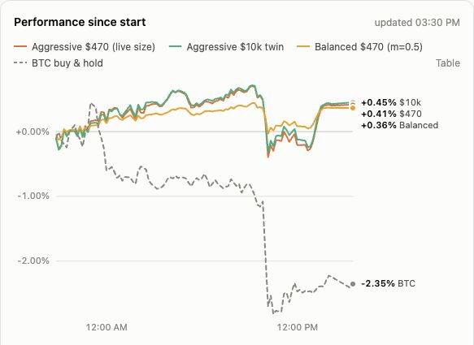
An outcome to inspect
Paper results show simulated behavior
Change since the
model started
Models fills, fees,
slippage and funding.
$470 paper book:
+0.41% in this capture
Funded returns and future
performance remain unproven.
Earlier paper capture. 7 October, run 15:30 SGT. Historical observation, not a forecast.
09
Notes:
Spoken pitch:
Finally, read the paper result. This earlier capture shows the model changing over time, with modeled fills and costs. It is useful for inspecting simulated behavior. It does not establish live returns or predict performance.
Evidence and interpretation:
The authentic earlier graph displays changes from each paper model’s starting capital. The $470 book showed +0.41% in this capture. Fills, fees, slippage and funding are modeled. The literal legend says live size, meaning model account size here, not funded execution. The graph predates current normalization code. These outcomes do not demonstrate future returns or funded performance.
Source baseline: 7c05d74. Earlier authentic captures:7October2026,last displayed run15:30SGT. Source review is separate from deployed-build verification.
https://github.com/JamesBurnsBacon/PerpParrot-Onchain-Trading-Agent-by-QuantFun/blob/7c05d74/packages/shared/copy.ts
https://perpparrot.vercel.app/

Slide 10
Know what you follow.
Understand why it changes.
Explore the paper demo
perpparrot.vercel.app
Read-only paper demo.
10
Notes:
Spoken pitch:
The clarity we offer answers two questions: what am I following, and why has the plan changed? Open the demo and see whether you can explain one plan: who contributes, what positions result, and what the paper system recorded. You can understand the positions together, instead of piecing together separate accounts.
Evidence and interpretation:
The reader can perform these inspection tasks in the public read-only paper demo: inspect selected traders and weights, read planned asset exposures, and check dry activity and modeled outcomes. No deposit, wallet onboarding, trading authorization or self-service selection is demonstrated.
Source baseline: 7c05d74. Earlier authentic captures:7October2026,last displayed run15:30SGT. Source review is separate from deployed-build verification.
https://github.com/JamesBurnsBacon/PerpParrot-Onchain-Trading-Agent-by-QuantFun/blob/7c05d74/packages/shared/copy.ts
https://perpparrot.vercel.app/

Slide 11
Appendix / Current source
How the implementation evolved
6 October
7 October
Later 7 October
Combined target math
Review and recovery
Roster and fixed policies
Latest: normalization and at most 15 positions
Scale: 2 ÷ max(30-day average leverage, 0.05). Unknown average: 1.
Code: 7c05d74. Counted cap 5×. Minority half. Largest 15 retained and rescaled.
11
Notes:
Verified history: combined position math and scoring on 6 October; scheduled behavioral review and recovery on 7 October; per-wallet roster, bench and winding down at 15:48–16:02 SGT; fixed exposure multipliers and a 5× aggressive gross cap at 16:09; per-source average-leverage normalization from 16:15, present in reviewed commit 7c05d74. Unknown or invalid average leverage leaves scale at one. These are source implementation facts, not measured deployment or churn improvements. Latest reviewed baseline is 7c05d74. Counted gross equals the larger signed side plus half the smaller signed side. At most the fifteen largest absolute asset exposures are retained and rescaled to preserve counted gross, then capped. Roster sizing is now twelve to fifteen sources, distinct from the six-source earlier capture. The repository also reports retrospective fixed-price turnover replay, not a PnL study; this deck makes no measured current churn claim.
Source baseline: 7c05d74. Earlier authentic captures:7October2026,last displayed run15:30SGT. Source review is separate from deployed-build verification.
https://github.com/JamesBurnsBacon/PerpParrot-Onchain-Trading-Agent-by-QuantFun/blob/7c05d74/packages/shared/copy.ts
https://perpparrot.vercel.app/

Slide 12
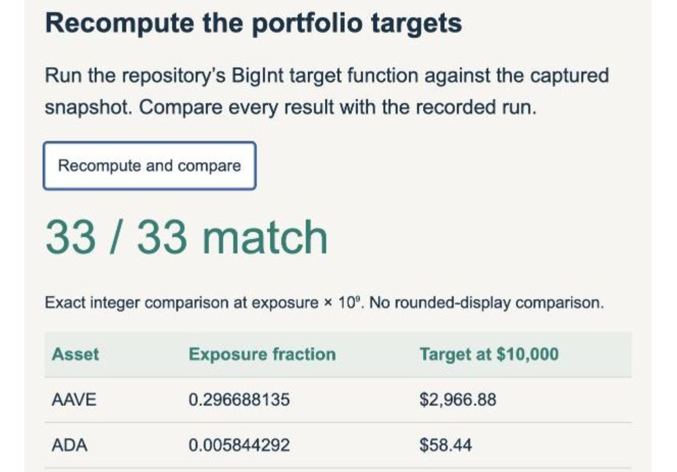
Appendix / Historical fixture
One old snapshot. 33 exact matches.
33 / 33
Historical calculation
comparison
One recorded snapshot.
Fresh exact-target
comparison pending.
Historical fixture. This does not verify the latest pipeline or funded execution.
12
Notes:
The historical screenshot comes from slide 6 of the supplied PerpParrot-Gamma-Editable-Master.pptx. One recorded snapshot matched the original shared target calculation in all 33 integer outputs. It predates fixed-weight corrections, roster wind-down caps and latest leverage normalization. It does not validate the latest pipeline or funded execution. A fresh current-math replay remains pending. A fresh exact-target comparison using the latest implementation remains pending; the repository’s newer turnover replay addresses a different question.
Source baseline: 7c05d74. Earlier authentic captures:7October2026,last displayed run15:30SGT. Source review is separate from deployed-build verification.
https://github.com/JamesBurnsBacon/PerpParrot-Onchain-Trading-Agent-by-QuantFun/blob/7c05d74/packages/shared/copy.ts
https://perpparrot.vercel.app/

Slide 13
Appendix / Current code: 7c05d74
Controls and review boundaries
Rule | Current implementation
Exposure / positions | Counted cap 5×; minority side at half. At most 15 positions.
Ordinary trade | Aggressive: $10 and 10% target and 0.5% equity
Portfolio variants | Targets and equity floor ×1 / ×0.5 / ×0.25
Exit and wind-down | Full close: 3 zero runs. Wind-down: reductions only.
AI review | One provider. Basic fallback omits strict fields/veto.
Unknown action | Hold affected asset and reconcile status.
Current code. Funded dispatch and restart recovery remain unverified.
13
Notes:
Current code has 5× gross caps per source and combined portfolio. Aggressive ordinary trades require the $10 minimum, 10% target drift and 0.5% equity floor. Target and equity-floor multipliers are 1, 0.5 and 0.25. Full closes require three zero-target runs. Winding-down seats follow same-sign reductions within recorded caps. Unknown actions hold affected assets while reconciliation proceeds. One provider and basic fallback remain review limitations; no complete safety or exactly-once guarantee follows. Latest 7c05d74 changes gross counting and retains at most fifteen positions. Minority exposure counts at half. These are implementation rules, not guarantees of equal risk.
Source baseline: 7c05d74. Earlier authentic captures:7October2026,last displayed run15:30SGT. Source review is separate from deployed-build verification.
https://github.com/JamesBurnsBacon/PerpParrot-Onchain-Trading-Agent-by-QuantFun/blob/7c05d74/packages/shared/copy.ts
https://perpparrot.vercel.app/

Slide 14
Appendix / Provenance
Evidence and the next proof
Evidence | What it supports | Next check
Current code | Normalization, roster and controls | Verify replay and deployment
Earlier UI capture | Sources, targets and paper view | Verify deployment and capture
Public API / 16:30 | Six seats. Paper books. Dry executor. | Verify funded execution
Historical 33/33 | One old exact snapshot | Fresh current-math replay
Proposed validation | No completed future result | Recovery and future holdout
Public API: paper run16:30. Executor dryRun=true, lastRunAt=null. Funded fills remain unverified.
14
Notes:
Evidence classes remain separate: source at reviewed commit 7c05d74; earlier authentic UI capture with last run 15:30 SGT; later public API observations with paper run 16:30 SGT; historical 33/33 fixture; and proposed validation. Public executor status reports dryRun=true and lastRunAt=null. These observations neither establish funded fills nor map the deployed commit. The conditional UI word live is not proof of funded results. Next work is latest-math replay, verified deployment capture, funded recovery and future holdout evaluation. Next work includes independent verification of the repository-reported turnover replay, a fresh exact-target comparison, deployment verification, and funded recovery validation.
Source baseline: 7c05d74. Earlier authentic captures:7October2026,last displayed run15:30SGT. Source review is separate from deployed-build verification.
https://github.com/JamesBurnsBacon/PerpParrot-Onchain-Trading-Agent-by-QuantFun/blob/7c05d74/packages/shared/copy.ts
https://perpparrot.vercel.app/

