Slide 1
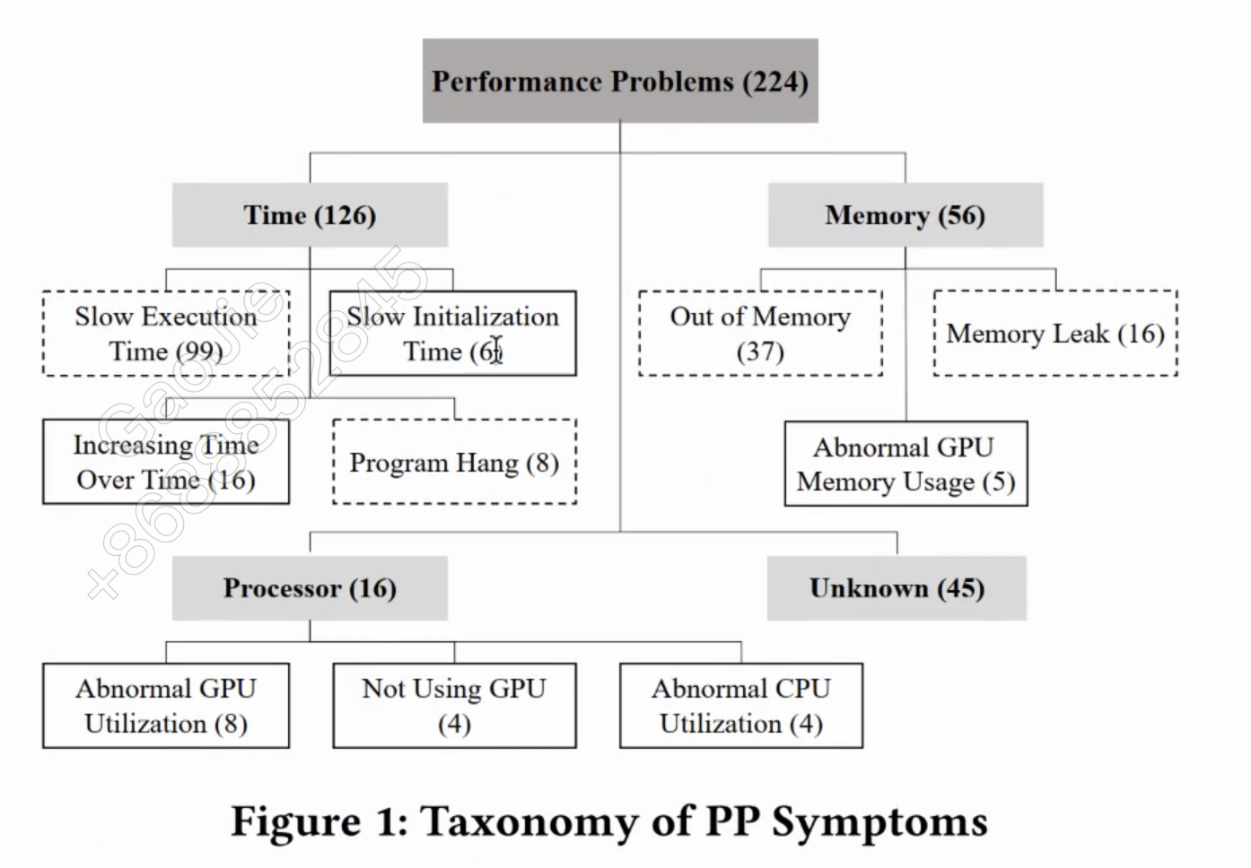

Slide 2
Data processing type
Up-down stream interaction (123)
Different Instances (123)
Components with ML model reuse (123)
Intra-module interaction (123)
Output Selection (123)
Usage constraints (123)
Priority Order (123)
Output Refinement (123)
Avoid used combinedly (123)
Functionality Equivalence (123)
Confidence Checking (123)
Must used combinedly (123)
Must used combinedly (123)
Usage constraints (123)
Avoid used combinedly (123)
Data Dependency (123)
User-defined constraints (123)

Slide 3
Component Interaction Type(40/226)
Inter-Mdule Interaction (32/170)
Intra-Module Interaction (8/56)
Usage Constraints (2/3)
Priority Order (1/7)
Usage Constraints (5/31)
Output Selection (1/18)
Avoid Being Used Combinedly (1/2)
Output Refinement (1/4)
Functionality Equivalence (2/18)
Must Be Used Combinedly (1/1)
Confidence Checking (2/50)
Component Instantiation (NA)
Must Be used Combinedly (2/4)
User-Defined Constraints (NA)
Data Dependency (26/95)
Component Inheritance(2/2)
Avoid Being Used Combinedly (3/27)
Notes:
实线代表都有，虚线1代表ml-ml, 虚线二代表ml-nonml

Slide 4
Data processing type
Components with ML model reuse (123)
Up-down stream interaction (123)
Different Instances (123)
Intra-module interaction (123)
Usage constraints (123)
Output Selection (123)
Priority Order (123)
Usage constraints (123)
Avoid used combinedly (123)
Output Refinement (123)
Functionality Equivalence (123)
Must used combinedly (123)
Must used combinedly (123)
Confidence Checking (123)
Avoid used combinedly (123)
user-defined constraints (123)
Data Dependency (123)

