Slide 1


ESB Innovation Project
Final Pitch – EV Club
James Carron
4th July 2018
Telecom Services
Notes:
1

Slide 2
ESB Innovation Project
Final Pitch – EV Club
James McGarry (Home Services, Electric Ireland)
Brian Meade (SET – SES)
Ronan O’Gadhra (Generation, G&WM)
Ayda Esfandyari (PhD Candidate, DIT)
Notes:
<number>

Slide 3
Domain
How to help consumers benefit from system services revenue by aggregating energy assets on the customer side (which may be customer or ESB owned)
Notes:
<number>

Slide 4
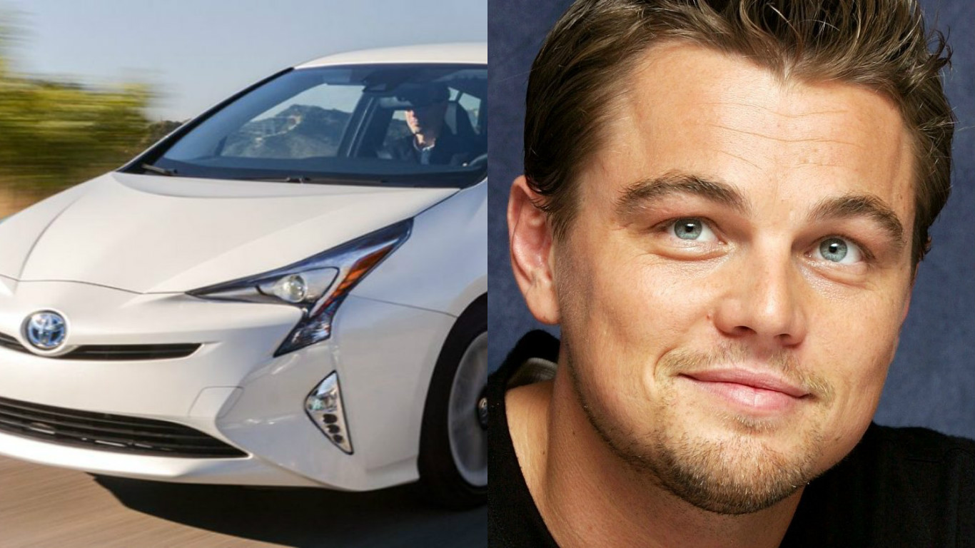
Problem Statement
The Irish motorist needs a financial reason to choose EV’s because currently there is only an environmental reason.

Slide 5

Solution
ESB EV club allows new EV owners generate additional income by selling excess power. Our EV Club platform will give control to customers to meet their transport and home energy needs

Slide 6
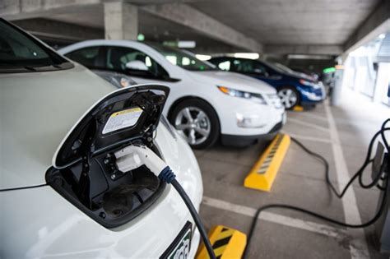
Solution
Cars are predominantly left idle outside the office and at home overnight.
Charging can be performed at any point during the night
Utilize the battery when there is high demand on the grid
Only use 25% of capacity so as to not inconvenience the customer
User App controls if the system can take power from the car or not. Ie the customer is looking to

Slide 7
Plans
Connect Car to Grid from 5 → 7pm, get free electricity
20% EV Battery Cost
80% Home Electricity Cost
More connected more saving

Slide 8
The Ask
100k, 3 people for 12 months

Slide 9
Plans

