Slide 1
Final For SOA
The design system IoT broadcasting heavy rain warning using 4G/5G and LoRa Technology
Speaker: Chi-Duong, Ngo(吳志陽)
ID: M11128033

Slide 2
Content
1. Overview
2. Design Hardware
3. Design Software
4. Result

Slide 3

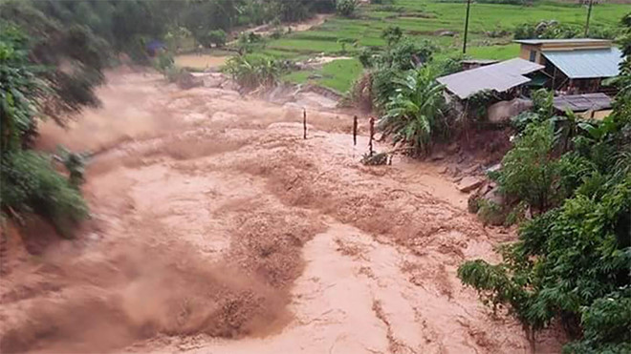
1. Overview
Landside cause a lot of damage to people and property in VietNam
The one of main reason is the heavy rain during a long time
50-100 mm/24h
Rainfall
>100 mm/24h

Slide 4




1. Overview
Web Server
SMS
4G
SMS
Staff
HTTP
HTTP
Staff
UART
Rainfall
Datalogger
LoRa
Broadcasting
Datalogger
Rainfall sensor
Loudspeadker
Rain station
Broadcasting station
Antena 4G
Antena 4G
AC
AC
BAT
Power converter
4G/5G module
Power converter
4G/5G module
BAT
Control Unit
Rainfall sensor
Control unit
Temperature and humidity
LoRa module
Antena
LoRa
SD Card
LoRa module
Power Amplifier
Rainfall datalogger
Antena LoRa
Broadcasting datalogger
Loudspeaker

Slide 5
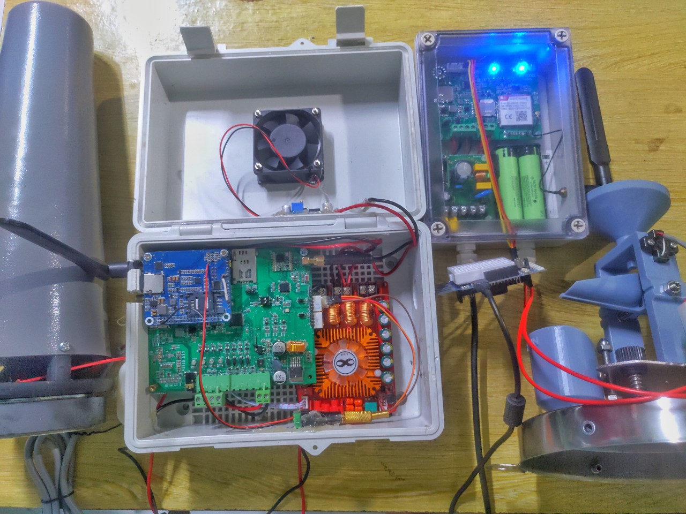
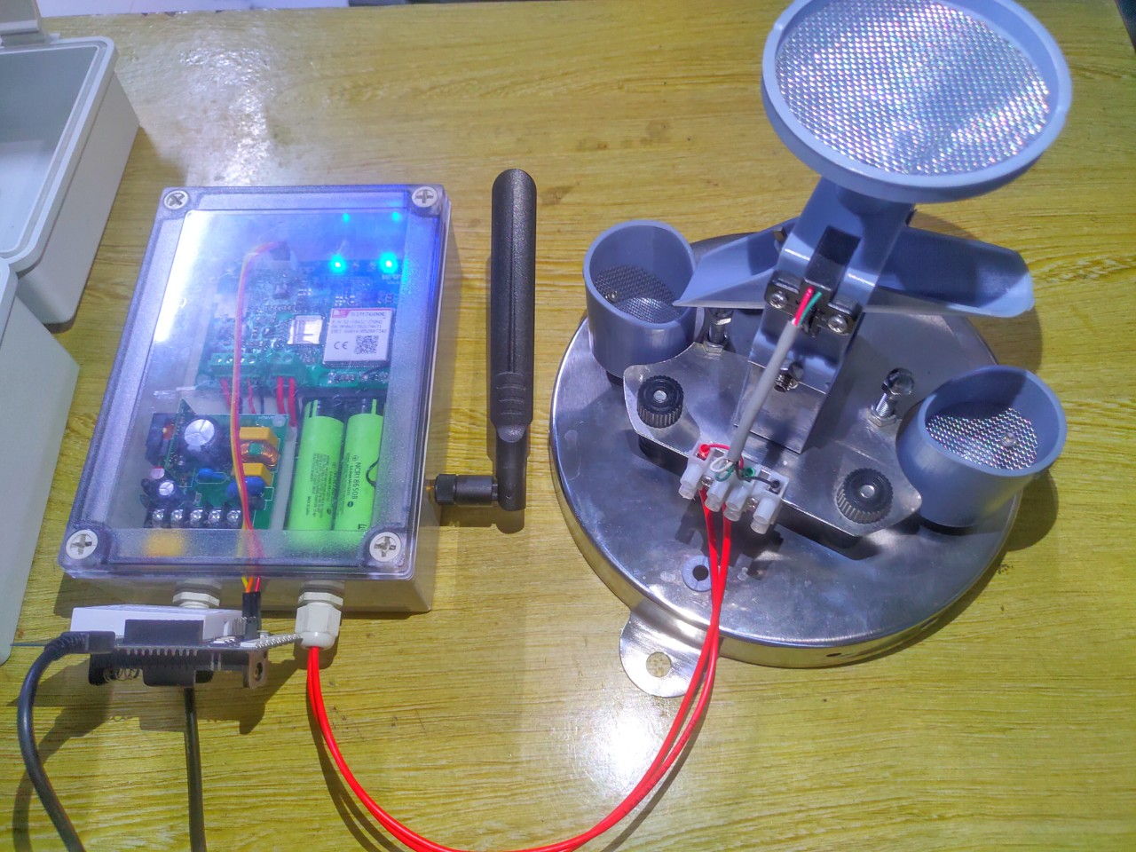
2. Design Hardware
Structure of real system

Slide 6
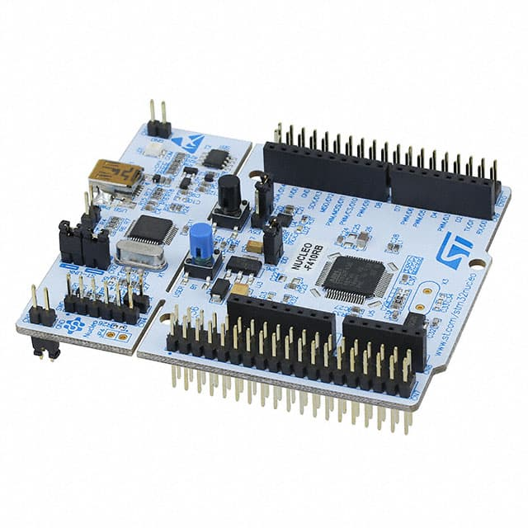
2. Design Hardware
Firebase Database
Structure of demo system
HTTP PUT
HTTP
GET
Rain station using
Python
Broadcasting station using
Python
UART COM 5
UART COM 3

Slide 7
3. Design Software
- Because the secret the technology, in this presentation, I will present about the software of the demo system. It will be relating the SOA course.
Start
Firmware Algorithm flowchart
Interrupt Service Rountine from UART
initialize Peripherals
Handling the data
Check the timer >= 2s
Send the Data
via COM3
Generate the rainfall Data
Send the Data
via COM5
end

Slide 8
3. Design Software
Rain Station Python Algorithm flowchart
Start
Start
key = input()
Initialize parameter of UART
key == ‘q’ ?
Thread 1
uart == true?
Thread 2
uart = FALSE
read data via COM5 and formart data to Json
break
end
Send HTTP request with PUT method

Slide 9
3. Design Software
Broadcasting Station Python Algorithm flowchart
Start
Start
data >warning data
key = input()
Initialize parameter of UART
key == ‘q’ ?
uart == true?
Thread 1
Send data via UART COM3
Thread 2
uart = FALSE
Send HTTP request with GET method
break
Handling the data
end

Slide 10
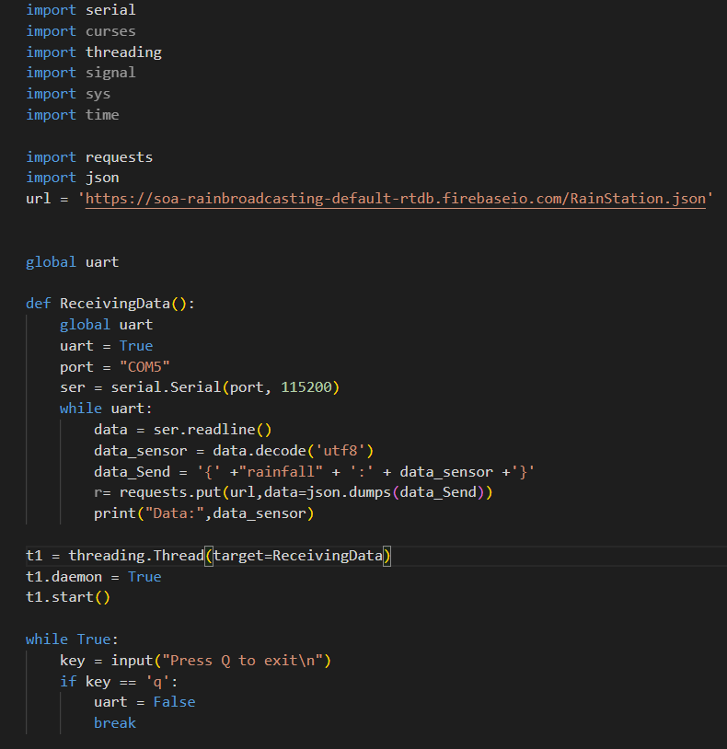
4. Result
Import Library
url to HTTP Server - Firebase
Initialize the UART parameter
Receive data from UART
Format to JSON data
HTTP request with PUT method
Running with Threading

Slide 11
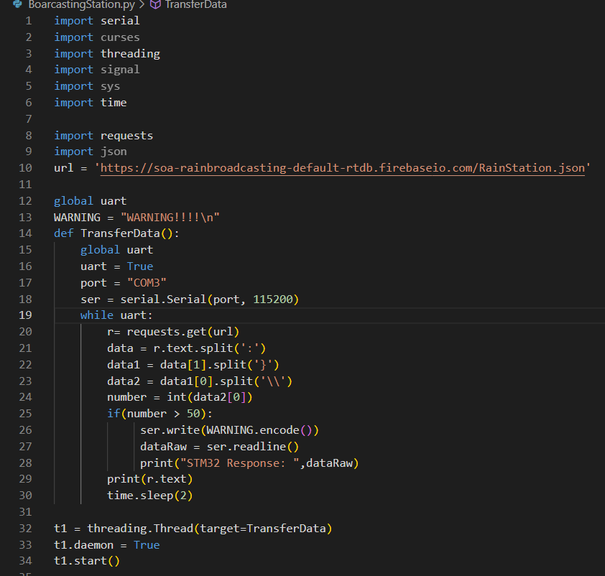
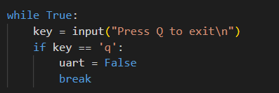
4. Result
Import Library
url to HTTP Server - Firebase
Initialize the UART parameter
HTTP request with GET method
Handling the data and send if the data > warn data
Running with Threading

Slide 12
DEMO Prototype

Slide 13
Thank for your listening

