Slide 1
Predicting Corporate Bankruptcy Using Financial Ratios
Springboard Data Science Capstone Project
A Focus on Minimizing Type II Errors
Suk Won Choi

Slide 2





Problem & Goal
Corporate Bankruptcy Can Lead To:
Financial Loss
Damage In Reputation
Time & Efforts To Recovery
Loss In Opportunities
Bankruptcy
Financial Loss
Reputation Damage
Develop a Reliable Model That:
Effectively Distinguish Between Companies At High Risk of Bankruptcy and Those That Are Not
Minimize Costly Errors
Time to Recovery
Opportunities Loss

Slide 3





Overview
At-a-glance
Data
EDA
Feature Engineering
Modeling
Performance Evaluation
Provide a summary of the dataset, including key features, class distribution, and any initial insights.
Analyze the data to uncover patterns, relationships, and anomalies, and visualize key trends
Create new features, handle outliers, and address multicollinearity to enhance model performance.
Build and compare multiple machine learning models to predict bankruptcy, optimizing for the best performance.
Assess relevant model metrics to determine the most reliable prediction model.

Slide 4
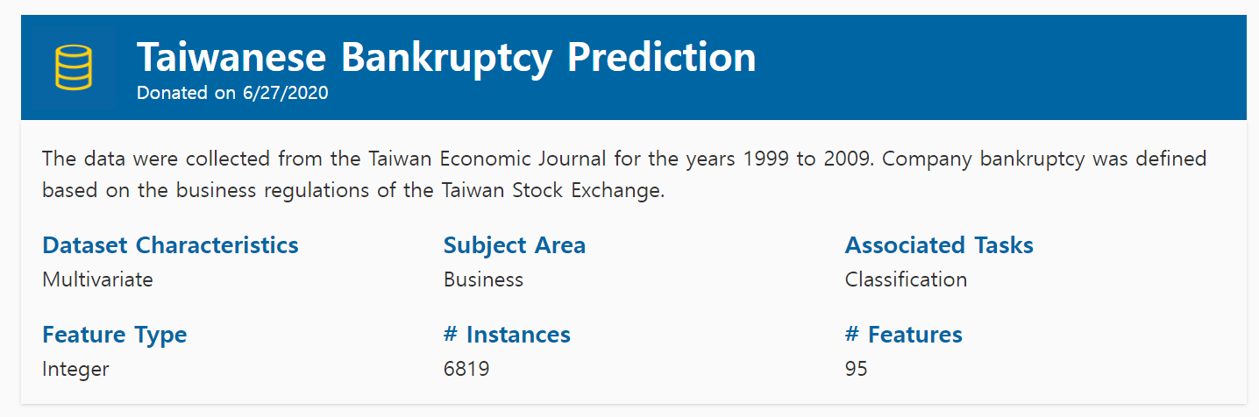
Dataset Overview (1) Data Source
Data Source: UCI Machine Learning Repository
Data Source: https://archive.ics.uci.edu/dataset/572/taiwanese+bankruptcy+prediction

Slide 5
Dataset Overview (2) Binary Target Variable
High Imbalance: Bankrupcy vs Non-Bankruptcy
96.9%
3.1%
Bankruptcy
Non-Bankruptcy

Slide 6
Dataset Overview (3) Features
93 Numerical Features and 2 Categorical Features
Profitability
Liquidity
Solvency
Activity
Growth
Other
Numerical
(93)
Features
(95)
Categorical
(2)
Net Income Flag
Liability-Assets Flag

Slide 7
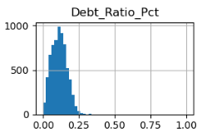
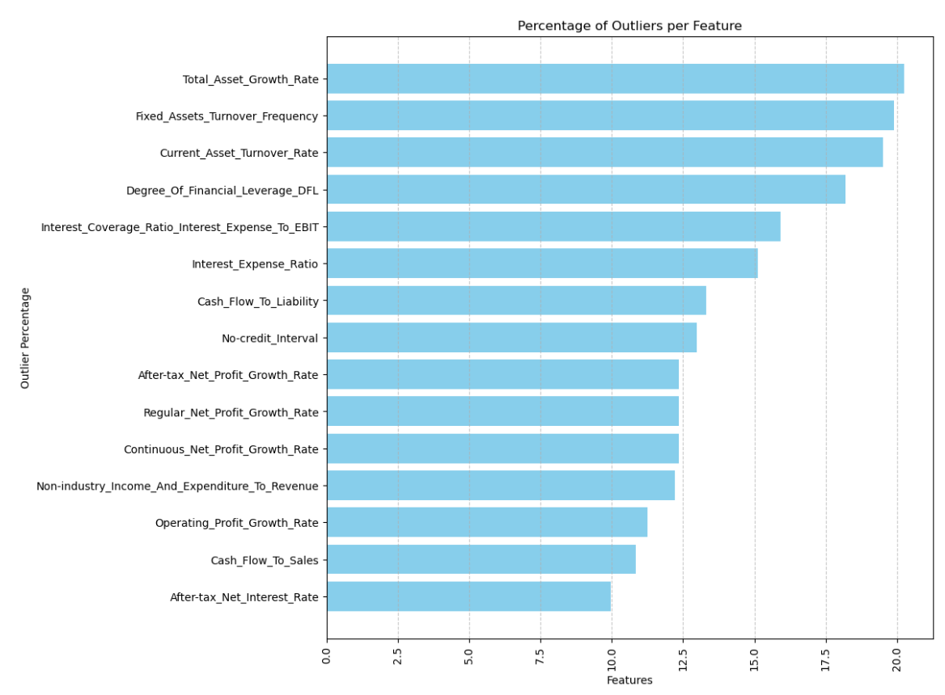
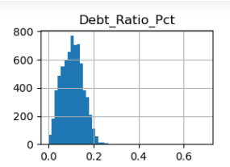
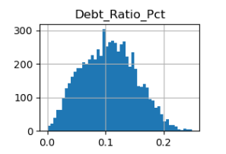
Exploratory Data Analysis (1) Numerical Features
Trade-off: Clean Distribution vs. Retaining Critical Information
Skewed Distribution by Outliers
High Proportion of Outliers
Original
Log Transformed
VS
Outlier Removed

Slide 8
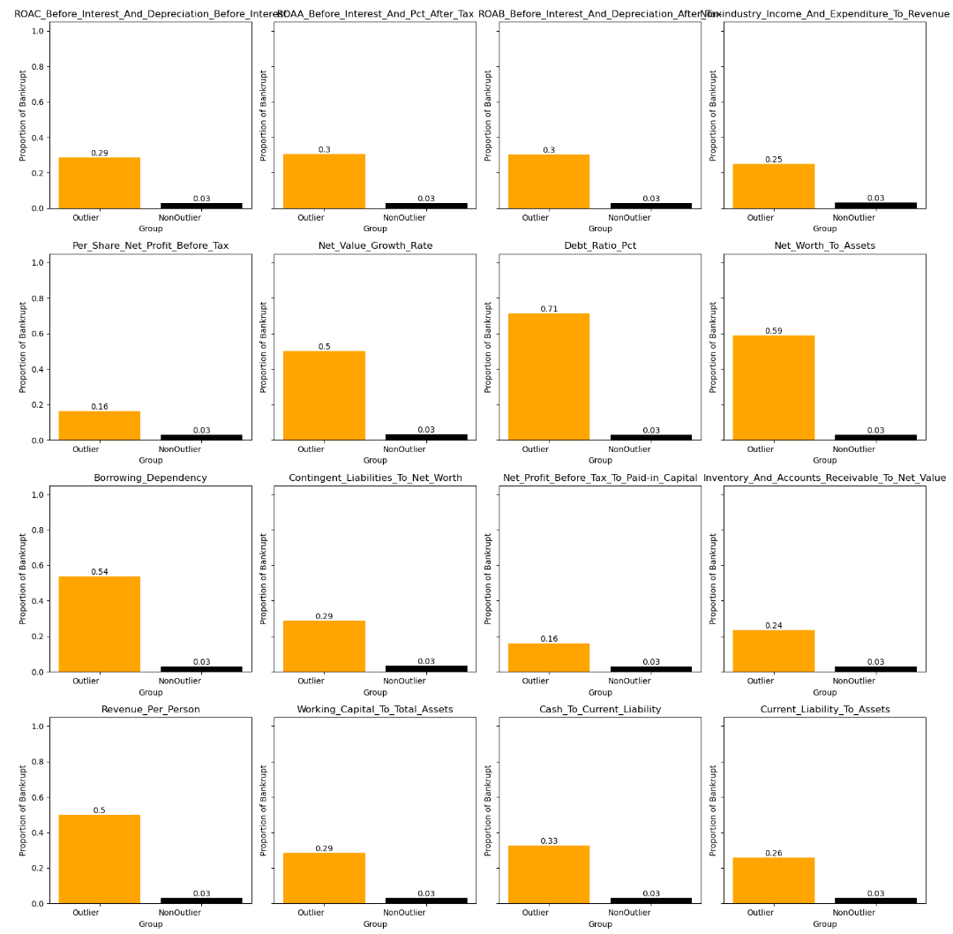
Exploratory Data Analysis (2) Outliers
Outliers Matter:
How Rare Events Drive Predictions
Critical Insights Hidden in Outliers: Essential for Predicting Extreme Events

Slide 9
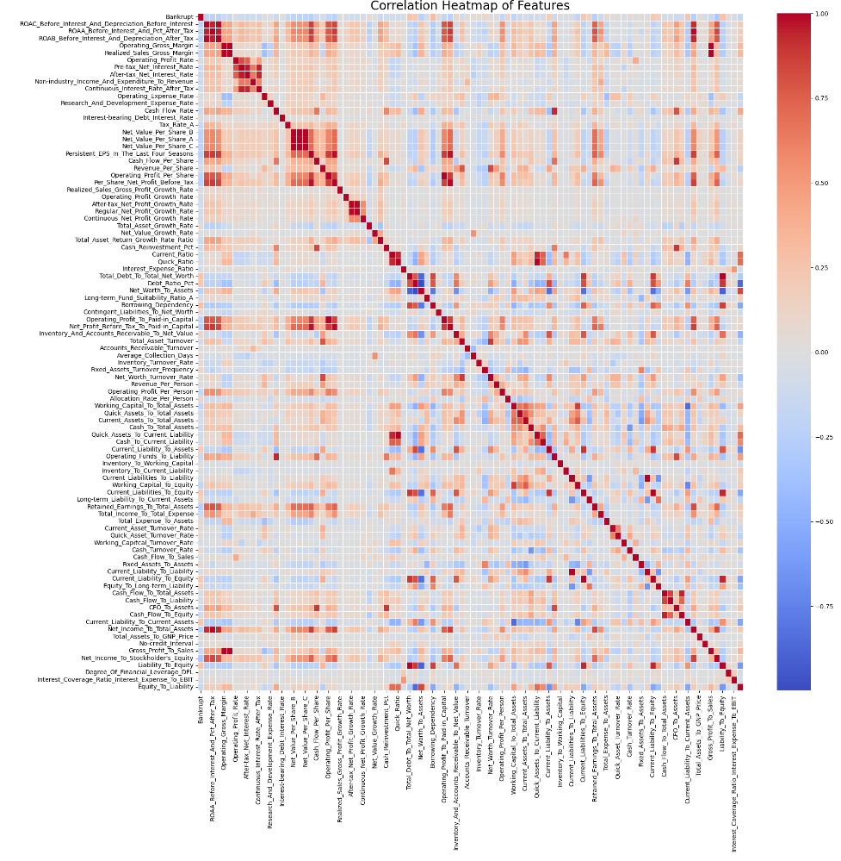
Exploratory Data Analysis (3) Relationship Between Features
Multicollinearity Alert
131 Feature Pairs with High Correlation (>0.7)
Tackling Multicollinearity
Applying Feature Selection or Dimensionality Reduction

Slide 10
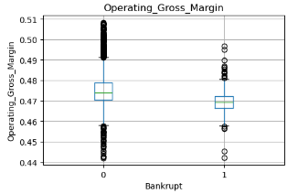
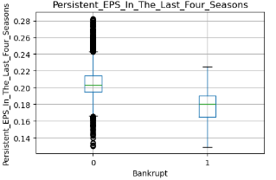
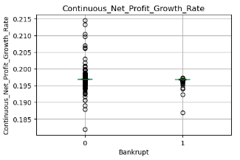
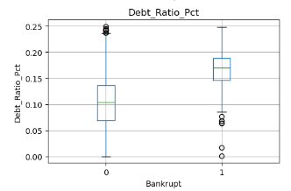
Exploratory Data Analysis (4) Numerical Features and Target Variable
Useful Features For Prediction
Profitability:
Operating Gross Margin, ROA related features, Sales Gross Margin, etc.
Profit:
EPS, Operating Profit, Net Profit, Cash Flow, etc.
Growth:
Net Profit Growth Rate, Operating Profit Growth, etc.
Stability (Solvency or Liquidity Ratios):
Current Ratio, Quick Ratio, Debt Ratio, Net Worth to Asset, etc.

Slide 11
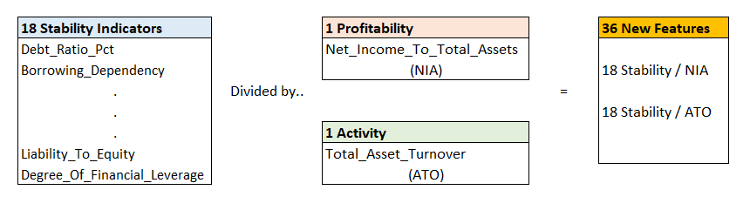
Feature Engineering: New Feature Generation
Ratio Between Features: 36 New Features
1
Outlier Dummy Features: 30 New Features
2

Slide 12
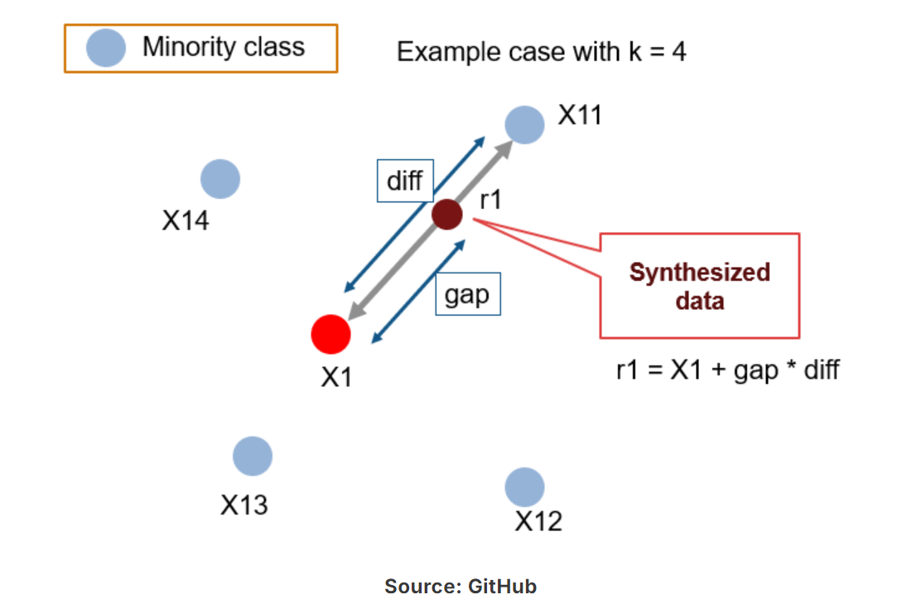
Modeling (1): Balancing the Dataset
SMOTE:
Synthetic Minority Oversampling Technique
Generating synthetic examples for the minority class to improve model performance
Analyzing existing minority data points and then generating new ones similar to them

Slide 13
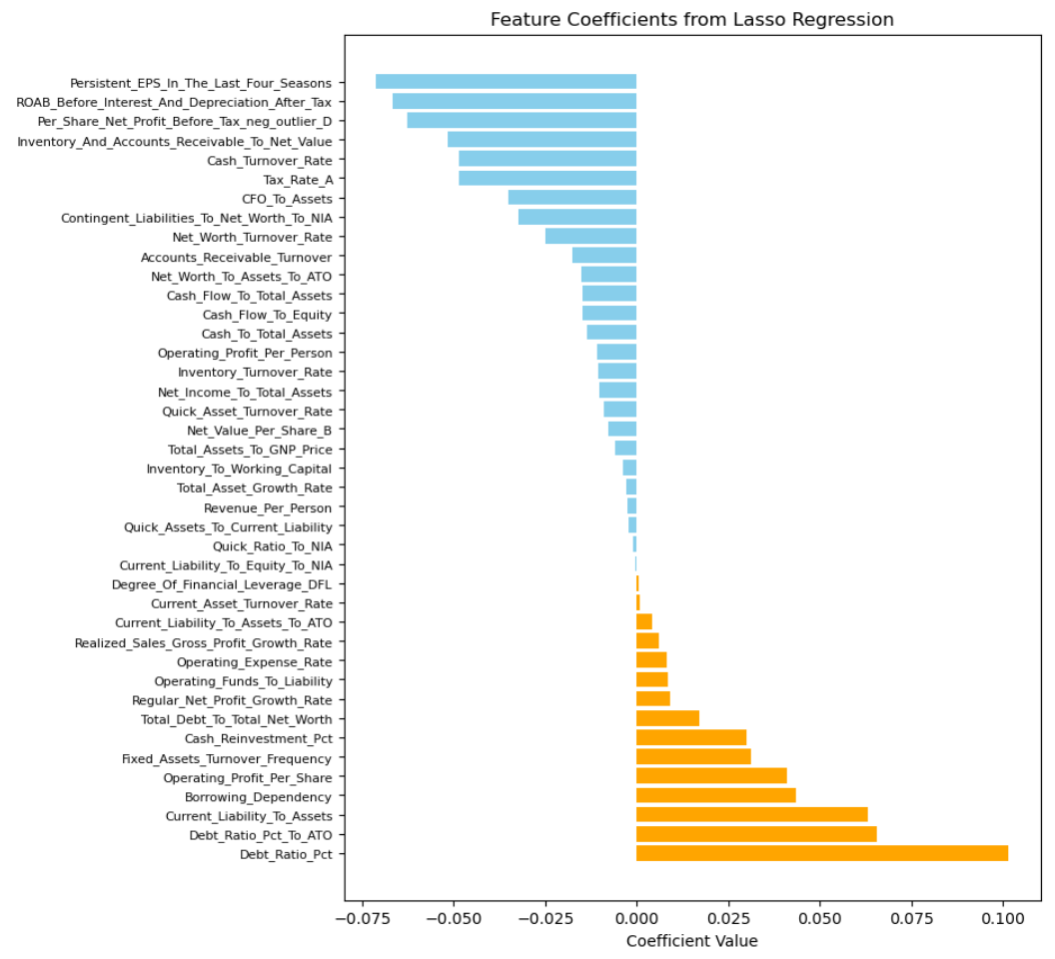
Modeling (2): Feature Selection
Lasso Regression
1
Penalizing less important features, effectively shrinking their coefficients to zero
Selected 41 features for modeling, which is almost a quarter of the original 158 features
Inverse relationship with bankruptcy: Profitability and Activity Ratios
Positive relationship with bankruptcy: Solvency and Liquidity Ratios
7 newly generated indicators included

Slide 14
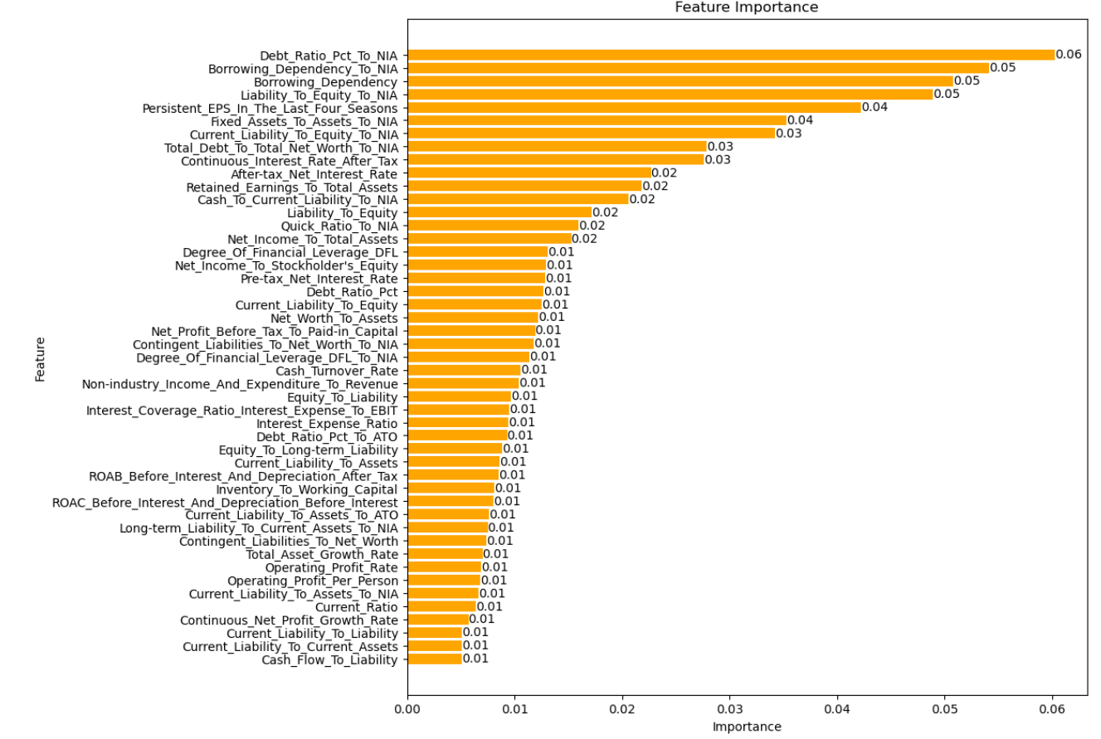
Modeling (2): Feature Selection
Random Forest
2
Evaluated feature importance by measuring how much each feature reduces impurity
Selected 47 features for modeling
Included 14 newly generated indicators based on interaction terms
6 newly generated indicators among top 10 most important features

Slide 15
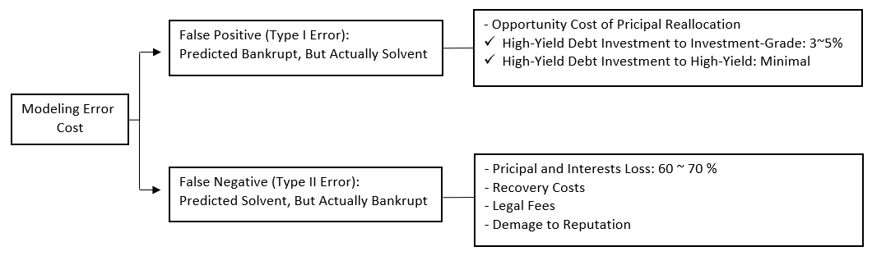
Modeling (3): Setting-Up Evaluation Metrics
Cost Implications of Error Types
False Negative Error Cost > False Positive Error Cost
The most reliable performance metric: Recall > Precision > Accuracy
F-Beta Score: Enabling weight more on Recall than Precision

Slide 16
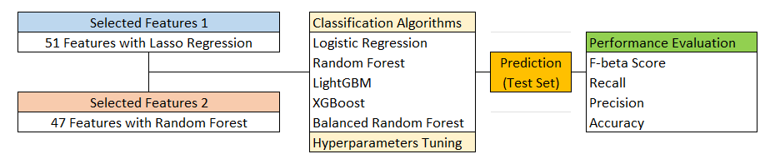
Modeling (4): Model Building
Fitting Models With 5 Different Algorithms
Two-Sets of Selected Features
Logistic Regression, Random Forest, LightGBM, XGBoost, and Balanced Random Forest
Comparing 10 Results Using F-beta, Recall, Precision, and Accuracy

Slide 17
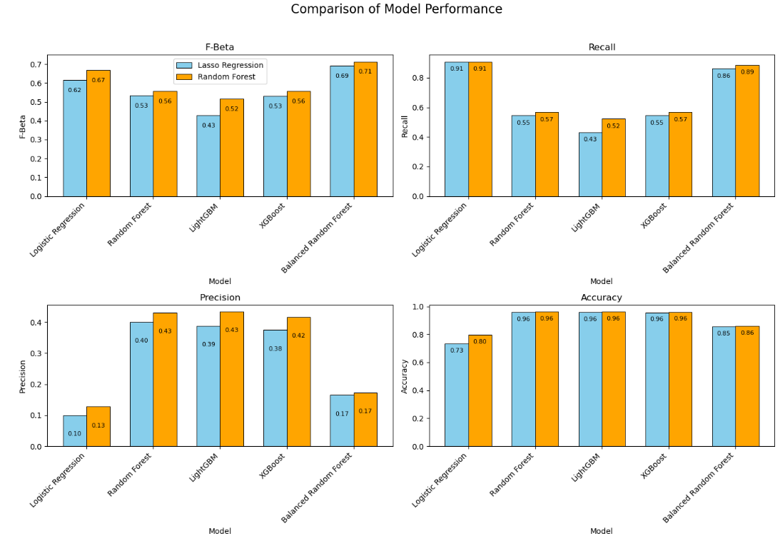
Modeling (5): Performance Evaluation
What is the Best Model?
Random Forest Is Better for Feature Selection
Best F-beta score achieved with Balanced Random Forest
Logistic Regression considered as a conservative alternative

Slide 18
Application of the Model
Enhanced Risk Management Strategies
Strategic Investment Decisions
Regulatory Compliance and Reporting
Decision Support Systems
1
2
3
4

Slide 19
Further Research
1
Incorporating Additional Data Than Historical Financial Data
Analysts' Financial Estimates
Stock Market Data
Macro Economic Data
Enhancing Model Complexity
Combining multiple models or using advanced ensemble techniques
Investigating deep learning methods such as neural networks
2

