Slide 1
Predictive Modeling For Airbnb Price
Springboard Data Science Capstone Project
A Comparative Study of Models and Techniques
Suk Won Choi

Slide 2
I. Problem: Optimizing Pricing Strategies for Airbnb Listings
Challenges:
Inefficient pricing models overlook diverse factors.
Leads to suboptimal pricing, missed revenue opportunities, and host dissatisfaction.
Proposed Solution:
Develop a data-driven, scalable pricing model.
Integrates property features Including property attributes, amenities, location, and description
Provides accurate price predictions and clear insights.
Benefits:
Builds host trust in recommendations.
Maximizes revenue and occupancy rate.

Slide 3





Steps To Solution
At-a-glance
Data Cleaning
EDA
Feature Engineering
Modeling
Performance Evaluation
Converse data types, handle missing values, remove irrelevant columns, and create some features
Analyze the data to uncover patterns, relationships, and anomalies, and visualize key trends
Identify, engineer, and refine critical features to enhance the model’s predictive capabilities
Build a scalable pricing model using various machine learning techniques to accurately predict daily rental prices
Assess relevant model metrics to determine the most reliable prediction model.

Slide 4
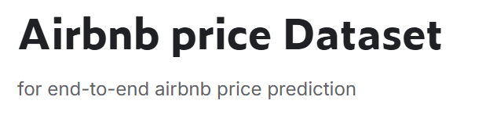

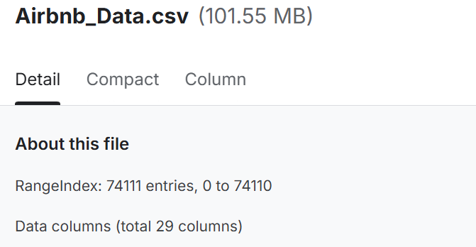
II. Dataset Overview
Data Source: Kaggle
Data Source: https://www.kaggle.com/datasets/rupindersinghrana/airbnb-price-dataset/data

Slide 5
III. Data Cleaning
Missing Values Imputation
Removal of Irrelevant Columns
Conversion of Data Types
Creation of New Feature
Check duplication
Date-related columns to datetime format
Categorical variables to categorical data type
Numerical Features: Impute missing values in bathrooms, bedrooms, and beds using KNN, leveraging each other.
Categorical Features: Impute missing values in neighbourhood and zipcode using Random Forest, utilizing latitude and longitude.
Other Features: Impute their respective median values.
Removem non-informational, such as thumbnail_url, id, and name to streamline the analysis and avoid unnecessary complexity.
Is_new_listing feature was derived by checking if the host_response_rate, review_scores_rating, first_review, and last_review columns were all missing.
No duplicated rows

Slide 6
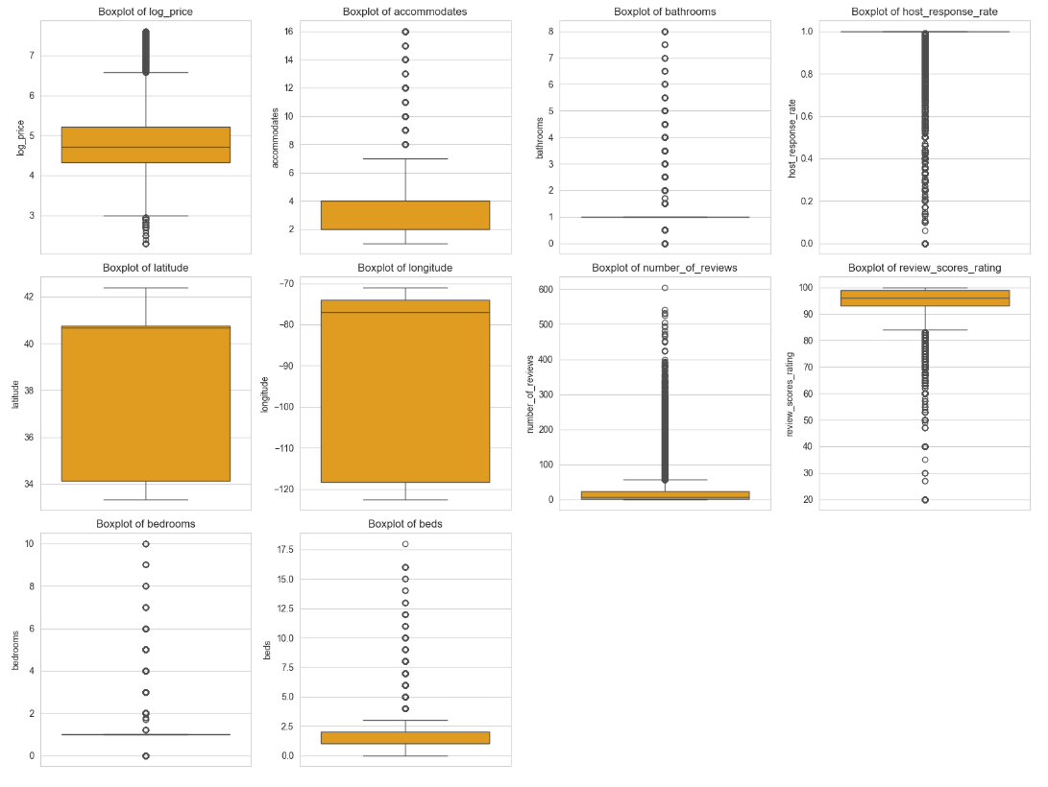
IV. Exploratory Data Analysis: Univariate Analysis
1-1. Distribution of Numerical Variables
Target Variable (log_price):
Symmetric distribution.
Unusually low prices removed as data entry errors
Accommodates, bedrooms, bathrooms:
Right-skewed with outliers, but realistic
Location Variables:
Left-skewed, no outliers
Other Numerical Variables:
Left-skewed, no abnormal outliers.

Slide 7
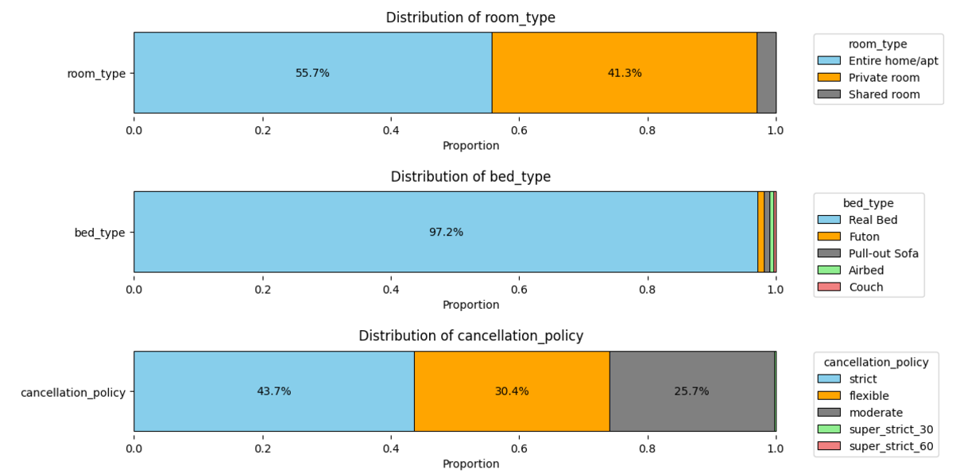
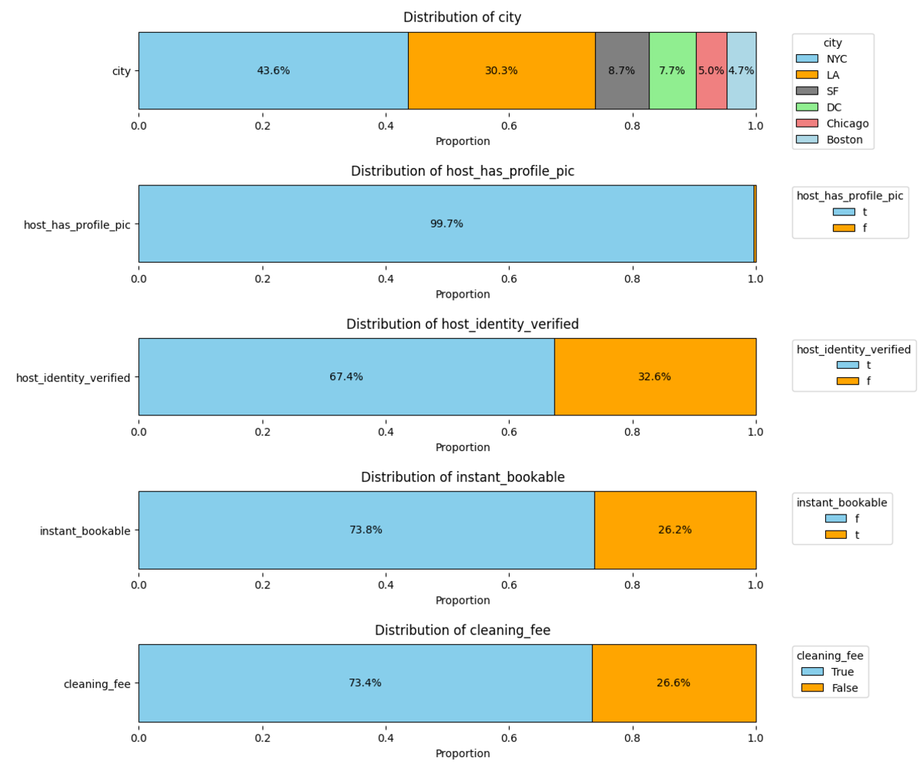
IV. Exploratory Data Analysis: Univariate Analysis
1-2. Distribution of Categorical Features
Room Type & Cancellation Policy: Categories are well-balanced.
Bed Type & Host Profile Picture: High concentration in one category likely reduces explanatory power for the target variable. Therefore, these features will be removed.
Other Features: No severe imbalance, so they can be used as features.

Slide 8
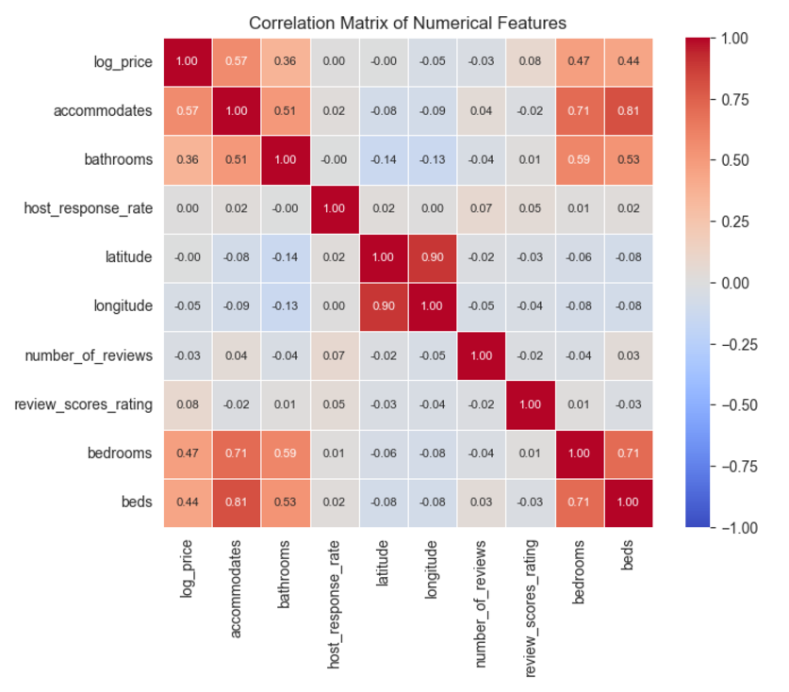
IV. Exploratory Data Analysis: Bivariate Analysis
2-1. Correlation between Numerical Variables
High Correlation with Target Variable:
Accommodates, Bedrooms, Bathrooms, and Beds: High correlation with log_price.
Multicollinearity Among Features:
Accommodates, Bedrooms, Beds: Correlation coefficients exceed 0.7.
Modeling Approach:
Lasso Regression: Used as a baseline model to mitigate multicollinearity through feature selection.
Random Forest, XGBoost, GBM, and MLP to be compared for performance, as they are less affected by multicollinearity.

Slide 9
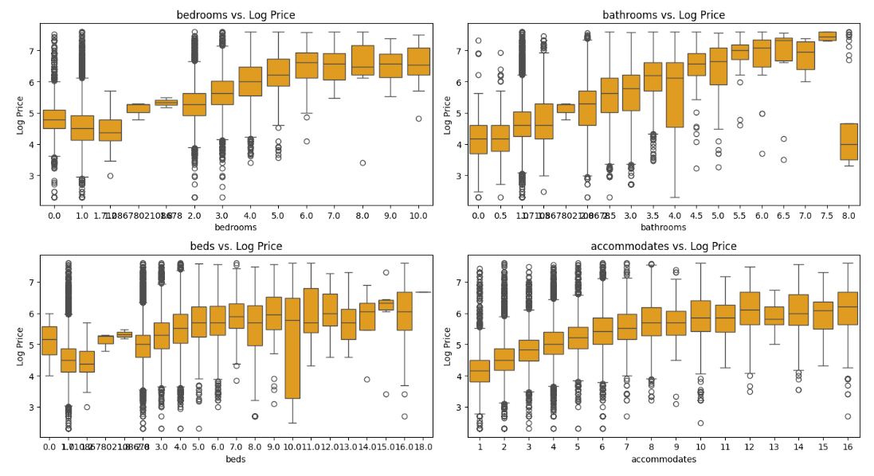
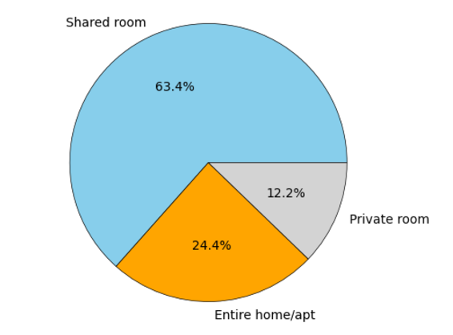
IV. Exploratory Data Analysis: Bivariate Analysis
2-2. Target vs Non-Continuous Numerical Features
Positive relationship between the features and target variable
Notably lower log price at Bathrooms = 8
Most of these listings are shared rooms, which significantly affects pricing.
< Room Type Distribution for Properties with 8 Bathrooms >

Slide 10
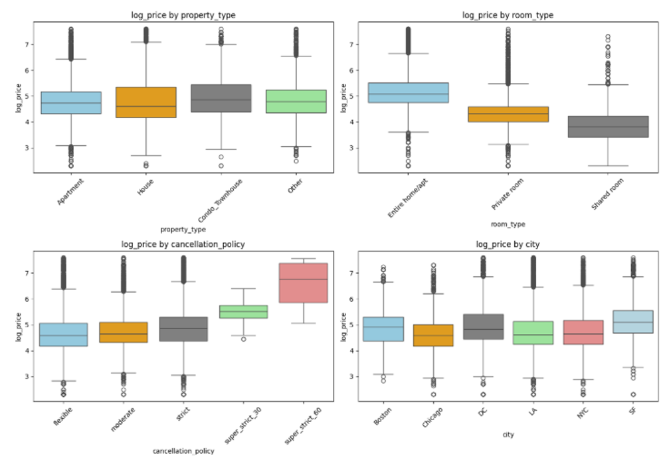
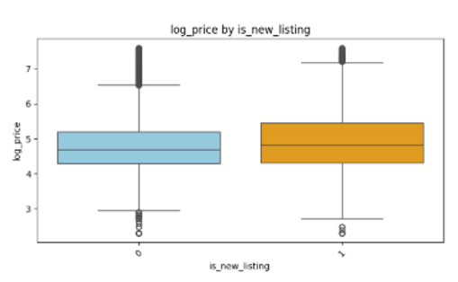
IV. Exploratory Data Analysis: Bivariate Analysis
2-3. Target vs Categorical Features
Room Type: Entire home/apt has the highest prices, followed by Private room, with Shared room being the lowest.
Cancellation Policy: Stricter policies correlate with higher prices, indicating premium offerings.
City: Boston, Washington, D.C., and San Francisco show significantly higher prices due to local demand and market dynamics.
New Listing Status: New listings are priced higher, suggesting a premium for fresh properties.
Other Features: Some categorical variables show minimal impact on pricing differentiation.

Slide 11
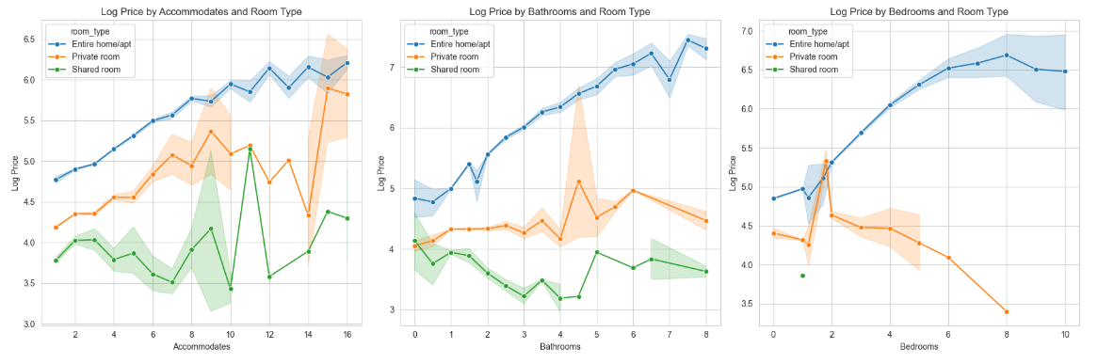
IV. Exploratory Data Analysis: Bivariate Analysis
2-4. Interaction Effects
Feature Interactions Exist: Notable interactions observed, e.g., between room_type, bedrooms, bathrooms, and accommodates.
High Dimensionality Challenge: Explicitly testing all interactions is impractical due to the large number of features.
Model Suitability: Tree-based models and AI methods, which inherently capture interactions, are expected to outperform Lasso regression.

Slide 12
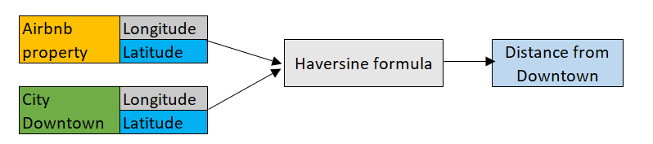
V. Feature Engineering: Creating New Features
1. Distance from Downtown
Distance Computation: Calculated using Haversine formula, which measures great-circle distance on Earth's surface.
Impact on Pricing: Properties closer to downtown areas likely have higher demand and revenue potential.
Why Haversine?: Ensures accurate measurements by accounting for Earth's spherical shape.

Slide 13
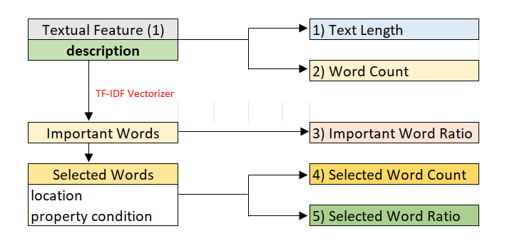
V. Feature Engineering: Creating New Features
2. New Features from 'description' column: Features Generation From Text
Text Length and Word Count: Calculated total length of the description and the word count
Important word ratio using TF_IDF: Applied a TF-IDF vectorizer to extract the 300 most important words and calculated the ratio of these words to the total word count
Selected Word Count and Selected Word Ratio: Filtered important words based on their potential relevance to pricing and demand (e.g. location and property condition-related words)

Slide 14
V. Feature Engineering: Creating New Features
3. New Features from 'amenities' column: Features Generation From String
Total Number of Amenities: The total count of amenities available in each property
5 Clustered Amenities Groups:
Divided properties into 5 clusters based on amenities using the K-Means algorithm.
Optimal K Selection: Determined using the Elbow Method for effective grouping.
4. Hosting Duration
Converted The host_since feature, which indicates when the host began offering their property, into a numerical feature reflecting the number of years a host has been active.

Slide 15
V. Feature Engineering: Encoding Categorical Features
5. One-hot Encoding
Converted categorical variables into a series of binary columns, enabling the model to interpret these categorical variables in a numerical format
property_type, room_type, cancellation_policy, cleaning_fee, city, host_identity_verified, instant_bookable, and amenities_cluster
6. Binary Encoding: zipcode and neighbourhood
Zipcode (669 categories) and neighbourhood (619 categories) posed risks of overfitting and inefficiency with one-hot encoding
Applied binary encoding, reducing dimensionality to 10 columns per feature.
Preserved category uniqueness while ensuring a compact, efficient feature set.

Slide 16
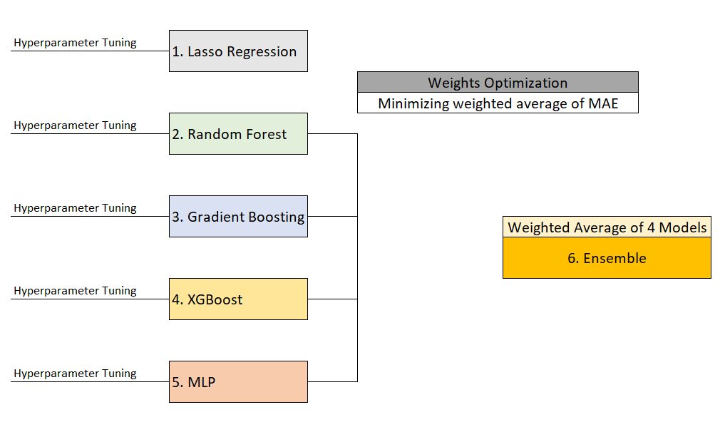
VI. Modeling and Performance Evaluation
Weights = [0.2, 0.2, 0.4, 0.2]

Slide 17
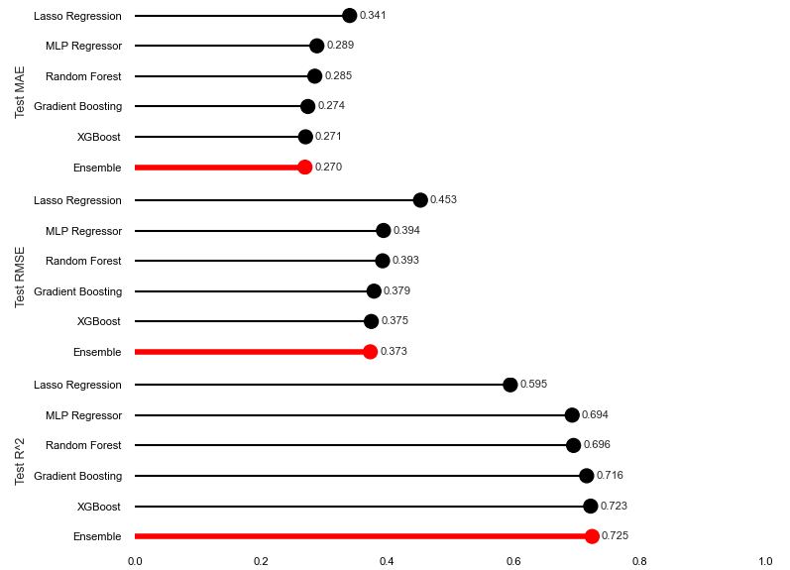
VI. Modeling and Performance Evaluation
Model Performance Overview
Ensemble Model: The best overall performer, delivering the most accurate and reliable predictions
XGBoost: A close second, with performance nearly on par with the Ensemble model.
Gradient Boosting (GBM): Slightly behind Ensemble and XGBoost but still achieves strong metrics.
MLP Regressor & Random Forest: Both models show similar performance, slightly less effective than the top performers.
Lasso Regression: The weakest model, limited by its inability to capture non-linear relationships and feature interactions.

Slide 18
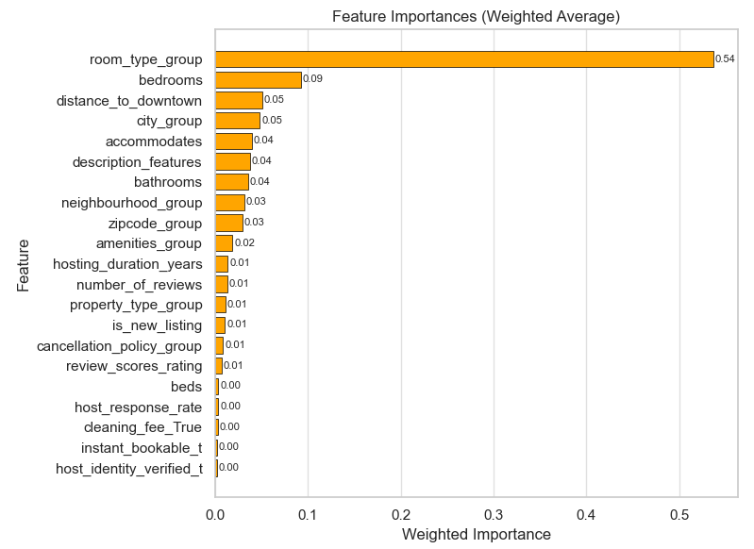
VI. Modeling and Performance Evaluation
Feature Importance
Room Type is the most critical feature, significantly influencing a listing's value and appeal.
Features like Bedrooms and Accommodates, describing property size and capacity, are highly impactful.
Location-related attributes (e.g., distance to downtown, city, zipcode) strongly affect desirability.
Amenities and property description provide meaningful explanatory power for listing quality.
Guest experience factors (e.g., Reviews, Host Response Rate) also contribute, though less prominently.
* Weighted Average of Normalized Feature Importance of XGBoost, GBM, and Random Forest * The importances of encoded features were aggregated to calculate the importances of the original features.

Slide 19
Application of the Model
Enhancing Booking Rates through Optimal Pricing
Market Competitiveness Analysis:
Evaluate a listing's competitiveness by analyzing similar properties and suggesting an appropriate price range.
Dynamic Pricing Strategies:
Implement models for peak and off-peak seasons, enabling flexible pricing to optimize revenue or minimize vacancy rates while covering fixed costs.
Property Value Enhancement Guide:
Help hosts improve listings by enhancing amenities, refining property descriptions, and highlighting location and condition to boost appeal, justify higher pricing, and increase bookings.

