Slide 1
Optimizing Ticket Prices for Big Mountain Resort
Data-Driven Recommendations for Enhanced Revenue

Slide 2
Identifying the Problem
Objective: Optimize ticket pricing to increase revenue without compromising customer satisfaction
Current adult weekend ticket price at Big Mountain Resort: $81.00
Key variables: Vertical drop, lift infrastructure, number of runs, snowmaking area
Importance of aligning pricing strategy with market positioning and resort capabilities

Slide 3
Recommendation and Key Findings
Increase adult weekend ticket price to $95.87 based on model predictions
Implement Scenario: Increase vertical drop and add additional chairlift to boost ticket prices and revenue
Increase the ticket price by $1.99 and revenue by $3,474,638
Monitor and manage operational costs to ensure profitability

Slide 4
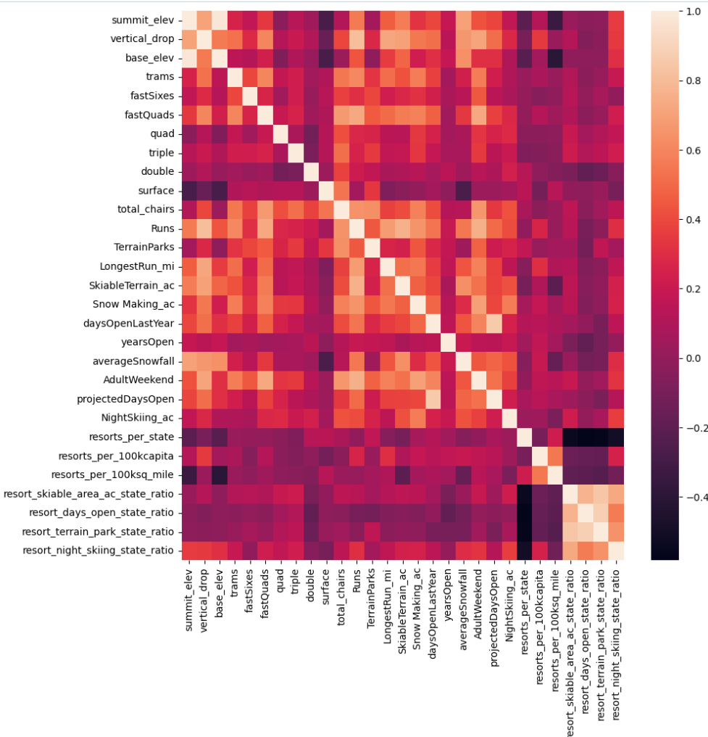
Correlation Analysis using Heat map: Ticket Price vs Features
Significant Positive Correlations:
Fast Quads
Runs
Snow Making Area
Total Chairs
Vertical Drop
Noteworthy Findings:
Night Skiing Capacity

Slide 5
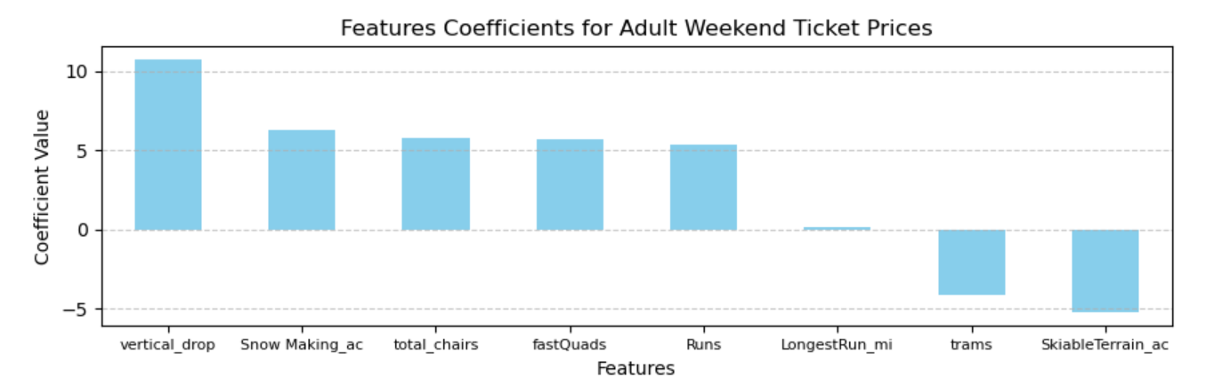
Linear Model Insights
Initial model with all features showed a symptom of overfitting
Wide gap of R-squared between train and test set: 82% vs 72%
Refined model with 8 features improved performance by selecting key features
vertical drop is the biggest positive feature, and skiable Terrain is the biggest negative feature

Slide 6
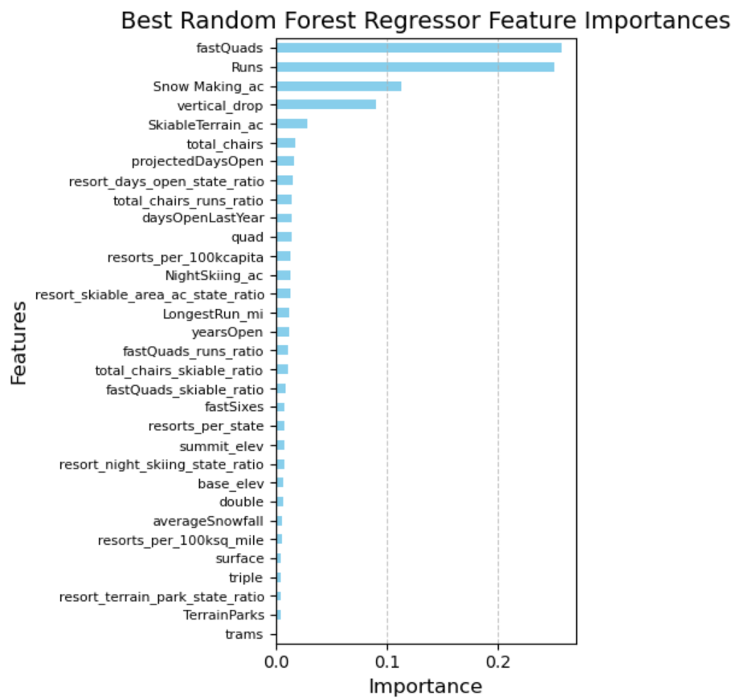
Random Forest Model Insights: Superior Model Performance
Random forest model outperformed linear model (CV score: 0.71)
Lower Mean Absolute Error (MAE) and smaller standard deviation than linear model
Important features: Fast quads, number of runs, snowmaking area, vertical drop
Upside room for ticket price by the model
Modelled price $95.87 and actual price $81.0.
Room for an increase even with the expected mean absolute error of $10.39

Slide 7
Scenario Analysis
Simulations under four scenario options
1. Permanently closing down up to 10 of the least used runs
2. Increase the vertical drop by adding a run to a point 150 feet lower down but requiring the installation of an additional chair lift
3. Same as number 2, but adding 2 acres of snow-making cover
4. Increase the longest run by 0.2 miles to boast 3.5 miles length, requiring an additional snow-making coverage of 4 acres
Best Performance Improvement under Scenario 2:
Price Increase: $1.99
Revenue Increase Over the Season: $ 3,474,638

Slide 8
Summary and Strategic Path Forward
Recommended price adjustment to $95.87 according to data-driven methodology
Prioritize Scenario 2 for revenue growth
Increase the vertical drop requiring the installation of an additional chair lift
Monitor costs to maintain profitability
Next steps: Implement recommendations, continuous performance monitoring, and analysis

