Slide 1




Francy Fu, Jim Cloud, William Hibner, Patrick Yu
Vehicle Accident Locations Near WashU

Slide 2
Our Inspiration
Safety - Where do vehicle accidents occur in and around Washington University
When do accidents occur?
Identify trends
Create awareness
Encourage change

Slide 3
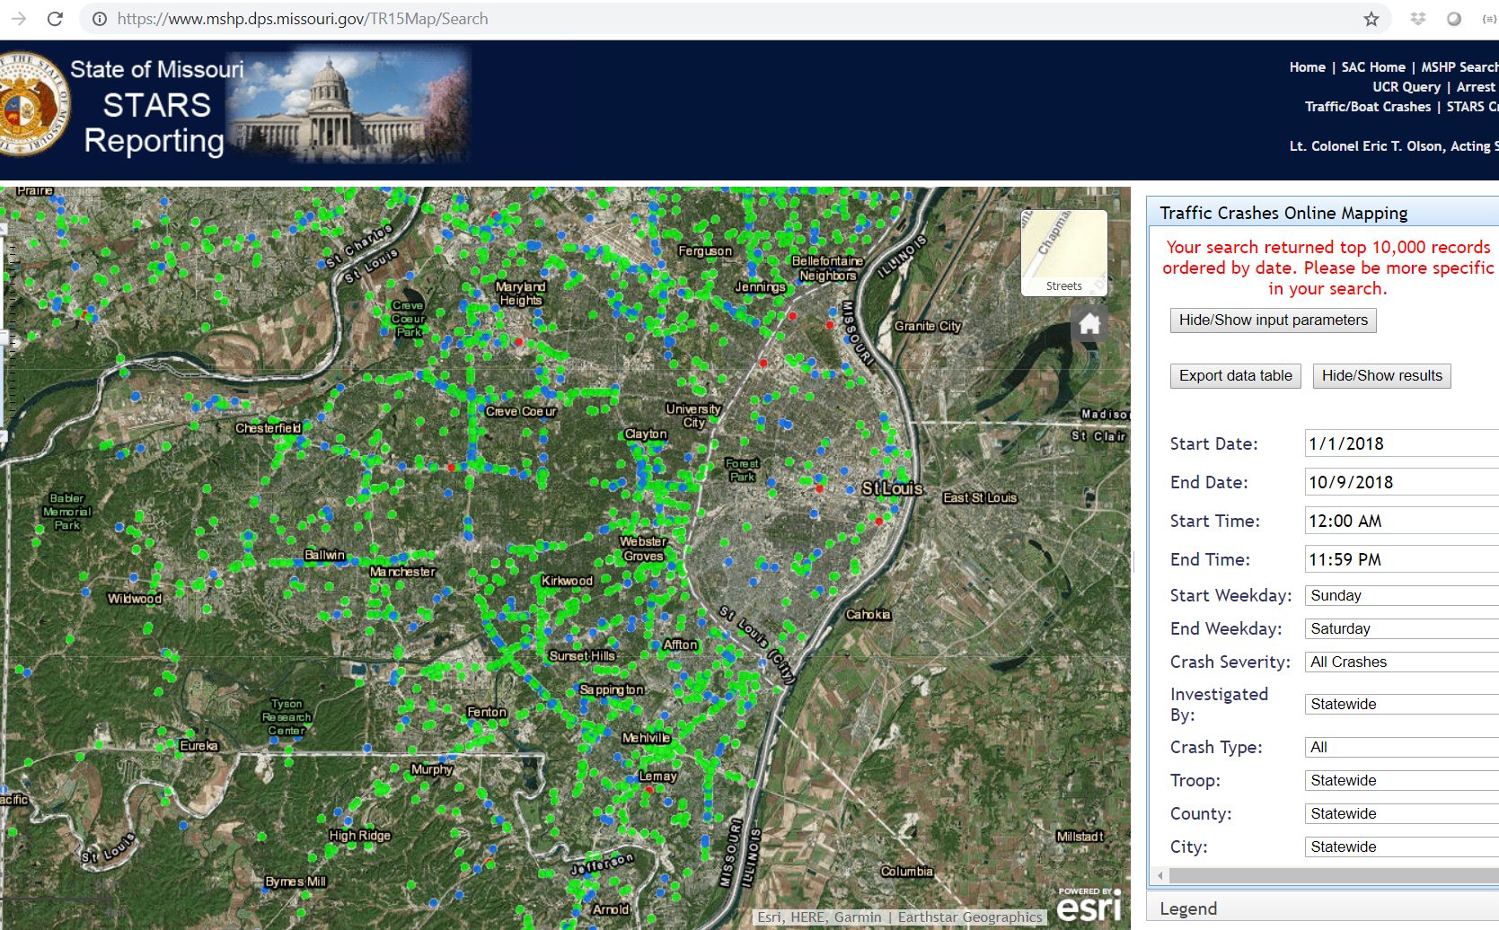
Data Source
Missouri State Highway Patrol Accident Data for City of St Louis, and St Louis County STARS - State Traffic Accident Reporting System

Slide 4
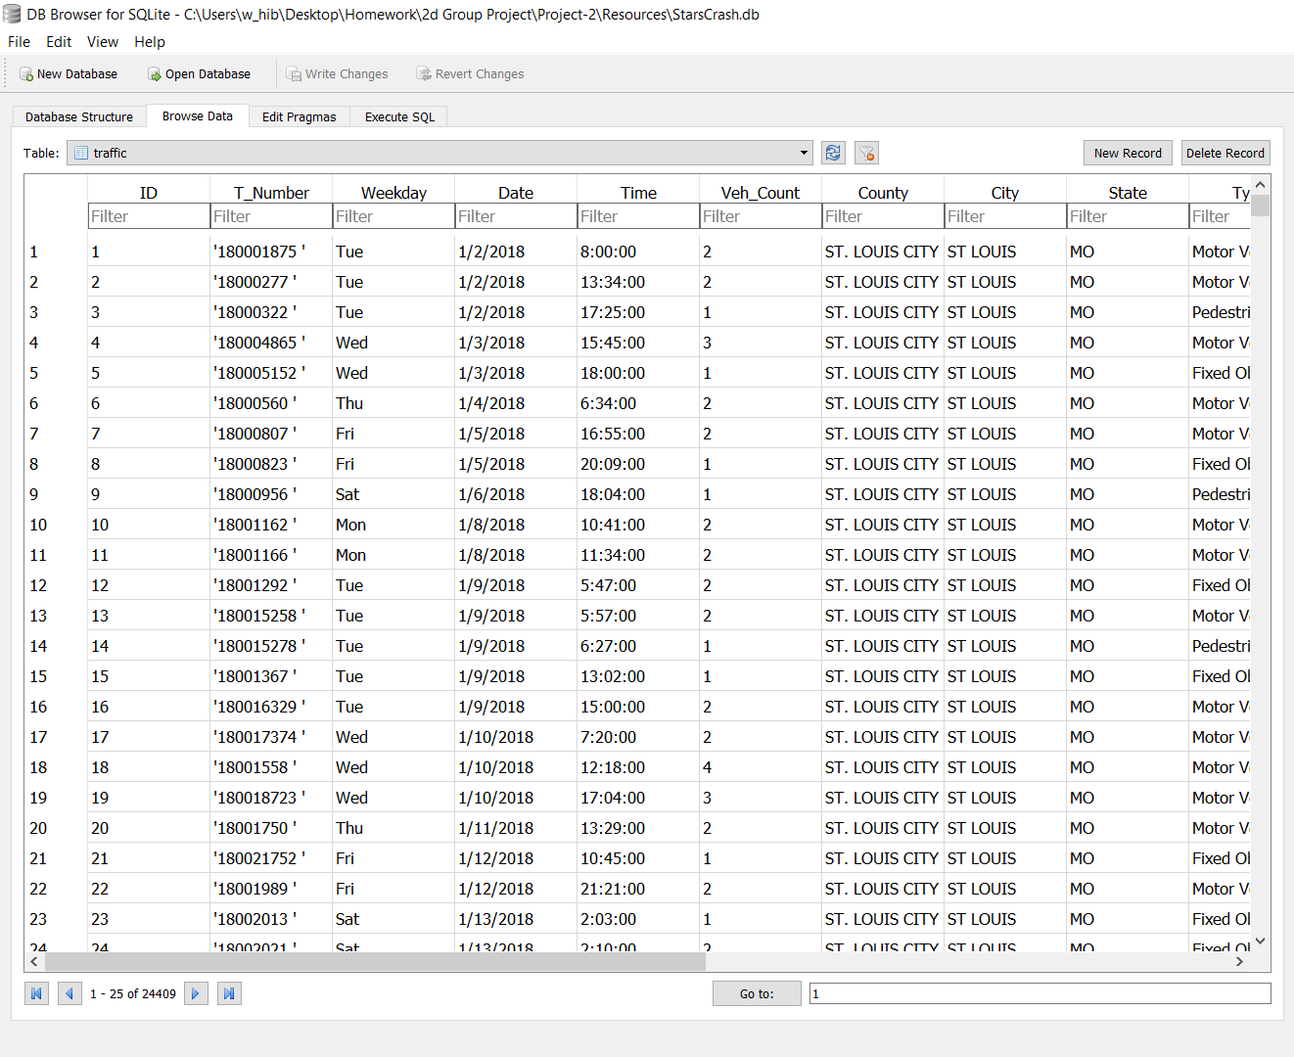
Data Munging
25, 400 records of accidents Jan – Oct 2018
Concatenate At & On Street locations to create an address
Converting address to Lat / Long utilizing an Excel Add-In
Some locations did not have enough info for a corresponding address

Slide 5
Data Snapshot
On average 86.5 accidents reported daily in & around WashU
147 fatal accidents recorded
959 accidents with injuries
Of 25,424 records 24, 409 had sufficient detail to create a Lat/Long to be plotted on a map
Most (6000) accidents occur in unincorporated areas followed by Chesterfield, Florissant, & Maryland Heights each reporting 1000+ accidents

Slide 6
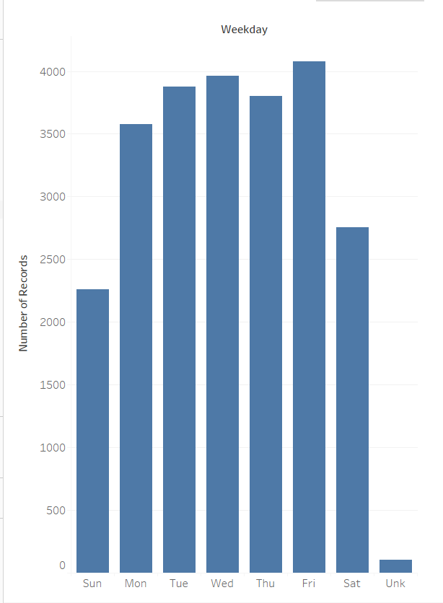
What Day of Week?
Accidents mostly occur during weekdays
Fridays have the greatest number of accidents
Sundays have the fewest accidents

Slide 7
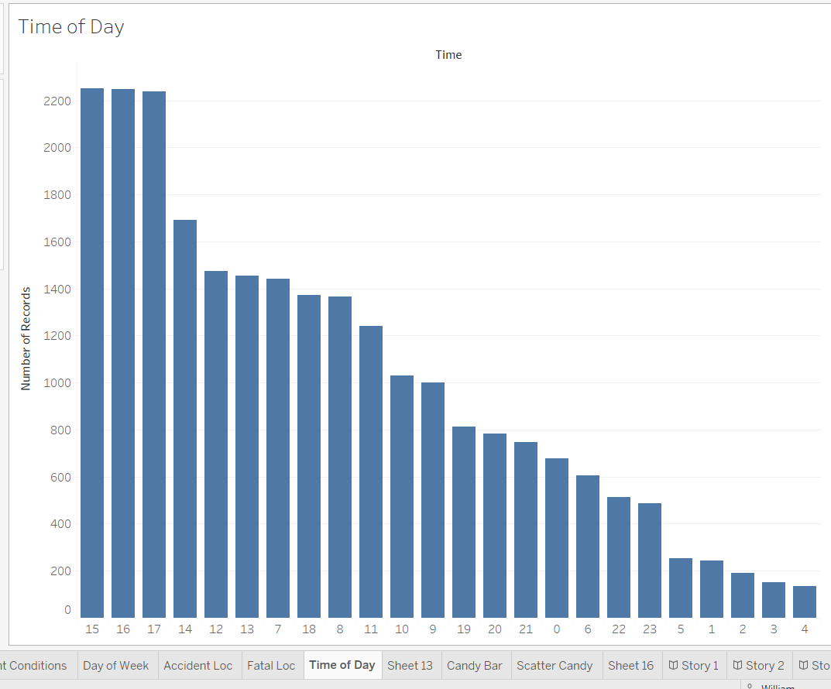
Time of Day
Accidents mostly occur 3-5pm
3-4 am have the fewest accident occurrences
24 Hour Clock

Slide 8
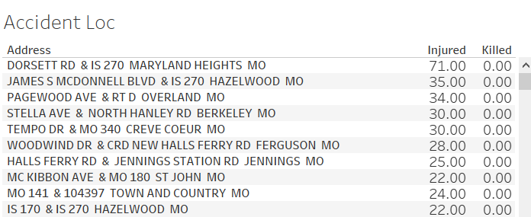
Locations with most injuries

Slide 9
Conclusion
Avoid locations with most injuries
Most accidents occur late afternoons and early evenings ?
Speak to elected officials to make regulatory and infrastructure improvements
Accidents can and do occur at all hours of day – drive carefully

