Slide 1
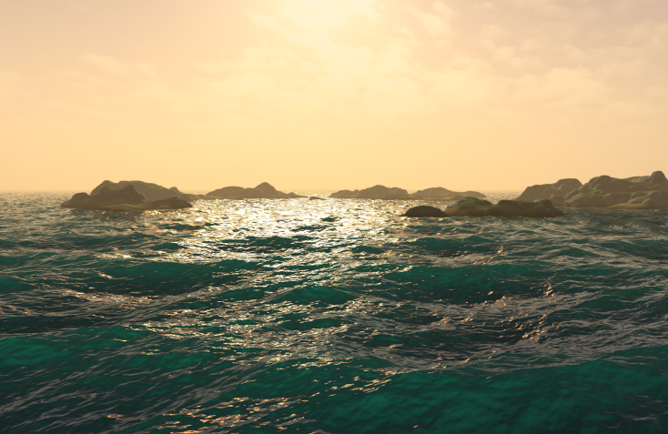
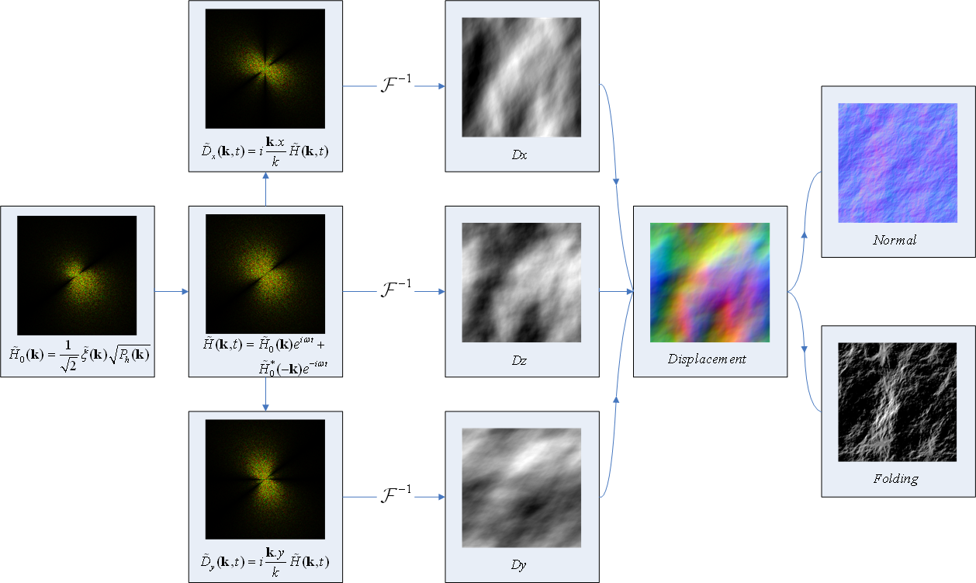
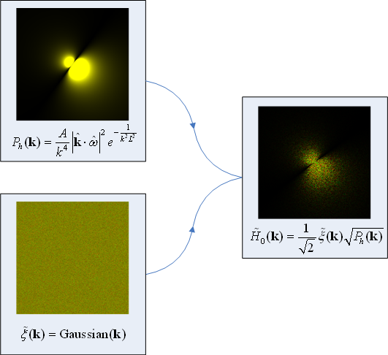
NVIDIA WaveWorks
Simulates wind-driven waves in real time using the GPU
Simulates in frequency domain, then performs inverse FFT
Highest detail setting will run in < 2ms on GTX680
Ease of use / integration
Controlled via a simple C API
Simulation results accessed via HLSL API
Lighting/shading remains under full application control
Flexible save/restore for D3D state across C API calls
Simulation Pipeline

Slide 2
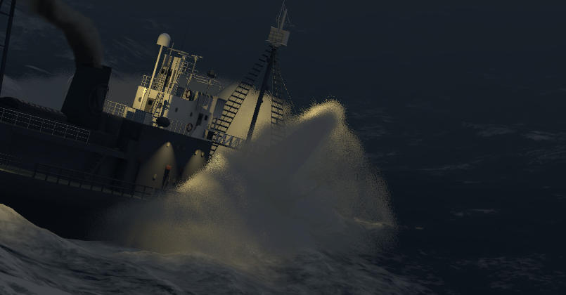

NVIDIA WaveWorks
Supported configurations
Also includes
Quad-tree tile-based LODing
Host readback (e.g. for simulation of water-borne objects)
DX11 tessellation
Geo-morphing for DX9/10
Foam simulation
Beaufort presets
GPU acceleration for evolving spectra
 | CPU sim | GPU sim
Windows/D3D9 | ✓
Windows/D3D9Ex | ✓ | ✓
Windows/D3D10 | ✓ | ✓
Windows/D3D11 | ✓ | ✓
Windows/GL | ✓ | ✓
Windows/sim-only | ✓ | ✓
Linux/sim-only | ✓ | ✓
PS4 | ✓
Xbone | ✓ | ✓

