Slide 1

Bio-informatics: Quantitative and Evolutionary Genetics I0D53A 2020-2021
Population genomics
Class I: Population Genetics
Prof. Filip Volckaert (lecturer)
Dr. Janne Swaegers (tutor)
Laboratory of Biodiversity and Evolutionary Genomics
KU Leuven
Ch. Deberiotstraat 32, 3000 Leuven
Phone: +32 16 32 39 72,
E-mail: filip.volckaert@kuleuven.be; janne.swaegers@kuleuven.be
URL: http://bio.kuleuven.be/eeb/lbeg

Slide 2
Content
Week | Date | Day | Topic | Lecturer
43 | 21-23 Oct 2020 | W - F | Population genetics | Filip Volckaert – Janne Swaegers
44 | 28 Oct –30 Nov 2020 | W - F | Natural selection and conservation genomics | Filip Volckaert – Janne Swaegers
45 | 4 – 6 Nov 2020 | W - F | Landscape genomics | Filip Volckaert – Janne Swaegers
46 | 11 - 13 Nov 2020 | W - F | Transcriptomics | Filip Volckaert – Janne Swaegers

Slide 3
What is a population?
A group of individuals of the same species living in close enough proximity that any member of the group can potentially mate with any other member (evolutionary paradigm).
What is population genetics?
(1) The analysis of the amount and distribution of genetic variation in populations and the forces that control this variation.
(2) A field of biology that studies the genetic composition of biological populations, and the changes in genetic composition that result from the operation of various factors, including natural selection. Population geneticists pursue their goals by developing abstract mathematical models of gene frequency dynamics, trying to extract conclusions from those models about the likely patterns of genetic variation in actual populations, and testing the conclusions against empirical data (http://plato.stanford.edu/entries/population-genetics).

Slide 4
A few cases of population genetics.
Population genetics is embedded in the natural environment. Here are a few cases you might be familiar with.
Resistance to the insecticide DDT across Africa among populations of Anopheles mosquitoes, which carry the malaria parasite Trypanosoma. Resistance is due to a mutation in the glutathione S-transferase gene (https://www.sciencemag.org/news/2016/10/after-40-years-most-important-weapon-against-mosquitoes-may-be-failing).
Occurrence of the autosomal recessive disease cystic fibrosis in the European population due to a mutation in the cystic fibrosis transmembrane conductance regulator gene (https://www.cff.org/What-is-CF/Genetics/CF-Genetics-The-Basics/#:~:text=Cystic%20fibrosis%20is%20an%20example,and%20is%20a%20CF%20carrier).
Dispersal of the oak Quercus across Europe after the last Ice age (starting 14,000 years ago) such that its genetic diversity traces the expanding populations (Newton et al. 1999 Trends in Ecology and Evolution 14:140-145).
Tracing of escaped farmed Atlantic salmon in Norwegian fjords for environmental management (Glover et al. 2009 - DOI: 10.1093/icesjms/fsn056).

Slide 5
Outline
Detecting genetic variation
The timescale of population genetics
3. The gene-pool concept and the Hardy-Weinberg law
4. Genetic variation and its measurement
Genetic divergence and its measurement
Deviations from HWE and exercises

Slide 6
1. Detecting genetic variation
Macromolecules harbouring genetic variation
Proteins (allozymes, proteoom)
Chromosomes (karyotypes)
DNA (nuclear DNA, mitochondrial DNA, chloroplast DNA)
Types of DNA variation
Single nucleotide polymorphisms (SNPs): a type of polymorphism involving variation of a single base pair.
Microsatellites (tandem repeats) : repetitive DNA sequences usually several base pairs in length
Copy number variation (CNV): the number of copies of a particular gene varies from one individual to the next
Retroposons: repetitive DNA fragments which are inserted into chromosomes after they had been reverse transcribed from any RNA molecule
For more information see: https://www.genome.gov/genetics-glossary

Slide 7
1. Detecting genetic variation
Single nucleotide polymorphisms (SNPs)
The simplest form of variation at a locus is when another nucleotide is present at the site of a specific nucleotide.
It are the most common types of polymorphisms in most genomes. A SNP is common in a population when it occurs at a frequency of at least 5%. A SNP is rare when it occurs at a frequency of <5%.
SNPs occur in genes (exons and introns), and regulatory regions. They can be classified as synonynous, non-synonynous or nonsense
Mutations outside coding sequences are called silent SNPs.
SNPs are detected by sequencing (parts of) the genome and by comparing sequences between and within individuals. High-throughput sequencing enables to do discover many SNPs in many individuals.

Slide 8
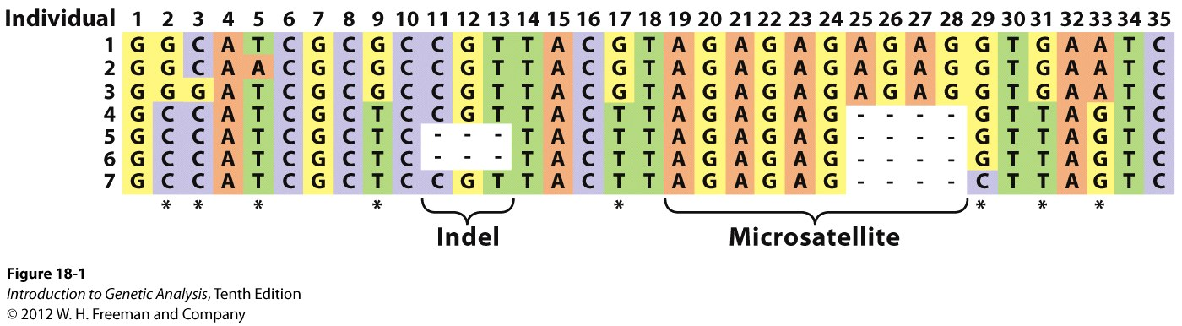
Variation in the aligned DNA sequences of 7 individual chromosomes. * shows the location of the SNPs, while also an indel and microsatellite can be seen.

Slide 9
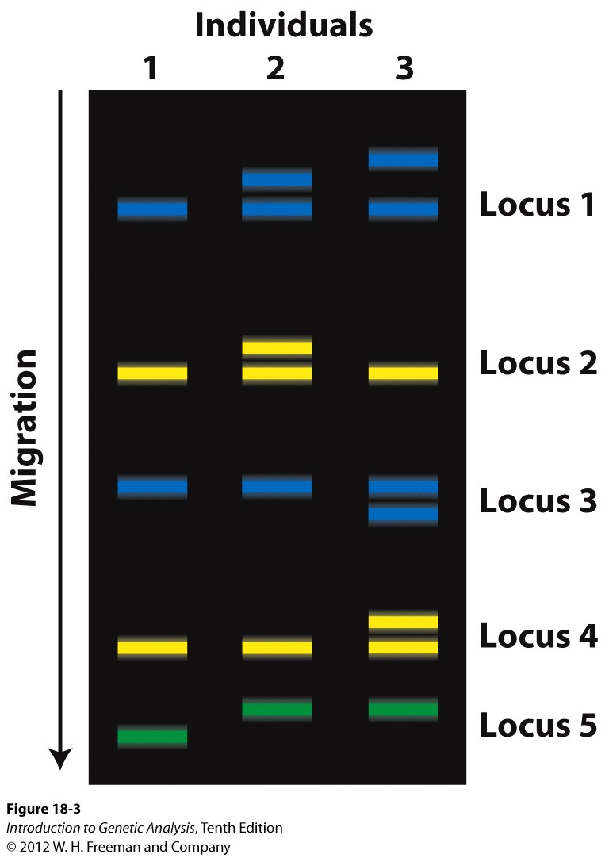
Microsatellites
Microsatellites are powerful loci for population genetic research because:
The number of alleles is very high (20 or more)
Their mutation rate is very high (and hence variation is very high)
They are very common in the genome
They are found throughout the genomes of most organisms and may be present in exons, introns, regulatory regions and non-functional DNA sequences.

Slide 10
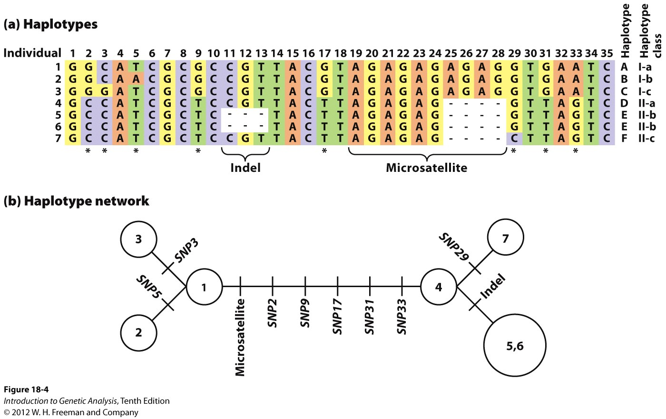
Haplotypes
The genotypes of linked loci are called haplotypes.
Haplotype networks show the relations between haplotypes by putting each mutatioin on the branches of the network.

Slide 11
2. The timescale of population genetics
A. Sequence variation
INDIV #1 ACTGGGTGGCGAGGGTGGGTGGTAAAGCGC
INDIV #2 ACTGAGTGGTGAGGGTGGGTGGTAGAGCGC
Focus on evolutionary timescales
Phylogeography, phylogenetics (cfr. prof. Lemey), coalescence
B. Allele and genotype frequencies
Microsatellites SNPs
Locus 1 Locus 2 Locus 3
INDIV #1 113115 211211 188190 AA GC TA
INDIV #2 113113 219229 178190 AA GG TT
Focus on ecological and evolutionary timescales
Population genetics (this course)

Slide 12
Evolution in time:
case of 3 individuals evolving into 3 groups through mutation.
time
Present/
recent past
past
Notes:
Characteristics of four designs for evolutionary inference through geographic (design A and B), geographic-genomic (design C) and genomic (design D) replication in natural populations. A) Parallel sympatric divergence. An ancestral population (grey dot) colonizes similar environments (blue shapes) and divergent selection within each environment promotes adaptive divergence and reproductive isolation between derived populations (black and white dots). B) Parallel parapatric or allopatric divergence. An ancestral population (grey dot) colonizes different environments (blue and green shapes) and divergent selection between environments promotes adaptive divergence and reproductive isolation between derived populations (black and white dots). C) Convergent evolution of geographically isolated species. A geographical barrier facilitates divergence between two species (triangles and dots) derived from a common ancestor (grey square), and divergent selection between environments (green, blue and orange shapes) promotes adaptive divergence and reproductive isolation between populations (black, white and grey symbols). D) Convergent evolution of coexisting species. Two ancestral species (grey dot and triangle) colonize different environments (green, blue and orange shapes) within the same area, and divergent selection promotes adaptive divergence and reproductive isolation between populations of each species (black, white and grey symbols).

Slide 13
3. The gene-pool concept and the Hardy-Weinberg equilibrium
Population genetics starts with the determination of the allele frequencies (i.e. the relative values).
Definition: The expected genotype frequencies of the progeny at a locus with two alleles are a binomial function of the allele frequencies of the parents:
(p + q)² = p² + 2pq + q²
A a A/A A/a a/a
Important concepts!
Wild type
Homo-/heterozygote
Locus
Genotype frequencies
Allele frequencies
Polymorphism
For more information see: https://www.genome.gov/genetics-glossary
The Hardy-Weinberg equilibrium deals with the relationship between the (paternal) allele frequencies p and q in the current generation and the expected genotype frequencies in the next generation (= sibs).
Important assumptions are:
Random mating, no mutation, no genetic drift, no selection and no immigration

Slide 14
Free exercise 1: Simulating evolving populations
Web browser for online simulation of drift, selection and mutation:
http://udel.edu/~mcdonald/evolmutpress.html
Select one of the simulation modules :
mutation
random drift
migration (gene flow)
Exercise 1:
Simulate Random drift with 20 replicate populations, and red allele frequency of 0.1 in panel 1.
Do the same for an allele frequency of 0.5. What difference do you notice?
Proceed to panel 2 and at an initial red allelle frequency of 0.4, 200 individuals, 1000 generations and 1 replicate.
Exercise 2:
Simulate Mutation pressure with settings of 100 generations, and a mutation rate from red-to-blue of 0.2 and from blue-to-red of 0.00 initially and in a second run 0.01.
What do you notice in each exercise and in comparison between both exercises?
We detail the concepts later on!

Slide 15
4. Genetic variation and its measurement
Positions 1, 4, 6, 7, 8, etc. are invariable and hence fixed.
But how does one measure variation?

Slide 16
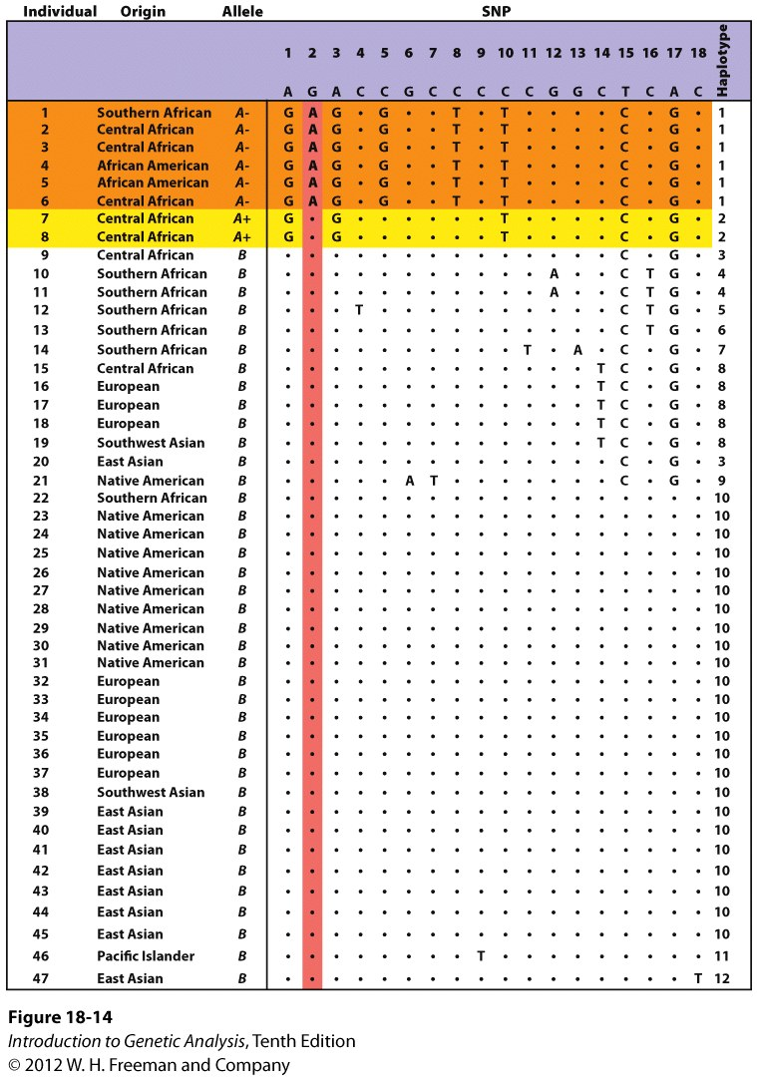
SNPs are listed for the G6PDH gene at your right.
The number of polymorphic or segregating sites (S) is 18 for the total of a 5102 bp long fragment.
The number of haplotypes (NH) is in this case 12 for the total sample.
The allele frequencies allow to calculate the gene diversity (GD).
GD = 1 – Σp²_{i} = 1 – (p²₁ + p²₂ + p²₃ + …+ p²_{n})
GD equals the expected number of heterozygotes under Hardy-Weinberg equilibrium, the expected heterozygosity (H_{E}).
The gene diversity averaged over alle nucleotide sites in a gene is called the nucleotide diversity.

Slide 17
Diversity measures:
Proportion of polymorphism P:
P = # polymorphic loci/total # of loci
Level of observed heterozygosity H_{o} or the proportion of heterozygotes genotyped:
H_{o} = measured heterozygosity/total # of genotypes
Level of expected heterozygosity H_{e} or the proportion of heterozygotes expected from the HW proportion of allele frequencies
H_{e} = heterozygosity calculated from allele frequencies/total # of genotypes
Mean # of alleles per locus (MNA) or the total # of alleles divided by the # of loci.
MNA = Σ # of alleles per locus /total # of loci
Allelic richness (AR): a measure of allelic diversity that takes into account sample size (using a rarefaction curve)

Slide 18
5. Genetic divergence and its measurement
How do we measure genetic divergence?
With the F-statistics developed by Sewall Wright (1968).
Population 1
Population 2
The total amount of genetic variation within a species (H_{T}) can be partioned into genetic differences among individuals within a single population (H_{S}) and genetic differences among different populations.
H_{T} = 1 – Σ_{i=1}p²_{i} = expected heterozygosity value of the total sample
H_{S} = 1 – Σ_{i=1} p²_{i,s} = expected heterozygosity averaged over all subpopulation

Slide 19
Measures derived from the level of heterozygosity are the F-statistics:
F-statistics quantify the deficit of heterozygotes relative to the expected HW proportions in the specified base population. F is the proportion by which heterozygosity is reduced relative to a random mating population with the same allele frequencies.
F = 1 – (H_{O} /H_{E})
F = (H_{E} – H_{O})/H_{E}
F_{IS} is a measure of departure from HW proportions within local subpopulations
F_{ST} is a measure of genetic divergence among subpopulations
F_{IT} is a measure of the total departure from HW proportions which includes departures from HW proportions within local populations and divergence among subpopulations

Slide 20
F_{IS} = (H_{S} – H_{I}) /H_{S} (inbreeding coefficient)
– 1 (outcrossing) < F_{IS} < 1 (inbreeding)
F_{ST} = (H_{T} - H_{S}) / H_{T} (fixation index)
0 < F_{ST} < 1
F_{IT} = (H_{T} – H_{I}) / H_{T} (overall inbreeding coefficient)
– 1 < F_{IT} < 1
With
H_{T} = 1 – Σ_{i=1}p²_{i} = expected heterozygosity value of the total sample
(=the expected HW heterozygosity if the total sample were panmictic)
H_{I} = observed heterozygosity value averaged over all subpopulations
H_{S} = 1 – Σ_{i=1} p²_{i,s} = expected heterozygosity averaged over all subpopulations
and
F_{IT} = F_{IS}+ F_{ST} - (F_{IS})(F_{ST})
F_{IS}(1)
F_{IT}
F_{IS}(2)
Population 1
F_{ST}
Population 2
20

Slide 21
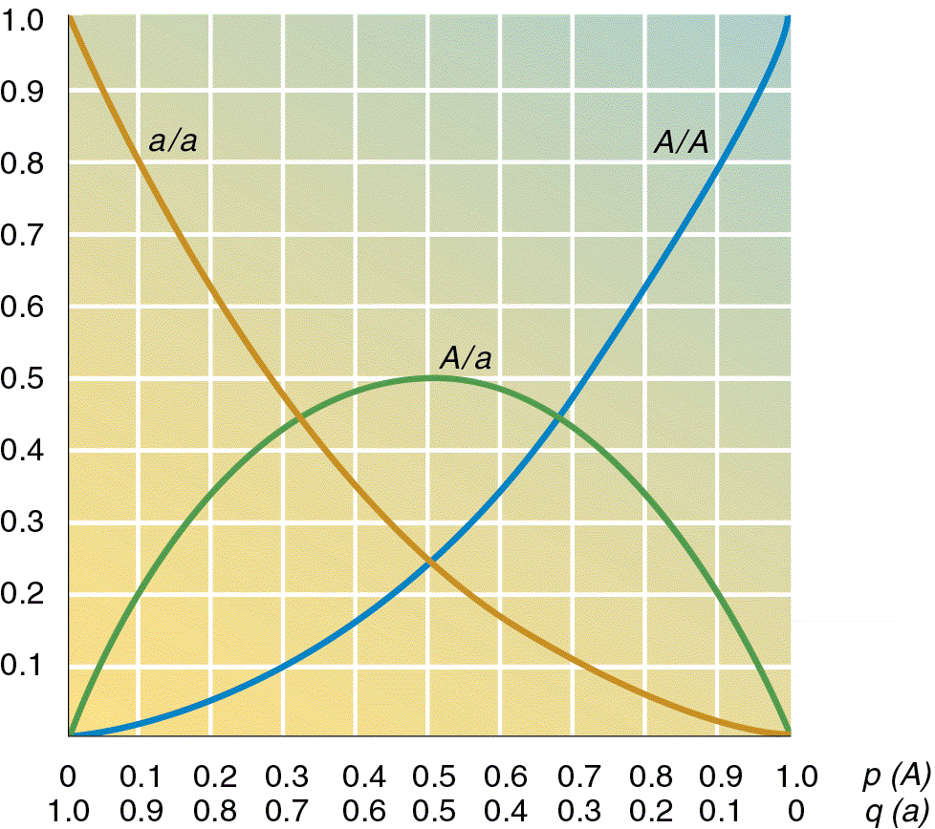
6. Deviations from HWE
Under HWE, the expected genotype frequencies in the next generation are:
(p+q)² = p² +2 pq + q²
with the frequency of genotypes:
A/A A/a a/a
p² 2pq q²
Assumptions:
Random mating
No mutation
No drift
No migration
No selection
Most unlikely in reality
Blue: neutral evolution
Red: selection/adaptive evolution
Populations evolve!
21
Notes:
21

Slide 22
There is lots of evidence for neutral evolution in natural populations. Think of populations which collapse and therefore loose a lot of individuals and hence genetic material.
Which alleles are lost will be partially random (which we consider here), and partially determined by selection (see next class). The same is true for expanding populations, or populations which migrate permanently over short or long distances. All these events will shuffle the alleles, and in this part of the class we are interested in the underlying stochastic (non-adaptive/ neutral) mechanisms.
In this class we’ll study the principles and patterns of neutral evolution
Task 1: Case study: analyse population genetic structure of stickleback in R
Task 2: simulate neutral evolution with EasyPop

Slide 23
Your compass to the class
Aim
Understanding genetic diversity and genetic differentiation
Drivers of neutral genetic variation
Milestones
- Installing R packages and importing data
- Calculating genetic diversity and genetic differentiation
- Detecting and interpreting genetic heterogeneity and genetic structure
- Installing EasyPop and simulating various scenarios
Tools
- R packages adegenet, pegas, hierfstat and genetics
- EasyPop software

Slide 24
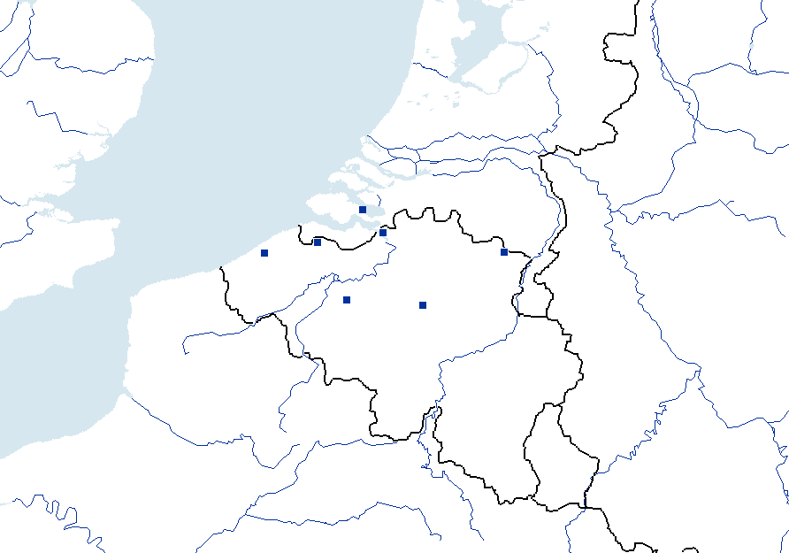
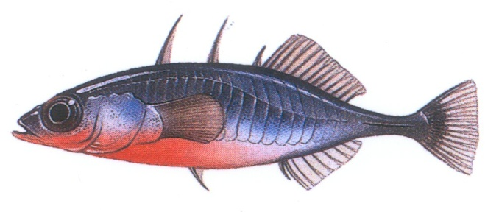
Case study: the three-spined stickleback
The Netherlands
NORTH SEA
2
1
3
4
7
This small fish (<10 cm) lives in salt and freshwater along the coasts of North America and Western/Northern Europe. Search for Gasterosteus aculeatus on http://www.fishbase.org for biological information.
5
6
Meuse
Scheldt
Belgium
Questions:
To what degree does 1) gene flow/migration, genetic drift, mutation and 2) selection influence genetic diversity (e.g. allelic richness) and genetic divergence (e.g. F_{ST}) between populations?
Relative IMPACT | Lowland/coastal (# 1, 2, 3 and 4) | Inland (# 5, 6 and 7)
Gene flow/migration | ? | ?
Genetic drift | ? | ?
Mutation | ? | ?
Selection | ? | ?

Slide 25
A few words about the data file:
The data file contains the microsatellite genotypes (five loci) of seven sample sites of the threespine stickleback (Gasterosteus aculeatus) (n = 345).
The seven sampling sites are located in Belgium and The Netherlands, namely
the Belgian coast
pop 1 – Oudenburg
pop 3 – Boerenkreek
pop 4 - Doel
the Dutch coast
pop 2 – Yerseke
the River Scheldt watershed
pop 5 – Erpenbeek
pop 6 - Heverlee
the River Meuse watershed
pop 7 - Lozen
Sampling sites:
The Netherlands
NORTH SEA
2
Meuse
3
1
4
7
Scheldt
5
6
Belgium

Slide 26
Data have been analysed and published (“Detecting Holocene divergence in the anadromous-freshwater threespine stickleback system (Gasterosteus aculeatus)” by Raeymaekers, J., Maes, G.E., Audenaert, E. and Volckaert, F.A.M. (2005) Molecular Ecology 14: 1001-1014
[see file Raeymaekers et al-MolEcol-2005.pdf]
Primers of the five microsatellite loci used here (Gacµ4, Gacµ7, Gacµ9, Gacµ10 and Gacµ14) have been published (Taylor EB (1998) Microsatellites isolated from threespine stickleback Gasterosteus aculeatus. Molecular Ecology 7, 925-931)
Resources of a non-model species:
Microsatellite, numerous SNP sequences and full genomes have been submitted to GenBank (http://www.ncbi.nlm.nih.gov) – look under the taxonomy data base. A linkage map of threespine stickleback is available from Peichel et al. (2001) Nature 414: 901-905. The fully assembled genome is available at Ensembl - http://www.ensembl.org/Gasterosteus_aculeatus/Info/Index.

Slide 27
How are the genotype data organized and stored?
1. genepop (.gen) format
Microsatellite genotypes of threespined stickleback
Gac4b
Gac7b
Gac14b
Gac9b
Gac10b
Pop
Pop-1, 0506 1315 0303 0411 0000
Pop-1, 0411 0000 0303 1818 1317
Pop-1, 0606 1116 0000 0000 0000
Pop-1, 0606 0111 0304 0611 0615
Pop-1, 0406 1316 0303 0816 0613
Pop-1, 0611 1113 0303 0618 0000
Pop-1, 0606 1113 0404 0610 1523
Pop-1, 0606 1113 0404 0000 0000
Pop-1, 0505 1116 0303 0411 0000
...

Slide 28
How are the genotype data stored? (2) fstat (.dat) format
7 5 42 3
Gac4b
Gac7b
Gac14b
Gac9b
Gac10b
1 005006 013015 003003 004011 0
1 004011 0 003003 018018 013017
1 006006 011016 0 0 0
1 006006 001011 003004 006011 006015
1 004006 013016 003003 008016 006013
1 006011 011013 003003 006018 0
1 006006 011013 004004 006010 015023
1 006006 011013 004004 0 0
1 005005 011016 003003 004011 0
1 006006 012013 003003 003006 021025
1 006010 013013 003004 006010 018028
1 006009 010011 003003 006011 006014
1 004011 013013 003004 011011 006006
1 005008 013013 003003 003011 029038
1 006011 011015 003004 013013 022023
...

Slide 29
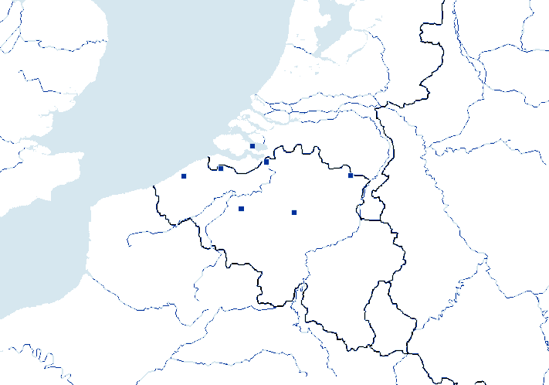
Looking for evidence of gene flow, mutation and drift in stickleback (= neutral evolution)
Gene flow/migration (m): transfer of alleles and genes from one population to the other. This might impact the allele frequency.
Genetic drift: accumulation of random events that change the make up of a gene pool slightly. Genetic drift ~ 1/effective population size (Ne)
Mutation rate (µ): change to the nucleotide sequence of the genetic material, either in single nucleotides (10⁻³<µ<10⁻⁸ events per generation) or chromosome fragments
2
1
3
7
4
5
6
Relative IMPACT | Lowland/coastal (# 1, 2, 3 and 4) | Inland (# 5, 6 and 7) | Comments
Gene flow/migration | High/low? | High/low?
Genetic drift | High/low? | High/low?
Mutation | High/low? | High/low?
Selection | ? | ?

Slide 30
Task 1: Interpretation of the genetic pattern of threespine stickleback
- Analyse the genetic diversity of all stickleback populations, separately and hierarchically, and interpret the data. A question you might ask is: why are they so different?
Analyse the genetic divergence between and among the coastal and inland samples, and interpret the data. A question you might ask is: why are they so different?

Slide 31

Analyzing population genetic data in
Old school population genetic software is:
• often of high quality
but with poor data interoperability
• very few multivariate methods
• not adaptable
• not programmable
• restricted to a limited number of individuals (cases) and genetic markers (e.g., 250 markers in Genetix).
→ problem: researcher has to fit and trim his/her data to the available tools
The R software, a community-based project has:
• good data interoperability
• most multivariate methods
• lots of statistical tools
• several genetic/phylogenetic packages
• is a programming language
• allows analyzing tens of thousands of genetic markers for tens of thousands of cases
→ solution: researcher can develop his own analytical tools to address specific problems

Slide 32
In case you’re not familiar with R
There are some excellent online courses. We suggest to take one within the next few days. Here are three suggestions, but there are more.
https://www.coursera.org/learn/r-programming or
https://www.datacamp.com or
http://popgen.nescent.org/index.html​
You can also take a course organised by the ICT services of the KU Leuven (ICTS) - https://admin.kuleuven.be/icts/english/students.

Slide 33
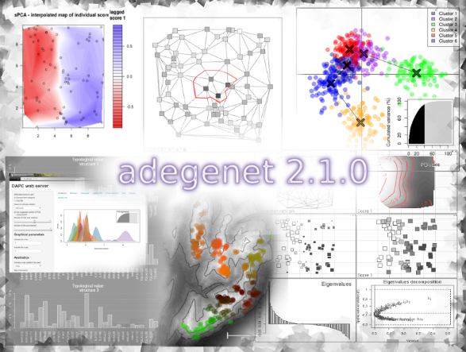
Analyzing population genetic data in
Start > All Programs > Rstudio
• The R version 4.0.3 software is downloadable at http://www.r-project.org
Multivariate analyses of genetic data, simulations, spatial genetics:
package adegenet: http://adegenet.r-forge.r-project.org
• Classical population genetics
package pegas: http://cran.r-project.org/web/packages/pegas/index.html
package hierfstat: http://cran.r-project.org/web/packages/hierfstat/index.html
package genetics: http://cran.r-project.org/web/packages/genetics/index.html
• Phylogenetics
packages ape, phangorn, adephylo, picante
Use Rstudio, the graphical interface for R
http://www.rstudio.com
Access through Start>Search for Rstudio.

Slide 34
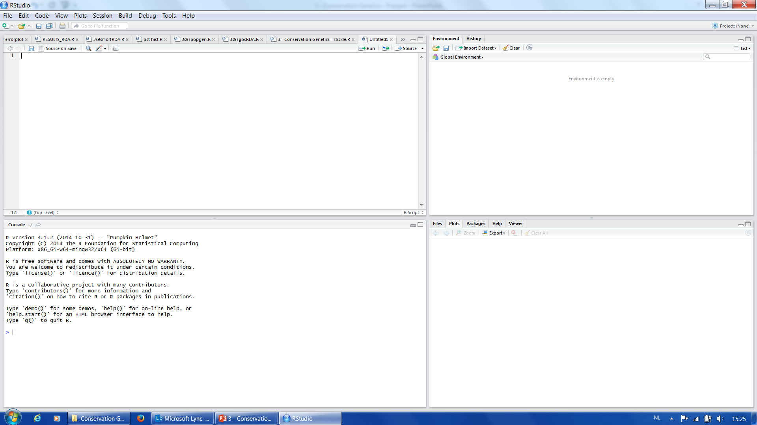
Analyzing population genetic data in
Start > All Programs > Rstudio
The ‘Editor’ allows you to type in scripts, save & open written scripts, and run scripts into the ‘R Console’ using Ctrl+r
e.g.: type in 2+2 and do ‘ctrl+r’
This window gives an overview of all objects in the active workspace
The ‘Console’ is your computing environment.
e.g.: type in 2+2 and press ‘enter’
This windows is for files, plots, packages, and help

Slide 35
One of the R packages we will use is adegenet developed by Thibaut Jombart (https://sites.google.com/site/thibautjombart).
Install the latest version 2.1.1 by typing the following script in the R Console on your laptop:
install.packages(adegenet)
Note: some laptops might not install properly the software. Please inform us.
Create your own personal library by pressing ‘yes’ & choose Belgium as the CRAN mirror.
Now load the package into the R Console:
library(adegenet)
For more information on the package:
library(help=ʺadegenet ʺ)
OR type:
?adegenet
Retype “ after loading the code line!

Slide 36
Analyzing population genetic data
Save data file I0D53A-POPGEN-data-GENEPOP.pop in a new folder Popgen on your desktop
Rename the file ‘stickle.gen’
(changing its extension from .pop into .gen)
Set your working directory in R. The working directory is the physical place on your computer where R will look for input files and write away output files.
setwd('H:/Desktop/Popgen')
If you want to know what the actual working directory is, type:
getwd()

Slide 37
Read file into R:
read.genepop(ʼstickle.gen’)
All you did so far was reading your data. You did not store your data yet, so you can not recall it later on.
Read file into R and store it in an object called data
data <- read.genepop(ʼstickle.gen’)
read.genepop() is what we call a FUNCTION. Functions are scripts that can be run in the R Console and which will give you an output.
To see how such a function looks like, type:
read.genepop
You’ll notice that there is a lot of scripting behind the function. Experienced R programmers write their own functions. Type in the following to obtain more information about a function
?read.genepop
Remark: you can import data from other softwares as well:
read.genetix or read.fstat
Pay attention to the quotes by editing in R or a text editor

Slide 38
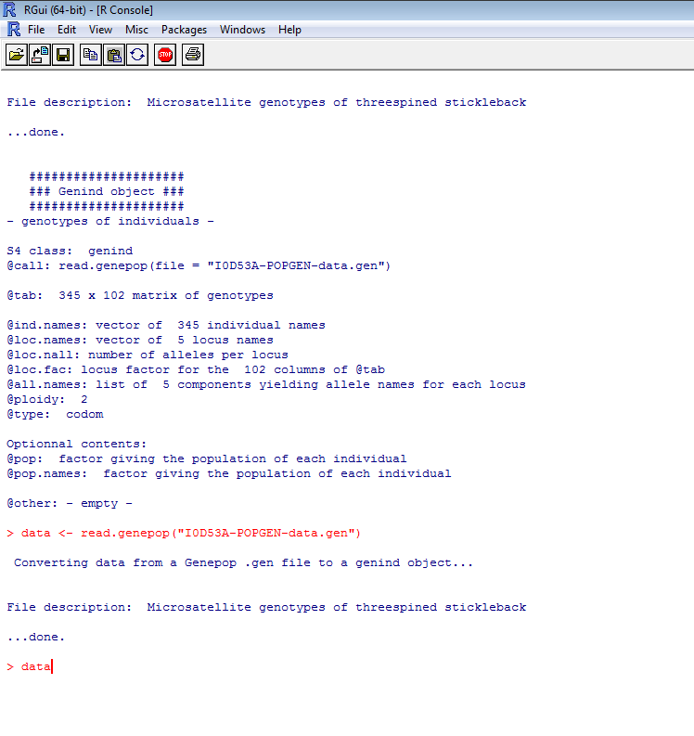
‘data’ is what we call an OBJECT.
Objects can have any form:
a matrix
a dataframe
a list of numbers or characters
a special package related format
…

Slide 39
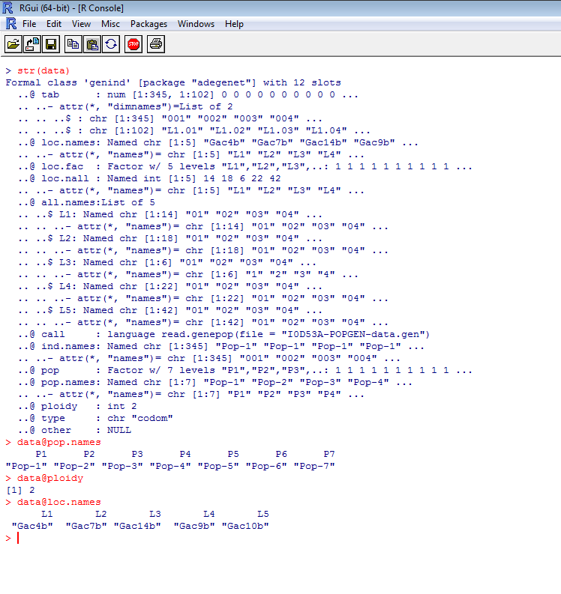
To see the structure of an object, use the function str()
str(data)
The object data is of type ‘genind’
A ‘genind’ object typically contains 12 slots, such as the names of the loci, the names of the population, ploidy level, etc.
Explore the slots of the object data using the @ sign, e.g.:
data@pop.names
data@ploidy

Slide 40
Calculating genetic variation
Adegenet contains a number of functions to analyse genetic variation
Estimate expected heterozygosity using the function Hs().
Hexp <- Hs(data)
Obtain the number of alleles per population using the function summary().
sum <- summary(data)
nall <- sum$pop.n.all
Visualize the results using the function barplot(), for instance:
barplot(nall, xlab = ʼPopulation’, ylab = ʼNumber of alleles’)

Slide 41
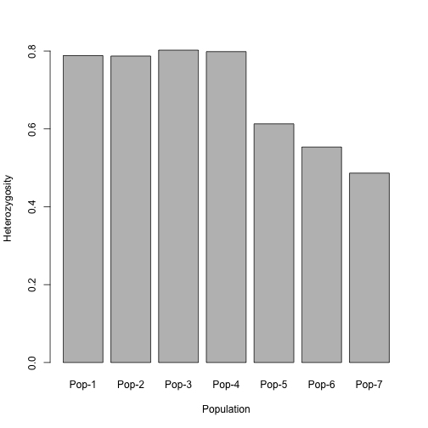
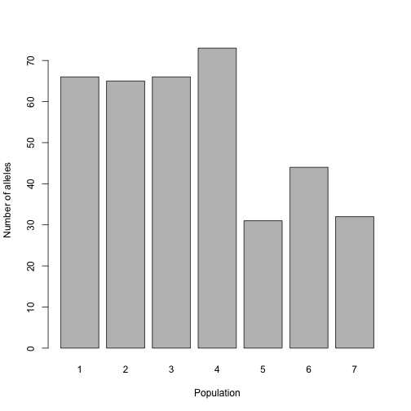
You should obtain something like this:
What do you notice?
How do you interpret the histograms?

Slide 42
Another R package is hierfstat version 0.04-22 by Jérôme Goudet (http://www.unil.ch/dee/page16479_en.html).
Install this package in R and load the package
Have a look at the content of the package
Now access file (ʼstickle.dat’)in fstat format
Read this file in R using read.fstat into an object
Estimate the allelic richness using the function allelic.richness() and store the results into an object called AR

Slide 43
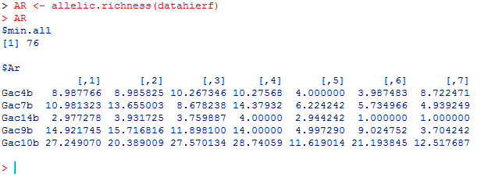
What do you see below and try to understand the results?
Minimum number of alleles used to rarify the data is 76.
The allelic richness of population 1 for locus Gac10b equals 27.25
Estimate the mean allelic richness over all loci per population
meanAR <- colMeans(AR$Ar)
Generate a barplot of the results.

Slide 44
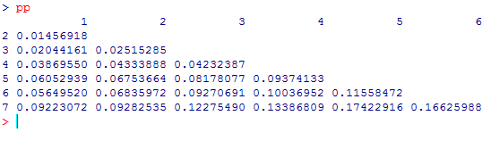
Calculating genetic structure
First, let’s assess the pairwise genetic differentiation as estimated with FST
pp <- pairwise.fst(data)
Have look at the object pp
pp
What do you see?
You can write these results into your working directory Popgen3 using:
write.table(as.matrix(pp), file = ʼpairwisefst.txt’)
You can import the file pairwisefst.txt into MS-Excel (do this at home).
The pairwise F_{ST} value between population six and population five is equal to 0.12

Slide 45
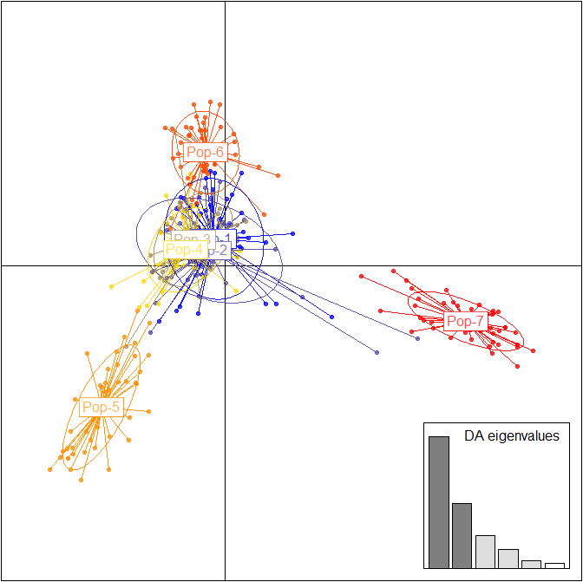
Let’s now assess the variability between populations using a Discriminant Analysis of Principal Components (DAPC). DAPC is a method that describes the diversity between pre-defined groups; it optimizes the variability between groups while minimizing the variability within groups. This is fundamentally different than for instance the Principal Component Analysis (PCA), which describes the global diversity, possibly overlooking differences between groups. If you want to learn more see Jombart et al. BMC Genetics 11; 94 (2010)
DAPC analyses can be performed using the function dapc()
dapcstickle <- dapc(data, n.pca = 40, n.da = 5)
Define 40 PCAs and 5 discriminant functions.
Have a look at your newly created object
dapcstickle
Let’s now visualize the results:
scatter(dapcstickle)
What do you see?
# axes
Notes:
This method descibes the diversity between pre-defined groups.

Slide 46
DAPC in itself requires prior groups to be defined. However, groups are often unknown or uncertain, so we need to identify genetic clusters. Here we will use a genetic clustering approach in R.
The function find.clusters is an algorithm that performs k-means clustering during which it tries to find a given number k of groups maximizing the variation between these groups.
To identify the optimal number of clusters, k-means is run sequentially with increasing values of k, and different clustering solutions are compared using Bayesian Information Criterion (BIC). Ideally, the optimal clustering solution should correspond to the lowest BIC. In practice, the ’best’ BIC is often indicated by an elbow in the curve of BIC values as a function of k.

Slide 47
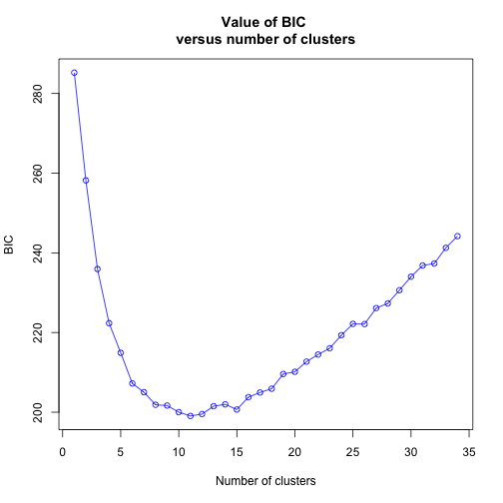
Run the following script in R:
clust <- find.clusters(data, n.pca = 100)
R will now ask you to choose the number of clusters. It will give you a plot like the one below, which are the BIC (Bayesian information criterion, a criterion for model selection used e.g. in phylogenomics) values (y-axis) for each k groups (x-axis). You can see that the BIC value does not decrease substantially any more around k = 7 or k = 8. We expect k = 7 since we study 7 populations.
k = 7

Slide 48
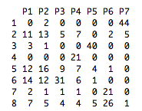
Have a look at the result for k = 8:
clust
By typing the following script you’ll see to which cluster all individuals are assigned:
as.data.frame(clust$grp)
We create a table that shows the number of individuals for a certain population assigned to a certain cluster
table(clust$grp,data$pop)
Populations
44 individuals of population seven are assigned to cluster 1
Clusters

Slide 49
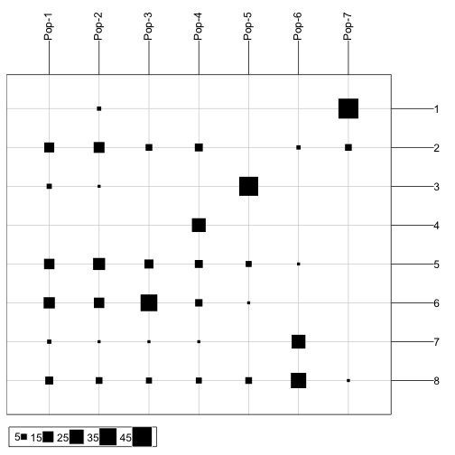
You visualize the previous table using the function table.value():
table.value(table(clust$grp,data$pop))
What do you notice?
How do you intepret this?

Slide 50
Task 1: A concise interpretation of the genetic pattern of threespine stickleback:
What do you think of the genetic diversity?
What about the genetic divergence among the inland samples?
What about the genetic divergence among the coastal samples?
Suggestion: The introduction and discussion sections of the paper by Raeymaekers et al. (2005) provide you useful information to fully grasp the interpretation.

Slide 51
Part 1: Looking for evidence of gene flow, mutation and drift (= neutral evolution)
Gene flow/migration (m): transfer of alleles and genes from one population to the other. It may change allele frequencies considerably.
Genetic drift: accumulation of random events that change the make up of a gene pool slightly. Genetic drift ~ 1/effective population size (Ne)
Mutation (µ): change to the nucleotide sequence of the genetic material, either in single nucleotides (10⁻³<µ<10⁻⁸ events per generation) or chromosome fragments
2
1
3
7
4
5
6
Relative IMPACT | Lowland/coastal (# 1, 2, 3 and 4) | Inland (# 5, 6 and 7) | Comments
Gene flow/migration | Higher | Lower | Large connectivity in the coastal area
Genetic drift | Low | Medium | Inland populations are often (very) small
Mutation | Low | Low | Mutation rate is from 10⁻⁴ to 10⁻⁶
Selection | ? | ? | Does selection drive populations to separate characteristics?

Slide 52
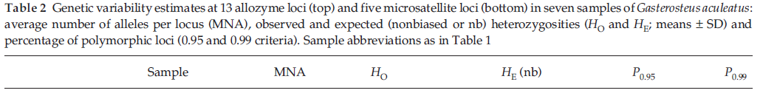
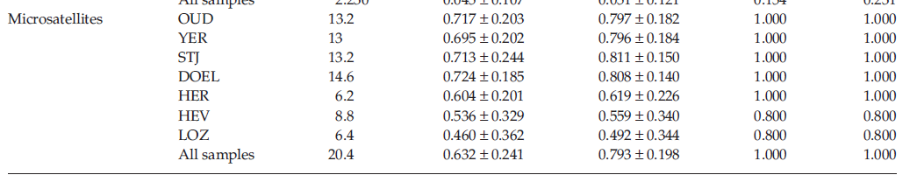
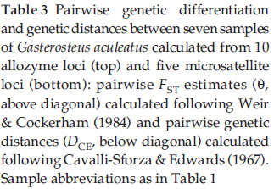
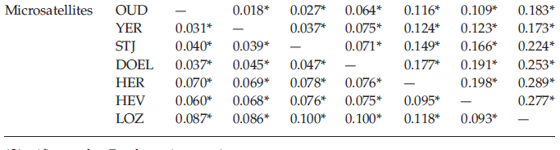
Appropriate tables from Raeymaekers et al. (2005)

Slide 53
Task 2: Simulate neutral evolution with EasyPop
The logic:
To get a feel for the evolutionary impact of order of magnitude changes in population parameters, simulate data and evaluate them with population genetic tools.
- Parameter of interest: F_{ST}
Modifiers of neutral evolution:
m (migration rate)
Ne (effective population size; drift ~1/Ne)
µ (mutation rate)
- All alleles have an equal probability to make it to the next generation

Slide 54
About EasyPop
EasyPop version 2.0.1 (Windows based) is available from
https://www.unil.ch/dee/en/home/menuinst/open-positions-and-public-resources/softwares--dataset/softwares/easypop.html
EasyPop is a computer program simulating population genetic datasets. It generates genetic data for haploid, diploid, and haplodiploid organisms under a variety of mating systems. It includes various migration and mutation models. Output can be generated for the FSTAT (http://www2.unil.ch/popgen/softwares/fstat.htm), GENEPOP (http://kimura.univ-montp2.fr/~rousset/Genepop.htm) genetic analysis packages. Both FSTAT and GENEPOP files can be imported in R or converted with PGDSpider (http://cmpg.unibe.ch/software/PGDSpider/) to input formats of other software packages (e.g. ARLEQUIN; http://cmpg.unibe.ch/software/arlequin35/)
Is EasyPop the right tool for you?
An inventory of population genetics modeling software is available at the Genetic Simulation Resources website (http://popmodels.cancercontrol.cancer.gov/gsr).
An alternative for Linux and Apple users is simuPOP and SLIM.

Slide 55
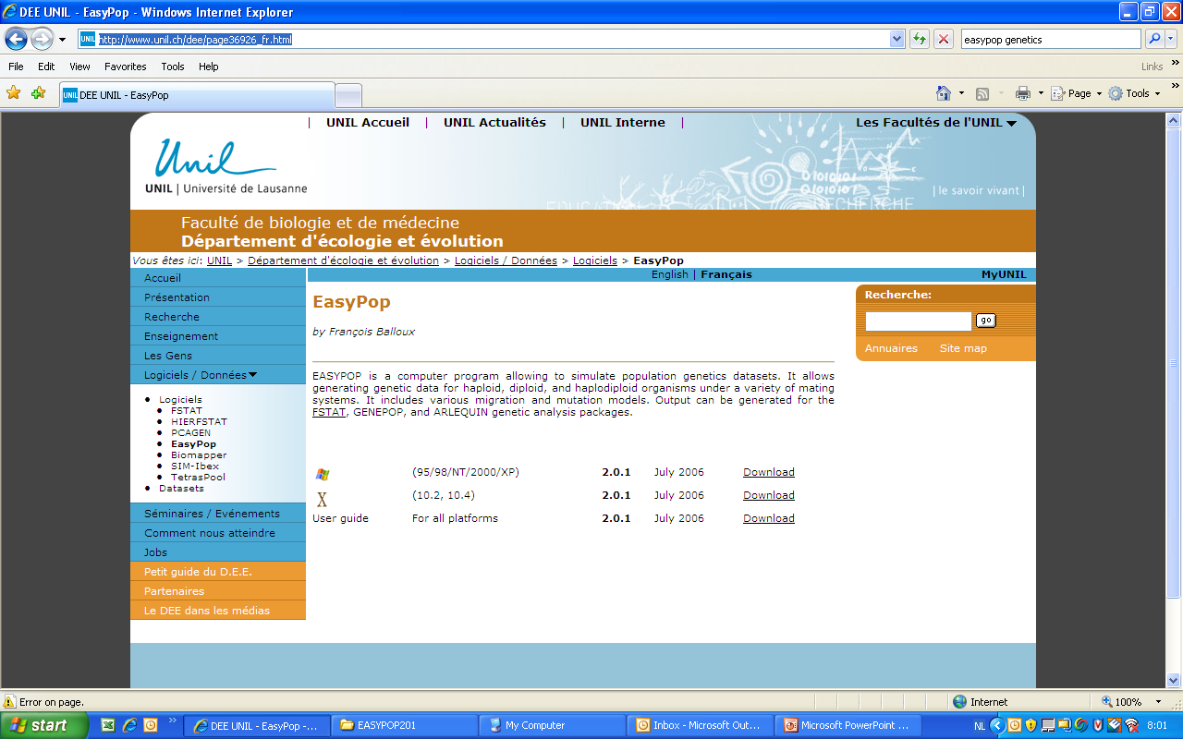

Slide 56
Step 2.1: installing and understanding EasyPop
Download EasyPop from the web
- Unizip and install under C:\Workdir (the output file .equ will appear here)
- The software functions appear in a dos environment as a line prompt.
- Before starting… The program prompts for choices on a range of parameters important for simulating populations (see next slide). They are explained in the EASYPOP_201_userguide.pdf. So get prepared ahead of time.

Slide 57
Here are clarifications for some of the choices you have to make:
Ploidy level: haplo-diploid/haploid/diploid: relates to number of chromosome sets (humans are diploid = 2n)
Mating system: Random mating/polygyny/monogyny: social structures with the most simple form: random mating (each male has equal chances to father each newborn)
Number of females/males in each population: is the actual number of individuals breeding = the effective population size (Ne)
Proportion of female/male migration (0 < m < 1) : we stick to a low value (0.01) as to keep gene flow very small
Free recombination between loci (= loci behave fully independently = no linkage disequilibrium)
Mutation rate: DNA microsatellites (used in this case) have mutation rates between 10⁻³ > µ > 10⁻⁵.
Mutation model: as microsatellites mutate in various modes, various models are in vogue, with the single step mutation model (SMM) being the most simple and KAM with the same probability to model in any direction.
Number of possible allelic states of a locus: the number of alleles in microsatellite loci may vary from 2 to > 100. Here we will take a reasonable number of 10.
Variability of the initial population: distribution of alleles over the genotypes of the first generation
Number of replicates: repeating the simulation several times will improve the reliability. We keep to a low value here as not to take too much calculation time.
Suggestion: to keep simulation time reasonably short, limit the number of loci, individuals, simulation runs, etc.

Slide 58
Simulation strategy
After a trial run (see simulation 1 on the following pages), each group will be assigned a different simulation by modifying another parameter.
Ne (effective population size) is equally split between males and females
Variable | m | µ | Ne | Fst (after 10⁴ generations)
Trial run | 10⁻³ | 10⁻⁴ | 10³ | ^{0.0543}
Group I | 10⁻¹ | 10⁻⁴ | 10³ | 0.0002
Group II | 10⁻⁵ | 10⁻⁴ | 10³ | 0.3944
Group III | 10⁻³ | 10⁻³ | 10³ | 0.0028
Group IV | 10⁻³ | 10⁻⁵ | 10³ | 0.0022
Group V | 10⁻³ | 10⁻⁴ | 10² | 0.0285
Group VI | 10⁻³ | 10⁻⁴ | 10⁴
End run

Slide 59
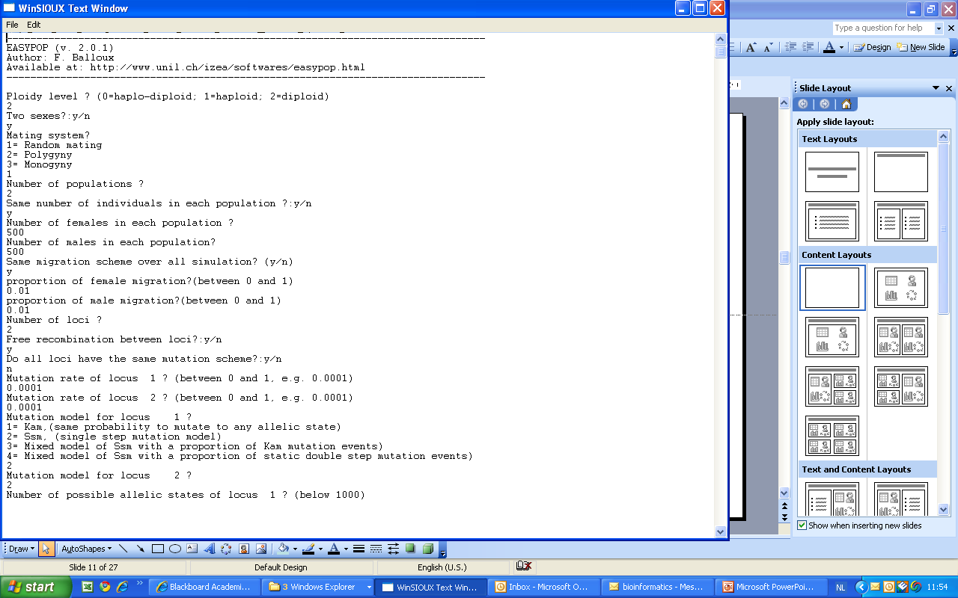
Step 2.2: test run
1
1

Slide 60
FEATURE | SIMULATION 1 | SIMULATION 2
Ploidy level ? (0=haplo-diploid; 1=haploid; 2=diploid) | 2 | 2
Two sexes?:y/n | y | y
Mating system? | 1 | 1
1= Random mating
2= Polygyny
3= Monogyny
Number of populations ? | 2 | 2
Same number of individuals in each population ?:y/n | y | y
Number of females in each population ? | 500
Number of males in each population? | 500
Same migration scheme over all simulations? (y/n) | y | y
proportion of female migration? (between 0 and 1) | 0.001
proportion of male migration? (between 0 and 1) | 0.001
Number of loci ? | 2 | 2
Free recombination between loci?:y/n | y | y
Do all loci have the same mutation scheme?:y/n | n | n
Mutation rate of locus 1 ? (between 0 and 1, e.g. 0.0001) | 0.0001 | 0.0001
Mutation rate of locus 2 ? (between 0 and 1, e.g. 0.0001) | 0.0001 | 0.0001
Grey rows: here the values will change thoughout the excercise

Slide 61
FEATURE | SIMULATION 1 | SIMULATION 2
Mutation rate of locus 1 ? (between 0 and 1, e.g. 0.0001) | 0.0001
Mutation rate of locus 2 ? (between 0 and 1, e.g. 0.0001) | 0.0001
Mutation model for locus 1 ? | 1 | 1
1= Kam, (same probability to mutate to any allelic state)
2= Ssm, (single step mutation model)
3= Mixed model (of Ssm with a proportion of Kam mutation events)
4= Mixed model (of Ssm with a proportion of static double step mutation events)
Mutation model for locus 2 ? | 1 | 1
Number of possible allelic states of locus 1 ? (below 1000) | 5 | 5
Number of possible allelic states of locus 2 ? (below 1000) | 10 | 10
Variability of the initial population | 1 | 1
1= Maximal, (randomly assigned alleles)
2= Minimal, (all individuals start with the same allele)
Number of generations ? | 10000 | 10000
Do you want the complete dataset in the '.dat' and '.gen' result files ?:y/n | y | y
Do you want a file giving the complete pedigree of the simulation ?:y/n (Please notice that this file can be very huge and will slow down simulations) | y | n
Name of the file? | oufile1 | -

Slide 62
FEATURE | SIMULATION 1 | SIMULATION 2
Ploidy level ? (0=haplo-diploid; 1=haploid; 2=diploid) | 2
Two sexes?:y/n | y
Mating system? | 1
1= Random mating
2= Polygyny
3= Monogyny
Number of populations ? | 2
Same number of individuals in each population ?:y/n | y
Number of females in each population ? (= effective population size Ne) | 500
Number of males in each population? (= effective population size Ne) | 500
Same migration scheme over all simulations? (y/n) | y
proportion of female migration? (between 0 and 1) | 0.01
proportion of male migration? (between 0 and 1) | 0.01
Number of loci ? | 2
Free recombination between loci?:y/n | y
Do all loci have the same mutation scheme?:y/n | n
Mutation rate of locus 1 ? (between 0 and 1, e.g. 0.0001) | 0.005
Mutation rate of locus 2 ? (between 0 and 1, e.g. 0.0001) | 0.0005
Mutation model for locus 1 ? | 2
1= Kam, (same probability to mutate to any allelic state)
2= Ssm, (single step mutation model)
3= Mixed model (of Ssm with a proportion of Kam mutation events)
4= Mixed model (of Ssm with a proportion of static double step mutation events)
Mutation model for locus 2 ? | 2 | 2
Number of possible allelic states of locus 1 ? (below 1000) | 5 | 5
Number of possible allelic states of locus 2 ? (below 1000) | 10 | 10
FEATURE | SIMULATION 1 | SIMULATION 2
Variability of the initial population | 1 | 1
1= Maximal, (randomly assigned alleles)
2= Minimal, (all individuals start with the same allele)
Number of generations ? | 10000 | 10000
Do you want the complete dataset in the '.dat' and '.gen' result files ?:y/n | y | y
Do you want a file giving the complete pedigree of the simulation ?:y/n (Please notice that this file can be very huge and will slow down simulations) | n | n
Name of the file? | trialrun | groupI
Number of replicates | 1 | 1
END

Slide 63
Output:
Each replicate gives as output a file set (001, 002, etc)
Outfile001.equ (output file with statistics by generation)
Outfile001.dat (input file for FSTAT)
Outfile001.gen (input file for GENETIX) see http://kimura.univ-montp2.fr/genetix/
(look in EasyPop exe folder)
1. Have a look at the simulated evolution of the Easypop F_{ST} values by generation:
- Transfer Outfile001.equ to MS-Excel.
Replace the decimal dot . by comma ,
Draw a line chart of generation (x) by F_{ST} (y)
2. What is the final F_{ST} value after x generations?

Slide 64
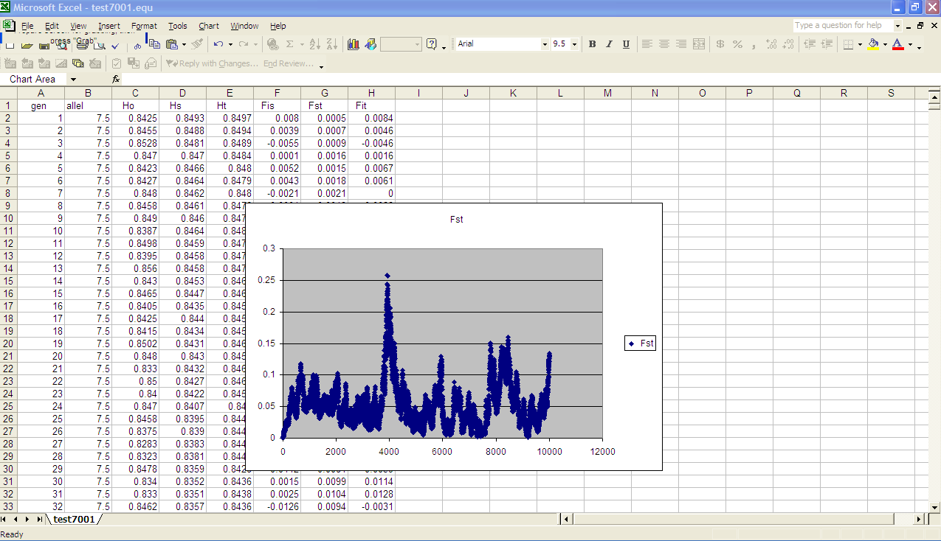
simulated evolution of the Easypop F_{ST}
Even better, you can prepare a small routine in R to plot your results.
F_{ST}
Generation
64
Notes:
64

Slide 65
Task 2.1:
Repeat the exercise by introducing the values assigned to your team (see below). Within your team you can run several simulations.
Ne (effective population size) is equally split between males and females
Parameter | m | µ | Ne | F_{ST} (after 10⁴ generations)
Trial run | 10⁻³ | 10⁻⁴ | 10³
Team I | 10⁻¹ | 10⁻⁴ | 10³
Team II | 10⁻⁵ | 10⁻⁴ | 10³
Team III | 10⁻³ | 10⁻³ | 10³
Team IV | 10⁻³ | 10⁻⁵ | 10³
Team V | 10⁻³ | 10⁻⁴ | 10²
Team VI | 10⁻³ | 10⁻⁴ | 10⁴

Slide 66
Interpretation of the results
Here is a sample of results.
Parameter | m | µ | Ne | F_{ST} (after 10⁴ generations)
Trial run | 10⁻³ | 10⁻⁴ | 10³ | 0.013 - 0.071
Team I | 10⁻¹ | 10⁻⁴ | 10³ | 0
Team II | 10⁻⁵ | 10⁻⁴ | 10³ | 0.488 – 0.565
Team III | 10⁻³ | 10⁻³ | 10³ | 0.020 – 0.038
Team IV | 10⁻³ | 10⁻⁵ | 10³ | 0.003 – 0.008
Team V | 10⁻³ | 10⁻⁴ | 10² | 0.030 – 0.420
Team VI | 10⁻³ | 10⁻⁴ | 10⁴ | 0.006-0.011
66
Notes:
66

Slide 67
Interpretation of the results
When looking at the F_{ST} values for the various conditions over time we notice that:
F_{ST} values may stabilize after some hunderds/thousands of generations;
Migration rate (m) does matter; high rates have a homogenizing effect;
Effective population size (Ne) does matter; large populations do not differentiate as fast as small populations;
Mutation rate (µ) does not matter on the “short” time scale studied here; the effect is small compared to the effect of m and Ne.
Task 2.2:
Try the same exercise at home and have a look at the mutation models:
Does the choice of mutation models matter? Compare KAM (K-allele model) and SMM (stepwise mutation model) (see EASYPOP_201_userguide.pdf)
Upload the output on Toledo.

Slide 68
Conclusion on R
R analysis is of great value for population genetic data analysis.
A major bonus is that you can handle large data matrices, so typical of nextgen sequencing.
But … computationally heavy for large data sets where Python is an alternative.
Optional reading
Jombart T. et al. (2010) Discriminant analysis of principal components: a new method for the analysis of genetically structured populations. BMC Genetics 11: 94
Knell R.J. (2013) Introductory R: A Beginner's Guide to Data Visualisation and Analysis using R. March 2013. http://www.introductoryr.co.uk
Hedrick P.W. (2005) Genetics of populations (3nd ed.) Jones & Bartlett
Gillespie J.H. (1997) Population genetics: a concise guide. John Hopkins University Press.

Slide 69
Files
I0D53A-POPGEN.pdf
I0D53A-POPGEN-data.pop
EASYPOPpc210.EXE.zip
EASYPOP_201_userguide.pdf
MolEcol-2005-Raeymaekers et al.doc
Files are available on the Evolutionary and Quantitative Genetics - I0D53A Toledo website.

