Slide 1

Bio-informatics:
Quantitative and Evolutionary Genetics
I0D53A
Population genomics
Class II: Neutral and adaptive evolution
Prof. Filip Volckaert (lecturer)
Dr. Janne Swaegers (tutor)
Laboratory of Biodiversity and Evolutionary Genomics
KU Leuven
Ch. Deberiotstraat 32, 3000 Leuven
Phone: 016 32 39 72,
E-mail: filip.volckaert@kuleuven.be; janne.swaegers@kuleuven.be;
URL: http://bio.kuleuven.be/eeb/lbeg

Slide 2
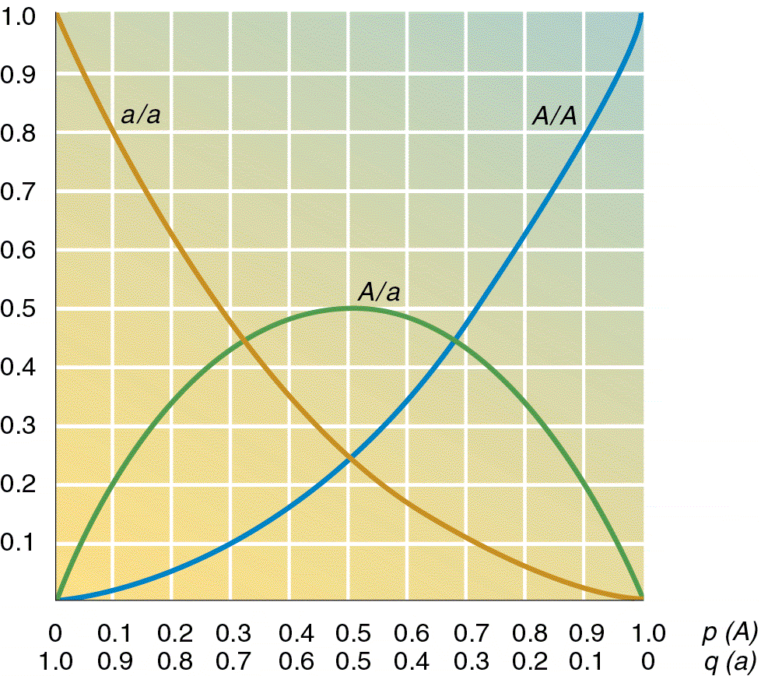
Deviations from HWE
Under HWE, the expected genotype frequencies in the next generation are:
(p+q)² = p² +2 pq + q²
with the frequency of genotypes:
A/A A/a a/a
p² 2pq q²
Assumptions:
Random mating
No mutation
No drift
No migration
No selection
Highly unlikely in reality
Blue: neutral evolution
Red: selection/adaptive evolution
Populations evolve!
2
Notes:
2

Slide 3
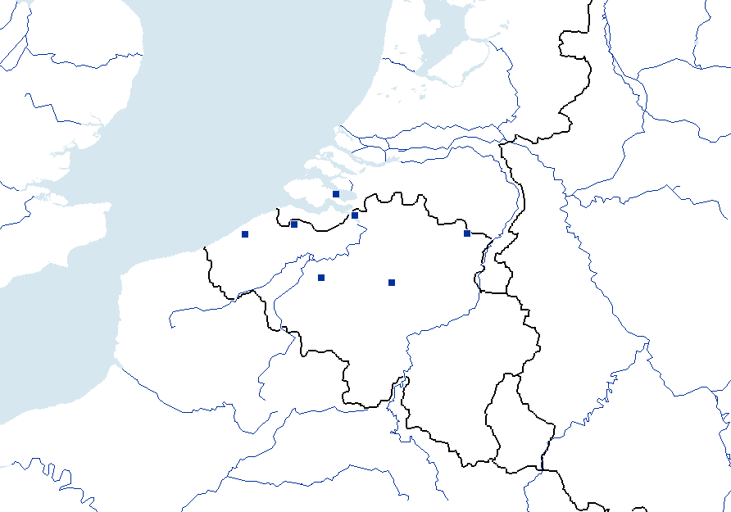
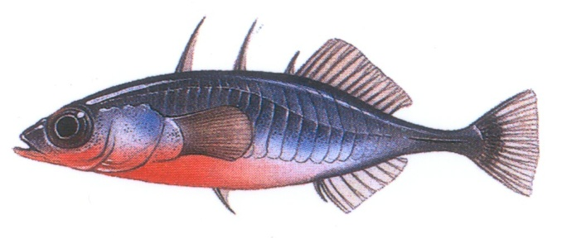
Case study: the three-spined stickleback
The Netherlands
NORTH SEA
2
1
3
4
7
Questions:
To what degree does 1) gene flow/migration, genetic drift, mutation and 2) selection influence genetic diversity (e.g. allelic richness) and genetic divergence (e.g. F_{ST}) between populations?
5
6
Meuse
Scheldt
Belgium
Relative IMPACT | Lowland/coastal (# 1, 2, 3 and 4) | Inland (# 5, 6 and 7) | Comments
Gene flow/migration (m) | Higher | Lower | Large connectivity in the coastal area
Genetic drift (~ 1/Ne) | Low | Medium | Inland populations are often (very) small
Mutation (µ) | Low | Low | Mutation rate is from 10⁻⁴ to 10⁻⁶
Selection | ? | ? | Does selection drive populations to separate characteristics?

Slide 4

There is lots of evidence for neutral evolution in natural populations. Think of populations which collapse and therefore lose a lot of individuals and hence genetic material.
Which alleles are lost will be partially random (which we consider here), and partially determined by selection. The latter applies to populations adapting to new conditions, where alleles and chromosome fragments will be reshuffled. In the first part of the class we are interested in the underlying stochastic (non-adaptive/ neutral) mechanisms.
This time we will study the patterns and processes of neutral and selective evolution with R
Computer lab 1: Analyse population genetic structure of stickleback
(i.e. generate indices of neutral genetic diversity + neutral genetic differentiation)
Computer lab 2: Identify signatures of selection in stickleback

Slide 5
Your compass to this class
Aim
Understanding genetic variation and hierarchical differentiation
Understanding selection
Drivers of selection
Milestones
Installing R packages and importing data
Detecting and interpreting genetic heterogeneity and genetic structure
Detecting selection
Tools
R packages adegenet,

Slide 6
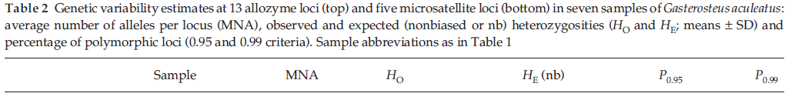
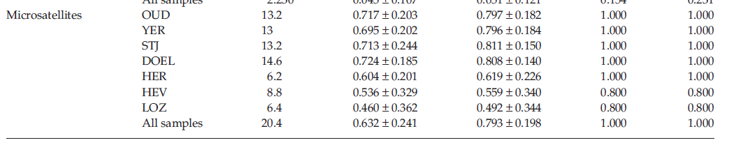
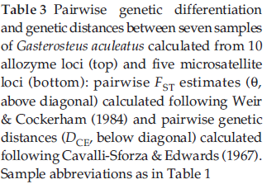
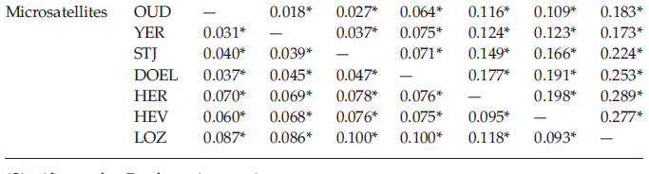
Computer lab 2.1. Analyse neutral population structure in stickleback
(i.e. Generate indices for genetic diversity and genetic differentiation)
→ Relevant tables from Raeymaekers et al. Mol Ecol 2005:

Slide 7
Step 1: Read the data
setwd(/your/working/’directory')
library(adegenet)
dat = read.genepop('stickle.gen')
Most of the analysis will be carried out with ADEGENET and other packages that use the ‘genind’ genetic data object type.
First let’s look at heterozygosity
dat.pop = seppop(dat)
dat.het = cbind(do.call("c", lapply(dat.pop, function(x) mean(summary(x)$Hobs))), do.call("c", lapply(dat.pop, function(x) mean(summary(x)$Hexp))) )
colnames(dat.het) = c('Observed heterozygosity', 'Expected heterozygosity')
Observed heterozygosity Expected heterozysigosity
Pop-1 0.7174418 0.7881554
Pop-2 0.6945932 0.7871591
Pop-3 0.7133605 0.8022704
Pop-4 0.7239355 0.7985027
Pop-5 0.6041739 0.6130383
Pop-6 0.5360000 0.5533600
Pop-7 0.4600714 0.4864783

Slide 8
Step 2 – Calculating genetic diversity
Here we will use the function Molecular Diversity Indices to calculate a set of diversity indices: number of alleles, expected and observed heterozygosity, θ (theta).
Let’s load the first package we are going to use
library(mmod)
diff_stats(dat)
$per.locus
Hs Ht Gst Gprime_st D
Gac4b 0.7629263 0.8222908 0.07219402 0.3510510 0.2921393
Gac7b 0.7475179 0.8223185 0.09096304 0.4140439 0.3456378
Gac14b 0.3342903 0.4734715 0.29395895 0.4911068 0.2439172
Gac9b 0.7273810 0.9072275 0.19823743 0.8212199 0.7696488
Gac10b 0.9147719 0.9622071 0.04929834 0.6693335 0.6493291
$global
Hs Ht Gst_est Gprime_st D_het D_mean
0.6973775 0.7975031 0.1255488 0.4740940 0.3860029 0.3772069

Slide 9
Step 2 – Calculating genetic diversity
Let’s now calculate some measures of diversity at the global population level, rather than at the locus level
library(hierfstat)
First calculate Weir and Cockerham 1984 F_{st} value (the upper triangular part of Table 2 of Raeymaekers et al. 2005
genet.dist(dat, diploid = T, method = 'WC84')
Pop-1 Pop-2 Pop-3 Pop-4 Pop-5 Pop-6
Pop-2 0.01770832
Pop-3 0.02722999 0.03735966
Pop-4 0.06386159 0.07531312 0.07095113
Pop-5 0.11643323 0.12364991 0.14921278 0.17677103
Pop-6 0.10865519 0.12334559 0.16555249 0.19069749 0.19758067
Pop-7 0.18272661 0.17273323 0.22439863 0.25348219 0.28878800 0.27744661
How do you interpret the values? Highest – lowest? Outlier? Map the values on the sampling map; do you notice a pattern? Values in the coastal region are comparable and above average for H and NA.

Slide 10
Step 2 – Calculating genetic diversity
What about inbreeding (F_{IS}) values as a measure of diversity?
basic.stats(dat)
$perloc
Ho Hs Ht Dst Htp Dstp Fst Fstp Fis Dest
Gac4b 0.7469 0.7631 0.8223 0.0592 0.8322 0.0691 0.0720 0.0830 0.0212 0.2916
Gac7b 0.7150 0.7479 0.8224 0.0745 0.8348 0.0869 0.0906 0.1041 0.0439 0.3447
Gac14b 0.2829 0.3348 0.4736 0.1387 0.4967 0.1618 0.2929 0.3258 0.1553 0.2433
Gac9b 0.5300 0.7297 0.9076 0.1779 0.9372 0.2075 0.1960 0.2214 0.2737 0.7677
Gac10b 0.9035 0.9149 0.9622 0.0473 0.9701 0.0552 0.0492 0.0569 0.0125 0.6488
$overall
Ho Hs Ht Dst Htp Dstp Fst Fstp Fis Dest
0.6357 0.6981 0.7976 0.0995 0.8142 0.1161 0.1248 0.1426 0.0894 0.3846
Significance: diversity is a suitable measure of biodiversity at the genetic level.

Slide 11
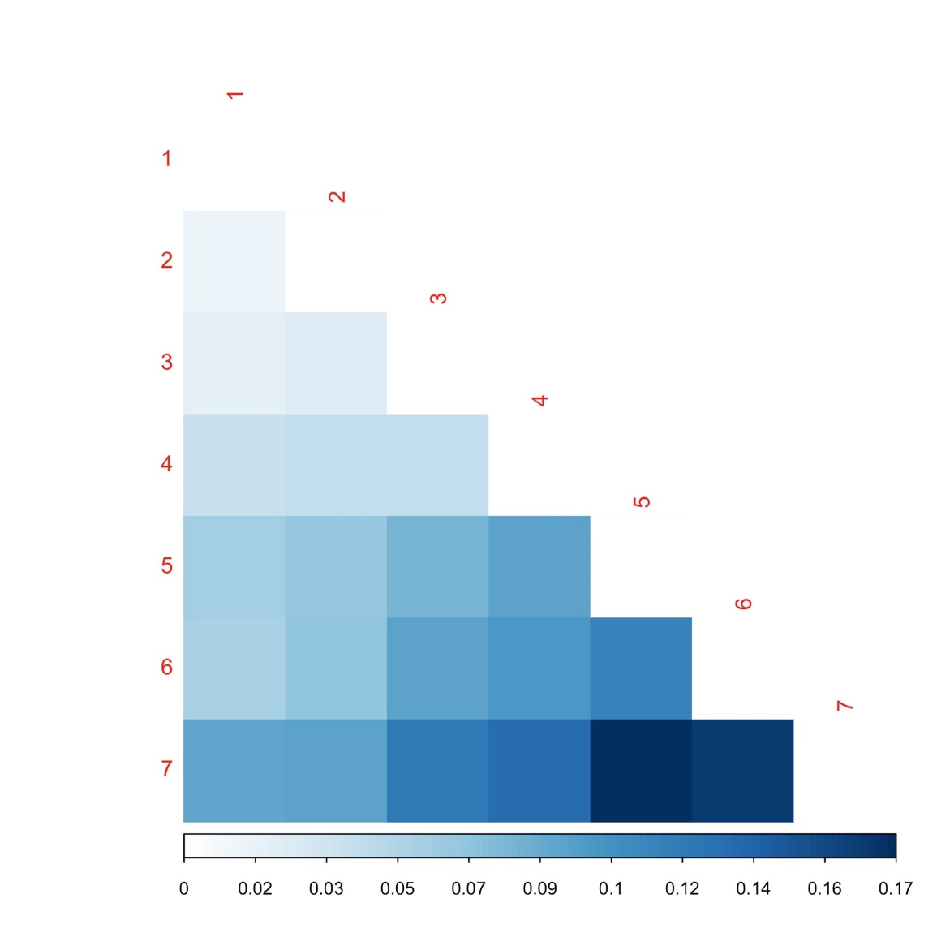
Let’s visualise the output of the F_{ST} analysis with heat maps
pp = genet.dist(dat, diploid = T, method = 'WC84’)
library(corrplot)
corrplot(as.matrix(pp), is.cor = F, type= 'lower', method = "color")

Slide 12
Step 4 – Calculating overall hierarchical genetic structure
We use AMOVA (Analysis of Molecular Variance) to calculate overall genetic structure by groupings based on the F_{ST} values.
In order to do so we have to adapt the ‘dat’ object with the grouping settings.
First we create a data frame that contains the hierarchical structure of the data:
dat_hier = data.frame(c(rep('coastal', 49+50+50+46), rep('inland', 50+50+50)), dat@pop)
(Important!) we give a name to the columns
names(dat_hier) = c('group', 'pop')
We now add the data frame to dat and make it a stratification factor
dat@other = list(population_hierarchy = dat_hier)
strata(dat) = data.frame(other(dat)$population_hierarchy)

Slide 13
Step 4 – Calculating overall hierarchical genetic structure
We can now check how the stratification looks like:
strata(dat)
group pop
1 coastal Pop-1
2 coastal Pop-1
3 coastal Pop-1
4 coastal Pop-1
5 coastal Pop-1
coastal Pop-1
Even though the stratification looks like a simple data frame, it will be necessary to specify the terms of the AMOVA.

Slide 14
Note that we discard sample 7 (Meuse) for this analysis, since statistical tests are only valid if groups contain at least 2 populations. In case of one population, one may consider it anyway as a genetic unit.
Load library (poppr)
dat2 = popsub(dat, blacklist = 'Pop-7')
Significance: hierarchical F_{ST} values evaluate more natural groupings of samples

Slide 15
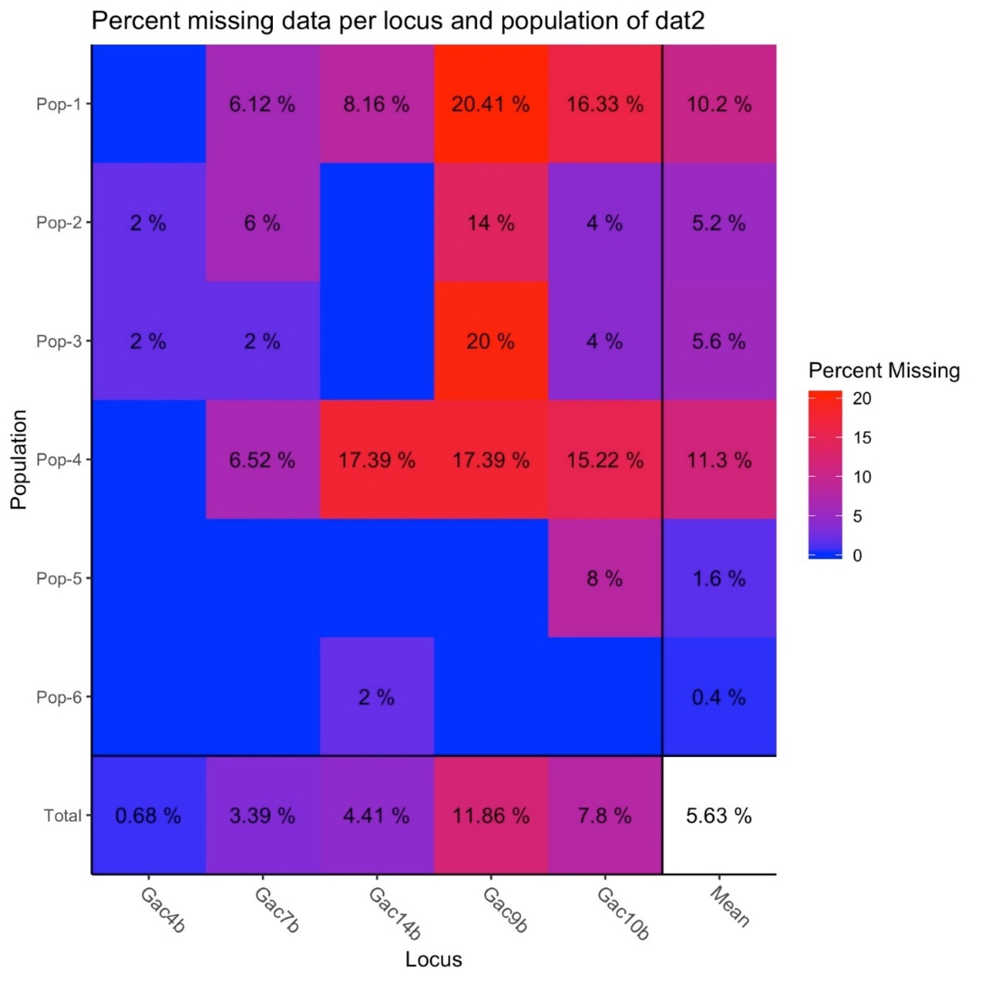
Before proceeding make sure not to have too many missing data: markers with 5% or more missing values would be dropped in the AMOVA
info_table(dat2, plot = TRUE)

Slide 16
We remove the missing data:
dat2 = missingno(dat2, type = 'genotype')
Found 2020 missing values.
63 genotypes contained missing values > 5%
Removing 63 genotypes: 001, 002, 003, 006, 008, 009, 019, 022, 023, 028, 029, 033, 035, 038, 039, 043, 046, 047, 048, 049,
052, 056, 057, 058, 068, 070, 095, 096, 099, 100, 103, 112, 116, 117, 118, 120, 137, 140, 141, 144, 145, 147, 155, 159, 161,
167, 168, 176, 177, 179, 186, 187, 188, 191, 192, 193, 194, 195, 204, 236, 241, 245, 293

Slide 17
Let’s finally run the AMOVA
stickamova = poppr.amova(dat2, ~group/pop, within = F)
The Netherlands
NORTH SEA
2
1
3
4
7
5
6
Meuse
Scheldt
Belgium

Slide 18
AMOVA results
$call
ade4::amova(samples = xtab, distances = xdist, structures = xstruct)
$results
DF Sum Sq Mean Sq
Between group 1 41.54596 41.545964
Between samples Within group 4 65.42529 16.356322
Within samples 226 436.64728 1.932068
Total 231 543.61853 2.353327
$componentsofcovariance
Sigma %
Variations Between group 0.2072163 8.205728
Variations Between samples Within group 0.3859802 15.284744
Variations Within samples 1.9320676 76.509528
Total variations 2.5252641 100.000000
$statphi
Phi
Phi-samples-total 0.23490472
Phi-samples-group 0.16651087
Phi-group-total 0.08205728
In words: the differentiation between the two groups is considerable and amounts to 8.21%, for an F_{ST} (here called Phi-samples-group ) = 0.17 while the differentiation within each group is similar (15.28 %). The variance within each individual population amounts to 76.51%
Group 1: COAST
1
4
2
15.28 %
3
8.21%
Group 2 : SCHELDT
15.28 %
6
5

Slide 19
Are your results significant?
To test this we will run a permutation test and see where our results sit in the output:
set.seed(1999)
sticksignif = randtest(stickamova, nrepet = 999)
sticksignif
class: krandtest lightkrandtest
Monte-Carlo tests
Call: randtest.amova(xtest = stickamova, nrepet = 999)
Number of tests: 3
Adjustment method for multiple comparisons: none
Permutation number: 999
Test Obs Std.Obs Alter P value
1 Variations within samples 1.9320676 -61.017869 < 0.001
2 Variations between samples 0.3859802 45.180250 > 0.001
3 Variations between group 0.2072163 2.805898 > 0.001

Slide 20
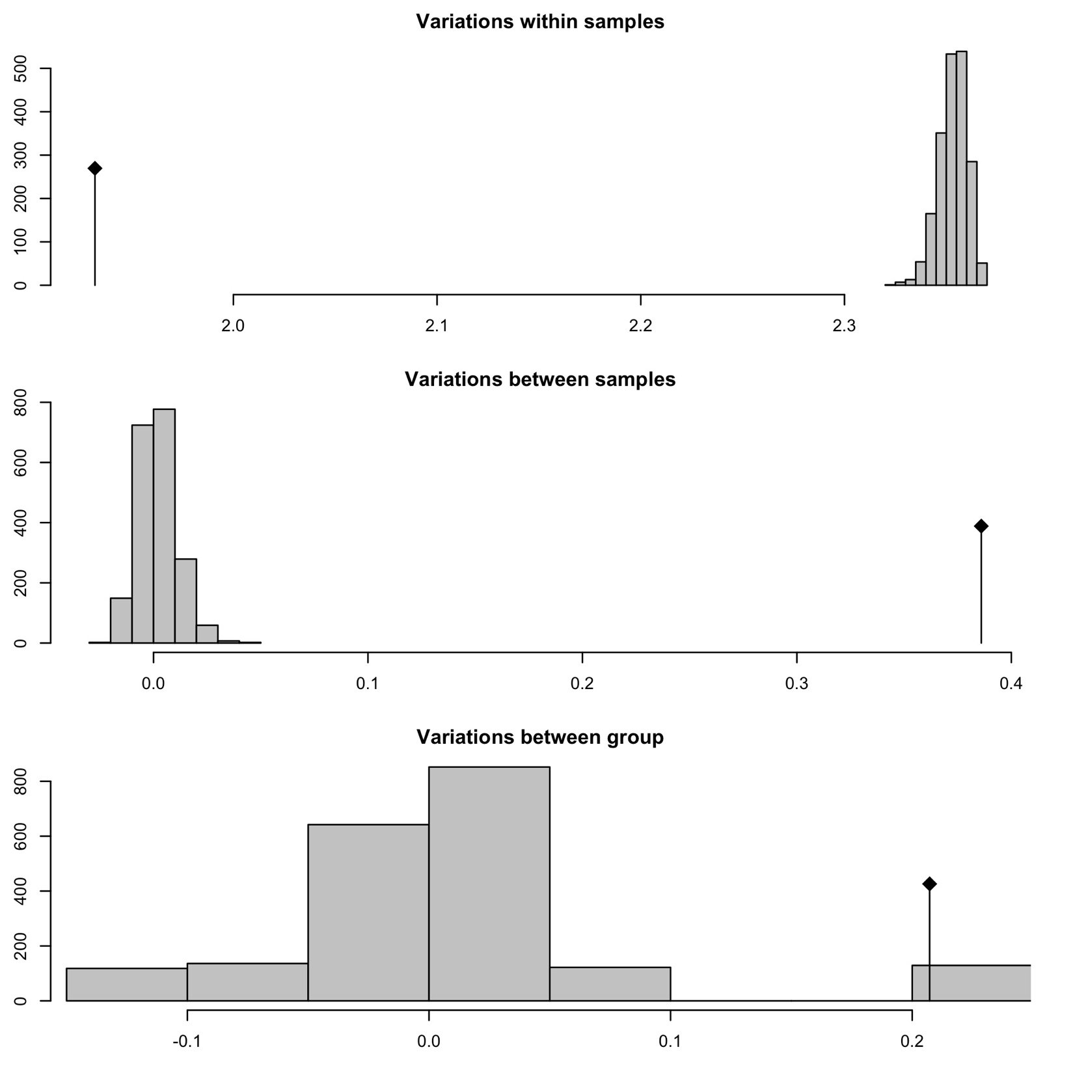

Slide 21
Assignment 2.1: A concise interpretation of the hierarchical genetic pattern of threespine stickleback:
What is your outcome of the AMOVA?
What is an AMOVA exactly? Explain with your own words.
How do you interpret the hierarchical pattern?
Suggestion: The introduction and discussion sections of the paper by Raeymaekers et al. (2005) provide you useful information to fully grasp the interpretation.

Slide 22
In conclusion
Population genetic samples reveal their genetic diversity and patterns through a diversity of statistical analyses.
R analysis turns out to be of great value for data analysis.
To stay up to date on the latest developments, keep track of journals such as BMC Evolutionary Biology, Genetics, Heredity, Human Genetics, Molecular Ecology, Molecular Ecology Resources and Proceedings of the National Academy of Sciences of the USA.

Slide 23
Bonus Point:
How to prepare a report on Genetic Diversity?
Using the library below and the simple command given you should get a full report in a nice PDF (you might have to install LaTeX though!)
library(PopGenReport)
popgenreport(dat, path.pgr=getwd(), mk.locihz = T, mk.hwe = TRUE, mk.fst = TRUE, mk.pcoa = TRUE, mk.allele.dist = TRUE, mk.null.all = TRUE, mk.allel.rich = TRUE, mk.differ.stats = TRUE, mk.Rcode = T)

Slide 24
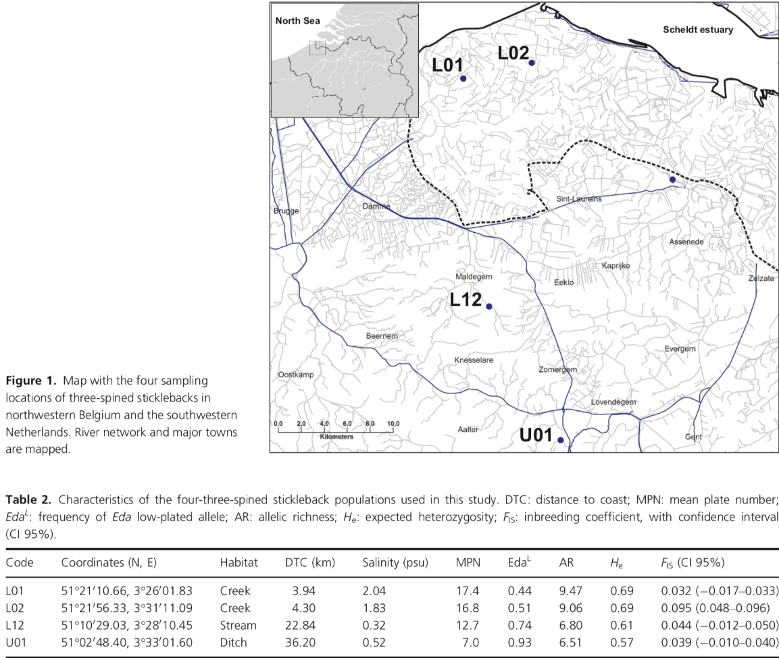
Computer lab 1.2: Looking for evidence of selection (= adaptive evolution)
What do we already know about stickleback evolution?
Lowland/coastal: ancestral, large effective population size (Ne), well connected (high m), little genetic differentiation (F_{ST})
Upland: postglacially derived, small Ne, more isolated (lower m), large F_{ST}
These are neutral (non-adaptive) processes, acting on the entire genome!
Now we have a look at the potential effects of selection, targetting specific areas in the genome

Slide 25
Computer lab 1.2: Looking for evidence of selection
Aim for this part of the lecture:
Coastal and inland habitats are very different. So, do sticklebacks experience selection when colonizing inland freshwater habitats? Do some loci (linked to particular genes) show signatures of selection?
First, let’s increase the number of populations (See Konijnendijk et al. 2015)
DATA:
2 lowland samples
2 inland samples
Allele frequencies were scored
At 87 microsatellite loci
25

Slide 26
Computer lab 1.2: Looking for evidence of selection
How do signatures of selection in the genome of natural populations look like?
Balancing selection: form of natural selection which work to maintain genetic polymorphisms (or multiple alleles) within a population.
e.g. Gobies in the North Sea experience light conditions that are very unstable in space and time, ranging from clear to turbid. As a result, populations are very polymorphic for the rhodopsin gene (responsible for light absorption in the eye). This is because the success of the different rhodopsin alleles fluctuates in space and time, or because it is an advantage for individual fish to be heterozygous. Different populations do not accumulate high levels of F_{ST} in this particular area of the genome.
Directional selection: form of natural selection which favors a single allele within a population. When different alleles are selected in different environments, we talk about divergent selection.
e.g. Gobies in the Baltic Sea experience turbid but stable light conditions. As a result, a specific allele of the rhodopsin gene responsible for good sight in turbid water is favoured by selection. Comparison with populations from a different light regime (e.g. the North Sea) will yield high levels of F_{ST} in and close to the rhodopsin gene.
26
Notes:
26

Slide 27



Computer lab 1.2: Looking for evidence of selection
How do signatures of selection in the genome of natural populations look like?
Balancing selection
Directional selection
Low F_{ST}
High F_{ST}
Bron: Maarten Larmuseau
Notes:
27

Slide 28
Computer lab 1.2: Looking for evidence of selection
How do signatures of selection in the genome look like?
When is F_{ST} in line with what we expect due to drift alone and when is F_{ST} higher than expected by drift alone? When is F_{ST} lower than expected by drift alone?
- To solve such questions we need a neutral genome-wide baseline, taking into account the neutral divergence among populations (reflecting divergence due to migration, effective population size, drift…)
- Loci that have extremely high F_{ST} compared to the genome-wide “neutral” F_{ST} may be under divergent selection.
- Loci that have extremely low F_{ST} compared to the genome-wide “neutral” F_{ST} may be under balancing selection.
- Importantly, the distribution of F_{ST}under neutrality depends on heterozygosity. As a consequence, heterozygosity levels must be taken into account when comparing the magnitude of F_{ST}.
Notes:
28

Slide 29
Detecting selection in DNA microsatellites
In order to detect selection with in microsatellite data we will use the R package ‘fsthet’.
devtools::install_github('spflanagan/fsthet_analysis/fsthet')
library(fsthet)
gpop = my.read.genepop(‘stick.pop’)
Now read the file stick.pop (alternatively use stick_old.pop), which contains the data from Konijnendijk et al. 2015. Note that the name of the markers in the file does not match 100% the names used in the paper!

Slide 30
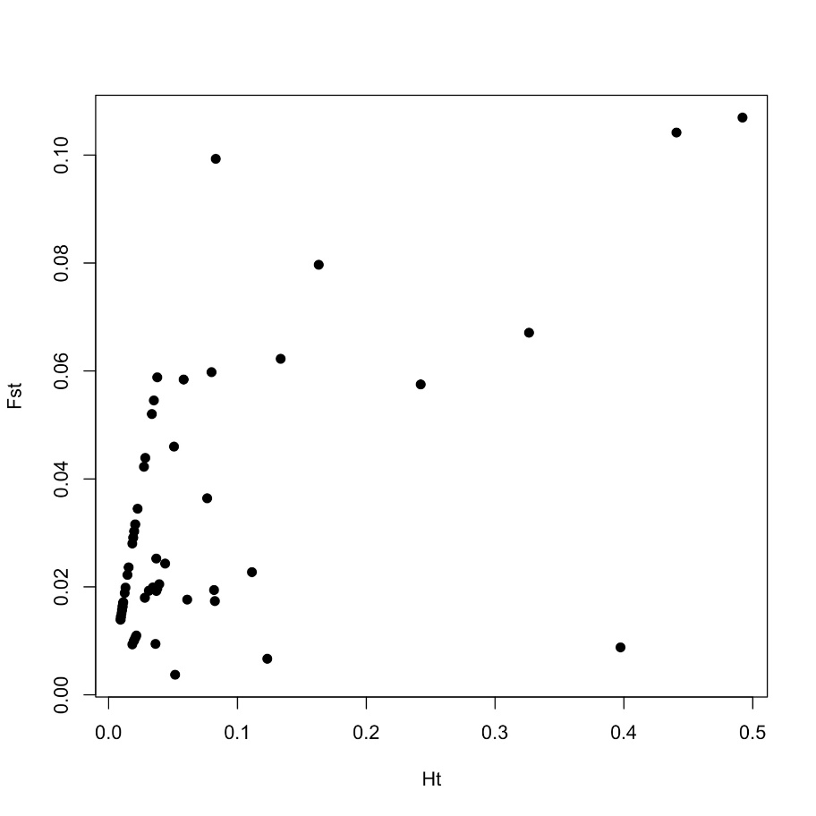
1. Calculate the actual F_{ST} between the markers:
fsts<-calc.actual.fst(gpop)
2. Now plot the F_{ST} on the Ht: what do you see?
plot(fsts$Ht, fsts$Fst,xlab="Ht",ylab="Fst",pch=19)

Slide 31
We need now to generate the distribution of the F_{ST} values to decide whether some values are excessively high or low given the data F_{ST} distribution. We use the function fst.boot(). If you look in the man page you will see there are a number of assumptions made about how many markers you have (hundreds). In addition there are different measures of F_{ST} we could use:
fst.options.print()
[1] For Wright's F_{ST}: fst, FST, Fst
[1] For a variance-based Fst (beta): var, VAR, Var
[1] For Cockerham and Weir's Theta: theta, Theta, THETA
[1] For Beta-hat (LOSITAN): Betahat, betahat, BETAHAT
31
Notes:
31

Slide 32
We start by running 100 sampling of the loci, without bootstrap, to get the empirical confidence intervals for outlier F_{ST} values. Because we only have 87 loci we adjust the number of loci in each quantile bin to be 10. We run each sampling for all 4 F_{ST} options
quant.out1 = as.data.frame(t(replicate(100, fst.boot(gpop,bootstrap=FALSE, fst.choice="betahat", min.per.bin=10))))
quant.out2 = as.data.frame(t(replicate(100, fst.boot(gpop,bootstrap=FALSE, fst.choice="theta", min.per.bin=10))))
quant.out3 = as.data.frame(t(replicate(100, fst.boot(gpop,bootstrap=FALSE, fst.choice="var", min.per.bin=10))))
quant.out4 = as.data.frame(t(replicate(100, fst.boot(gpop,bootstrap=FALSE, fst.choice="fst", min.per.bin=10))))
32
Notes:
32

Slide 33
Now you can look for outliers
outliers1<-find.outliers(fsts,boot.out=quant.out1)
outliers2<-find.outliers(fsts,boot.out=quant.out2)
outliers3<-find.outliers(fsts,boot.out=quant.out3)
outliers4<-find.outliers(fsts,boot.out=quant.out4)
Suggestion: the function points allows you to differentiate outliers from non-outliers in colour
Which results do you get?
outliers1
outliers2
outliers3
outliers4
Which conclusions do you reach?
33
Notes:
33

Slide 34
Suggestion: colour your graph output with points
plot(fsts$Ht, fsts$Fst,xlab="Ht",ylab="Fst",pch=19,col="black")
points(outliers1$Ht,outliers1$Fst,xlab="Ht",ylab="Fst",pch=19,col="pink")
points(outliers2$Ht,outliers2$Fst,xlab="Ht",ylab="Fst",pch=19,col="red")
points(outliers3$Ht,outliers3$Fst,xlab="Ht",ylab="Fst",pch=19,col="blue")
points(outliers4$Ht,outliers4$Fst,xlab="Ht",ylab="Fst",pch=19,col="green")

Slide 35
Detecting selection in SNPs
Install OutFLANK
library(devtools)
source(“https://bioconductor.org/biocLite.R”)
biocLite(“qvalue”)
library(qvalue)
library(vcfR)
devtools::install_github("whitlock/OutFLANK")
library(OutFLANK)
Note: OutFLANK might be sensitive to the R version you installed

Slide 36
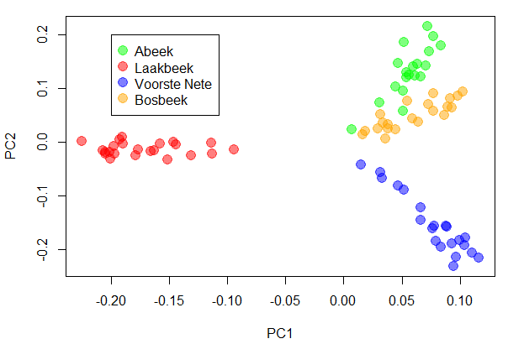
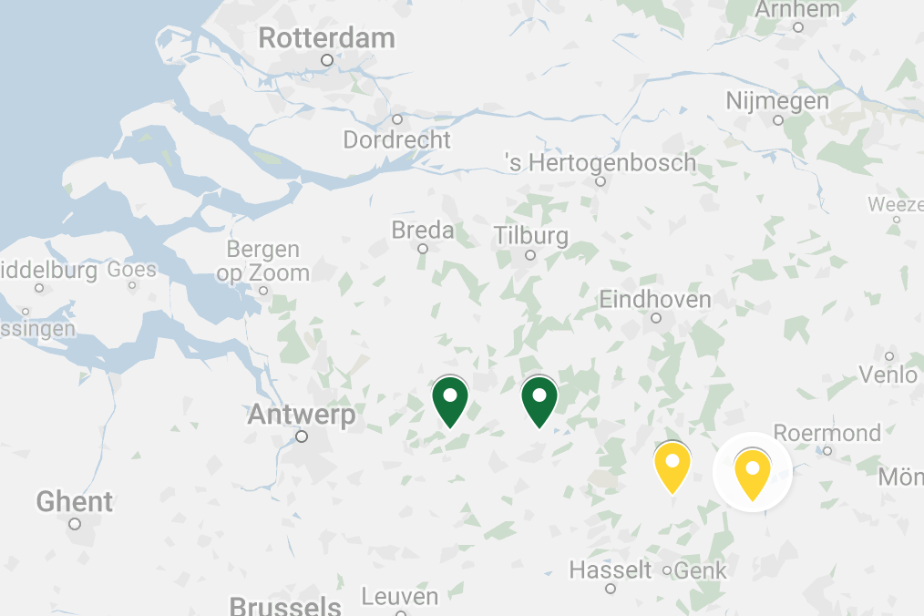
Detecting selection in SNPs
4 populations, 4509 SNPs
Laakbeek
Voorste Nete
Abeek
Bosbeek

Slide 37
######installing OutFLANK -> requires R 3.6.1###########################
library(devtools)
if (!requireNamespace("BiocManager", quietly = TRUE)) ### from the bioconductor website
install.packages("BiocManager")
BiocManager::install("qvalue")
​library(qvalue)
library(vcfR)
library(plyr)
library(processx) ### should be atleast 3.4.0
devtools::install_github("whitlock/OutFLANK")
library(OutFLANK)
#################################################################

Slide 38
Read in the R script called read-plink-bed.R. Keep this script because you will use often if you do work in bioinformatics. It is also part of the library MultiPhen
source(ʺread-plink-bed.Rʺ)
Now read in the SNP data, and the the marker and population data:
snps = read.plink('pl1')# SNPS
markers = read.table('pl1.bim', h = F)# Markers
pops = read.table('pops.tsv', h = F)# populations
Let’s replace the missing data coding from NA to 9
snps[is.na(snps)] = 9

Slide 39
Outflank does not like low quality SNPs with lots of missing data, so we will remove them:
t2 = apply(snps, 2, function(x){sum(x == 9)/length(x)})#we are calculating what percentage of the genotypes in each SNP is missing
snps2 = snps[, t2 <= .25]# we are pruning the data so that we keep SNPs missing in no more than 25% of the data
Now let’s run outflank:
ofl = MakeDiploidFSTMat(snps2, as.character(markers[t2 <= .25,2]), as.character(pops[,2]))# we are making a Fst matrix
outR = OutFLANK(ofl, NumberOfSamples = 4)

Slide 40
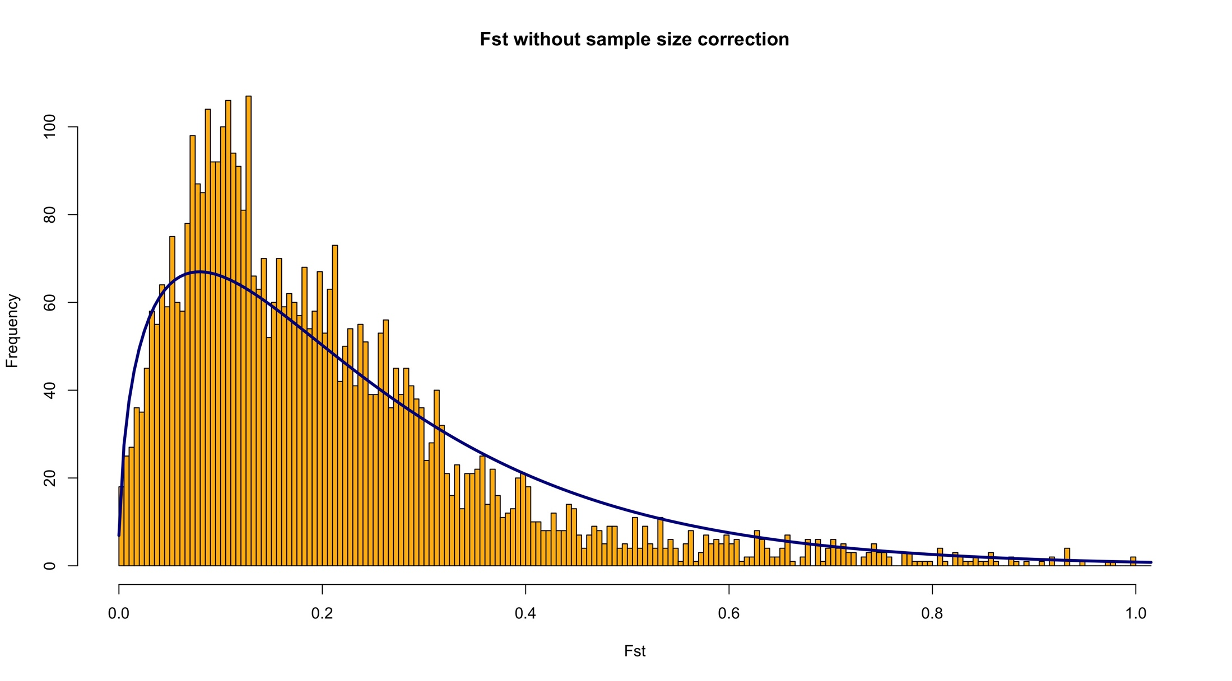
Let’s look at the results:
OutFLANKResultsPlotter(outR)

Slide 41
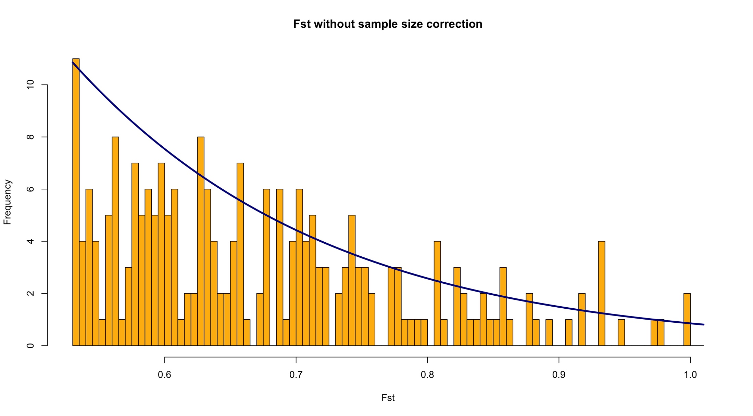
Let’s look at the results:
OutFLANKResultsPlotter(outR, Hmin = 0.01, Zoom = T)

Slide 42
Let’s look at the results:
head(outR$results, n = 10)#
LocusName He FST T1 T2 FSTNoCorr T1NoCorr T2NoCorr meanAlleleFreq indexOrder GoodH q values
1 64_33 0.2304919 0.04084300 0.004786630 0.11719585 0.06624018 0.007763695 0.11720523 0.13291139 1 goodH 0.8969305
2 205_42 0.1009778 0.07239222 0.003743742 0.05171471 0.09440468 0.004882333 0.05171707 0.05333333 2 goodH 0.8969305
3 433_16 0.1758307 0.11794438 0.010748537 0.09113225 0.13978504 0.012740099 0.09114065 0.09740260 3 goodH 0.8969305
4 479_42 0.1022644 0.15988737 0.008619551 0.05391014 0.19902174 0.010735957 0.05394364 0.05405405 4 goodH 0.8969305
5 485_25 0.3679591 0.28039392 0.055893701 0.19933992 0.30780169 0.061358030 0.19934273 0.24305556 5 goodH 0.8969305
6 628_73 0.1295465 0.09716886 0.006484657 0.06673596 0.11653979 0.007777999 0.06674114 0.06962025 6 goodH 0.8969305
7 1025_128 0.1420118 0.21841246 0.016506444 0.07557465 0.24111374 0.018222539 0.07557653 0.07692308 7 goodH 0.8969305
8 1028_21 0.1490139 0.18320682 0.014429322 0.07875974 0.21355652 0.016822021 0.07877081 0.08108108 8 goodH 0.8969305
9 1115_82 0.1128000 0.13332176 0.007831774 0.05874341 0.15842406 0.009307075 0.05874786 0.06000000 9 goodH 0.8969305
10 1115_93 0.1244444 0.11244090 0.007247696 0.06445782 0.13777906 0.008881618 0.06446276 0.06666667 10 goodH 0.8969305
p values p valuesRightTail OutlierFlag
1 0.3056801 0.8471599 FALSE
2 0.4712088 0.7643956 FALSE
3 0.7282112 0.6358944 FALSE
4 0.9780803 0.4890401 FALSE
5 0.5804178 0.2902089 FALSE
6 0.5992014 0.7003993 FALSE
7 0.8031343 0.4015671 FALSE
8 0.9144913 0.4572457 FALSE
9 0.8264306 0.5867847 FALSE
10 0.7173475 0.6413262 FALSE
You could at this stage sort the loci by F_{ST} value.
Unfortunately we have no evidence of selection at any of the loci. Because we test for multiple loci, p values are usually insignificant because of the high stringency. The q value (Bayesian posterior p-value) tests for the Positive False Discovery Rate. It also doesn’t point to any significant value.

Slide 43
Assignment 2.2: outlier detection
Repeat the outlier detection exercise in SNPs and compare your data by pruning 10% and 40% of the missing data.
What do you notice in the outlier loci you detect in that case? Why is that? How will this affect your search for possible evidence of adaptation?
Prepare your homework on the designated sheet and upload under assignments.

Slide 44
Conclusions
Relative IMPACT | Lowland/coastal (# 1, 2, 3 and 4) | Inland (# 5, 6 and 7) | Comments
Gene flow/migration | Higher | Lower | Large connectivity in the coastal area
Genetic drift | Low | Medium | Inland populations are often (very) small
Mutation | Low | Low | Mutation rate is from 10⁻⁴ to 10⁻⁶
Selection | Coastal and inland habitats impose different selection pressures responsible for divergence in plate number and divergence at the underlying gene. |  | Does selection drive the populations to separate characteristics?

Slide 45
References
Balloux F. (2001) EasyPop (Version 1.7): A computer program for population genetics simulations. Heredity 92: 301-302.
Beaumont M.A. & Nichols R.A. (1996) Evaluation loci for use in the genetic analysis of population structure. Proceedings of the Royal Society of London B 263: 1619-1626.
Griffiths A.J.F. et al. (2015) Introduction to Genetic Analysis. Chapter 18. Population Genetics. p.609-654
Hedrick P.W. (2011) Genetics of populations. Jones and Bartlett, Boston, MA
Konijnendijk N., Shikano T., Daneels D., Volckaert F.A.M., Raeymaekers J.A.M. (2015) Signatures of selection in the three-spined stickleback along a small-scale brackish water – freshwater transition zone. Ecology and Evolution 5, 4174-4186
Raeymaekers J.A.M., Van Houdt J.K.J., Larmuseau M.H.D., Geldof S., Volckaert F.A.M. (2007) Divergent selection as revealed by P_{ST} and QTL-based F_{ST} in three-spined stickleback (Gasterosteus aculeatus) populations along a coastal-inland gradient. Molecular Ecology 16: 891-905
Shikano T., Ramadevi J., Juha Merilä (2015) Identification of local- and habitat-dependent selection: Scanning functionally important genes in nine-spined sticklebacks (Pungitius pungitius). Molecular Biology and Evolution 27(12): 2775–2789.

